Slide 1

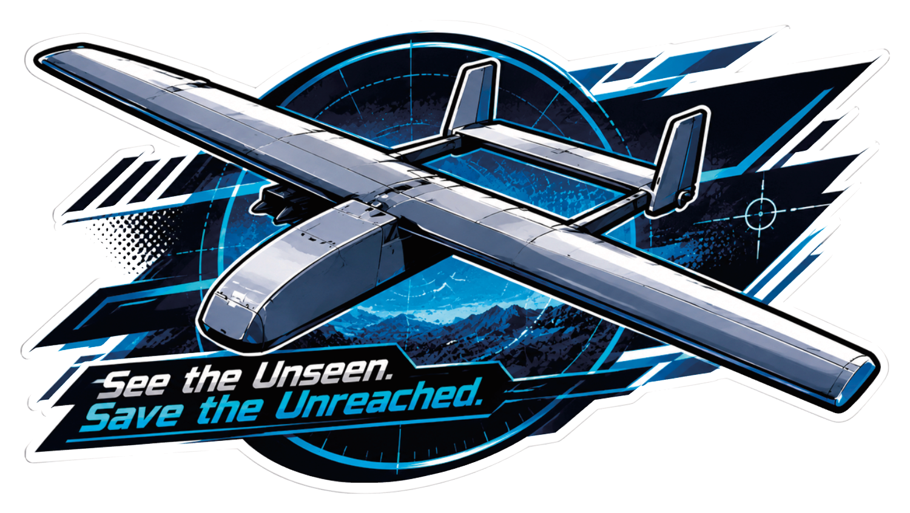
Garuda Vedang
See the Unseen. Save the Unreached.
Pranav Mishra , Peeyush Raj
Army public school Jalandhar cantt

Slide 2
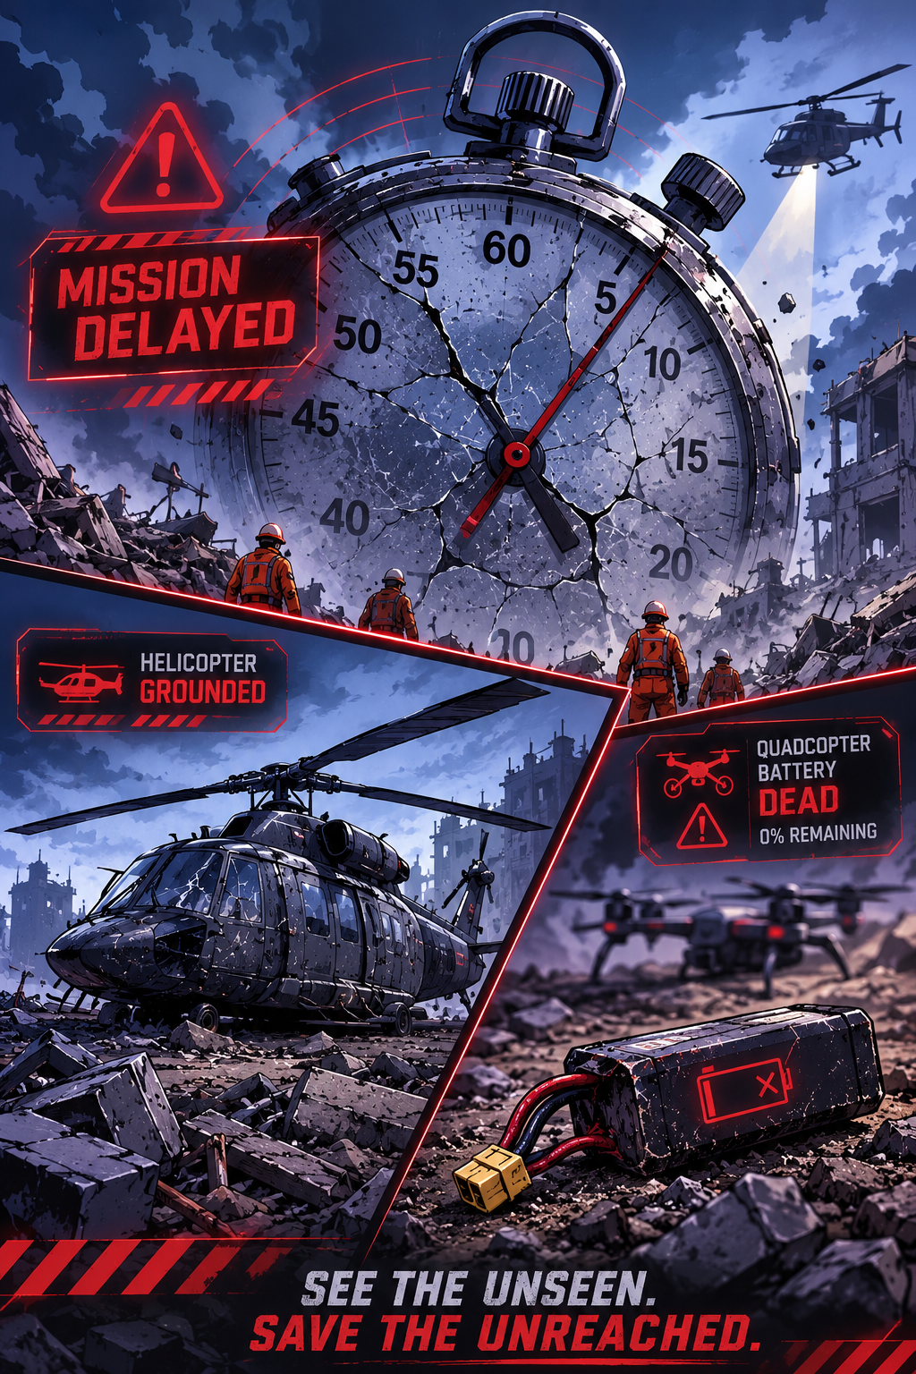
The Broken System…..
Boats & Ground Teams: Brave, but dangerously slow (<2 km/h) and blind to hidden hazards.
Standard Drones: Fast to launch, but batteries die in 25 minutes. They cannot see under thick tree canopies.
Helicopters: Powerful, but cost ₹1.5–3 Lakh per hour and are grounded by the very storms that cause the floods.
The Gap: Fixed-wing drones can watch a 12 km river, but can’t peek under a roof. Quadcopters can peek, but can’t reach the village. No affordable tool does both.
The first step toward change is awareness. The second step is acceptance……..

Slide 3
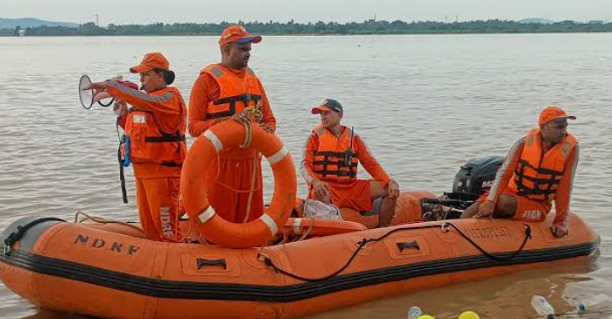
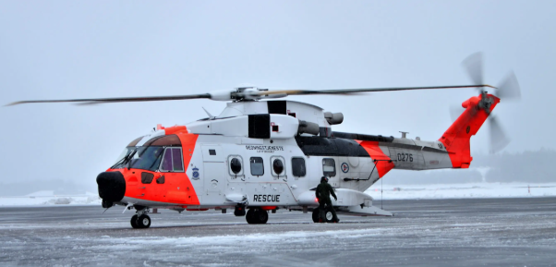
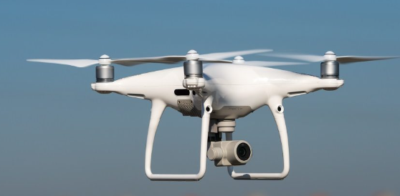
Manual SAR Teams (Boots/Boats)
Helicopters
Consumer Quadcopters
Where we Fail . What Exists
The Architectural Gap
Long Range vs. Close Inspection
Can’t reach far and look close.
High Cost vs. All-Weather Search Helicopters are costly and storms ground them.
Short Battery vs. Large Coverage Battery dies before the search ends.
Rough Terrain vs. Safe Access Mud, floods, and debris block rescue.

Slide 4
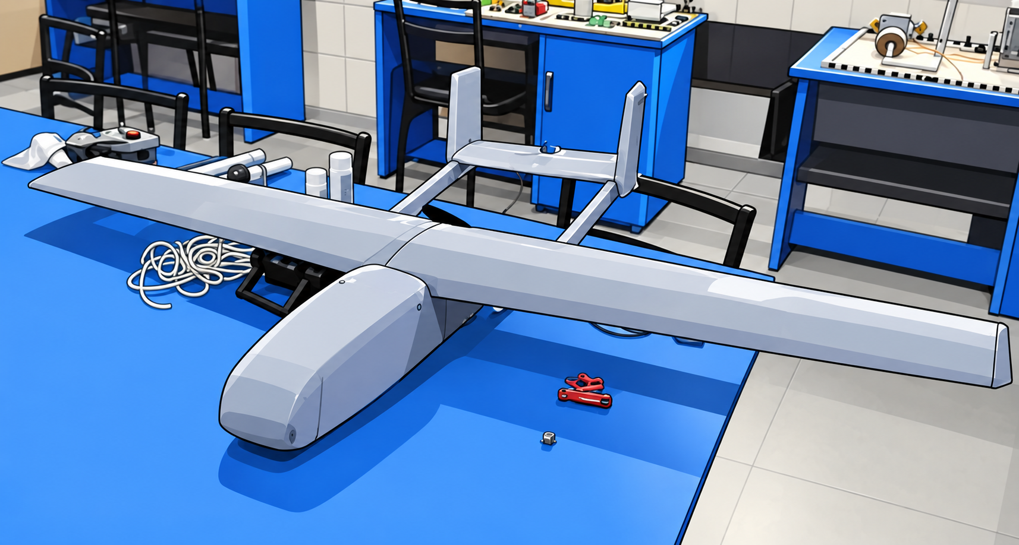

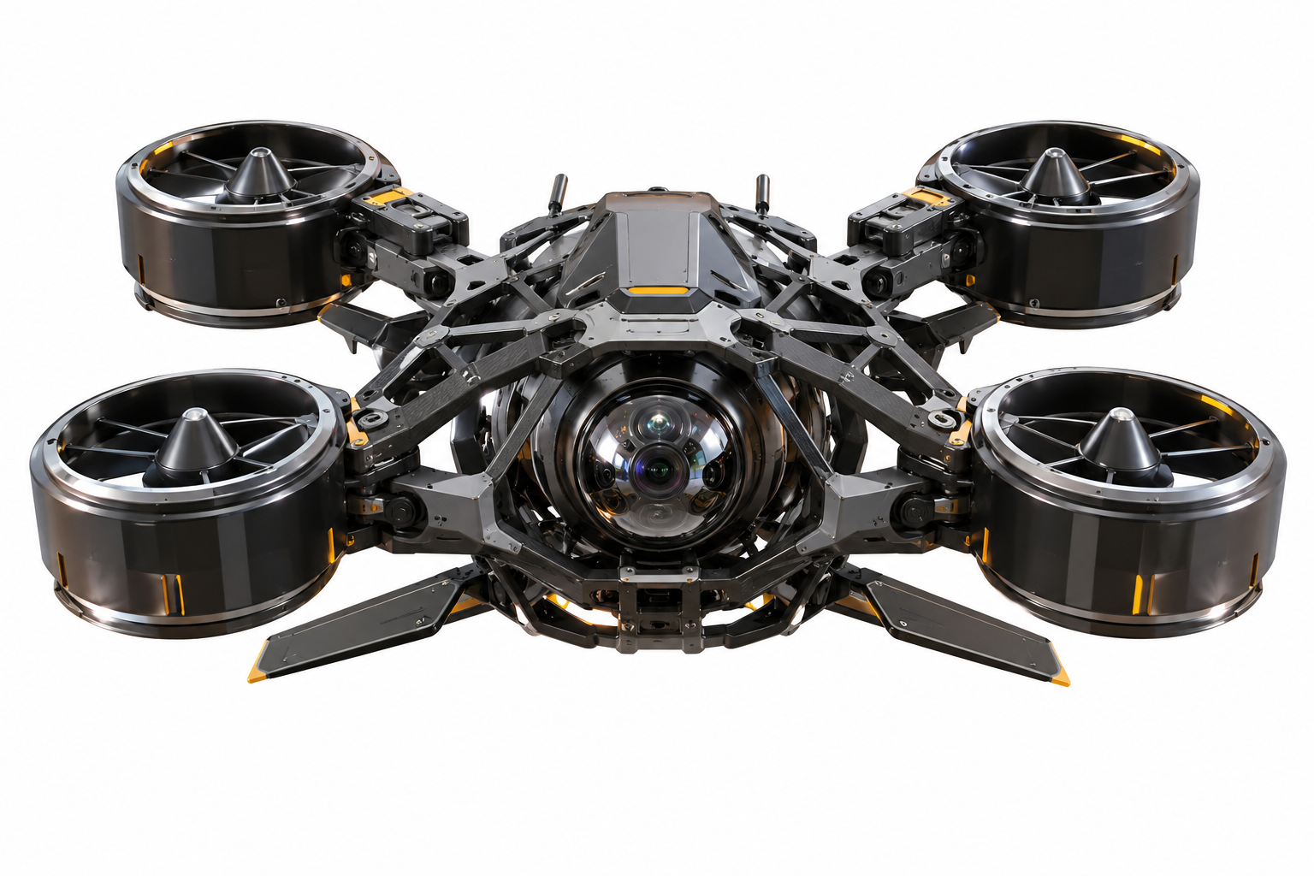
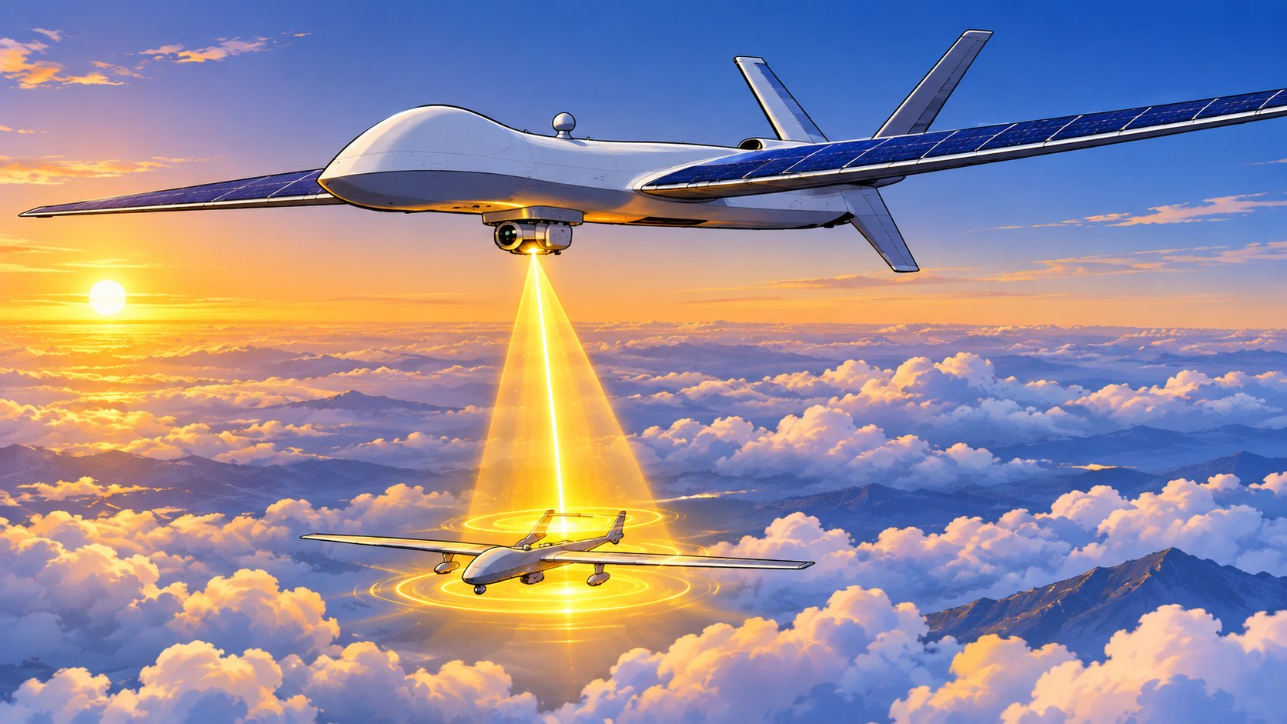
The 3-Tier Fleet
OUR SOLUTION 💡
🦅 GARUDA (Mothership): Long-range fixed-wing for macro thermal/4K mapping.
Shifting from blind ground search to verified aerial intelligence.
Scout Drone
Small highly agile and ai assisted flying in rough terrain.
The whole system is chained to one master control system called scarlet I which provides smart. efficient. and well coordinated system
☀️ SURYA VAHANA (Tanker): Beams laser power mid-air for continuous, 24/7 flight.

Slide 5
Technology & Innovation
GPS denied Navigation inspired by submarine naval navigation known as inertial navigation system
Mother daughter in air docking and releasing inspired from lockhhead martin cl 1201 concept
The Whole System is based on integrated architecture
Powered by AI
Past data analysis and active recconciance engine matching photos past and current to analyse damage predict probablity of life pressence under debris and use cv to analyse images and give precise location of possible life to search teams
Hybrid compute and coordination system with on device low compute task and off device heavy compute
Exploration of microwave transmitted air to air charging system

Slide 6
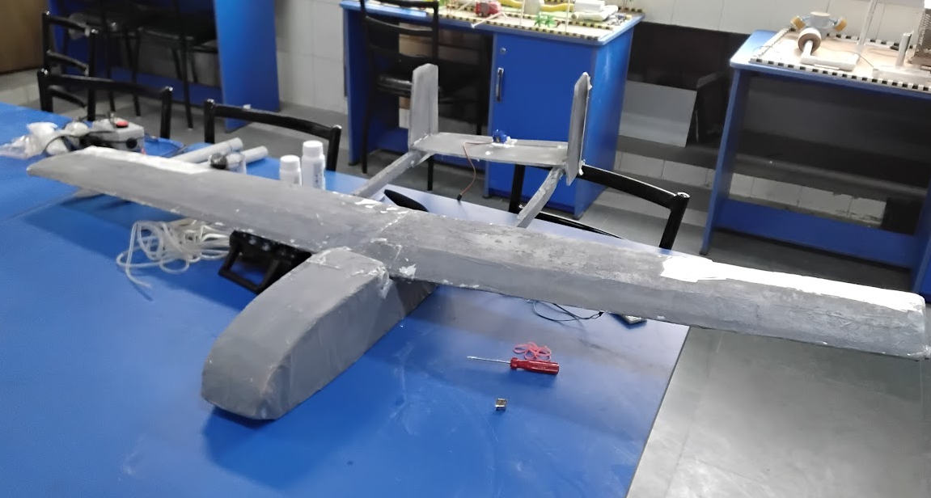
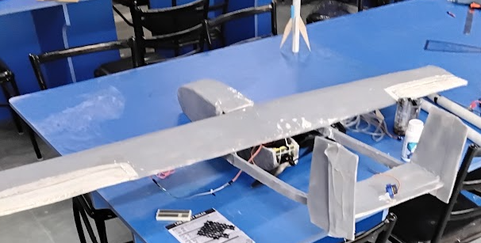
Prototype
At current stage we have built mothership testbed to test structure design docking redocking
Built to Test. Ready to Evolve

Slide 7
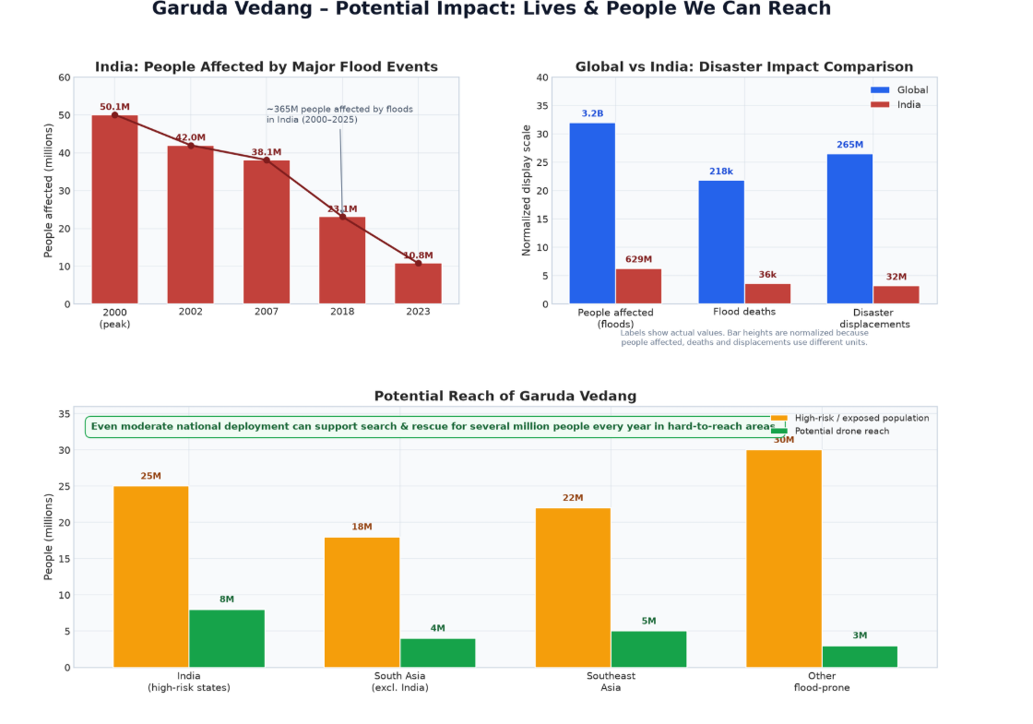
Reaching the Unreachable. Finding the Missing.

Slide 8
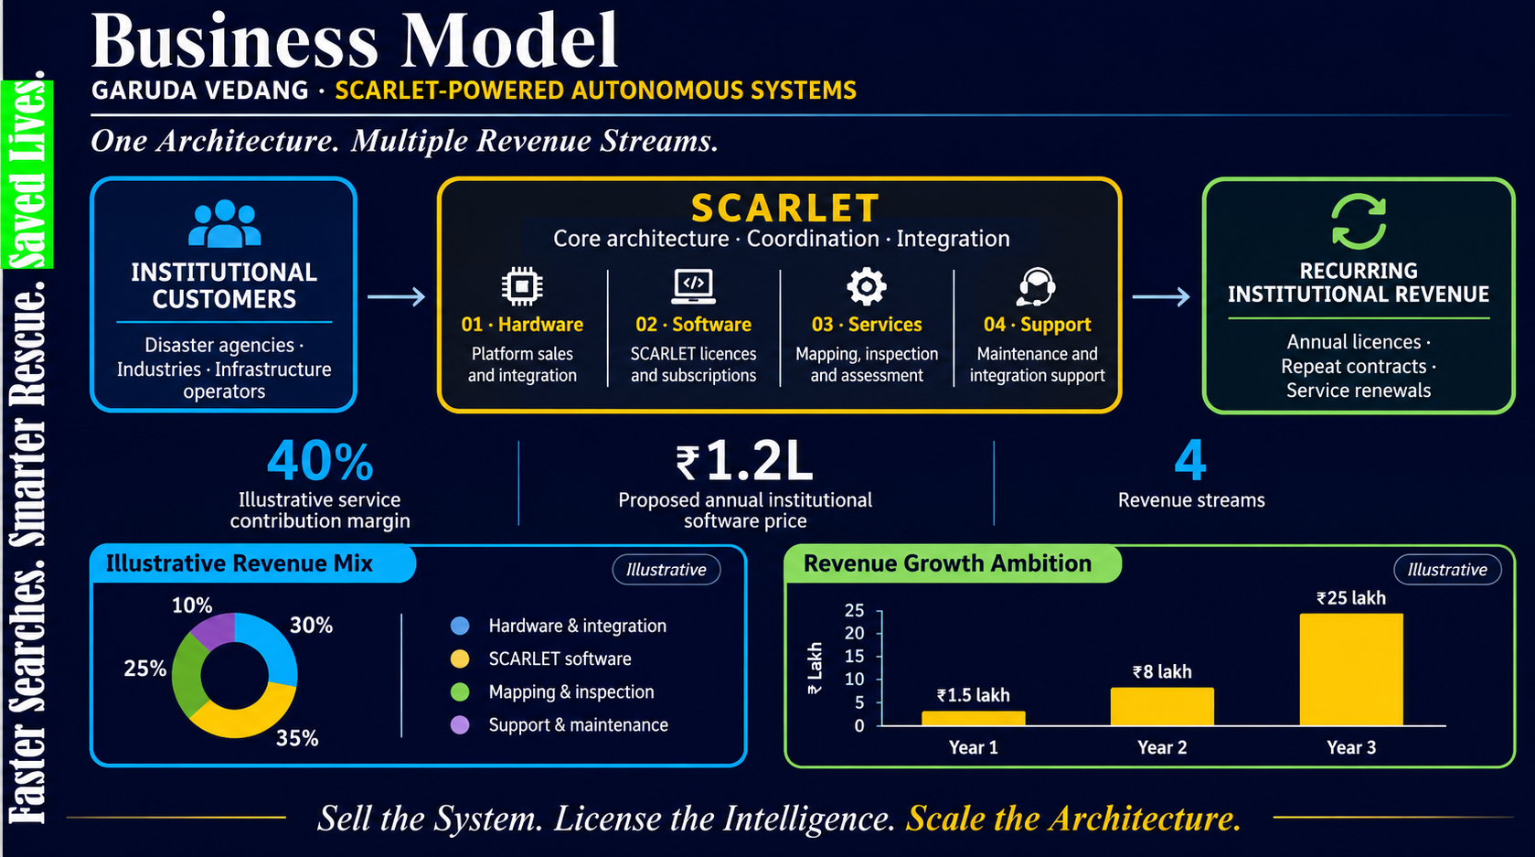
Faster Searches. Smarter Rescue. Saved Lives.

Slide 9
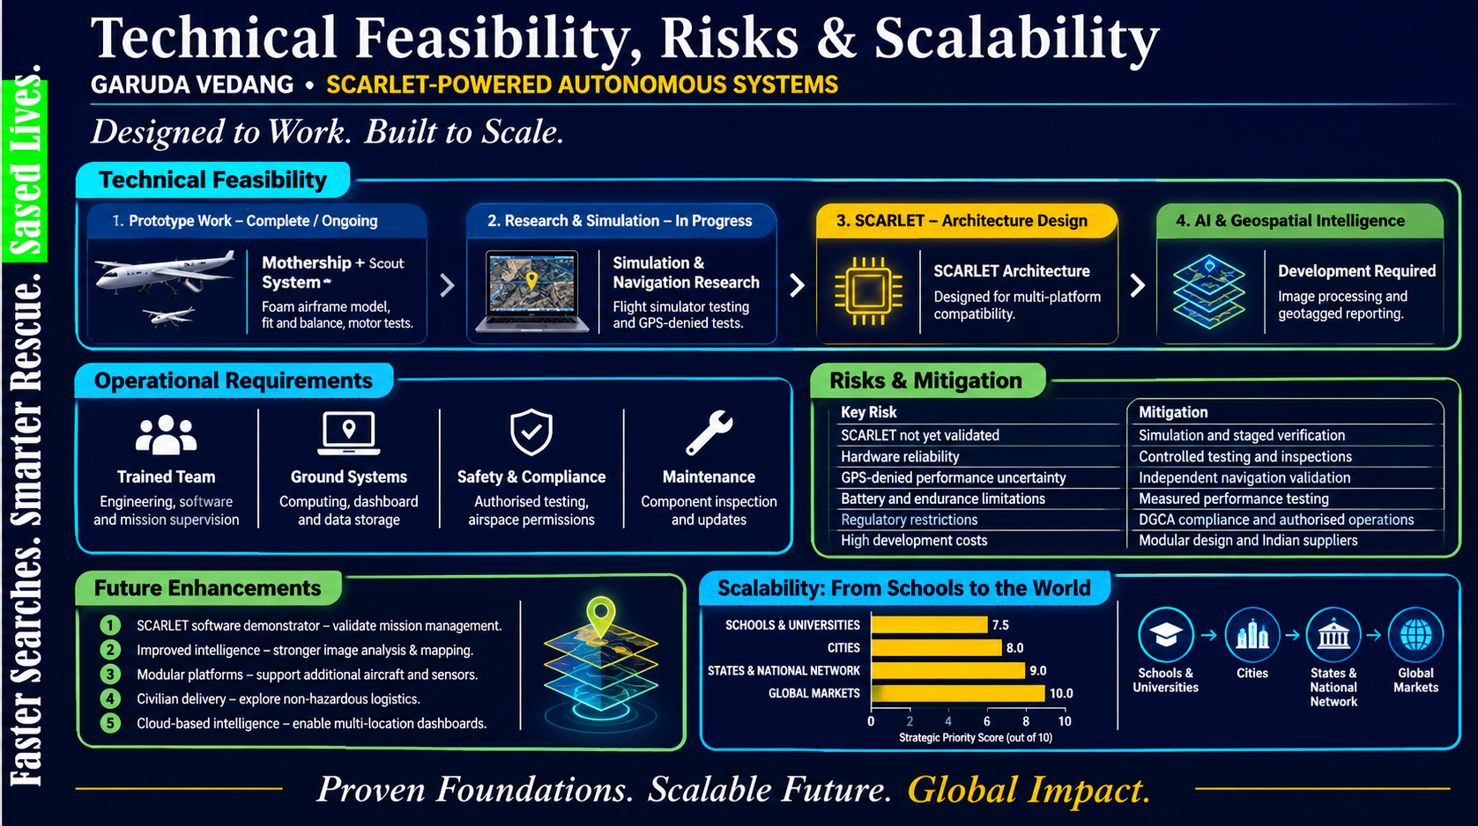
Affordable Innovation. Accessible to All.

Slide 11
Advantage: Two Drones. One Smarter Mission.

