Slide 1

AVANTA
CHANGE
Code and context
A clearer trust decision
for every software change.
CHECKS
Tests and security signals
TEAM PRIVANTRIX
Pranav Kumar Mishra
DECISION
Team Lead / System Architect / Lead Developer
Evidence and human approval
Aryan Kashyap
Research
Theme: Cybersecurity, Ethical Tech & Engineering Intelligence
AVANTA / PRIVANTRIX
01 / 12
Notes:
Speaker: Pranav Kumar Mishra
Opening: A clearer trust decision for every software change.
Explanation: A clearer trust decision for every software change. Help teams see why a software change deserves trust.
Handoff: Start with the situation that led to the project.

Slide 2

02 / PROBLEM & OPPORTUNITY
Writing the change is only the start of the decision.
01
A change arrives
A developer reviews code under release pressure.
The output should support a decision, not just add another log.
02
Signals sit apart
Tests, scanner findings and code context need to be assembled.
SOFTWARE CHANGE
03
Someone must decide
TECHNICAL CHECKS
The reviewer needs a clear reason to approve or reject.
HUMAN DECISION
AVANTA / PRIVANTRIX
02 / 12
Notes:
Speaker: Aryan Kashyap
Opening: Writing the change is only the start of the decision.
Explanation: A developer reviews code under release pressure. Tests, scanner findings and code context need to be assembled. The reviewer needs a clear reason to approve or reject. The output should support a decision, not just add another log.
Handoff: That gives us the gap to address.

Slide 3
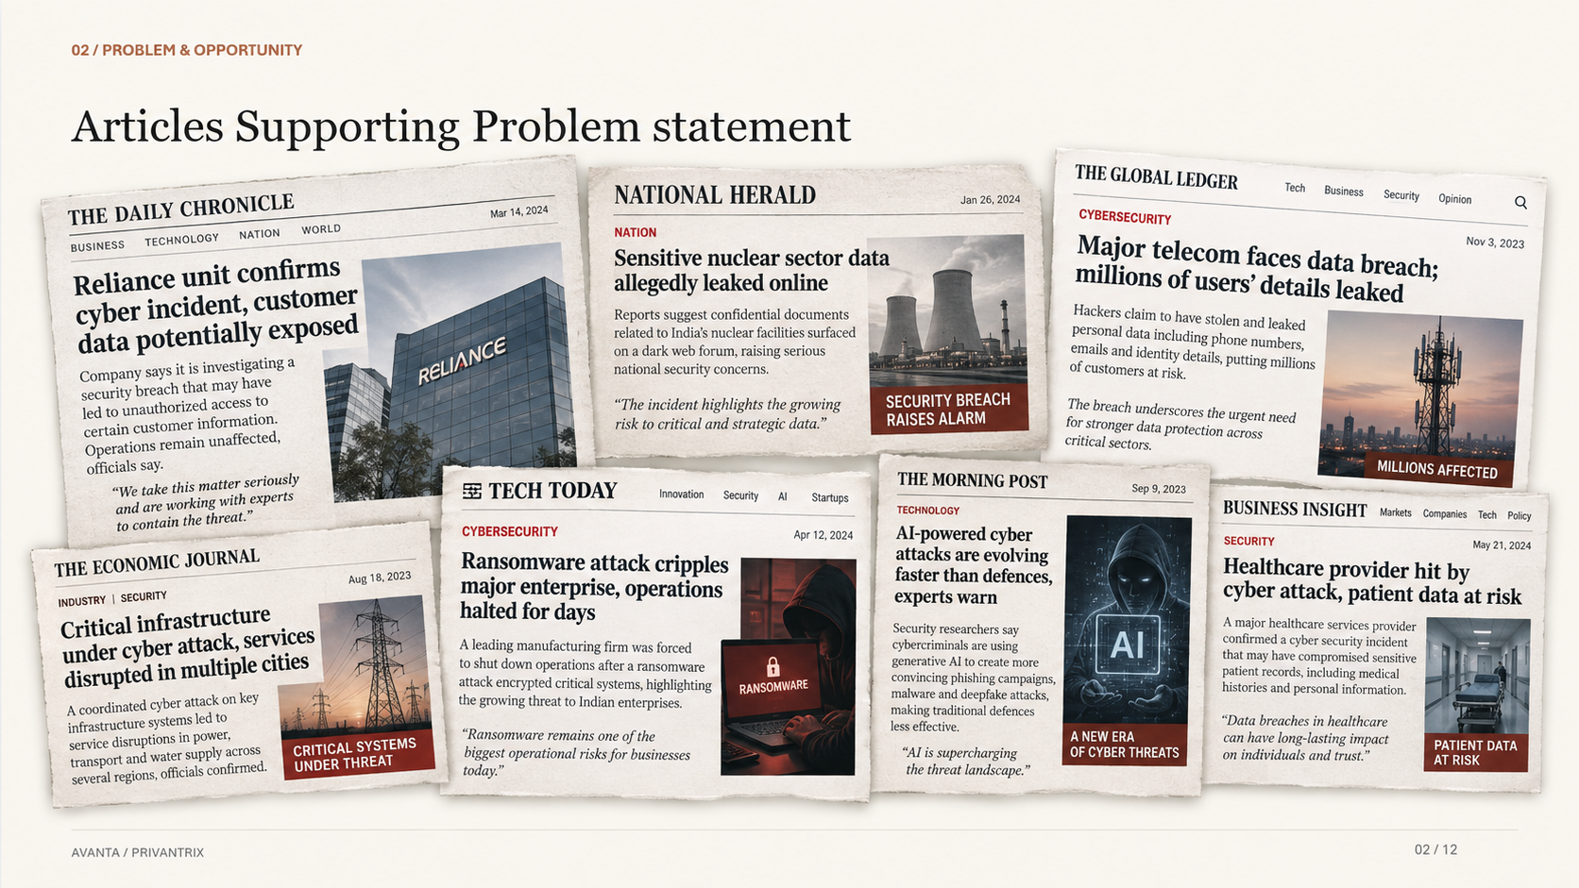
Notes:
Speaker: Aryan Kashyap
Opening: Writing the change is only the start of the decision.
Explanation: A developer reviews code under release pressure. Tests, scanner findings and code context need to be assembled. The reviewer needs a clear reason to approve or reject. The output should support a decision, not just add another log.
Handoff: That gives us the gap to address.

Slide 4
03 / EXISTING SOLUTIONS & GAP ANALYSIS
The tools contribute evidence. The reviewer needs a decision.
APPROACH
WHAT IT OFFERS
MISSION / WORKFLOW FIT
Coding assistants
Drafts and explanations
Correctness still needs checks.
Security scanners
Rule and dependency findings
Findings need context and triage.
CI / runtime tools
Behavior and operational signals
The reviewer connects the results.
Avanta
Assurance-loop architecture
Context + verification + approval.
Avanta brings the outputs into one evidence-linked review workflow.
AVANTA / PRIVANTRIX
03 / 12
Notes:
Speaker: Aryan Kashyap
Opening: The tools contribute evidence. The reviewer needs a decision.
Explanation: Avanta brings the outputs into one evidence-linked review workflow. The comparison is about the role each approach plays in the workflow.
Handoff: Here is how the system connects those needs.

Slide 5
04 / OUR SOLUTION
Connect the change, the checks and the human decision.
ASSURANCE-LOOP ARCHITECTURE
01
02
03
04
05
Observe
→
Understand
→
Repair
→
Verify
→
Approve
Change + context
Rudra context packet
Candidate patch
Tests + scanner rerun
Human decision
Verified changes inform the next review through private engineering memory.
AVANTA / PRIVANTRIX
04 / 12
Notes:
Speaker: Pranav Kumar Mishra
Opening: Connect the change, the checks and the human decision.
Explanation: Verified changes inform the next review through private engineering memory. Follow the diagram from input to the person who makes the decision.
Handoff: Now look inside the architecture.

Slide 6
05 / TECHNOLOGY & INNOVATION
Reasoning proposes a repair. Verification sets the boundary.
REASONING
01 / REPOSITORY CONTEXT
Connect the change to program structure and findings.
Context
↓
Candidate repair
02 / RUDRA / REASONING
Use context to propose a focused candidate repair.
03 / DETERMINISTIC GATES
Compiler, tests and security checks assess the change.
A model proposes.
Checks guide trust.
04 / REVIEW + MEMORY
An evidence packet supports approval and future context.
Architecture principle: a model proposes; checkable results support the trust decision.
AVANTA / PRIVANTRIX
05 / 12
Notes:
Speaker: Pranav Kumar Mishra
Opening: Reasoning proposes a repair. Verification sets the boundary.
Explanation: Architecture principle: a model proposes; checkable results support the trust decision. Each layer has a distinct responsibility within the system design.
Handoff: Next, look at the prototype and demonstration.

Slide 7
06 / PROTOTYPE / MVP / DEMONSTRATION
One controlled change defines the MVP demonstration.
MVP DEMONSTRATION DESIGN
1
2
3
CONTROLLED INPUT
CANDIDATE REPAIR
REVIEW PACKET
Public or synthetic code with a known defect
Focused patch and change rationale
Diff, gate results and approval decision
NEXT ENGINEERING MILESTONE
Run the assurance loop end to end on one controlled case.
A controlled defect connects input, repair, verification and reviewer approval.
AVANTA / PRIVANTRIX
06 / 12
Notes:
Speaker: Pranav Kumar Mishra
Opening: One controlled change defines the MVP demonstration.
Explanation: A controlled defect connects input, repair, verification and reviewer approval. Point to the numbered elements, then explain the next engineering milestone: Run the assurance loop end to end on one controlled case.
Handoff: Return to the person using the system.

Slide 8
07 / TARGET USERS & USE CASES
Build around the people responsible for a release.
DEVELOPERS
ENGINEERING LEADS
SECURITY REVIEWERS
Review AI-assisted changes with the relevant checks in view.
Connect release decisions to a clear approval record.
Tie findings, context and repair into one triage workflow.
ONE USE-CASE JOURNEY
CODE CHANGE
→
CONTEXT + CHECKS
→
REVIEW PACKET
→
APPROVAL DECISION
AVANTA / PRIVANTRIX
07 / 12
Notes:
Speaker: Aryan Kashyap
Opening: Build around the people responsible for a release.
Explanation: Use the journey beneath the three user groups to show how information becomes an action.
Handoff: That leads to the outcomes we want to measure.

Slide 9


08 / IMPACT & OUTCOMES
Measure review quality alongside review speed.
EXPECTED IMPACT
VALIDATION METRICS
Less evidence assembly
Triage time
Connect the inputs used in review.
Repair success
Clearer repair decisions
Tie candidate changes to their checks.
Incorrect approvals
Stronger accountability
Review effort
Keep the human decision connected to its rationale.
9
SDG 9
16
SDG 16
Industry, Innovation & Infrastructure
Peace, Justice & Strong Institutions
AVANTA / PRIVANTRIX
08 / 12
Notes:
Speaker: Pranav Kumar Mishra
Opening: Measure review quality alongside review speed.
Explanation: These are expected benefits. The validation plan measures triage time, repair success, incorrect approvals, review effort. Each metric answers a different engineering question.
Handoff: Those measurements shape the deployment path.

Slide 10
09 / BUSINESS MODEL & IMPLEMENTATION
Start with one assurance loop and grow from there.
IMPLEMENTATION PATH
01
02
03
04
05
Local MVP
Verification
Reviewer workflow
Controlled pilot
Private runtime
One codebase
Tests + scanners
Approval packet
Team feedback
Workspace expansion
DEPLOYMENT MODEL
REPOSITORY / TEAM MODEL
→
PRIVATE RUNTIME
→
INTEGRATION
→
SUPPORT
A staged service model pairs a bounded pilot with integration and ongoing support.
AVANTA / PRIVANTRIX
09 / 12
Notes:
Speaker: Pranav Kumar Mishra
Opening: Start with one assurance loop and grow from there.
Explanation: A staged service model pairs a bounded pilot with integration and ongoing support. Each stage prepares the system for the next level of use.
Handoff: The next question is what can fail and how we respond.

Slide 11
10 / FEASIBILITY & SCALABILITY
Automation must preserve control when a check fails.
ENGINEERING VALIDATION PRIORITIES
Test coverage · Repair bounds · Context integrity · Rollback · Human control
RISK
WHY IT MATTERS
ENGINEERING RESPONSE
Incomplete checks
A passing test can miss risk
Security-specific checks + human review
Unsafe repair
A patch introduces new failures
Bounded attempts + rollback
Poisoned context
Misleading inputs affect reasoning
Scope control + provenance review
SCALABILITY PATH
ONE CODEBASE
→
RELIABLE GATES
→
TEAM WORKSPACE
→
PRIVATE MULTI-REPO RUNTIME
AVANTA / PRIVANTRIX
10 / 12
Notes:
Speaker: Pranav Kumar Mishra
Opening: Automation must preserve control when a check fails.
Explanation: The risk table links a concrete failure to an engineering response. Follow the scale path only as each stage meets its validation priorities.
Handoff: These choices explain what makes the design distinctive.

Slide 12
11 / COMPETITIVE ADVANTAGE
Context, verification and approval belong in one workflow.
Make the reason
for trust
inspectable.
01
Context follows the change
Rudra links code context with candidate repair.
02
Checks shape the decision
Verification results accompany the proposed change.
03
People retain approval
A human gate closes the assurance loop.
FUTURE DIRECTION
Controlled run → review feedback → CI integration → private team memory
AVANTA / PRIVANTRIX
11 / 12
Notes:
Speaker: Pranav Kumar Mishra
Opening: Context, verification and approval belong in one workflow.
Explanation: Rudra links code context with candidate repair. Verification results accompany the proposed change. A human gate closes the assurance loop. The future direction continues this engineering focus.
Handoff: The next step belongs to our team.

Slide 13
12 / TEAM & VISION
Build software trust that a person can inspect.
THE TEAM
WHERE WE TAKE THIS NEXT
Pranav Kumar Mishra
01
Complete one controlled end-to-end run.
Team Lead / System Architect / Lead Developer
02
Inspect failures as well as passes.
System leadership, architecture and development.
03
Refine the reviewer evidence packet.
Aryan Kashyap
Research
04
Expand into a bounded team pilot.
Research and comparative analysis.
Notes:
Speaker: Pranav Kumar Mishra
Opening: Build software trust that a person can inspect.
Explanation: Help teams see why a software change deserves trust. Close by inviting feedback on the next engineering milestone.
Handoff: Thank you. We welcome your questions.

Slide 14
12 / ACKNOWLEDGMENTS
01 — USENIX SECURITY 2026
CUTTING THE FUSE
ACTIONABLE APT ATTACK BLOCKING IN PROVENANCE-BASED IDS
SMALL ANNOTATION UNDERNEATH:
DETECTION ≠ RESPONSE
EXISTING IDS ALERTS STILL NEED ACTIONABLE MITIGATION.
USENIX PAPER
02 — USENIX SECURITY 2025
ORTHRUS
ACHIEVING HIGH QUALITY OF ATTRIBUTION IN PROVENANCE-BASED INTRUSION DETECTION SYSTEMS
ANNOTATION:
ALERT FATIGUE REMAINS UNRESOLVED
SECURITY TEAMS NEED ATTACK CAUSALITY, NOT THOUSANDS OF ALERTS.
USENIX ORTHRUS LISTING
03 — 2025
LARGE LANGUAGE MODELS ARE AUTONOMOUS CYBER DEFENDERS
ANNOTATION:
AUTONOMOUS DEFENSE IS BECOMING TECHNICALLY VIABLE.
READ THE PAPER
04 — USENIX SECURITY 2025
CHAINFUZZ
EXPLOITING UPSTREAM VULNERABILITIES IN OPEN-SOURCE SUPPLY CHAINS
ANNOTATION:
A VULNERABILITY UPSTREAM CAN BECOME YOUR VULNERABILITY DOWNSTREAM.
USENIX CHAINFUZZ
05 — 2025
FOREWARNED IS FOREARMED
LLM-BASED AGENTS IN AUTONOMOUS CYBERATTACKS
ANNOTATION:
ATTACKERS ARE BECOMING AUTONOMOUS TOO.
Help teams see why a software change deserves trust.
THANK YOU
AVANTA / PRIVANTRIX
12 / 12
Notes:
Speaker: Pranav Kumar Mishra
Opening: Build software trust that a person can inspect.
Explanation: Help teams see why a software change deserves trust. Close by inviting feedback on the next engineering milestone.
Handoff: Thank you. We welcome your questions.

Slide 15


