Slide 1
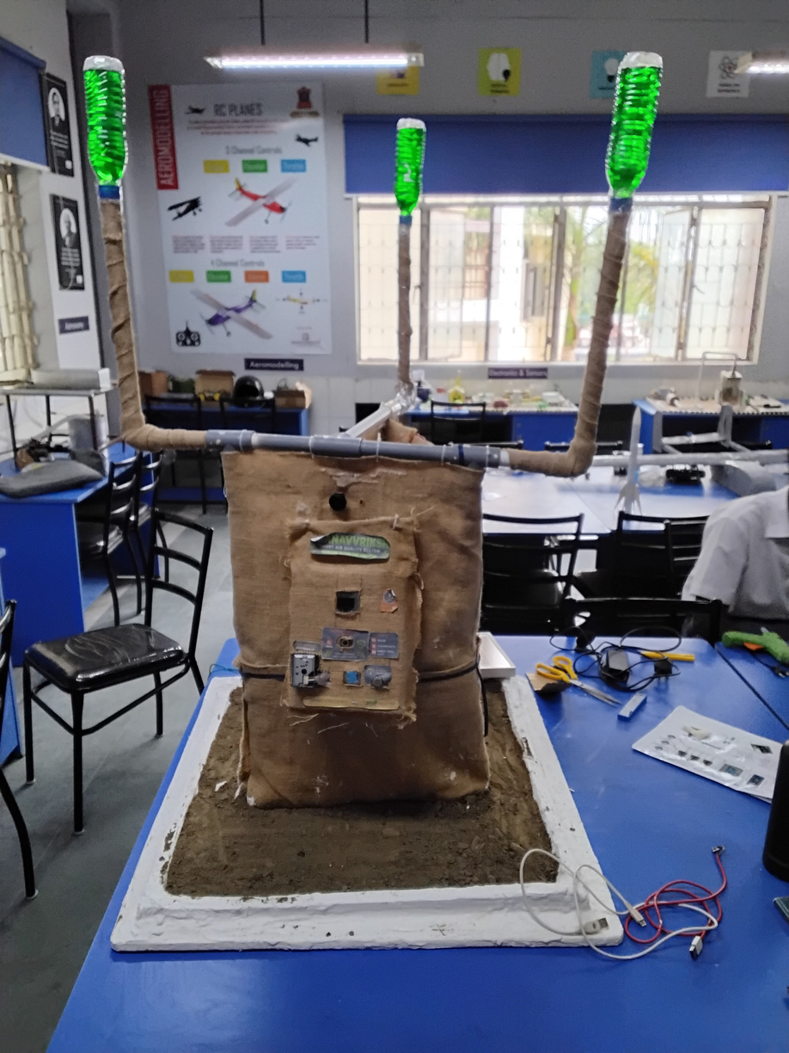
01 / COVER SLIDE
ECO
GUARDIAN
Sense the air.
Make the response visible.
TEAM ECO GUARDIAN
Aditya
Team Lead / Chief Design
Pranav Kumar Mishra
Lead Software / Software Engineering & Architecture
Theme: Climate & Sustainable Tech
ECO GUARDIAN
01 / 12
Notes:
Speaker: Aditya
Opening: Sense the air. Make the response visible.
Explanation: Sense the air. Make the response visible. Make local environmental information understandable, actionable and maintainable.
Handoff: Start with the situation that led to the project.

Slide 2

02 / PROBLEM & OPPORTUNITY
A local air signal matters when people can act on it.
01
Conditions change
Dust and selected gas conditions need local attention.
Connect a local condition
to a local response.
02
A reading needs meaning
People need a visible signal they can interpret.
AIR CONDITIONS
03
Action needs a system
LOCAL SIGNAL
Monitoring, airflow and maintenance must work together.
HUMAN RESPONSE
ECO GUARDIAN
02 / 12
Notes:
Speaker: Aditya
Opening: A local air signal matters when people can act on it.
Explanation: Dust and selected gas conditions need local attention. People need a visible signal they can interpret. Monitoring, airflow and maintenance must work together. Connect a local condition
to a local response.
Handoff: That gives us the gap to address.

Slide 3
03 / EXISTING SOLUTIONS & GAP ANALYSIS
Sensing and filtration need a useful local interface.
APPROACH
WHAT IT OFFERS
MISSION / WORKFLOW FIT
Air purifier
Air treatment
Monitoring and action depend on the product.
Air-quality meter
Local readings
The operator interprets and responds.
Gas monitor
Gas-specific monitoring
Sensor choice and calibration set the scope.
Eco Guardian
Integrated physical design
Sensing + filtration + local feedback.
Our design brings the air path and the user-facing signal into one unit.
ECO GUARDIAN
03 / 12
Notes:
Speaker: Aditya
Opening: Sensing and filtration need a useful local interface.
Explanation: Our design brings the air path and the user-facing signal into one unit. The comparison is about the role each approach plays in the workflow.
Handoff: Here is how the system connects those needs.

Slide 4
04 / OUR SOLUTION
Connect the air path to a visible local response.
ENVIRONMENTAL MONITORING WORKFLOW
01
02
03
04
05
Intake
→
Sense
→
Control
→
Filter
→
Inform
Local air conditions
Dust + selected gas signals
Microcontroller logic
Multi-stage air path
Display + local warning
Readings and service checks guide calibration and filter maintenance.
ECO GUARDIAN
04 / 12
Notes:
Speaker: Aditya
Opening: Connect the air path to a visible local response.
Explanation: Readings and service checks guide calibration and filter maintenance. Follow the diagram from input to the person who makes the decision.
Handoff: Now look inside the architecture.

Slide 5
05 / TECHNOLOGY & INNOVATION
Product design and software meet at one device.
01 / PRODUCT DESIGN / ADITYA
Jute-based enclosure and a structured air-path concept.
02 / SENSING + CONTROL
Dust, gas and environmental signals connect to controller logic.
03 / SOFTWARE / PRANAV
Readings, thresholds and the local information workflow.
04 / POWER + INTERFACE
Solar-power concept, display and local feedback.
Design focus: sensing, airflow, power and an understandable local interface.
ECO GUARDIAN
05 / 12
Notes:
Speaker: Pranav Kumar Mishra
Opening: Product design and software meet at one device.
Explanation: Design focus: sensing, airflow, power and an understandable local interface. Each layer has a distinct responsibility within the system design.
Handoff: Next, look at the prototype and demonstration.

Slide 6
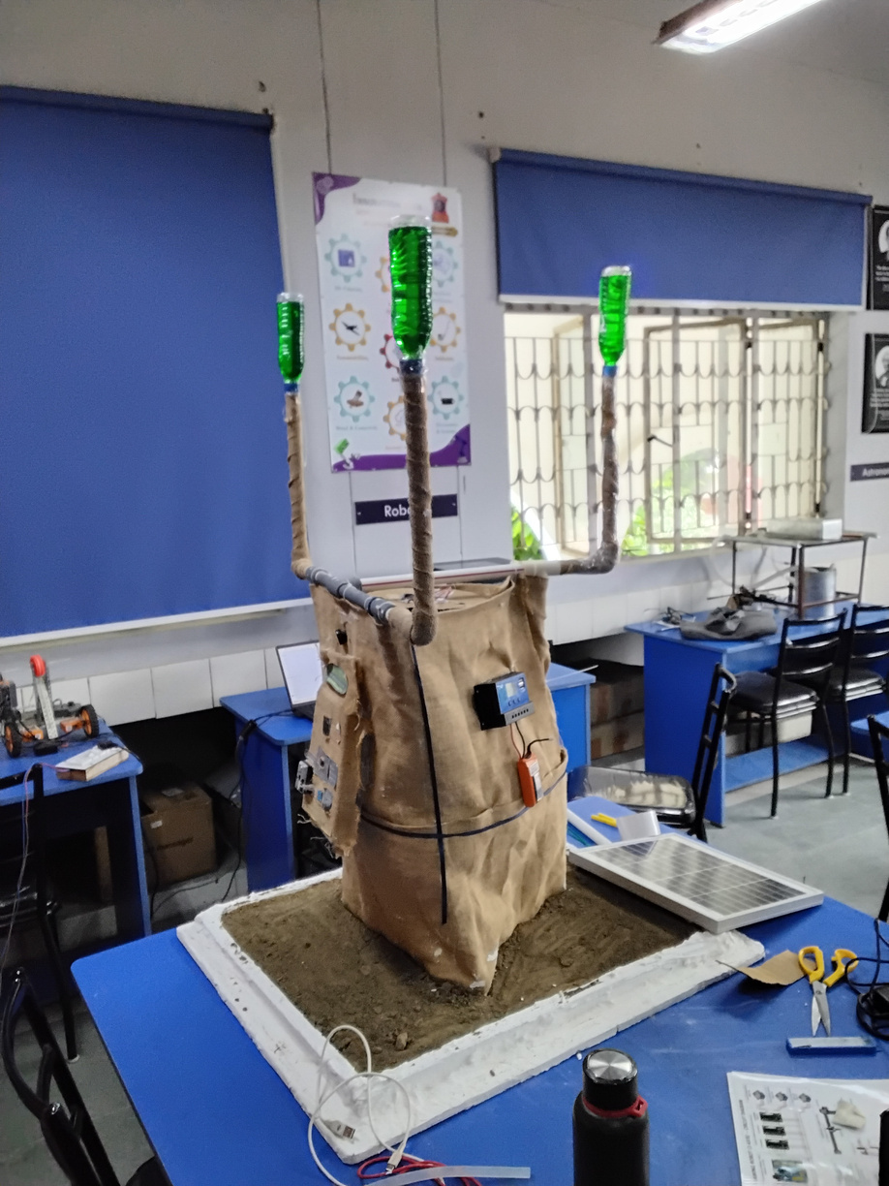
06 / PROTOTYPE / MVP / DEMONSTRATION
We brought the physical system into one assembly.
PHYSICAL PROTOTYPE
01 / AIR-PATH STRUCTURE
Vertical elements and enclosure
1
02 / LOCAL INTERFACE
Display and attached electronics
03 / POWER LAYER
Panel beside the assembly
2
NEXT ENGINEERING MILESTONE
3
Calibrated sensor readings and controlled air-path measurements.
The enclosure, vertical air-path elements, display and panel are assembled into one device.
ECO GUARDIAN
06 / 12
Notes:
Speaker: Aditya
Opening: We brought the physical system into one assembly.
Explanation: The enclosure, vertical air-path elements, display and panel are assembled into one device. Point to the numbered elements, then explain the next engineering milestone: Calibrated sensor readings and controlled air-path measurements.
Handoff: Return to the person using the system.

Slide 7
07 / TARGET USERS & USE CASES
Start where monitoring and maintenance happen together.
CAMPUSES + ECO-CLUBS
WORKSHOPS + LOCAL SITES
COMMUNITY OPERATORS
Local monitoring and environmental learning.
A local signal connected to a defined response.
Clear readings from a serviceable local unit.
ONE USE-CASE JOURNEY
LOCAL CONDITIONS
→
DEVICE READINGS
→
OPERATOR REVIEW
→
RESPONSE + SERVICING
ECO GUARDIAN
07 / 12
Notes:
Speaker: Aditya
Opening: Start where monitoring and maintenance happen together.
Explanation: Use the journey beneath the three user groups to show how information becomes an action.
Handoff: That leads to the outcomes we want to measure.

Slide 8


08 / IMPACT & OUTCOMES
Make local air conditions clearer—and performance measurable.
EXPECTED IMPACT
VALIDATION METRICS
Clearer local awareness
Sensor agreement
Air conditions translated into visible information.
Particulate change
A practical filtration path
Physical treatment integrated with the sensing design.
Power demand
Maintainable monitoring
Alert response
A unit that connects readings with service needs.
11
SDG 11
12
SDG 12
Sustainable Cities & Communities
Responsible Consumption & Production
ECO GUARDIAN
08 / 12
Notes:
Speaker: Pranav Kumar Mishra
Opening: Make local air conditions clearer—and performance measurable.
Explanation: These are expected benefits. The validation plan measures sensor agreement, particulate change, power demand, alert response. Each metric answers a different engineering question.
Handoff: Those measurements shape the deployment path.

Slide 9
09 / BUSINESS MODEL & IMPLEMENTATION
Calibrate one unit, then build the pilot around it.
IMPLEMENTATION PATH
01
02
03
04
05
Components
Calibration
Air-path tests
Campus pilot
Field evaluation
Complete the list
Establish baselines
Measure performance
Logs + servicing
Site-specific use
DEPLOYMENT MODEL
EDUCATIONAL KIT / CAMPUS UNIT
→
CALIBRATION
→
SERVICE ACCESS
→
MAINTENANCE
A serviceable unit pairs locally available materials with calibration and routine maintenance.
ECO GUARDIAN
09 / 12
Notes:
Speaker: Aditya
Opening: Calibrate one unit, then build the pilot around it.
Explanation: A serviceable unit pairs locally available materials with calibration and routine maintenance. Each stage prepares the system for the next level of use.
Handoff: The next question is what can fail and how we respond.

Slide 10
10 / FEASIBILITY & SCALABILITY
Reliable readings depend on a maintainable device.
ENGINEERING VALIDATION PRIORITIES
Sensor calibration · Airflow · Power demand · Alert thresholds · Service access
RISK
WHY IT MATTERS
ENGINEERING RESPONSE
Sensor drift
False or missed local warnings
Reference calibration + maintenance
Filter performance
Air path may miss its objective
Paired airflow and particulate tests
Environmental exposure
Reliability changes over time
Enclosure review + routine servicing
SCALABILITY PATH
ONE CALIBRATED UNIT
→
CAMPUS PILOT
→
MAINTAINABLE DESIGN
→
CONNECTED SITES
ECO GUARDIAN
10 / 12
Notes:
Speaker: Pranav Kumar Mishra
Opening: Reliable readings depend on a maintainable device.
Explanation: The risk table links a concrete failure to an engineering response. Follow the scale path only as each stage meets its validation priorities.
Handoff: These choices explain what makes the design distinctive.

Slide 11
11 / COMPETITIVE ADVANTAGE
Sensing, physical design and local feedback belong together.
A useful signal
needs a useful
physical system.
01
An integrated physical build
Enclosure, electronics, display and panel in one assembly.
02
Design and software co-development
The product makes readings visible and servicing practical.
03
Local feedback at the center
Monitoring is connected to an operator response.
FUTURE DIRECTION
Calibration → air-path evaluation → campus pilot → connected monitoring
ECO GUARDIAN
11 / 12
Notes:
Speaker: Aditya
Opening: Sensing, physical design and local feedback belong together.
Explanation: Enclosure, electronics, display and panel in one assembly. The product makes readings visible and servicing practical. Monitoring is connected to an operator response. The future direction continues this engineering focus.
Handoff: The next step belongs to our team.

Slide 12
12 / TEAM & VISION
Make environmental information useful where people live and work.
THE TEAM
WHERE WE TAKE THIS NEXT
Aditya
01
Calibrate the sensing layer.
Team Lead / Chief Design
02
Measure the physical air path.
Product leadership, physical design and user-facing system direction.
03
Refine servicing and the interface.
Pranav Kumar Mishra
Lead Software / Software Engineering & Architecture
04
Run a supervised campus pilot.
Software engineering, control workflow and system architecture.
Make local environmental information understandable, actionable and maintainable.
THANK YOU
ECO GUARDIAN
12 / 12
Notes:
Speaker: Aditya
Opening: Make environmental information useful where people live and work.
Explanation: Make local environmental information understandable, actionable and maintainable. Close by inviting feedback on the next engineering milestone.
Handoff: Thank you. We welcome your questions.

