Slide 1
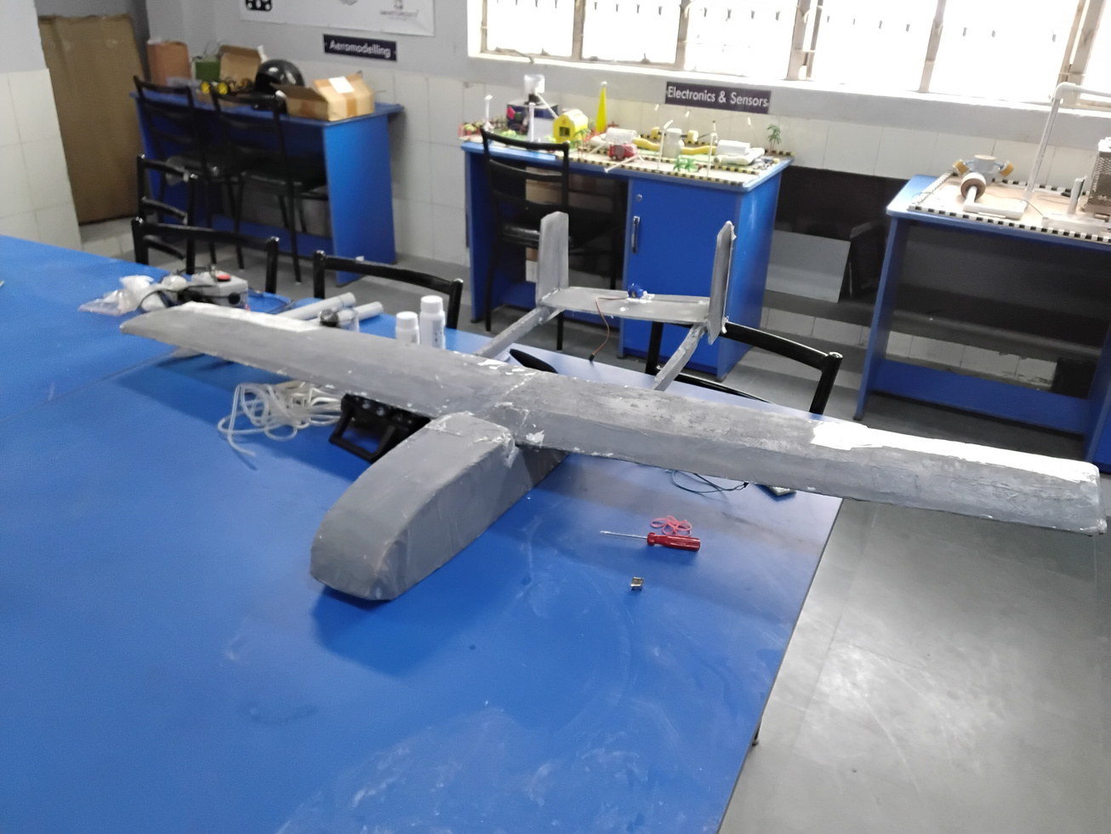
01 / COVER SLIDE
GARUDA
VEDANG
Aerial intelligence for disaster-response decisions.
TEAM VEDANG
Peeyush Raj
Team Lead / Aerostructure Designer
Pranav Kumar Mishra
Lead Software / Software Engineering & Architecture
Theme: Aerospace & Frontier Tech
GARUDA VEDANG
01 / 12
Notes:
Speaker: Peeyush Raj
Opening: Aerial intelligence for disaster-response decisions.
Explanation: Aerial intelligence for disaster-response decisions. Give responders a faster view of places that are hardest to reach.
Handoff: Start with the situation that led to the project.

Slide 2

02 / PROBLEM & OPPORTUNITY
When roads fail, information becomes the first bottleneck.
01
Access breaks down
Damaged terrain slows ground assessment.
Information is the
first useful handoff.
02
Decisions cannot wait
Teams need visual context before committing people and resources.
DIFFICULT ACCESS
03
Observation opens a route
AERIAL OBSERVATION
An aerial view can guide the next ground response.
REVIEWED CONTEXT
GARUDA VEDANG
02 / 12
Notes:
Speaker: Peeyush Raj
Opening: When roads fail, information becomes the first bottleneck.
Explanation: Damaged terrain slows ground assessment. Teams need visual context before committing people and resources. An aerial view can guide the next ground response. Information is the
first useful handoff.
Handoff: That gives us the gap to address.

Slide 3
03 / EXISTING SOLUTIONS & GAP ANALYSIS
The mission needs both an aerial view and a local handoff.
APPROACH
WHAT IT OFFERS
MISSION / WORKFLOW FIT
Ground response
Direct intervention
Physical access limits assessment.
Local aerial inspection
Fast view of a nearby area
Range and endurance shape the mission.
Wide-area imagery
Broad geographic context
Local timing and mission flexibility vary.
Garuda Vedang
Fixed-wing mission platform
Aerial observation + responder handoff.
Our design connects the aircraft to the decision on the ground.
GARUDA VEDANG
03 / 12
Notes:
Speaker: Peeyush Raj
Opening: The mission needs both an aerial view and a local handoff.
Explanation: Our design connects the aircraft to the decision on the ground. The comparison is about the role each approach plays in the workflow.
Handoff: Here is how the system connects those needs.

Slide 4
04 / OUR SOLUTION
From aerial search to an actionable responder handoff.
MISSION WORKFLOW
01
02
03
04
05
Deploy
→
Observe
→
Process
→
Review
→
Respond
Reach the search area
Imagery + mission data
Organize location context
Operator checks the information
Hand off to field teams
Human review connects aircraft observations to field action.
GARUDA VEDANG
04 / 12
Notes:
Speaker: Pranav Kumar Mishra
Opening: From aerial search to an actionable responder handoff.
Explanation: Human review connects aircraft observations to field action. Follow the diagram from input to the person who makes the decision.
Handoff: Now look inside the architecture.

Slide 5
05 / TECHNOLOGY & INNOVATION
Aerostructure and software meet in one mission architecture.
01 / AEROSTRUCTURE / PEEYUSH
Fixed-wing twin-boom platform with a central fuselage.
02 / FLIGHT + NAVIGATION
Navigation, onboard sensing and mission-state processing.
03 / SOFTWARE ARCHITECTURE / PRANAV
Imagery, telemetry and the operator information workflow.
04 / RESPONDER INTERFACE
Aircraft observations organized into usable mission context.
Design focus: a physical platform and an information workflow built around the same mission.
GARUDA VEDANG
05 / 12
Notes:
Speaker: Peeyush Raj / Pranav Kumar Mishra
Opening: Aerostructure and software meet in one mission architecture.
Explanation: Design focus: a physical platform and an information workflow built around the same mission. Each layer has a distinct responsibility within the system design.
Handoff: Next, look at the prototype and demonstration.

Slide 6
06 / PROTOTYPE / MVP / DEMONSTRATION
We built the airframe around the mission.
PHYSICAL PROTOTYPE
01 / MAIN WING
Fixed-wing geometry
02 / TWIN-BOOM TAIL
2
Two-boom tail arrangement
1
03 / CENTRAL FUSELAGE
Central aircraft body
3
NEXT ENGINEERING MILESTONE
Integrated flight + mission-system validation.
Fixed-wing airframe developed as the platform for the Garuda Vedang disaster-response system.
GARUDA VEDANG
06 / 12
Notes:
Speaker: Peeyush Raj
Opening: We built the airframe around the mission.
Explanation: Fixed-wing airframe developed as the platform for the Garuda Vedang disaster-response system. Point to the numbered elements, then explain the next engineering milestone: Integrated flight + mission-system validation.
Handoff: Return to the person using the system.

Slide 7
07 / TARGET USERS & USE CASES
One aircraft workflow serves three response decisions.
FIELD RESPONDERS
DISASTER CONTROL ROOMS
RELIEF / MEDICAL TEAMS
Visual context before entering difficult terrain.
Aerial information for search-area prioritization.
Location context for dispatch and aid planning.
ONE USE-CASE JOURNEY
DISASTER AREA
→
GARUDA OBSERVATION
→
REVIEWED LOCATIONS
→
GROUND RESPONSE
GARUDA VEDANG
07 / 12
Notes:
Speaker: Pranav Kumar Mishra
Opening: One aircraft workflow serves three response decisions.
Explanation: Use the journey beneath the three user groups to show how information becomes an action.
Handoff: That leads to the outcomes we want to measure.

Slide 8


08 / IMPACT & OUTCOMES
Earlier context. More focused search. A clearer handoff.
EXPECTED IMPACT
VALIDATION METRICS
Earlier visual context
Flight stability
Reconnaissance before difficult ground access.
Location accuracy
More focused search
Reviewed imagery supports location prioritization.
Mission coverage
Better information handoff
Information handoff time
Mission data organized for human decisions.
9
SDG 9
11
SDG 11
Industry, Innovation & Infrastructure
Sustainable Cities & Communities
GARUDA VEDANG
08 / 12
Notes:
Speaker: Pranav Kumar Mishra
Opening: Earlier context. More focused search. A clearer handoff.
Explanation: These are expected benefits. The validation plan measures flight stability, location accuracy, mission coverage, information handoff time. Each metric answers a different engineering question.
Handoff: Those measurements shape the deployment path.

Slide 9
09 / BUSINESS MODEL & IMPLEMENTATION
Integrate the aircraft, then take the mission into the field.
IMPLEMENTATION PATH
01
02
03
04
05
Airframe
Flight + control
Mission system
Controlled field
Disaster response
Validation
Integration
Integration
Trial
Pilot
DEPLOYMENT MODEL
AIRCRAFT SYSTEM
→
OPERATOR SOFTWARE
→
TRAINING
→
MAINTENANCE + SUPPORT
Institutional deployment brings the aircraft, software and operating support together.
GARUDA VEDANG
09 / 12
Notes:
Speaker: Peeyush Raj
Opening: Integrate the aircraft, then take the mission into the field.
Explanation: Institutional deployment brings the aircraft, software and operating support together. Each stage prepares the system for the next level of use.
Handoff: The next question is what can fail and how we respond.

Slide 10
10 / FEASIBILITY & SCALABILITY
Control the aircraft. Protect the information. Scale carefully.
ENGINEERING VALIDATION PRIORITIES
Mass & balance · Flight stability · Navigation · Communications · Information accuracy
RISK
WHY IT MATTERS
ENGINEERING RESPONSE
Flight stability
Loss of controllability
CG checks + controlled flight envelope
Communication loss
Mission-data interruption
Failsafe design + manual override
False detection
Poor responder information
Human review + image-backed context
SCALABILITY PATH
ONE AIRCRAFT
→
VALIDATED MISSION
→
FIELD PILOT
→
MULTI-AIRCRAFT OPERATIONS
GARUDA VEDANG
10 / 12
Notes:
Speaker: Peeyush Raj
Opening: Control the aircraft. Protect the information. Scale carefully.
Explanation: The risk table links a concrete failure to an engineering response. Follow the scale path only as each stage meets its validation priorities.
Handoff: These choices explain what makes the design distinctive.

Slide 11
11 / COMPETITIVE ADVANTAGE
Designed around the mission, from airframe to information.
The aircraft is one part.
The handoff completes
the mission.
01
Mission-first airframe
Fixed-wing geometry designed around aerial observation.
02
Aerostructure + software co-design
Physical and information systems share one mission architecture.
03
Human-reviewed response
Information is organized for decisions, beyond raw data alone.
FUTURE DIRECTION
Flight validation → mission integration → field trials → expanded autonomy
GARUDA VEDANG
11 / 12
Notes:
Speaker: Peeyush Raj
Opening: Designed around the mission, from airframe to information.
Explanation: Fixed-wing geometry designed around aerial observation. Physical and information systems share one mission architecture. Information is organized for decisions, beyond raw data alone. The future direction continues this engineering focus.
Handoff: The next step belongs to our team.

Slide 12
12 / TEAM & VISION
Give responders a faster view of hard-to-reach places.
THE TEAM
WHERE WE TAKE THIS NEXT
Peeyush Raj
01
Complete integrated aircraft validation.
Team Lead / Aerostructure Designer
02
Connect sensing and mission software.
Airframe architecture, structural configuration and physical platform development.
03
Run controlled search-and-response trials.
Pranav Kumar Mishra
Lead Software / Software Engineering & Architecture
04
Move into disaster-response evaluation.
Software architecture, mission information workflow, computing and system integration.
Give responders a faster view of places that are hardest to reach.
THANK YOU
GARUDA VEDANG
12 / 12
Notes:
Speaker: Peeyush Raj
Opening: Give responders a faster view of hard-to-reach places.
Explanation: Give responders a faster view of places that are hardest to reach. Close by inviting feedback on the next engineering milestone.
Handoff: Thank you. We welcome your questions.

