Slide 1
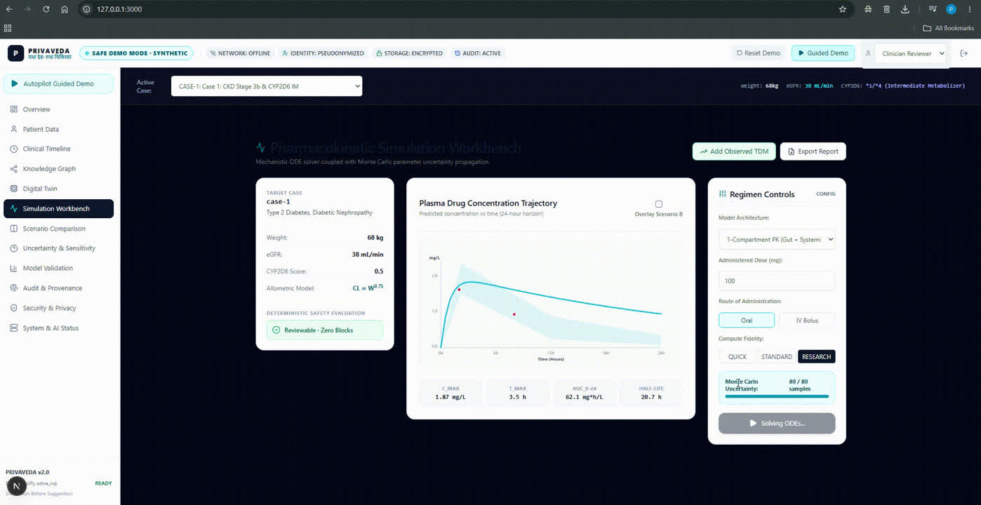
01 / COVER SLIDE
PRIVAVEDA
Patient-specific simulation.
Clearer clinical review.
TEAM PRIVAVEDA
Pranav Kumar Mishra
Team Lead / Project Lead
Theme: Healthcare & HealthTech
PRIVAVEDA
01 / 12
Notes:
Speaker: Pranav Kumar Mishra
Opening: Patient-specific simulation. Clearer clinical review.
Explanation: Patient-specific simulation. Clearer clinical review. Make patient-specific simulations easier to understand, one validated use case at a time.
Handoff: Start with the situation that led to the project.

Slide 2

02 / PROBLEM & OPPORTUNITY
The same medicine can require a different conversation.
01
Context changes
Labs, medicines and patient characteristics shape the review.
Bring the patient context beside the model.
02
Information is fragmented
A clinician must connect patient context with model output.
PATIENT CONTEXT
03
The decision needs clarity
SIMULATED EXPOSURE
Exposure scenarios and uncertainty should be reviewed together.
CLINICIAN REVIEW
PRIVAVEDA
02 / 12
Notes:
Speaker: Pranav Kumar Mishra
Opening: The same medicine can require a different conversation.
Explanation: Labs, medicines and patient characteristics shape the review. A clinician must connect patient context with model output. Exposure scenarios and uncertainty should be reviewed together. Bring the patient context beside the model.
Handoff: That gives us the gap to address.

Slide 3
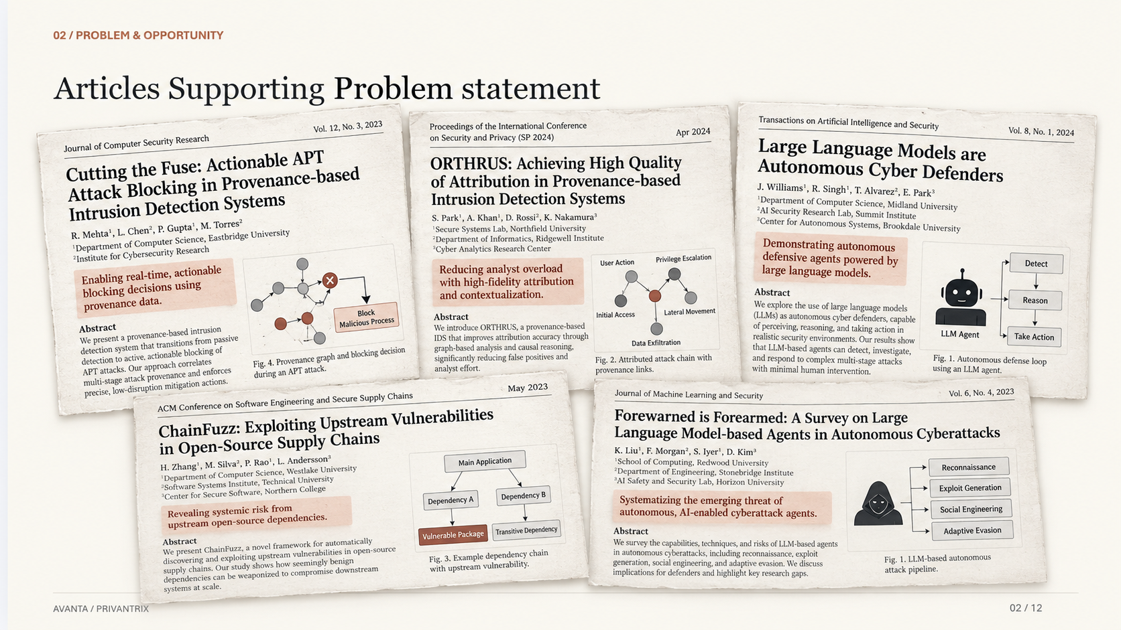
Notes:
Speaker: Pranav Kumar Mishra
Opening: The same medicine can require a different conversation.
Explanation: Labs, medicines and patient characteristics shape the review. A clinician must connect patient context with model output. Exposure scenarios and uncertainty should be reviewed together. Bring the patient context beside the model.
Handoff: That gives us the gap to address.

Slide 4
03 / EXISTING SOLUTIONS & GAP ANALYSIS
Precision dosing begins with a strong clinical baseline.
APPROACH
WHAT IT OFFERS
MISSION / WORKFLOW FIT
Guidelines + monitoring
Clinical standards and observed levels
Combine the results with individual context.
Bayesian dosing tools
Patient-specific estimates
Model selection and workflow fit matter.
Specialist modeling tools
Detailed pharmacology analysis
Translate model output into clinical review.
Privaveda
Local simulation workflow
Patient context + uncertainty + review.
Our design makes the simulation easier to inspect within a clinician-led workflow.
PRIVAVEDA
03 / 12
Notes:
Speaker: Pranav Kumar Mishra
Opening: Precision dosing begins with a strong clinical baseline.
Explanation: Our design makes the simulation easier to inspect within a clinician-led workflow. The comparison is about the role each approach plays in the workflow.
Handoff: Here is how the system connects those needs.

Slide 5
04 / OUR SOLUTION
Bring patient context into one reviewable simulation.
CLINICIAN-LED WORKFLOW
01
02
03
04
05
Context
→
Model
→
Simulate
→
Check
→
Review
Labs + medicines
Patient-specific inputs
Exposure + uncertainty
Input and safety rules
Clinician judgment
New measured levels feed the next model update and review.
PRIVAVEDA
04 / 12
Notes:
Speaker: Pranav Kumar Mishra
Opening: Bring patient context into one reviewable simulation.
Explanation: New measured levels feed the next model update and review. Follow the diagram from input to the person who makes the decision.
Handoff: Now look inside the architecture.

Slide 6
05 / TECHNOLOGY & INNOVATION
The model simulates. The clinician decides.
01 / PATIENT CONTEXT
Labs, medicines and measured levels inform the simulation.
02 / PK MODEL + BAYESIAN UPDATE
Estimate exposure and represent uncertainty.
03 / EVIDENCE GATE
Input-quality checks and abstention rules constrain the output.
04 / LOCAL REVIEW + AUDIT
Clinician-facing scenarios, explanations and a decision record.
Architecture principle: explanations support the simulation; they do not choose the dose.
PRIVAVEDA
05 / 12
Notes:
Speaker: Pranav Kumar Mishra
Opening: The model simulates. The clinician decides.
Explanation: Architecture principle: explanations support the simulation; they do not choose the dose. Each layer has a distinct responsibility within the system design.
Handoff: Next, look at the prototype and demonstration.

Slide 7
06 / PROTOTYPE / MVP / DEMONSTRATION
A simulation workbench puts the patient beside the curve.
SYNTHETIC DEMO WORKBENCH
01 / PATIENT CONTEXT
Case inputs alongside the model
02 / EXPOSURE TRAJECTORY
1
2
3
Concentration and uncertainty
03 / SCENARIO CONTROLS
Settings for a reviewable comparison
NEXT ENGINEERING MILESTONE
Reproduce one model evaluation with specialist feedback.
Patient context, concentration trajectories and scenario controls in one interface.
PRIVAVEDA
06 / 12
Notes:
Speaker: Pranav Kumar Mishra
Opening: A simulation workbench puts the patient beside the curve.
Explanation: Patient context, concentration trajectories and scenario controls in one interface. Point to the numbered elements, then explain the next engineering milestone: Reproduce one model evaluation with specialist feedback.
Handoff: Return to the person using the system.

Slide 8
07 / TARGET USERS & USE CASES
Start with the people who review complex dosing decisions.
CLINICAL PHARMACISTS
SPECIALIST CLINICIANS
HOSPITAL CLINICAL + IT TEAMS
Connect changing labs and medicines to exposure scenarios.
Review uncertainty in a focused clinical use case.
Assess workflow fit, governance and local operation.
ONE USE-CASE JOURNEY
NEW CLINICAL INPUT
→
UPDATED SIMULATION
→
SCENARIO REVIEW
→
RECORDED DECISION
PRIVAVEDA
07 / 12
Notes:
Speaker: Pranav Kumar Mishra
Opening: Start with the people who review complex dosing decisions.
Explanation: Use the journey beneath the three user groups to show how information becomes an action.
Handoff: That leads to the outcomes we want to measure.

Slide 9


08 / IMPACT & OUTCOMES
Make uncertainty visible and review quality measurable.
EXPECTED IMPACT
VALIDATION METRICS
Clearer scenario review
Prediction error
Patient context and exposure shown together.
Interval calibration
Visible uncertainty
Review the range around a prediction.
Safety-gate behavior
Traceable decisions
Clinical review time
Connect each review to its inputs and model.
3
SDG 3
9
SDG 9
Good Health & Well-Being
Industry, Innovation & Infrastructure
PRIVAVEDA
08 / 12
Notes:
Speaker: Pranav Kumar Mishra
Opening: Make uncertainty visible and review quality measurable.
Explanation: These are expected benefits. The validation plan measures prediction error, interval calibration, safety-gate behavior, clinical review time. Each metric answers a different engineering question.
Handoff: Those measurements shape the deployment path.

Slide 10
09 / BUSINESS MODEL & IMPLEMENTATION
Begin with one use case, then expand through validation.
IMPLEMENTATION PATH
01
02
03
04
05
Synthetic proof
Retrospective
Shadow-mode
Site readiness
Validated modules
Reproduce outputs
Model evaluation
Clinician review
Local governance
Careful expansion
DEPLOYMENT MODEL
HOSPITAL SITE LICENSE
→
LOCAL INTEGRATION
→
VALIDATED MODULES
→
SUPPORT
A hospital-centered model pairs local deployment with implementation and continuing support.
PRIVAVEDA
09 / 12
Notes:
Speaker: Pranav Kumar Mishra
Opening: Begin with one use case, then expand through validation.
Explanation: A hospital-centered model pairs local deployment with implementation and continuing support. Each stage prepares the system for the next level of use.
Handoff: The next question is what can fail and how we respond.

Slide 11
10 / FEASIBILITY & SCALABILITY
A reusable platform needs careful clinical boundaries.
ENGINEERING VALIDATION PRIORITIES
Model fit · Input quality · Uncertainty · Local security · Clinical workflow
RISK
WHY IT MATTERS
ENGINEERING RESPONSE
Model mismatch
Misleading exposure estimate
External and subgroup validation
Stale inputs
False confidence in a scenario
Data-quality gate + abstention
Record security
Sensitive clinical information
Access control + recovery + audit
SCALABILITY PATH
ONE USE CASE
→
VALIDATED MODEL
→
SITE EVALUATION
→
ADDITIONAL MODULES
PRIVAVEDA
10 / 12
Notes:
Speaker: Pranav Kumar Mishra
Opening: A reusable platform needs careful clinical boundaries.
Explanation: The risk table links a concrete failure to an engineering response. Follow the scale path only as each stage meets its validation priorities.
Handoff: These choices explain what makes the design distinctive.

Slide 12
11 / COMPETITIVE ADVANTAGE
A clearer decision starts with an inspectable simulation.
A curve is useful
when a clinician
can inspect it.
01
Patient and model, together
The workbench places patient context beside the exposure curve.
02
Uncertainty inside the review
A scenario includes a range, not just a single estimate.
03
Clinician-led architecture
Simulation and explanation support a human decision.
FUTURE DIRECTION
Model evaluation → specialist feedback → shadow-mode review → validated modules
PRIVAVEDA
11 / 12
Notes:
Speaker: Pranav Kumar Mishra
Opening: A clearer decision starts with an inspectable simulation.
Explanation: The workbench places patient context beside the exposure curve. A scenario includes a range, not just a single estimate. Simulation and explanation support a human decision. The future direction continues this engineering focus.
Handoff: The next step belongs to our team.

Slide 13
12 / TEAM & VISION
Start with one medicine. Prove it carefully.
THE TEAM
WHERE WE TAKE THIS NEXT
Pranav Kumar Mishra
01
Evaluate one focused model.
Team Lead / Project Lead
02
Document uncertainty and failure cases.
Project leadership, software architecture and the simulation workflow.
03
Work with clinical specialists.
04
Expand through validated modules.
Make patient-specific simulations easier to understand, one validated use case at a time.
THANK YOU
PRIVAVEDA
12 / 12
Notes:
Speaker: Pranav Kumar Mishra
Opening: Start with one medicine. Prove it carefully.
Explanation: Make patient-specific simulations easier to understand, one validated use case at a time. Close by inviting feedback on the next engineering milestone.
Handoff: Thank you. We welcome your questions.

