Slide 1
Timing Constraints Demo

Slide 2
Block Diagram
clk
rst
clk
rst
in1(5 bits)
in1_reg
adder_struct
out_net (5 bits)
out
out (5 bits)
5 bit register
in2(5 bits)
in2_reg
5 bit register
clk
rst

Slide 3
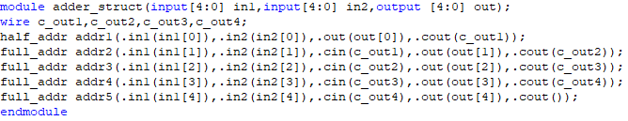
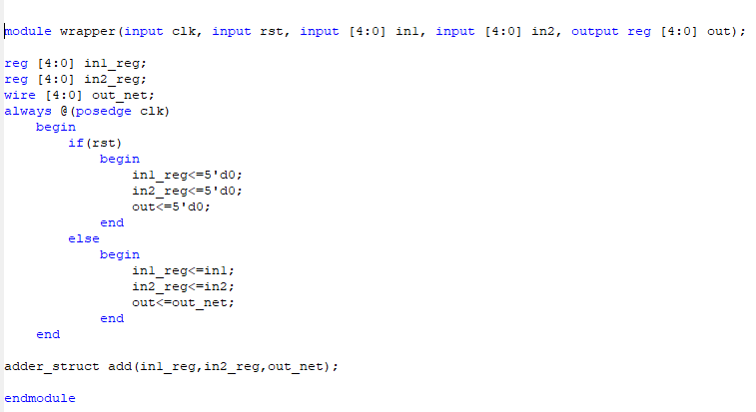

Description of the Verilog Modules
Combinational 5 bit adder module
Timing UCF
Same clock port as defined in wrapper module
Register initialization
adder_struct module instantiation

Slide 4
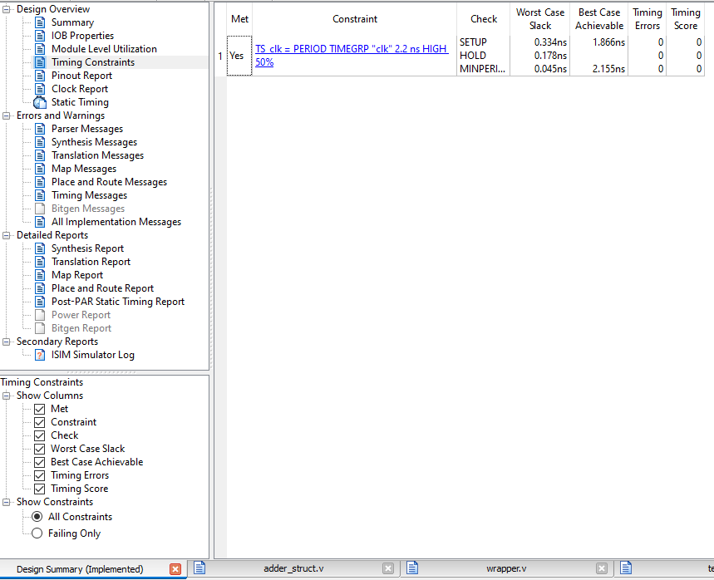
Timing Report
This is best achievable critical path (clock period) of the circuit
Click on timing constraints in the design summary after implementation

