Slide 1

Exploratory Data Analysis
G2M Case Study
15 June - 2022

Slide 2
CONTENTS
1. Executive Summary
2. Problem Statement
3. Approach
4. EDA
5. Recommendations

Slide 3
Executive Summary – G2M(cab industry) case study
XYZ is a private equity firm in US. Due to remarkable growth in the Cab Industry in last few years and multiple key players in the market, it is planning for an investment in Cab industry.
The explanatory data analysis was done by combining all 4 csv data sets through the common columns. By combining these data sets, I was able to do an EDA to find out which cab company is a better investment for XYZ firm.
I found that Yellow cab has a higher number of users in every city, and therefore the revenue was higher than the Pink cab in every city on average.
In the year 2016, the profit generated by Yellow cab in the 19 cities, on average was higher than the profit generated buy the Pink cab
For 2017 and 2018, the general outcome was also the same
The Yellow cab generated a higher revenue and profit each year. Therefore, our suggestion for XYZ company is to invest in the Yellow cab.
The analysis has been divided into four parts:
Data Understanding
Forecasting profit and number of users for each cab type
Finding the most profitable Cab company
Recommendations for investment

Slide 4
Data Exploration & Approach
Rows & Columns: (359392, 15)
Timeframe of the data: 2016-01-31 to 2018-12-31
Assumptions:
Outliers are present in Price_Charged feature but due to
unavailability of trip duration details ,we are not treating this as outlier.
Profit of rides are calculated in the Final Cab data by keeping other factors
constant and using Price charged and Cost of trip.
The number of users is grouped in terms of year and the company to show
the difference between Yellow cab and Pink cab.
Cab_Data.csv
Customer_ID.csv
Transaction_ID.csv
City.csv
Final cab data

Slide 5
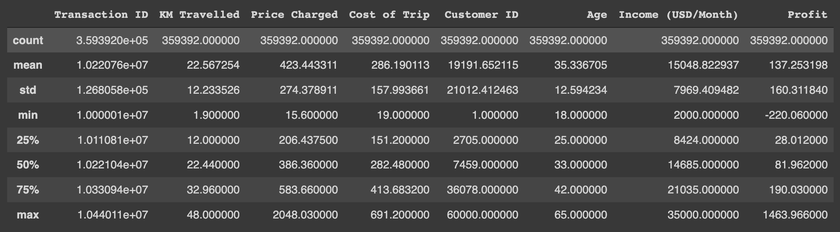
Profit Analysis
Descriptive Statistics
Final cab data
Descriptive Statistics

Slide 6
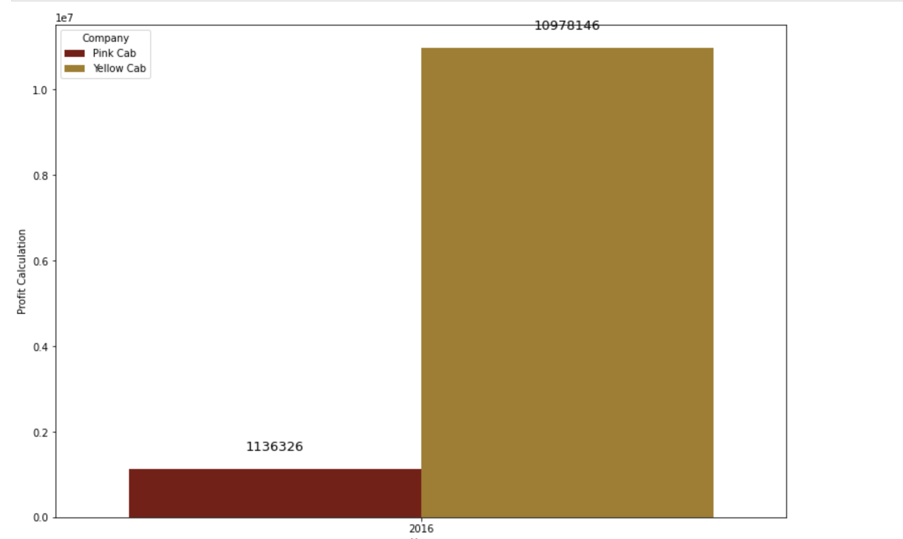
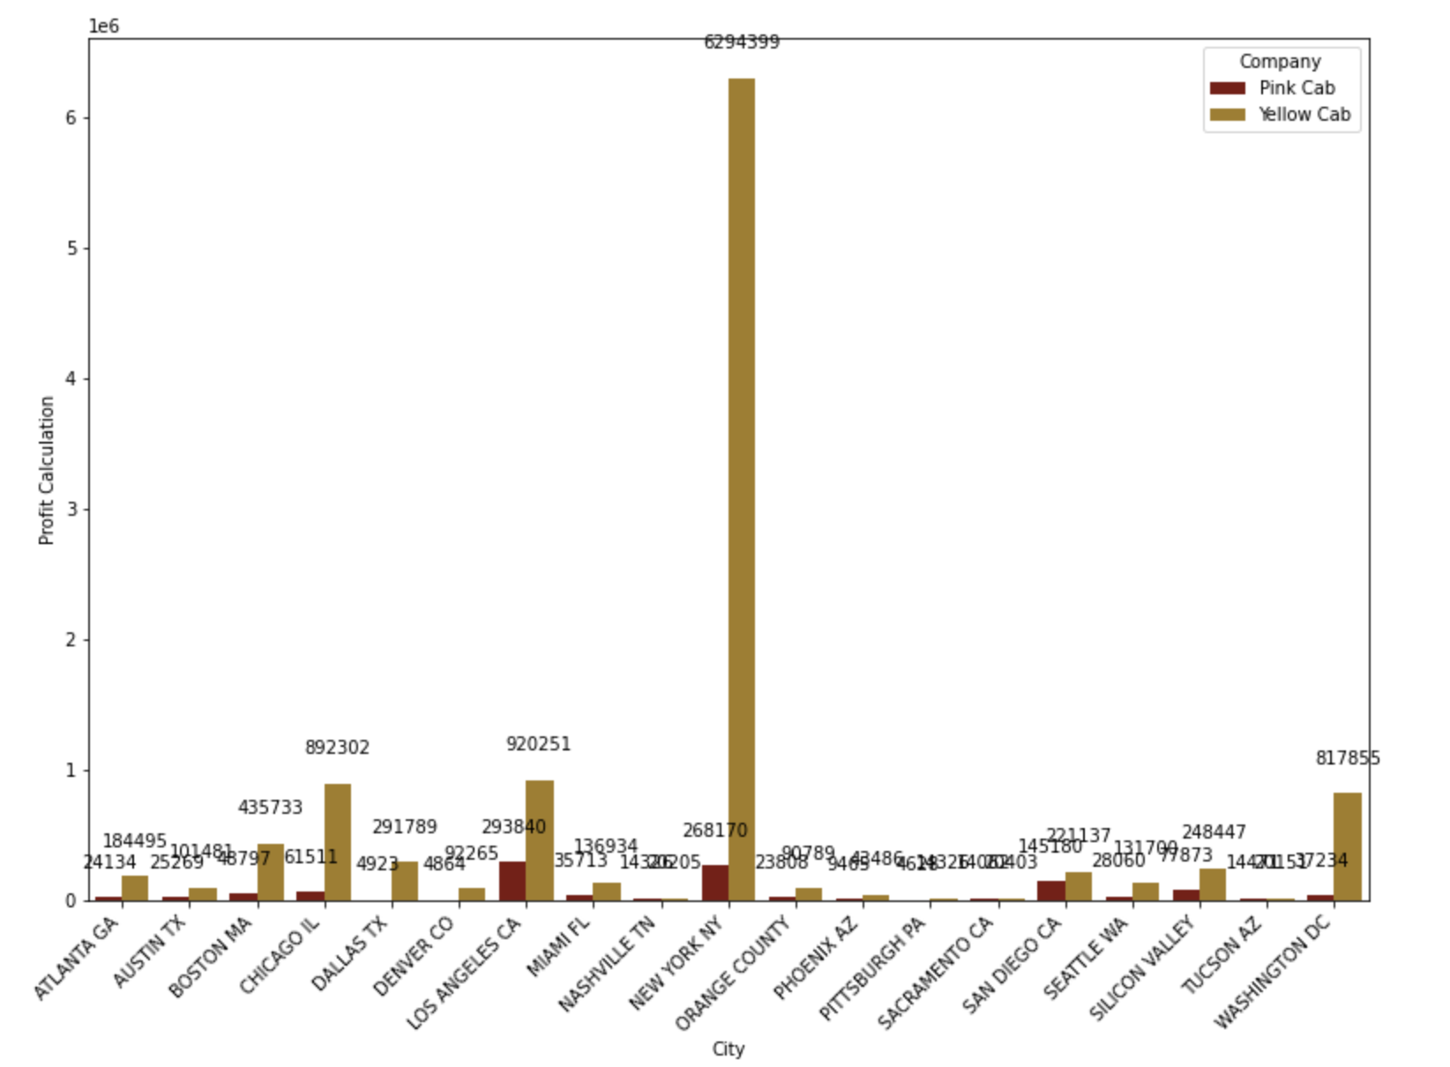
Profit Analysis
Profit Analysis for 2016
Profit for each company
Profit for each city and company
Profit in 2016: grouped by company
Profit in 2016: grouped by company & city

Slide 7
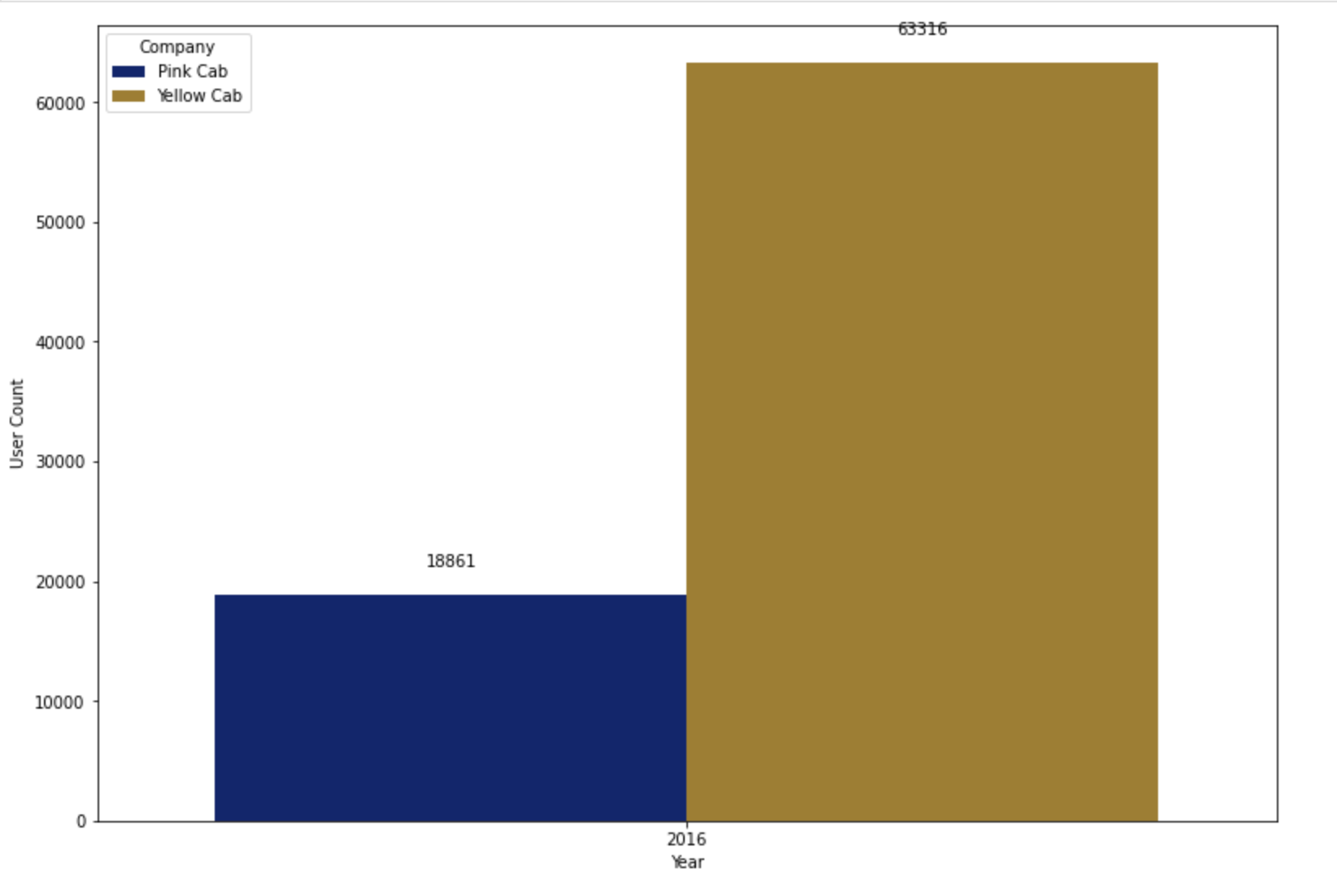
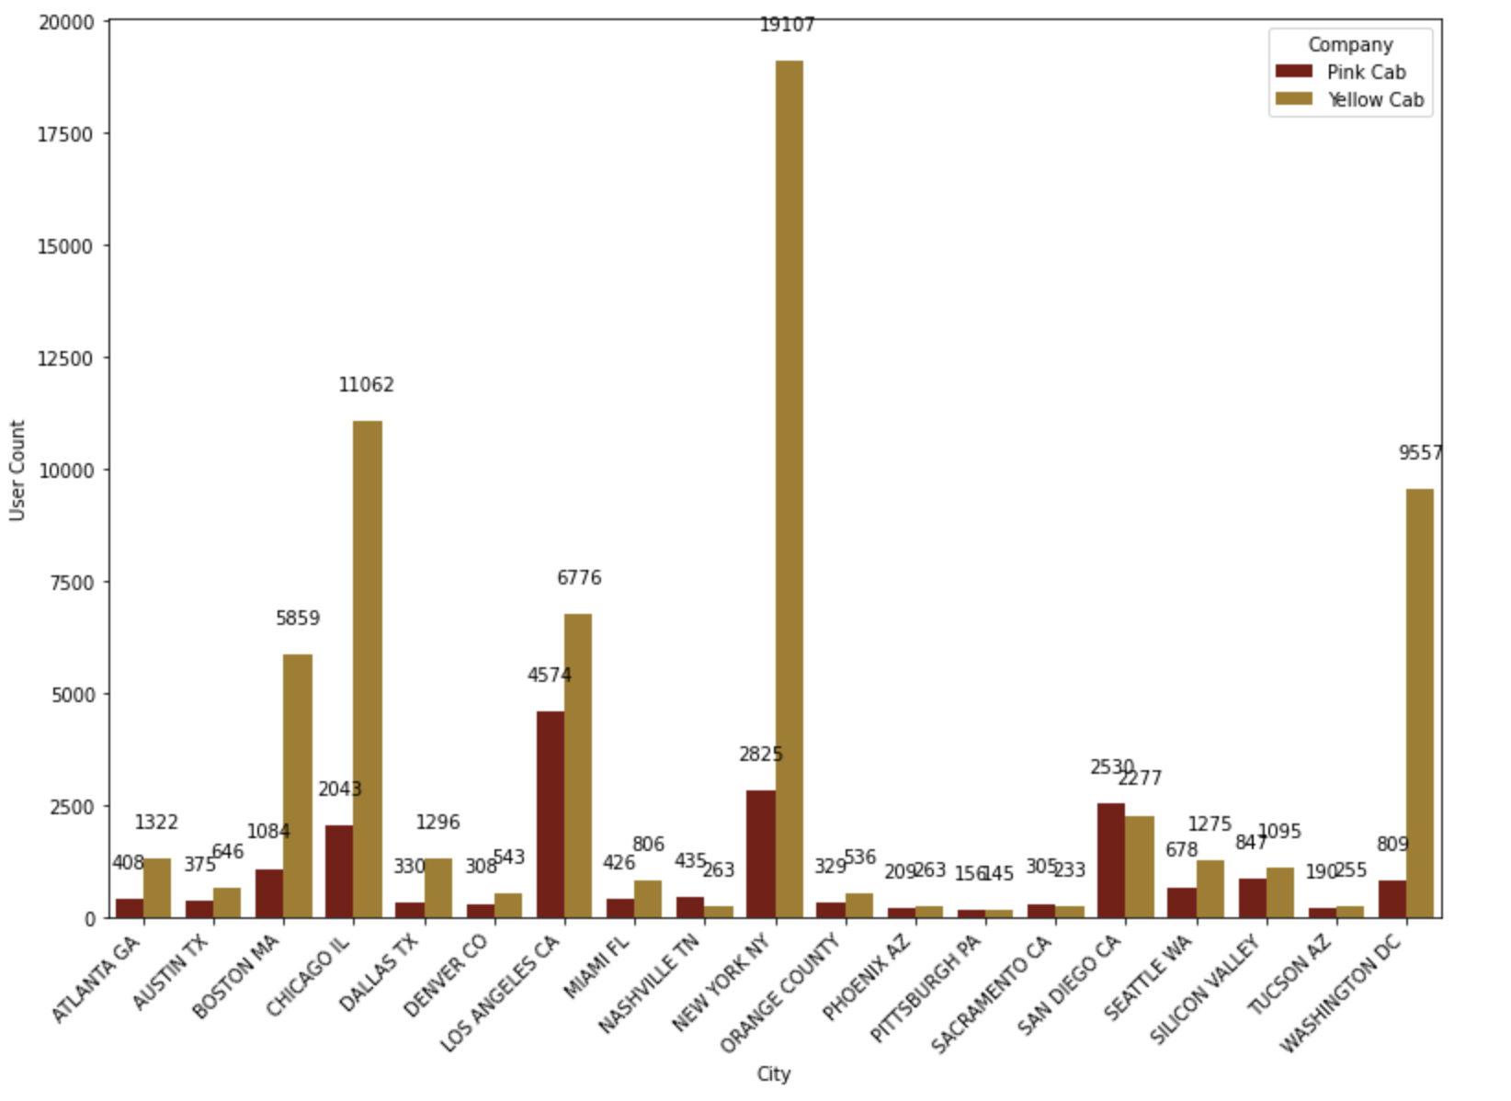
Profit Analysis
User Analysis for 2016
Users for each company
Users for each city and company
User count in 2016: grouped by company
User count in 2016: grouped by company & city

Slide 8
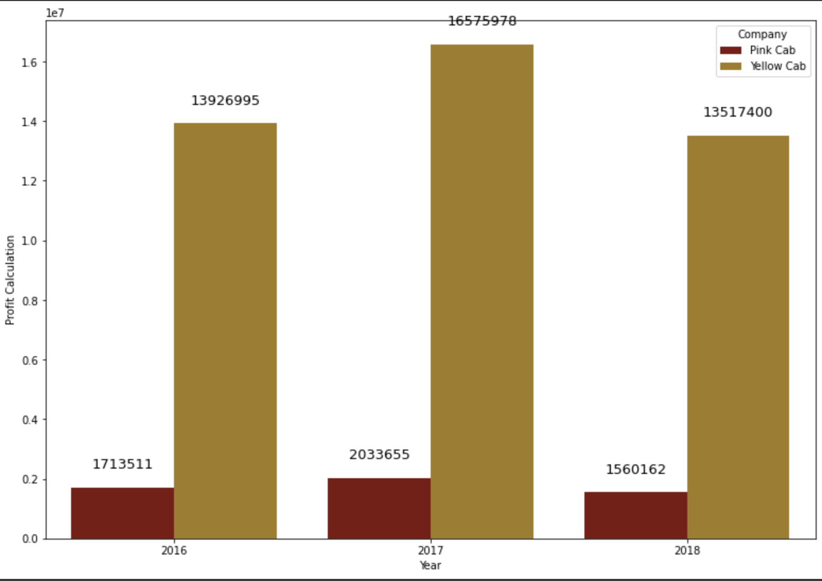
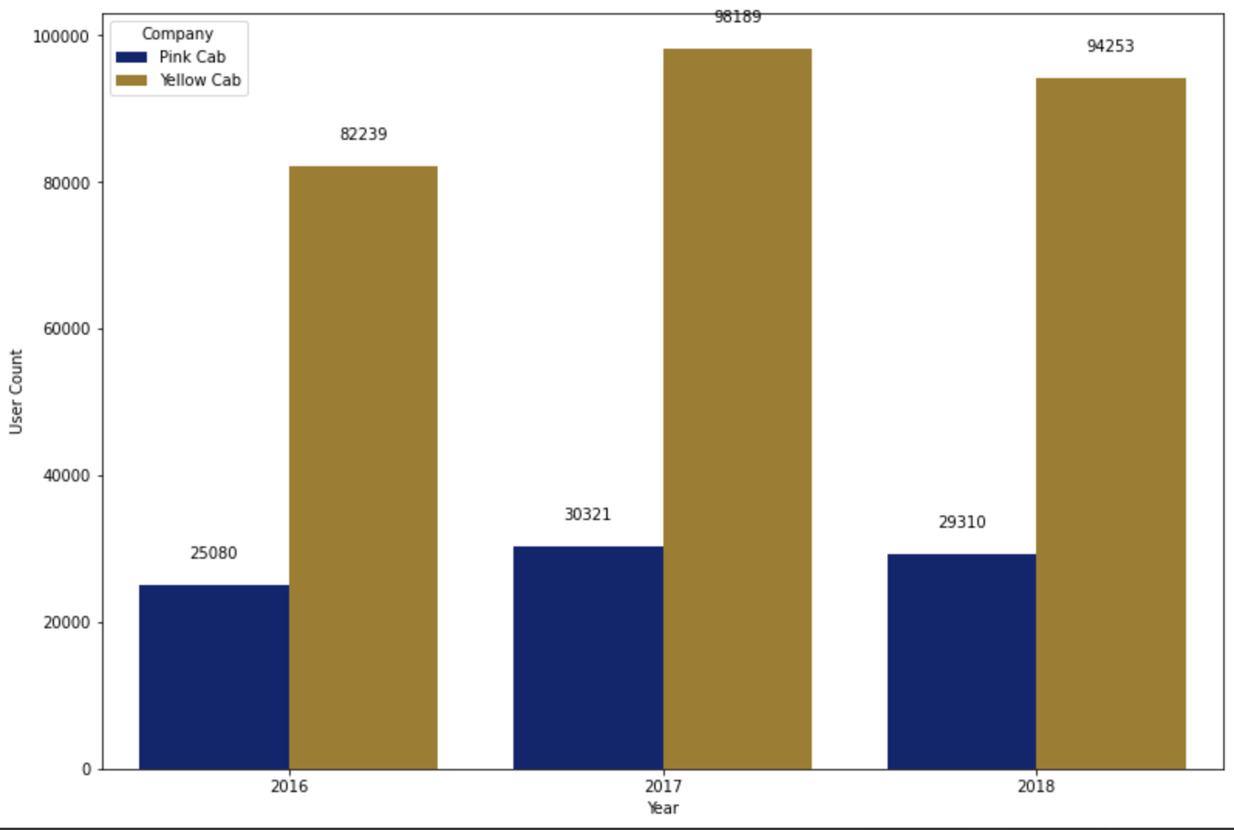
Profit Analysis
Profit & User Analysis for all 3 years
Profit grouped by company and year
Users grouped by company and year
Total Profit: grouped by company & year
User count: grouped by company & year

Slide 9
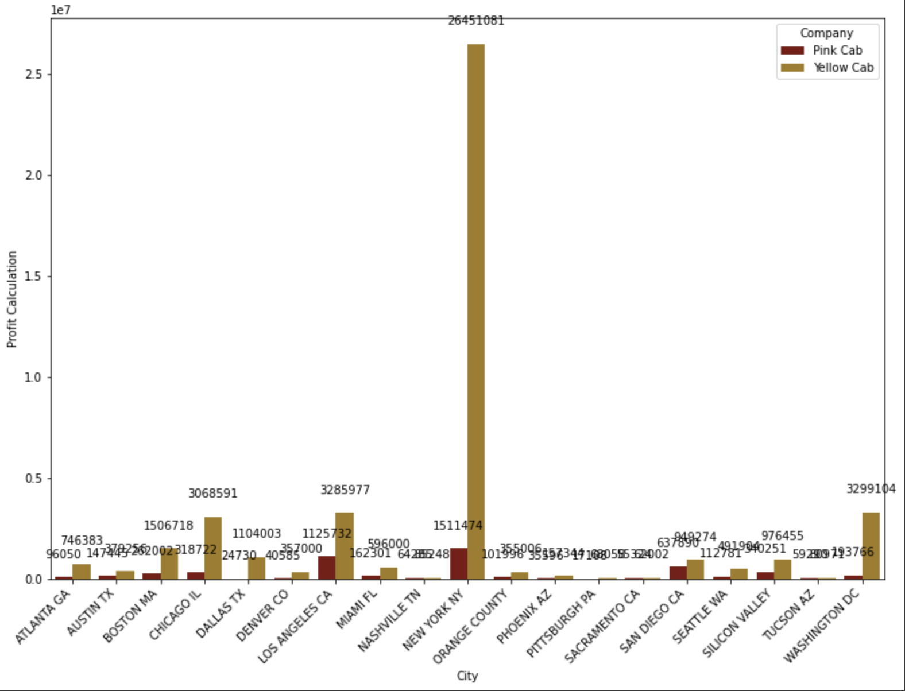
Profit Analysis
Profit Analysis for all 3 years by city
Profit grouped by company and age group
Yellow cab company outperforms the Pink cab company in terms of profit
The profit for the Yellow cab company is much higher in each city when compared to the Pink cab company
The data combines all three years
Total Profit: grouped by company & city

Slide 10
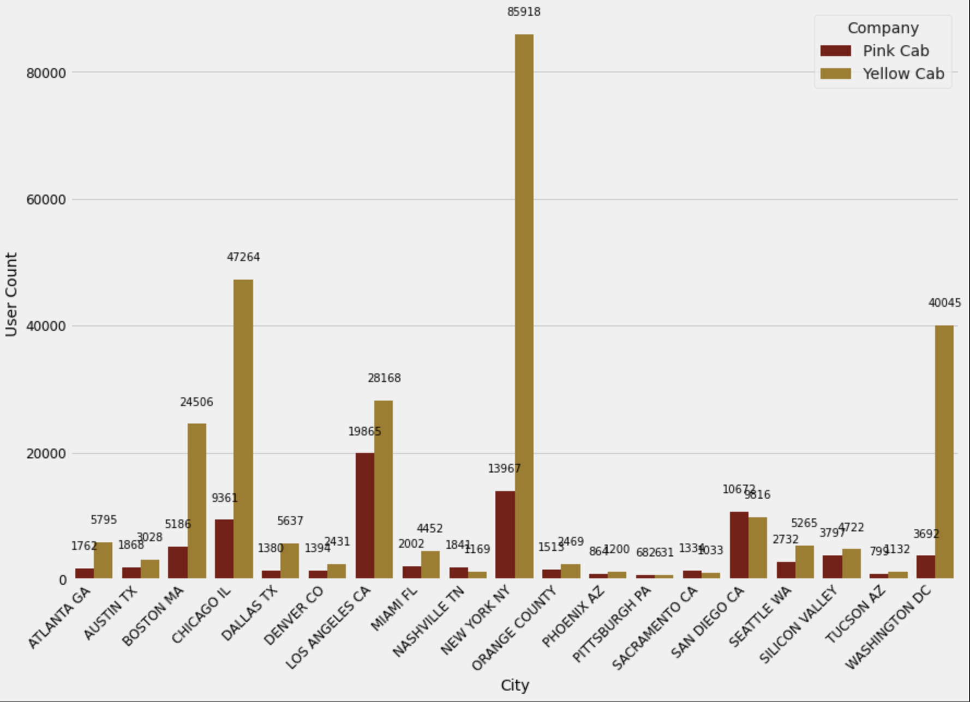
Profit Analysis
User Analysis by city
Profit grouped by company and city
Yellow cab company outperforms the Pink cab company in terms of number of users
The user count for the Yellow cab company is much higher in each city when compared to the Pink cab company, except for San Diego
The data combines all three years
User count: grouped by company & city

Slide 11
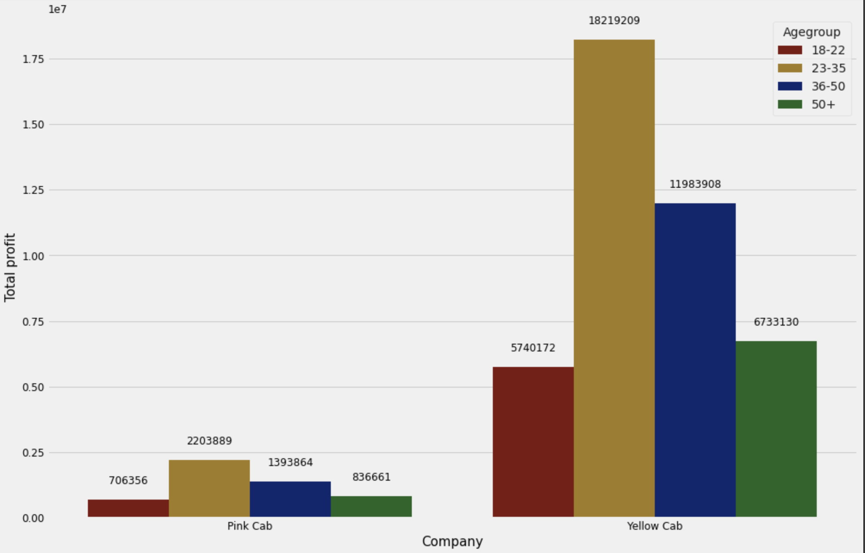
Profit Analysis
Profit Analysis by age group
Profit grouped by company and age group
Created labels for ages between 18-22, 23-35, 36-50, 50+
The profit for the Yellow cab company is much higher for all of the age groups, specially 23-25
The data combines all three years
Total Profit: grouped by age group & company

Slide 12
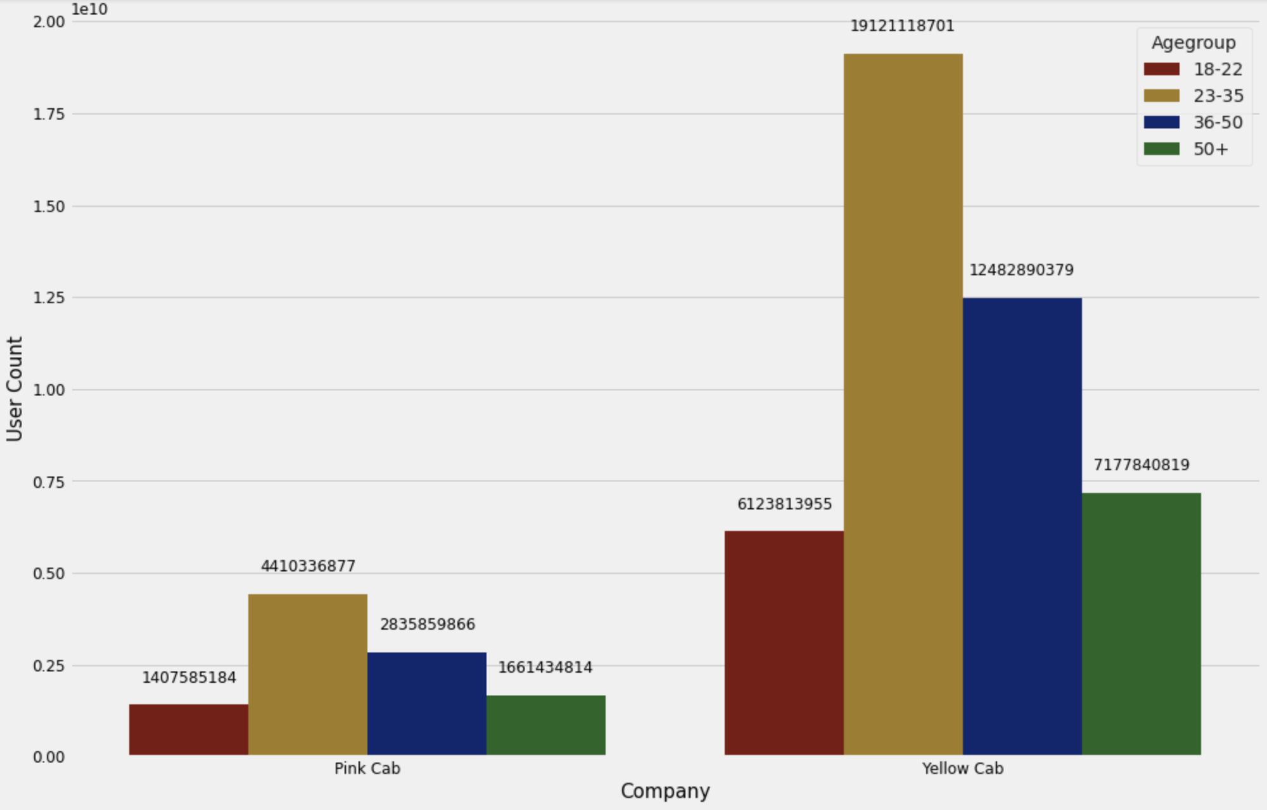
Profit Analysis
User Analysis by age group
User grouped by company and age group
Created labels for ages between 18-22, 23-35, 36-50, 50+
The user count for the Yellow cab company is much higher for all of the age groups, specially 23-25
The data combines all three years
User Count: grouped by age group & company

Slide 13
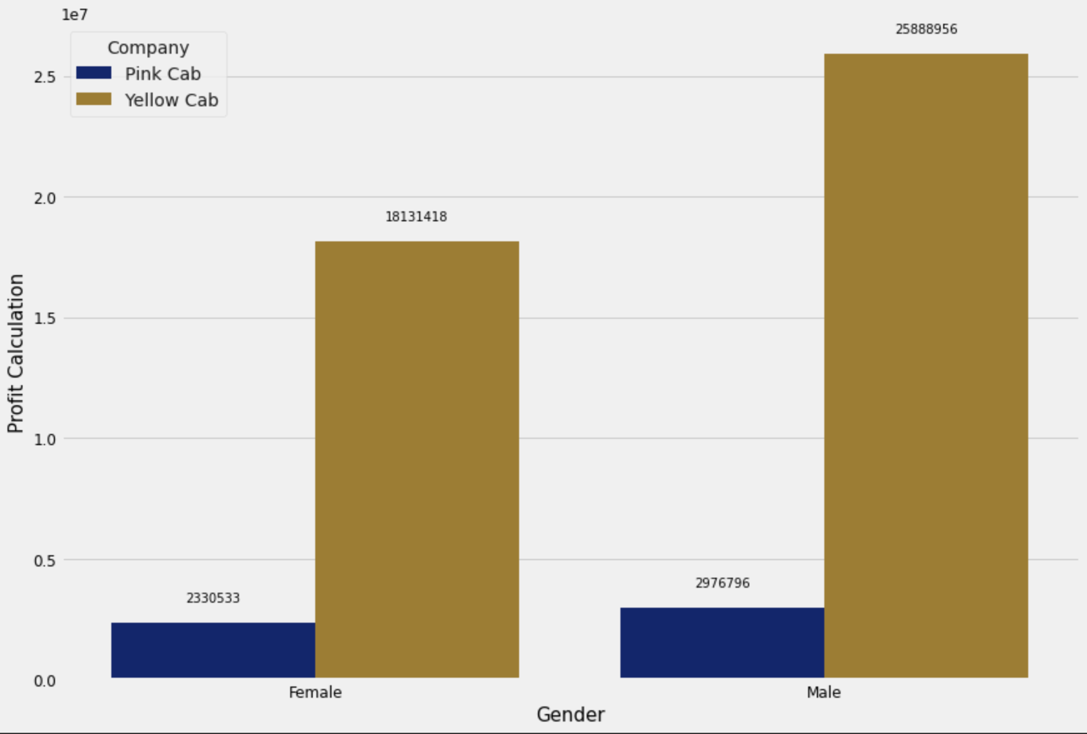
Profit Analysis
Gender wise Profit Analysis
Profit grouped by Company and Gender
Grouped the data based on company and Gender
The profit for the Yellow cab company is much higher for both Male and Female clients
For the Pink cab, the profit contribution is the same for Male and Female
The data combines all three years
Total Profit: grouped by age group & company

Slide 14
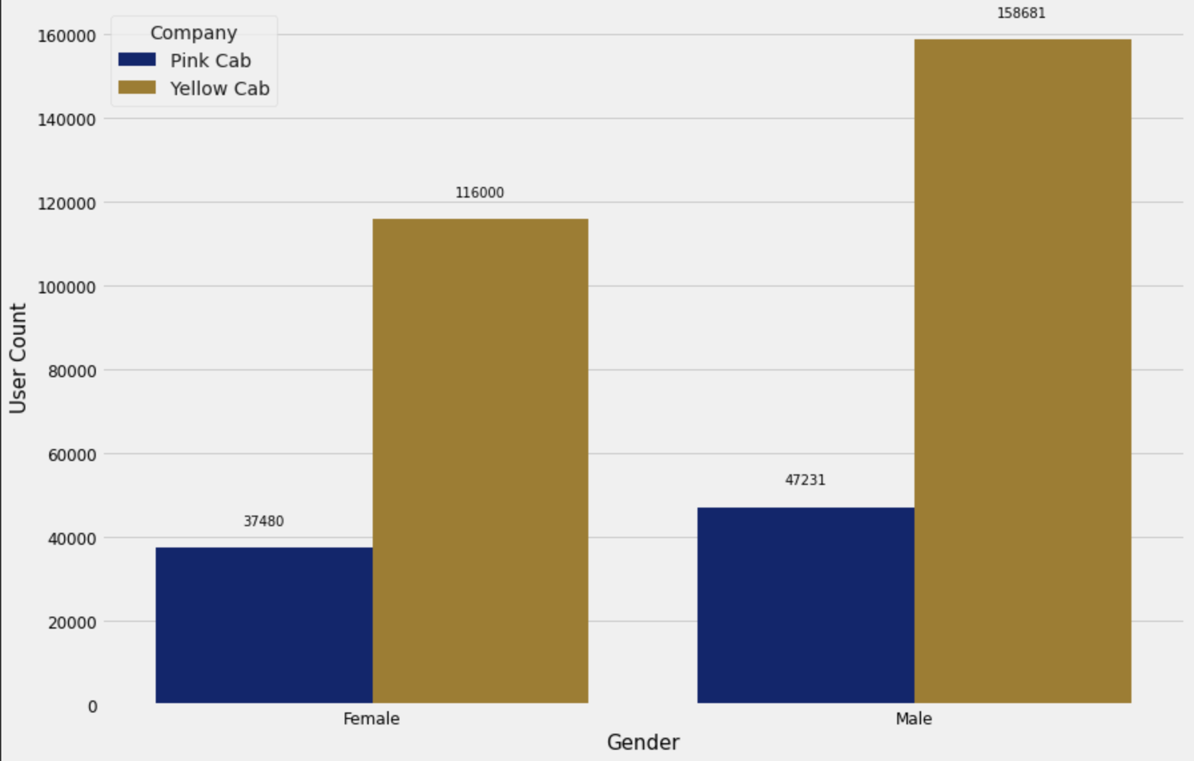
Profit Analysis
Gender wise User Analysis
User grouped by company and Gender
Grouped the data based on company and Gender
The users for the Yellow cab company is much higher for both Male and Female clients
For the Pink cab, the user contribution is the same for Male and Female
The data combines all three years
Total Users: grouped by age group & company

Slide 15
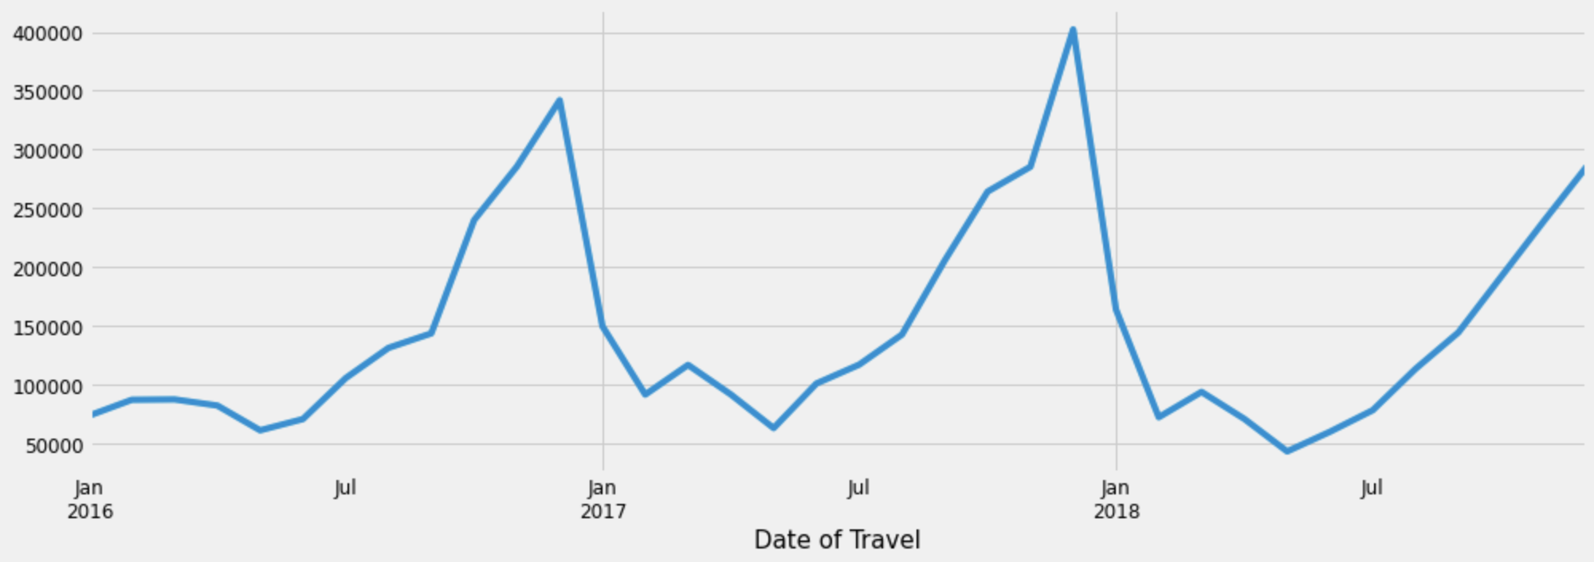
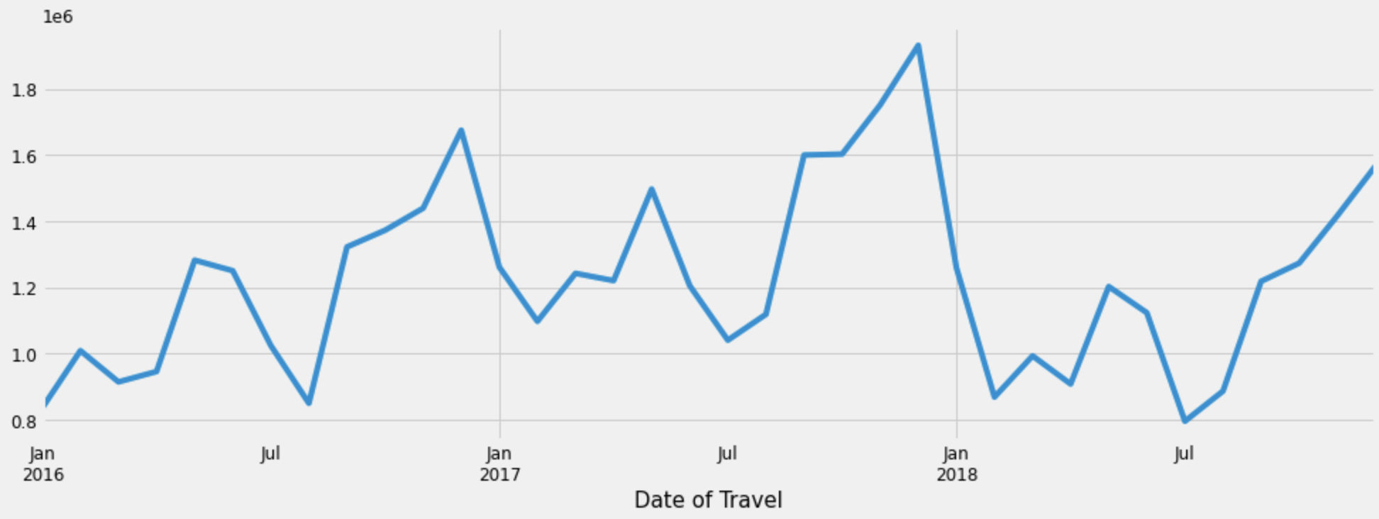
Profit Analysis
Profit & User Analysis
PINK CAB
Profit grouped by company and city for PINK CAB
YELLOW CAB
Profit: grouped by Date of Travel
Profit grouped by company and city YELLOW CAB
User count: grouped by Date of Travel

Slide 16
Recommendations
We have evaluated both the cab companies on following points and found Yellow cab better than Pink cab:
Customer Reach : Yellow cab has a much higher customer reach in 18 cities while Pink cab has higher customer reach in only 1 city. We have also observed that Yellow cab is doing good in covering other cab users as compared to Pink cab.
Gender wise Reach: We have analyzed this in two cases: by calculating the profit for each company based on gender and by calculating the number of users of each company based on gender. Yellow cab was higher in both the cases.
Age wise Reach : Yellow cab has a higher customer reach in all age groups ranging between 18-22, 23-35, 36-50 and 50+. It’s been observed that it’s even popular in 60+ age group as equally as its in 18-25 age group.
Profit Analysis: Yellow cab’s profit, on average is almost eight times the profit of the Pink cab (for all three years).
Ride count and Profit : Both the companies show a huge difference in the profit and the number of users. Yellow cab’s number of users is much higher than that of the Pink cab company. There is a direct correlation between the profit and the user count. Therefore, Yellow cab also shows a much higher profit.
After the above analysis, we can confirm that the company in which XYZ should invest in is the Yellow Cab company. This is mainly due to its high profit generation ability due to a large number of users when compared to the pink cab.

Slide 17
G2M Investment Strategy
Thank You
Pranav Walia

