Slide 1






Atliq Hardwares
My LinkedIn
Consumer Goods Ad-hoc Insights
Presented by Pranav Khot
SQL Project Challenge

Slide 2

Getting familiar with Atliq’s Business –
Their Markets and Product lines
Background/Context
AGENDA
Getting familiar with the input data
Ad-hoc requests along with the queried
results, visualizations and Insights

Slide 3
Our Company
Atliq Hardwares (imaginary company) - One of the leading computer hardware producers in India.
Background
The management noticed that they do not get enough insights to make quick and smart data-informed decisions.
Problem
There are 10 ad-hoc requests for which the company needs insights.
Approach
Run a SQL query to answer these requests. Convert it into visualizations and present the Insights to the top-
level management.
BACKGROUND/CONTEXT

Slide 4
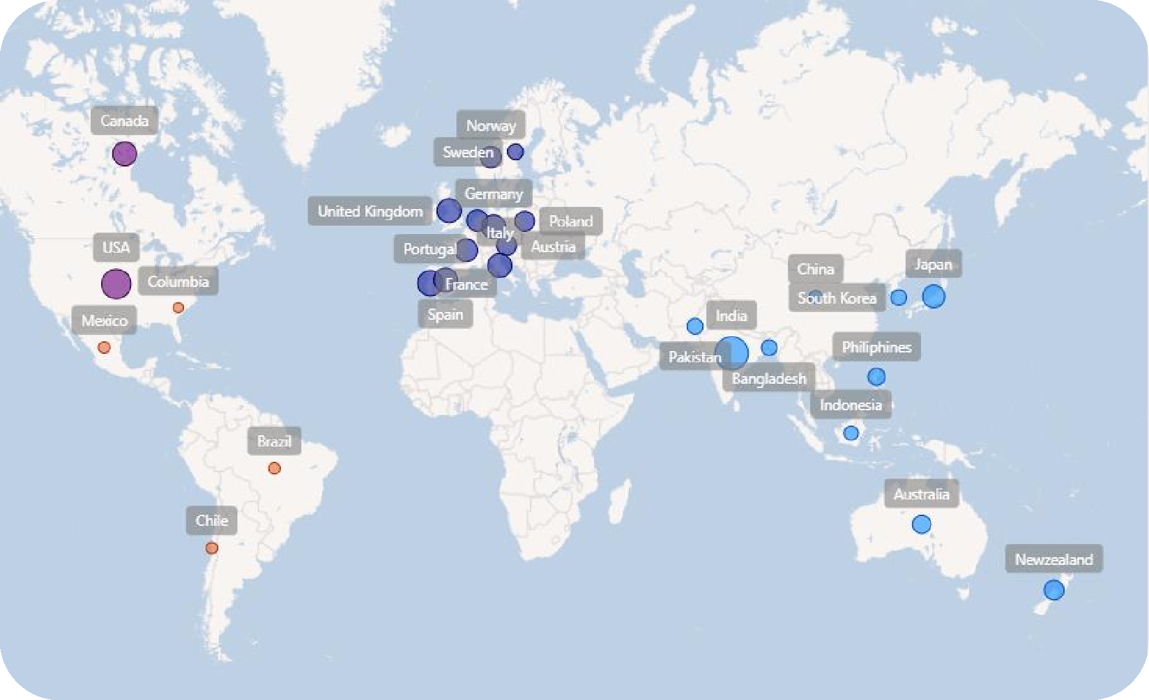
Getting familiar with Atliq’s Business –Their Markets and Product lines
Atliq’s Markets

Slide 5

































Atliq’s Product lines
PC
P&A
N&S
Desktop
Notebook
Peripherals
Accessories
Networking
Storage
Business laptop
Gaming laptop
Graphic card
Batteries
Wi Fi Extender
External SSD
Personal laptop
Business laptop
Internal HDD
Keyboard
USB Flash drives
Personal laptop
MotherBoard
Mouse
Processors

Slide 6

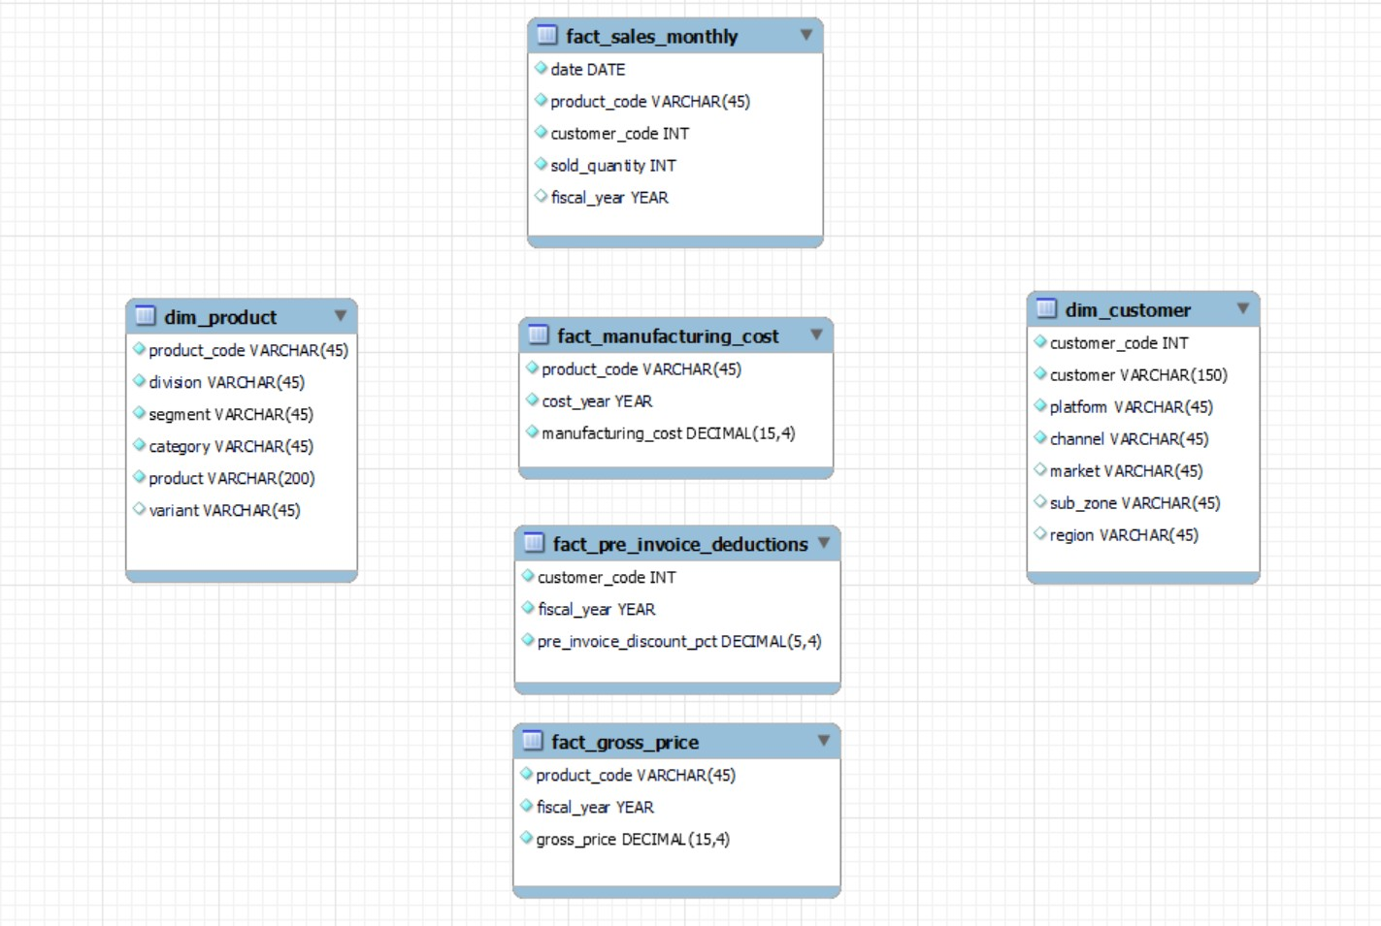
Getting familiar with the input data
Input data consists of sales data for FY 2020 and FY 2021, along with different other dimension tables like customer details, product details, etc.

Slide 7
Ad-hoc requests, queried results, Insights and visualization

Slide 8
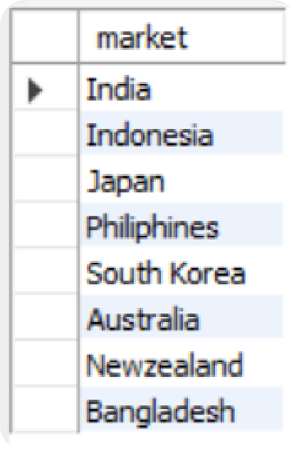

REQUEST 1:
OUTPUT
Provide the list of markets in
which customer "Atliq
Exclusive" operates its business in the APAC region.

Slide 9
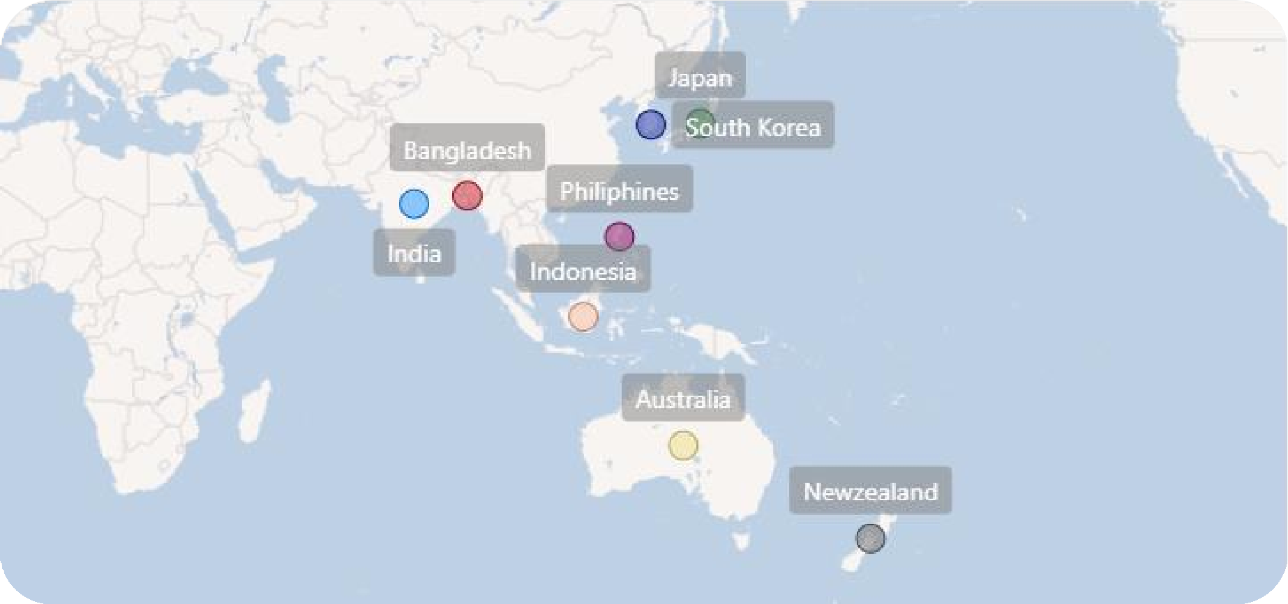
Insights
In the APAC region, our Exclusive store has established its presence in 8 major markets.

Slide 10
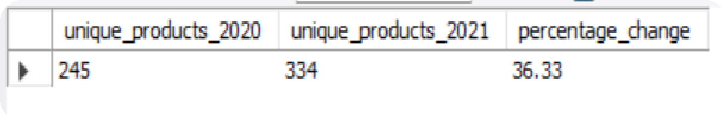

REQUEST 2:
OUTPUT
What is the percentage of unique product increase in 2021 vs. 2020? The final output contains these fields:
unique_products_2020 unique_products_2021 percentage_chg

Slide 11
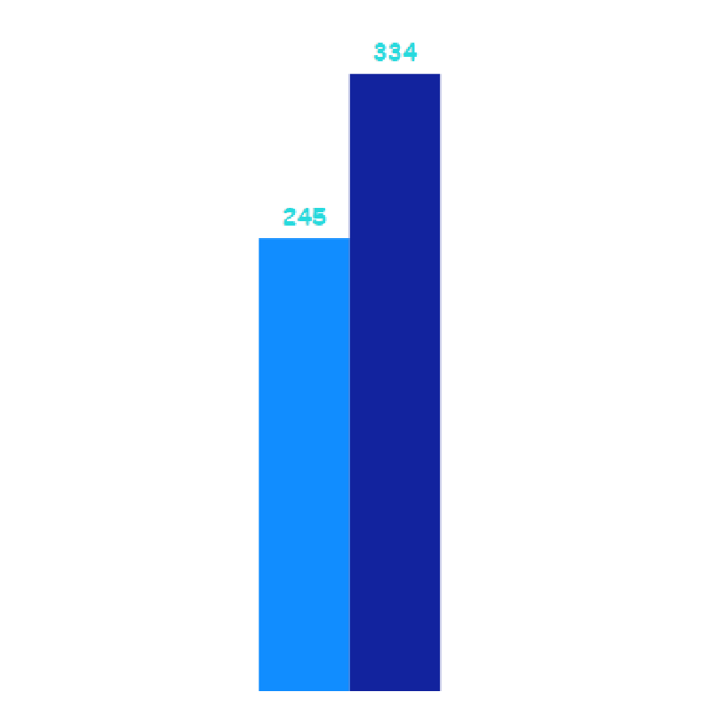
36.33
% increase
Insights
It’s a good sign that we are continuously innovating and introducing new products to the market. In FY 2020, we had a total of 245 products, but in FY 2021, our count increased by 36% to 334 products.
Product_count-2020 Product_count-2021
2020 2021
Count of Products

Slide 12
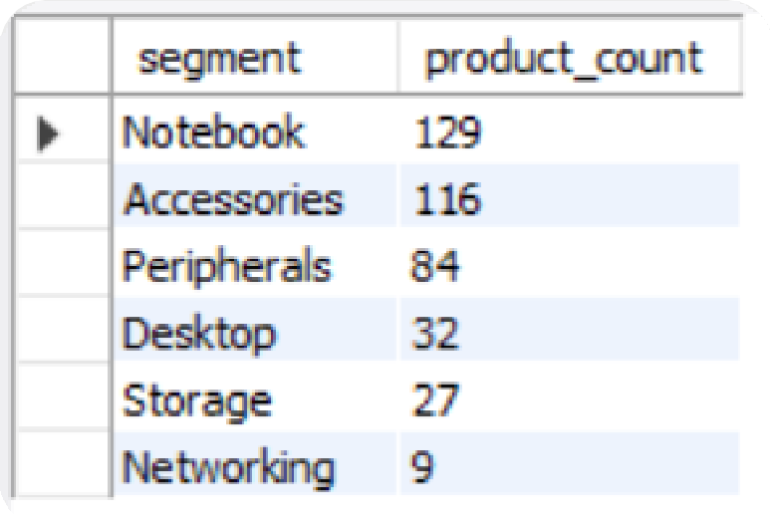
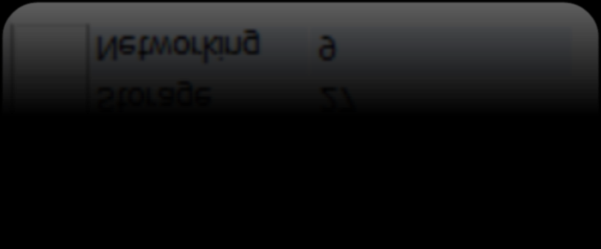
REQUEST 3:
OUTPUT
Provide a report with all the unique product counts for each segment and sort them in descending order of product counts. The final output contains 2 fields:
Segment product_count

Slide 13
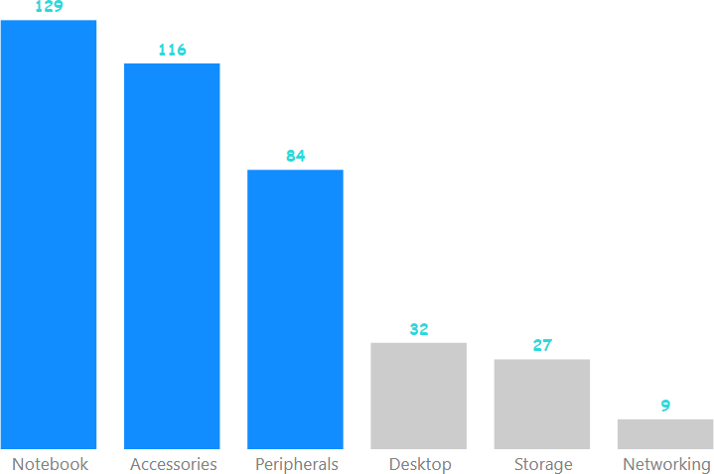
Insights
We provide a wide range of products under the segments Notebook, Peripherals, and Accessories, with an average of 110 products in each segment. However we still need to diversify our production in the Desktop, Networking, and Storage segments, where there are just an average of only 23 products per segment.
Average: 109.6
Average: 22.6
How many products are there in each segments?

Slide 14
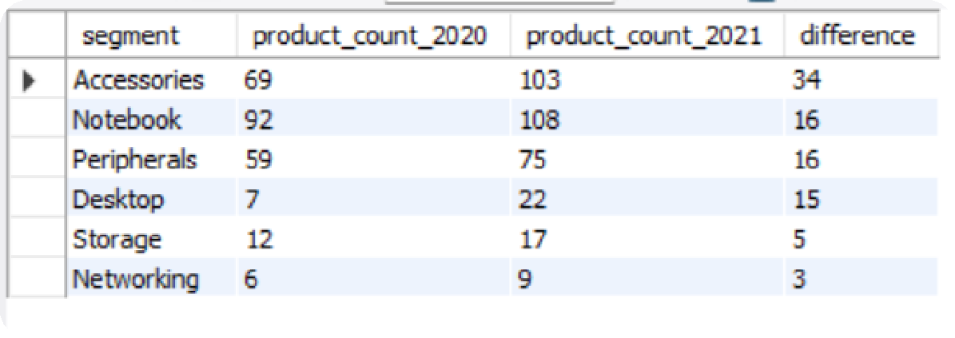
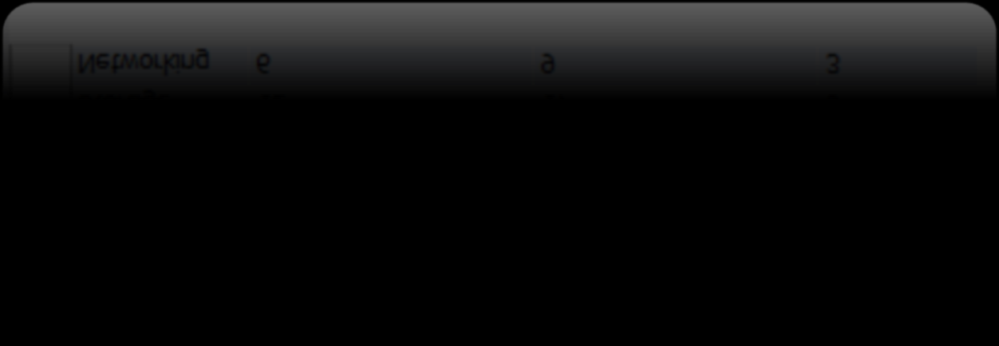
REQUEST 4:
OUTPUT
Follow-up: Which segment had the most increase in unique products in 2021 vs 2020? The final output contains these fields:
segment product_count_2020 product_count_2021 difference

Slide 15
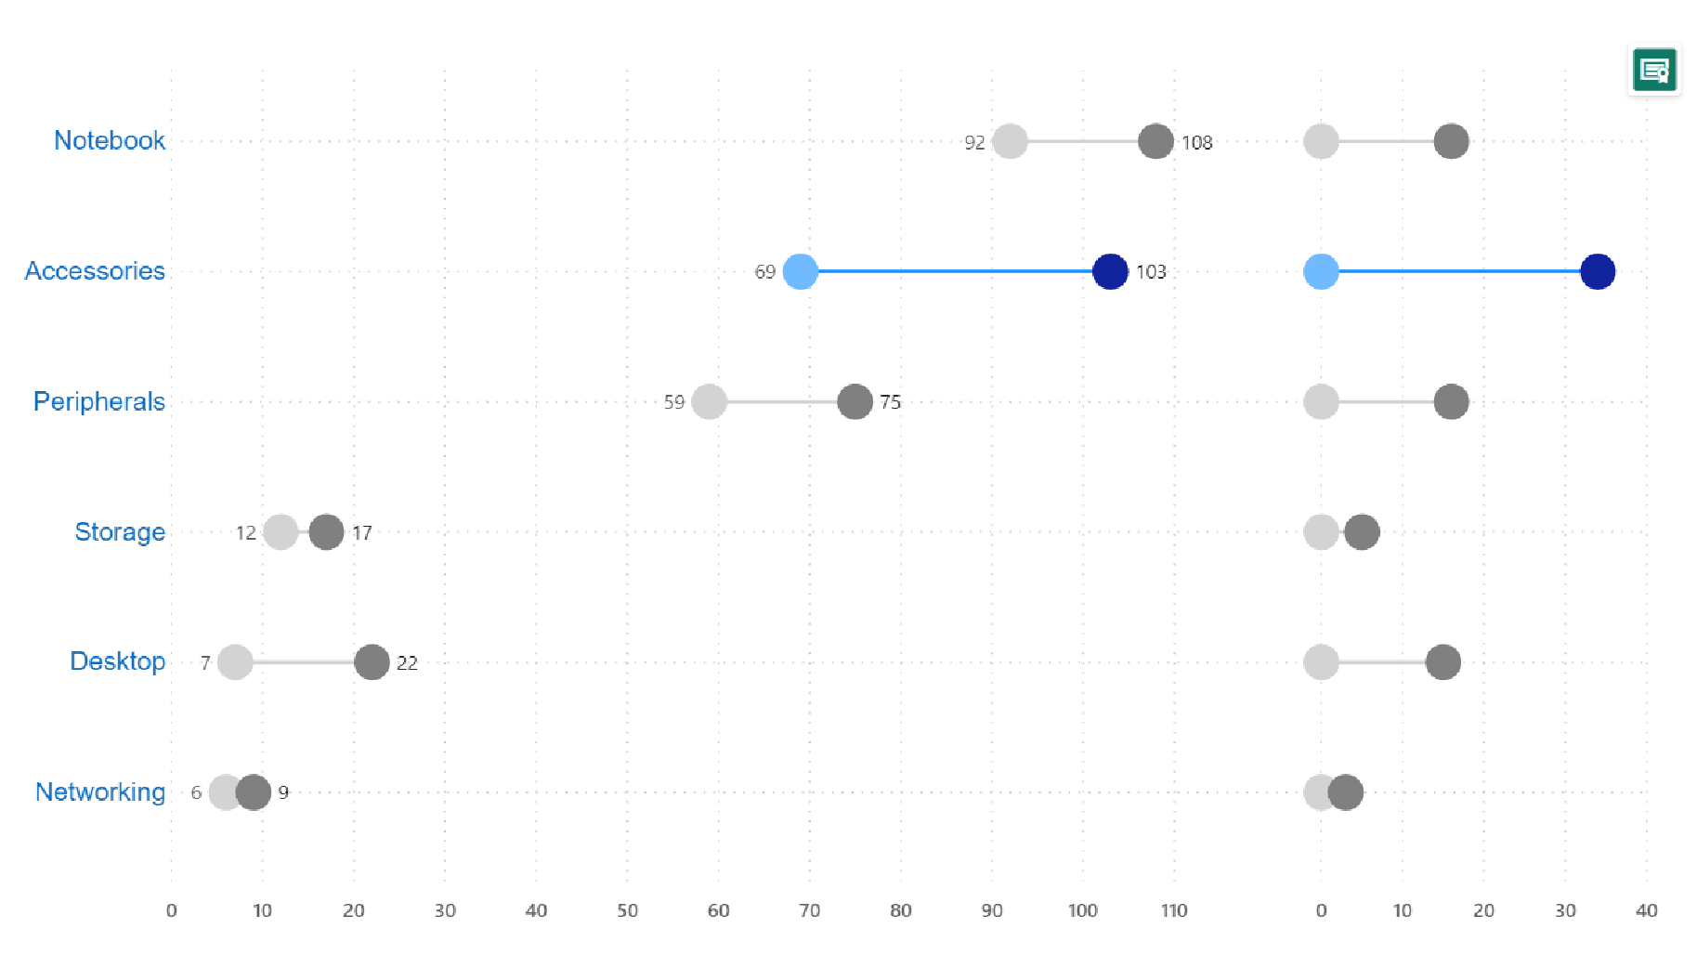
In 2021, we were mainly focusing on diversifying our accessories segment.
We introduced 34 new products to the market in accessories.
Insights
34
Product_count-2020
Product_count-2021
Comparison of Product count in 2020 vs 2021 for each of the segments
Which segment had
^{the most increas}Cere?ated by Pranav Khot

Slide 16
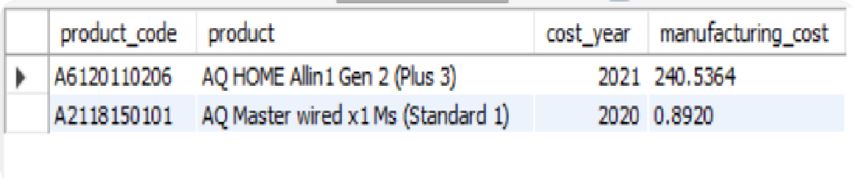

REQUEST 5:
OUTPUT
Get the products that have the highest and lowest manufacturing costs. The final output should contain these fields:
product_code product manufacturing_cost

Slide 17


Insights
Which of our products has
the highest manufacturing cost?
Which of our products has
the lowest manufacturing cost?
240.54$
0.89$
AQ HOME Allin1 Gen 2 (Plus 3) Personal Desktop
AQ Master wired x1 Ms (Standard 1) Mouse

Slide 18
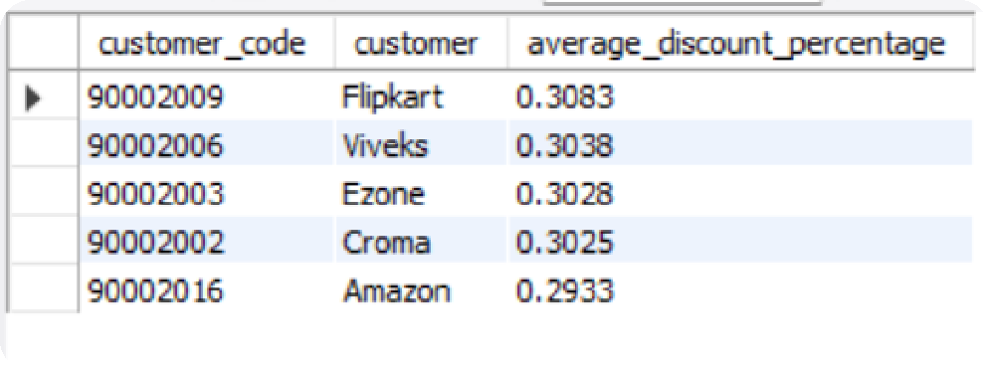

REQUEST 6:
OUTPUT
Generate a report which contains the top 5 customers who received an average high pre_invoice discount_pct for the fiscal year 2021 and in the Indian market. The final output contains these fields:
customer_code customer
average_discount_percentage

Slide 19
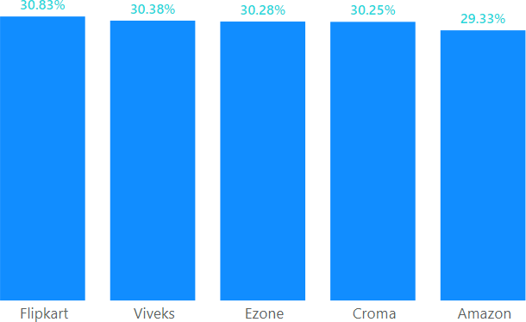
Insights
In 2021, we offered nearly equal pre-invoice discount percentages to each of our top 5 customers, given that Flipkart is the most discounted customer in the Indian market, which equals 30.83%.
Who are the top 5 customers for whom we offered the most pre-invoice discount percentage in 2021 and in the Indian market?
Created by Pranav Khot

Slide 20
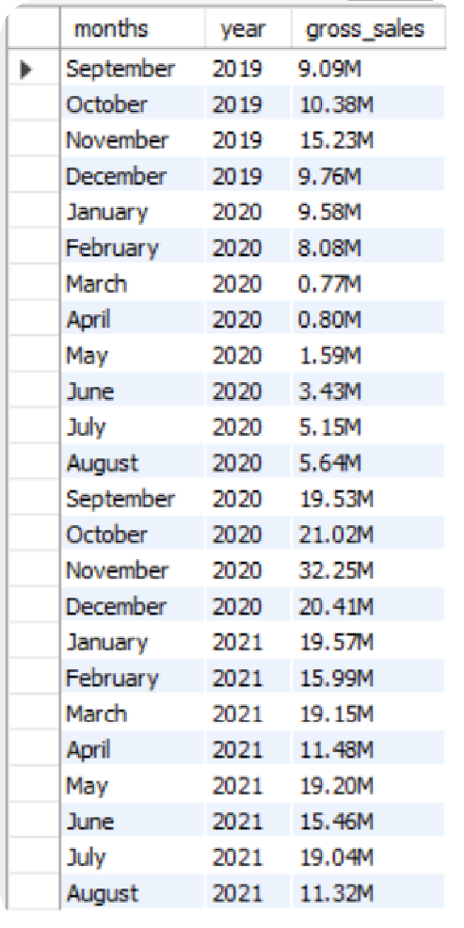

OUTPUT
REQUEST 7:
Get the complete report of the
Gross sales amount for the
customer “Atliq Exclusive” for each month. This analysis helps to get an idea of low and high- performing months and take strategic decisions. The final report contains these columns:
Month Year
Gross sales Amount
Created by Pranav Khot

Slide 21
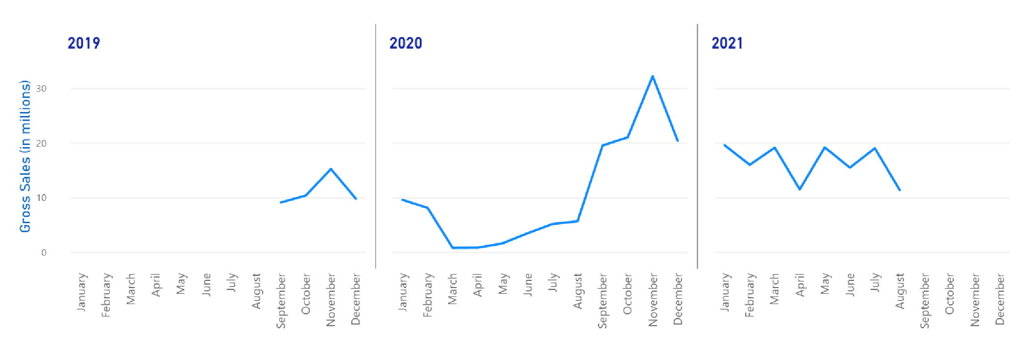
For Atliq Exclusive, November 2020 marked the highest sales, and March 2020 marked the lowest gross sales. It’s very evident that the lower sales between March and August are because of COVID-19. However, it’s a very good sign that the sales increased quickly after August and reached the highest level since the last two years in November.
Insights
Atliq Exclusive Sales Trend
32.25M
0.77M
FY 2020
In FY 2020, we have a total sales of 79.50M
FY 2021
In FY 2021, we have a total sales of 224.42M
Altogether we have a total sales of 303.92M
Created by Pranav Khot

Slide 22
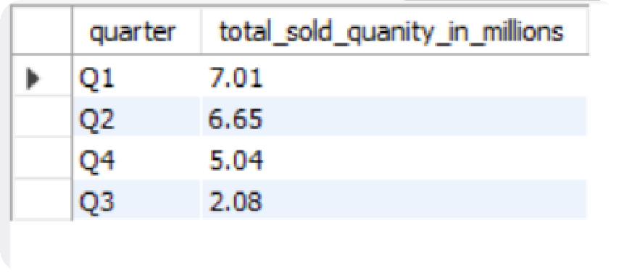

REQUEST 8:
OUTPUT
In which quarter of 2020, got the
maximum total_sold_quantity? The final output contains these fields sorted by the total_sold_quantity:
Quarter total_sold_quantity

Slide 23
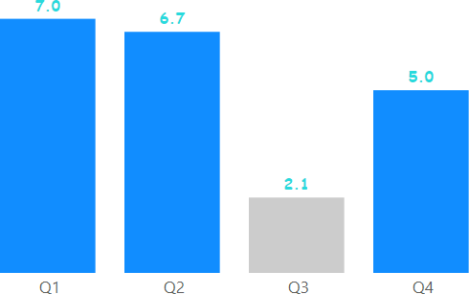
Insights
How many quantities were sold during the quarters of FY 2020?
Quarter 1 has the maximum
total sold quantity
In millions
This again complements the previous insight. That is the effect of COVID-19 on our sales. The sold quantity decreased
to 2.1 million in quarter 3 of FY 2020, which was actually March, April, and May when COVID-19 was at its peak.
But we started recovering very early despite the continuance of the pandemic. This early recovery during quarter 4 is probably because of the increased need for hardware like desktops and notebooks as majority of the students began or continued to do their coursework online during this time, and there was a huge demand for computer accessories during this period.

Slide 24
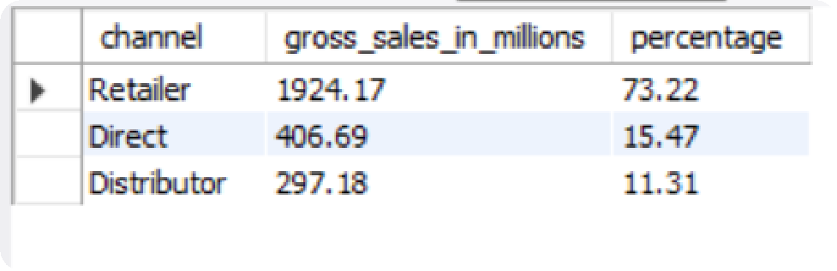

REQUEST 9:
OUTPUT
Which channel helped to bring more gross sales in the fiscal year 2021 and the percentage of contribution? The final output contains these fields:
channel gross_sales_mln percentage

Slide 25
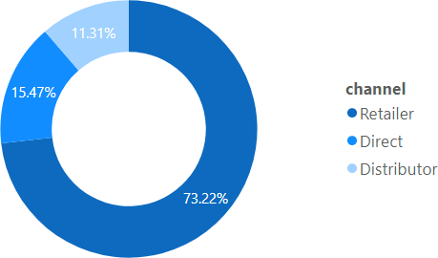
Insights
The majority of our sales took place via retailers, which is 75% of the total sales. Only a very small percentage of our sales happened through direct and distributor channels.
In FY 2021, How are our sales distributed among the different channels through which we sell our products?

Slide 26
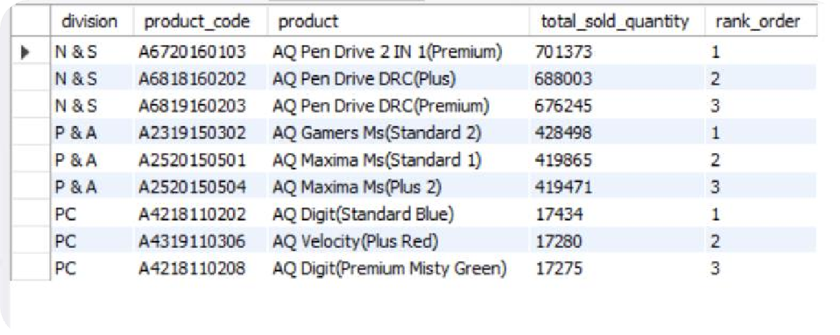

REQUEST 10:
OUTPUT
Get the Top 3 products in each division that have a high total_sold_quantity in the fiscal_year 2021? The final output contains these fields:
division product_code Product total_sold_quantity rank_order

Slide 27


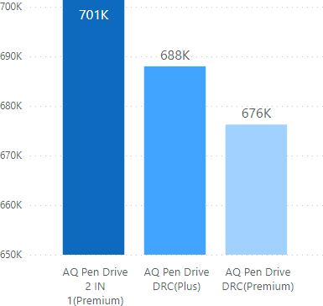
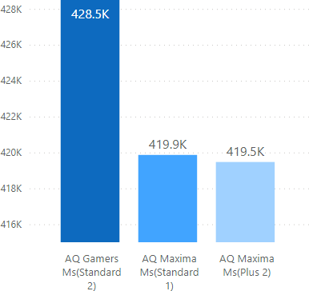
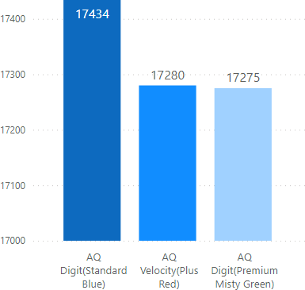



Insights
The top 3 selling products in N&S were pen drives, which were around 7 lakh in quantity.
The top 3 selling products in P&A were mouse, which were around 4 lakh in quantity.
The top 3 selling products in PC were personal laptops, which were around 17000 in quantity.
N&S
P&A
PC
Sold quantities
Which are the top 3 selling products in each of Atliq’s product lines in FY 2021?

Slide 28
END THANK YOU!

