Slide 1

Data Analytics Challenge-2018
Presented By:
Pranav Sathe
Tools & Languages Used: Tableau, R, SAS, Microsoft Excel, Python

Slide 2
Data Description
Our Dataset contains employment data from 2005 -2012. The Data Fields & Data Description of the Training as well as the Test Data is given below.
ID | ID represents a person within the Dataset
Education | Education Level of a Person
Age | Age of a Person
Age Range | Age Range of a Person
Employment Status | Whether the person is employed or not
Weekly Earnings | Earnings in dollar/week
Column k - Column x | Avg time spent a person on an activity per day in mins
Total | Total of average time spend in hours by a person in day

Slide 3
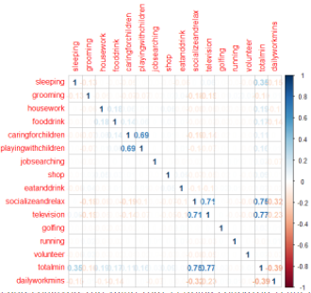
Data Prepossessing
Dataset consisted of 64007 records in training set. Further processing in MS Excel we evaluated, the total no. of hours exceeded 24 for around 2300 records. Since the total no of hours in a day is a maximum of 24 hours , therefore there exists a correlation between the activities present.
Detailed Link - http://bit.ly/2FTeMSP
From the Correlation Matrix, we can identify that there exists a high correlation between 4 columns given below
Socializing & Relaxing, Television (0.71)
Playing with Children, Caring for Children (0.69)
*Correlation values above 0.5 considered significant
Correlation Matrix

Slide 4
Data Cleaning
Since there exists a high correlation between 4 columns -Socializing & Relaxing ~Television (0.71) and Playing with Children ~ Caring for Children (0.69), we have effectively combined all the four columns into two columns.
Why we did this?
As most of the values where repeated, we analyzed and removed those values that were being repeated from the total.
Finally, the columns in the dataset added were “Hours Spent on Children” & “Socializing and Relaxing”.
(*The total has also been minimised to 24 after subtracting the columns that were being repeated.)
The Link to the Final Excel file after Data Preparation is given here - http://bit.ly/2FTeMSP

Slide 5
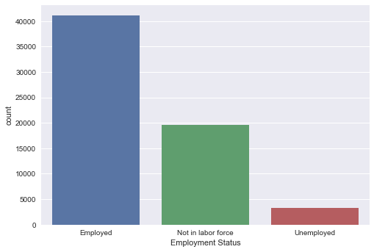
Data Visualization
Data Visualization is a general term that describes any effort to help people understand the significance of data by placing it in a visual context.
We have used Python(Seaborne Library) for the Visualization
Detailed Link - http://bit.ly/2FTeMSP
Using the link given, we can determine that there are around 41000 people who are employed compared to around just 3000 those who are unemployed in the Training Dataset. Data Visualisation helps to unravel various insights which will not be possible otherwise. The graph for one such insight is given below.

Slide 6
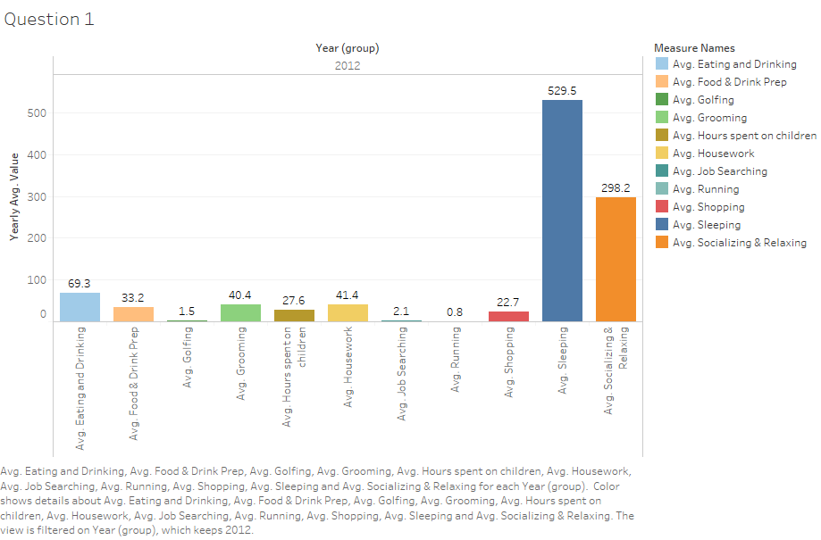
Question 1
Summary of Time Spending Pattern in 2012
We can determine that Avg Time sleeping is the highest in 2012 followed by Avg Socializing & Relaxing
Core Activities:
Sleeping (~49%)
Socializing & Relaxing (~28%)
Eating & Drinking (~6.5%)
Housework(~3.9%)
*Based on activities, keeping weekly working hours constant

Slide 7
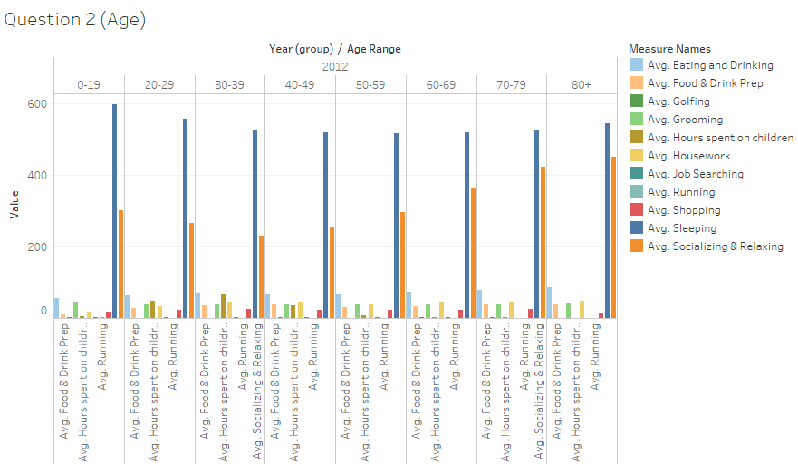
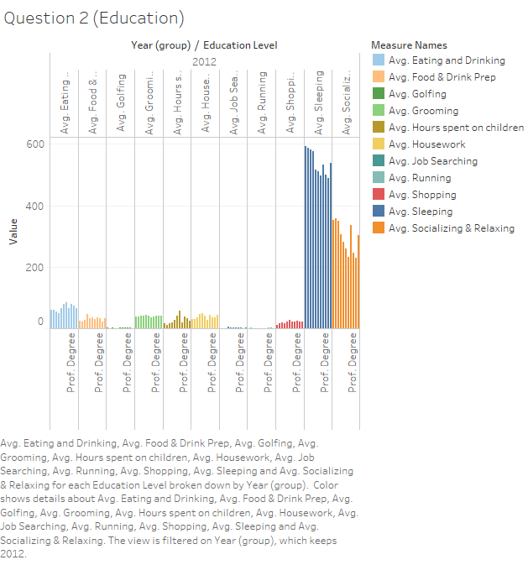
Question 2
Spending Time based on Age Group and Education Level
Based on Age ~ Time spending pattern visualized shows, Avg sleeping time is highest among lower age group(0-20), while socializing and relaxing is highest among older age group(80+).
Also, avg time spent on Child care is mostly in age group (20-50)
Based on Education ~ Time spending pattern visualized shows, Avg sleeping time is highest among 9th, 10th grade and high school, while least among those who hold Doctorate degrees.
Socializing and Relaxing is highest among 9th, 10th grade and high school.

Slide 8
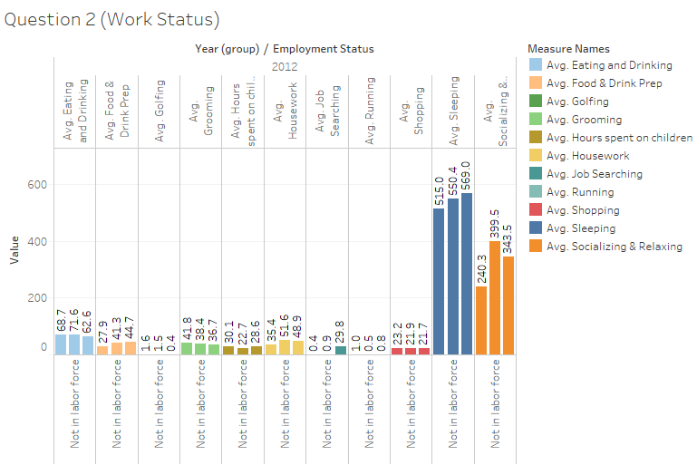
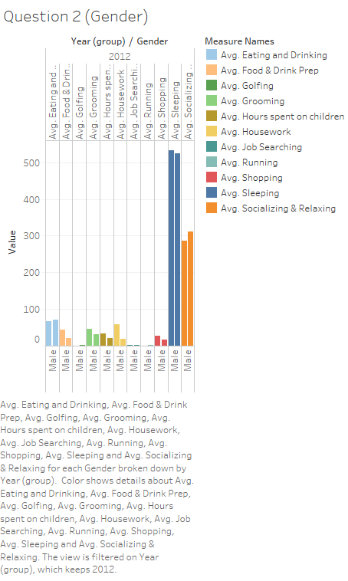
Question 2
Spending Time based on Work Status and Gender
Based on Work Status ~ Time spending pattern visualized shows, Avg sleeping time is highest among Unemployed while least in Employed
Also, avg time spent on Socializing & Relaxing is highest among Not in labor force, followed by Unemployed
Uniquely, Avg Job searching is highest among Unemployed (~96%)
Based on Gender ~ Time spending pattern visualized shows, Avg shopping time and Avg housework is highest among females, while socializing and relaxing is highest among males.
Uniquely, Female spent double time on Avg Food & Drink Prep

Slide 9
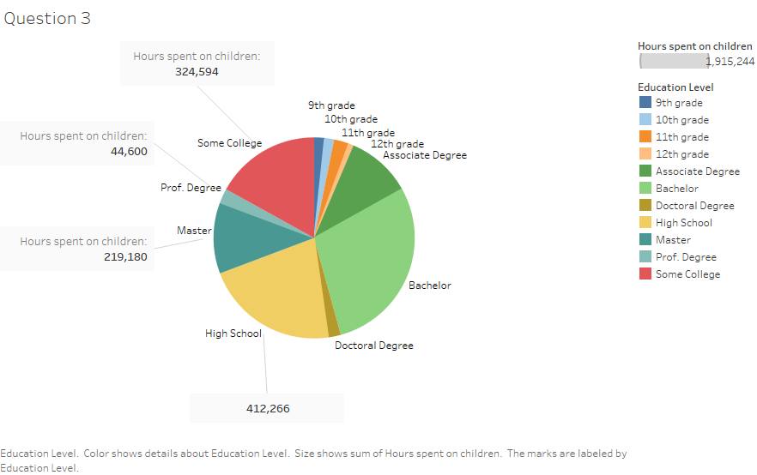
Question 3
Time spend on Baby care based on Education
Based on Education ~ Time spending pattern visualized shows, Education with respect to Baby Care is the Highest for Bachelor’s Degree (~29%) followed by a High School(~22%) .

Slide 10
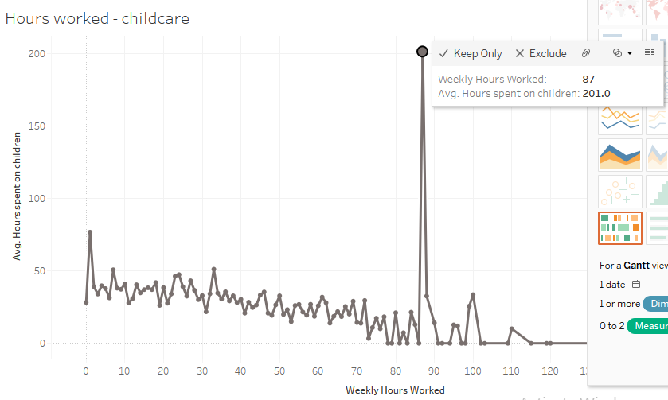
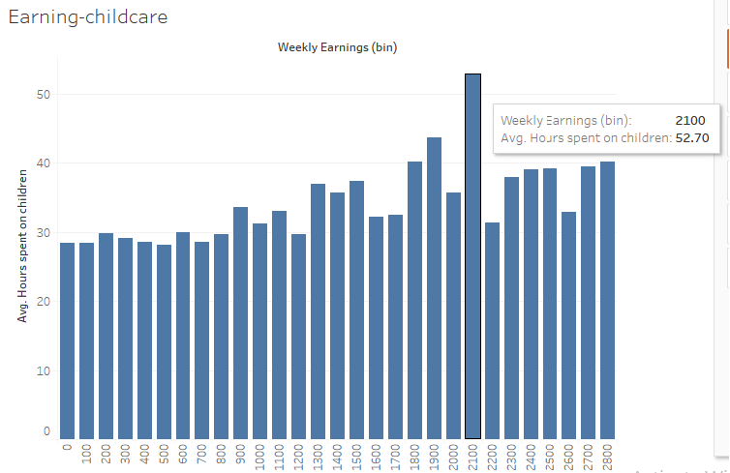
Question 3
Time spend on Baby care based on Hours worked & Weekly Earnings
Based on Hours worked ~ Time spending pattern visualized shows, Weekly Hours worked with respect to Baby Care is the Highest among those working around (85-90) hrs followed by (0-5) hrs .
Based on Weekly Earnings ~ Time spending pattern visualized shows, Weekly Earnings with respect to Baby Care is the Highest among those earning around (2100)
Additionally, with increase in earnings, hours spent on children increases
.

Slide 11
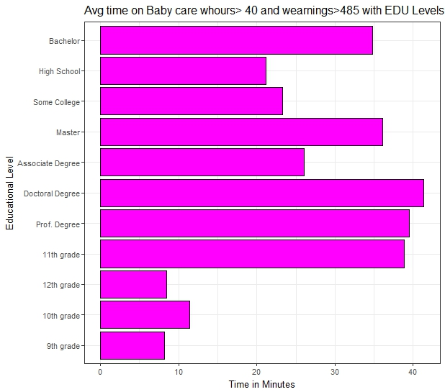
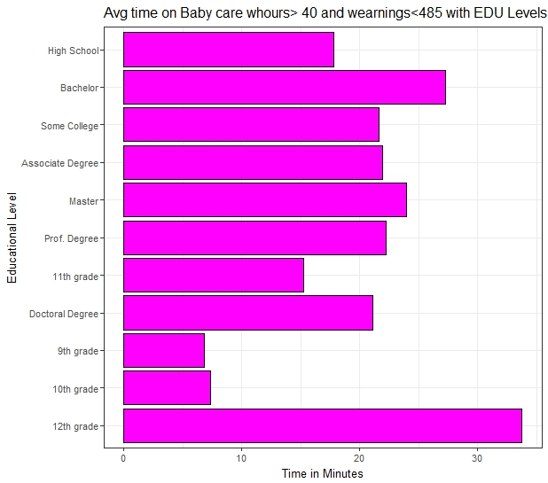
Question 3
Avg Time spent on baby care with respect to Educational level, differs with Weekly earnings and Weekly Hours worked
Weekly working hours >40 and Avg Weekly Earnings >485
Inference: Doctoral degree, spends most time caring for children
Weekly working hours >40 and Avg Weekly Earnings <=485
Inference: 12th grade, spends most time caring for children
*R programming used for above figures

Slide 12
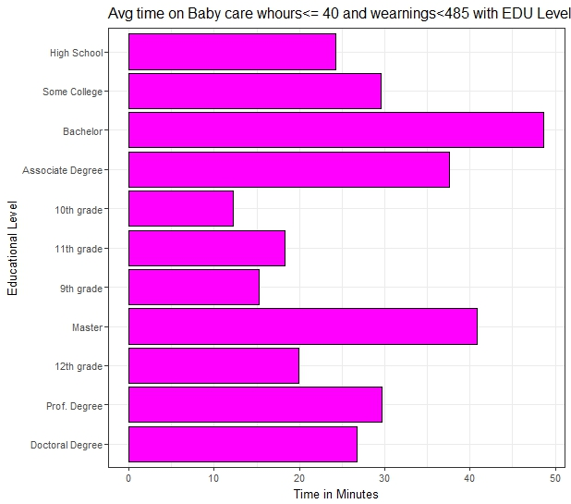
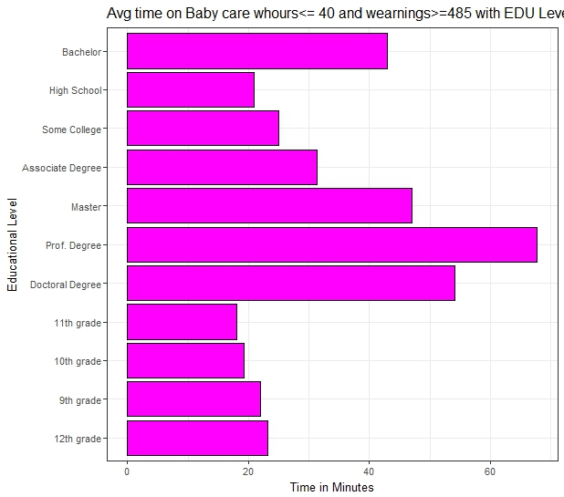
Question 3
Avg Time spent on baby care with respect to Educational level, differs with Weekly earnings and Weekly Hours worked
Weekly working hours <=40 and Avg Weekly Earnings <=485
Inference: Bachelor degree, spends most time caring for children
Weekly working hours <=40 and Avg Weekly Earnings >485
Inference: Prof. degree, spends most time caring for children
*R programming used for above figures

Slide 13
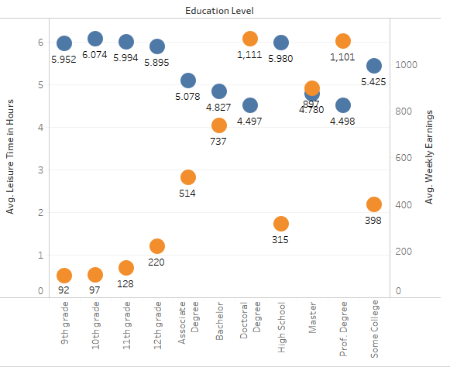
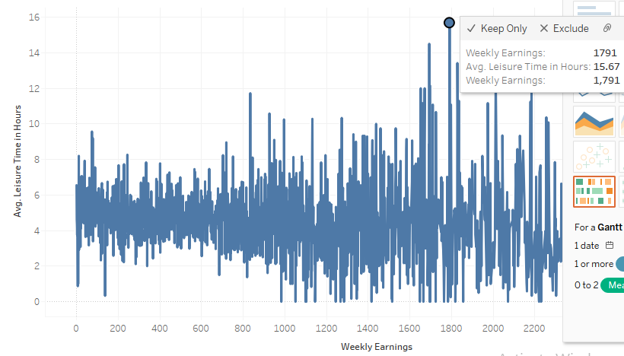
Question 4
Leisure time changing based on Income
Leisure time includes activities compromising of, Socializing & Relaxing, Shopping, Volunteering, Golfing and Running
Based on Income ~ Time spending pattern visualized shows, Leisure time with respect to Weekly Earnings is the Highest among those earning above (1600)
While, based on the Education level Leisure time is highest for 9th, 10th, 11th, 12th grade and High school while least for those having Doctorate. Interestingly, Doctorates have highest earnings while, those having low education having the least.

Slide 14
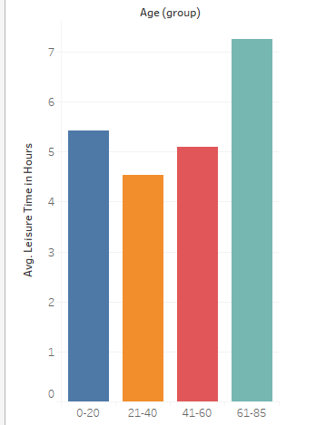
Question 4
Generations Leisure Spending Time
Based on Age Group (Generations) ~ Time spending pattern visualized shows, Age Group (Generations) with respect to Leisure time is the Highest among those falling in age group (61-85) hrs followed by (0-20) hrs.
There is a difference, that can be seen by the bar graph. Possibly, most of the people falling under the Age group (61-85) won’t be working anymore so most of their time is spent in Leisure activities.
Similar is the case with age group (0-20) as most of the activities, such as running, socializing etc are prominent among young age group as least of them are working.
Additionally, Age group (21-40) athe ones spending most of the time in working followed by (41-60) thus limiting their time spent on leisure activities.

Slide 15
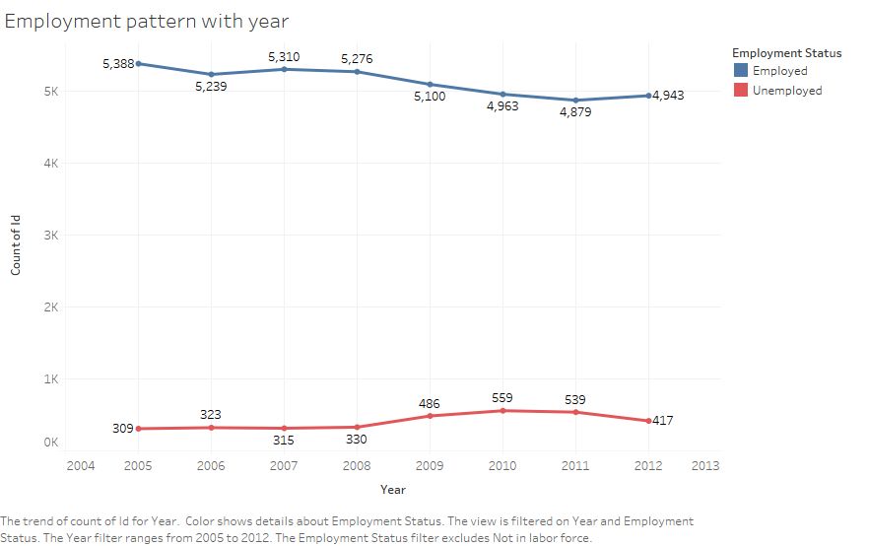
Question 5
Employment Pattern Analysis During The Great Recession
As depicted by the graph, Employment status is shown those who were Employed and Unemployed, the Great recession, decreased the number of employment by 3.3 % while the unemployment by increased by 47% which is a significant value.
As further seen, effects of the Great recession can be seen over the years, 2010 and 2011 in which further the Employment rate has gone down while Unemployment has increased exceptionally.

Slide 16
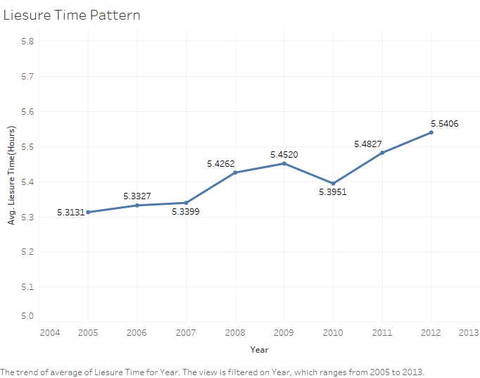
Question 5
Leisure Time Pattern Analysis During The Great Recession
Evaluating based on the Leisure Time pattern during the Great recession, it can be depicted it didn’t had major effect on leisure activities surely there was a downfall in the year 2009-2010, but no bigger significance can be noticed.

Slide 17
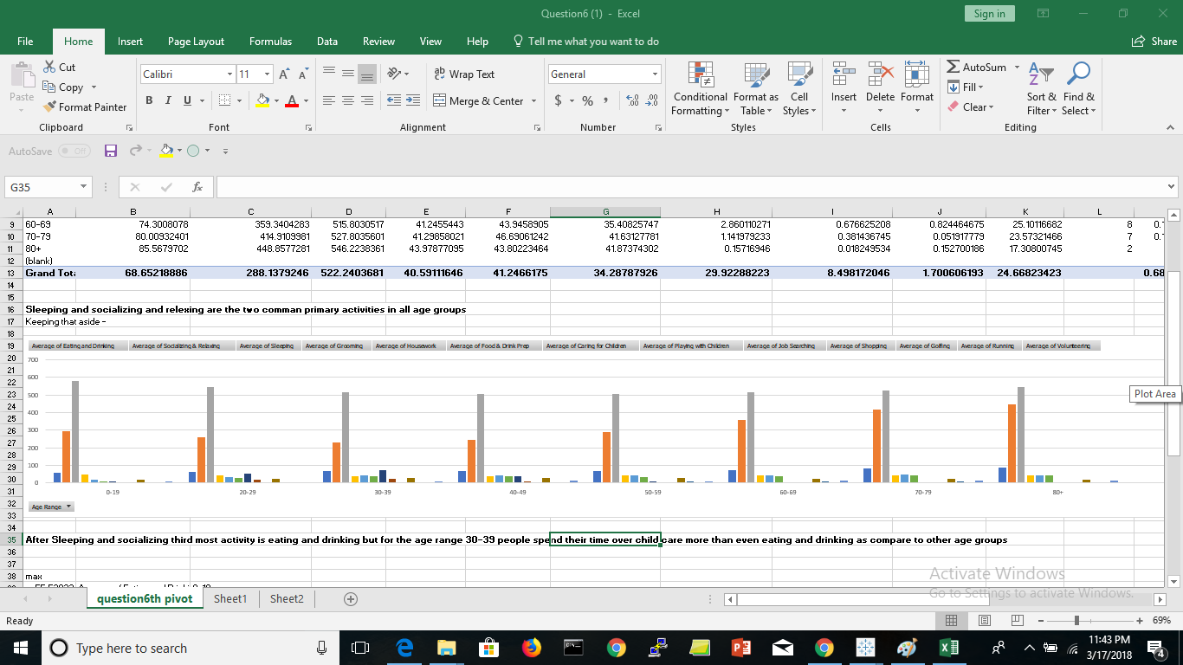
Question 6
Based on Age- Individual’s Primary Activity
As seen from the visualization depicted above, Sleeping is the Primary activity based on the number hours spend per day, followed by Socializing and Relaxing for all the age groups. It can be noticed, age groups (70-80) and (80+) spend most of the time in Socializing and Relaxing compared any other age group.
Inferences also can be drawn for age group, (20-29), as they spend least time in Socializing and Relaxing as well in Sleeping.
*Evaluated using MS Excel

Slide 18
Question 8
Confusion Matrix using Training Data Set(Random Forest)
OOB estimate of error rate: 5.37%
Confusion matrix:
Employed Not in labor force Unemployed class.error
Employed 40511 563 24 0.01428293
Not in labor force 12 19398 220 0.01181864
Unemployed 4 2612 662 0.79804759
Inference: We can see that the accuracy is around 94.63% and Random Forest was used because it is an ensemble algorithm to analyse multiple decision trees and come up with a prediction on the Test Dataset.

Slide 19
Question 8
Prediction using Test Data(Random Forest)
Employed | Not in Labour Force | Unemployed
20749 | 12181 | 340
Using R, Random Forest Classifier was run on the Test Dataset and the prediction for the Employment Status was obtained as given above.The mtry and the ntree values are passed when executing the Random Forest in R..

