Slide 1
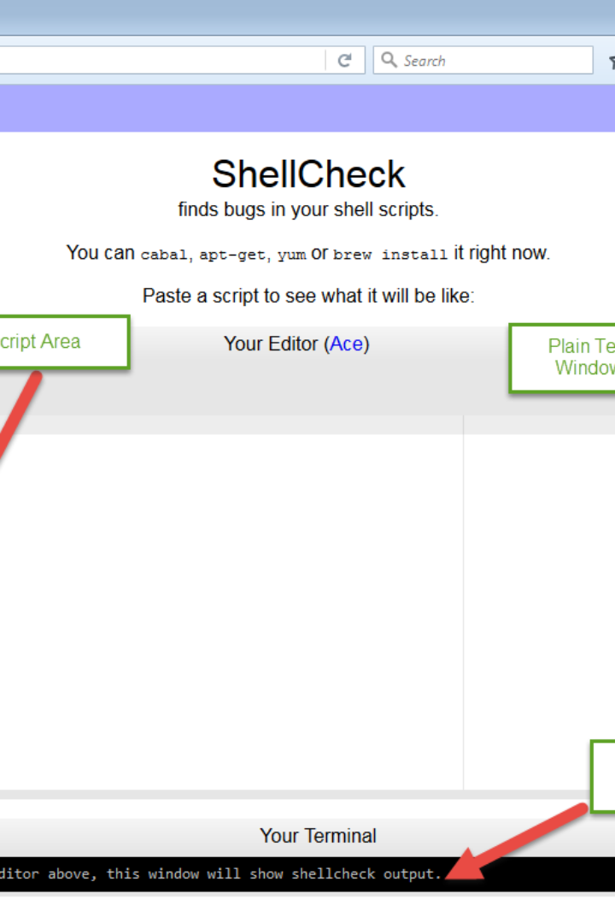


Print Lines Script
Introducing the Print Lines Script, a powerful tool that allows you to extract specific lines from files. Take control of your data and effortlessly manipulate text files with precision and efficiency.
by Pranava Dachepally

Slide 2

Getting Started
1
Save the Script
2
Make it Executable
Download the script and save it with a .sh extension, for example: print_lines.sh.
Run the command chmod +x print_lines.sh to make the script executable.
3
Run the Script
Execute the script by providing the file name, starting and ending line numbers as arguments. For instance, ./print_lines.sh my_file.txt 10 20.

Slide 3



Advanced Features
Command Line Interface
User-Friendly
Extract Multiple Files
Interact with the script seamlessly through the command line interface, no need for complex setups.
The script is designed for simplicity and ease of use, ensuring a smooth experience for all users.
Select multiple files to extract lines from, saving valuable time and effort.

Slide 4
Efficiency at Your Fingertips
Line Number Ranges
Automation
Define precise sets of lines to extract from files, ensuring accuracy and eliminating time-consuming manual searching.
Effortlessly extract lines from files as part of automated processes, boosting productivity.
Intuitive Syntax
Error Handling
The script features an intuitive syntax, making it accessible for both beginner and advanced users.
Handle errors gracefully with informative messages, minimizing troubleshooting time.

Slide 5
Flexible and Customizable
1
Custom Output File
Save the extracted lines to a separate output file, keeping your original file untouched.
2
Output Formatting
Choose between different output formats, such as preserving line numbers or excluding them for cleaner results.
3
Regex Support
Utilize powerful regular expressions to redefine line extraction patterns and supercharge your text processing tasks.

Slide 6



Secure and Reliable
File Integrity
Permission Control
Thorough Testing
Rest assured knowing that the script operates without modifying your original files, maintaining the integrity of your data.
Set file permissions to control who can access and execute the script, keeping your data secure.
Our script has undergone rigorous testing to ensure reliability, ensuring each line is accurately extracted as intended.

Slide 7

Expand Your Possibilities
1
Data Analysis
2
Text Manipulation
Extract relevant lines from log files for deeper analysis and troubleshooting.
Use the extracted lines as input for further text manipulation or transformation processes, giving you full control over your data.
3
Reporting
Create custom reports by extracting specific sections of text from documents, saving time and eliminating repetitive tasks.

Slide 8



Empower Your Workflow Today
Boost Productivity
Unlock Your Potential
Simplify Your Life
Take advantage of the Print Lines Script to streamline your workflow and accomplish more in less time.
Discover the limitless possibilities of text extraction and unleash your creativity in data manipulation.
Say goodbye to manual efforts and tedious tasks. Let the Print Lines Script do the work for you.

