Slide 1
Effect of infill parameters on spatial temperature distribution in fused deposition modeling
Pranav Addepalli

Slide 2
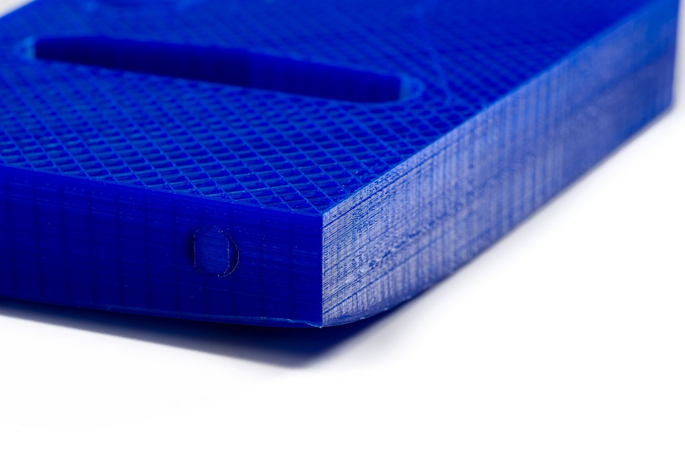
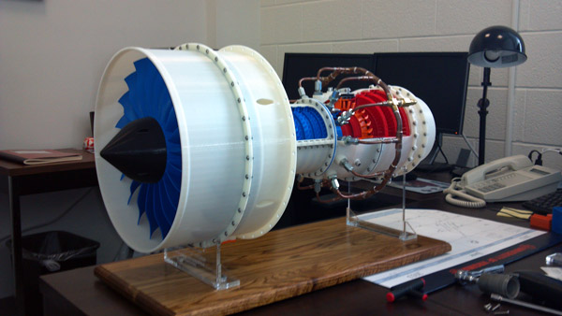
Significance
Warpage
Passive heating
Crucial for future 3D printing
Aerospace and defense, automotive, and healthcare
https://3dprinting.com/tips-tricks/how-to-choose-an-infill-for-your-3d-prints/
http://www.3dprinterworld.com/article/3d-printing-enables-university-students-become-aerospace-manufacturers

Slide 3
My Project
Studying the effect that various infill combinations have on
thermal conductivity
spatial temperature distribution
in PLA discs during the printing process.
https://www.dddrop.com/wp-content/uploads/2018/02/3D-printen-stevige-infill.jpg

Slide 4
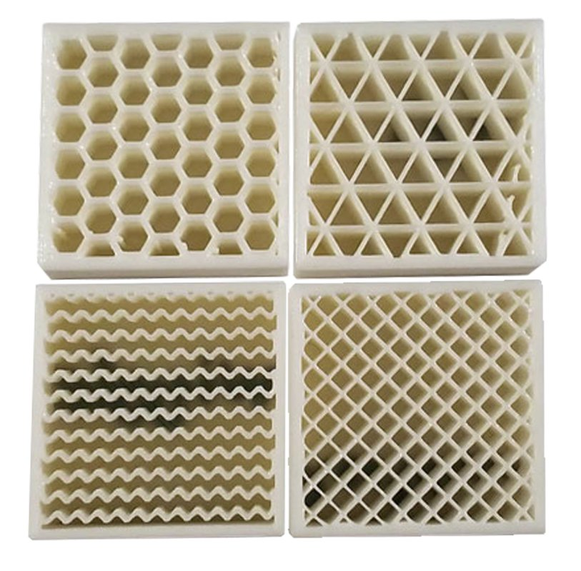
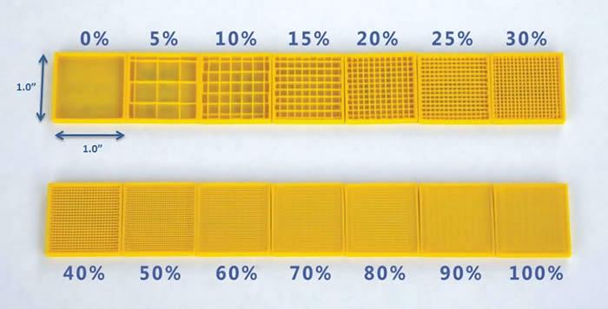
Variables
Infill type and infill percentage
Temperature distribution and thermal conductivity
https://3dprinting.com/tips-tricks/how-to-choose-an-infill-for-your-3d-prints/
http://tcadsolutions.com/3dprinting.html

Slide 5
Hypothesis
Conduction in porous structures is superior to radiation and natural convection
(Deng et. al., 2018; Larkin & Churchill, 1959; Kim & Viskanta, 1984)
Higher infill percentages will have higher thermal conductivities
Higher infill percentage → more plastic → more conduction
Hexagonal infill will have the highest thermal conductivity
Hexagons have the most “channels” → more pathways for heat flow

Slide 6
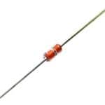
Materials
Thermistors
PLA
Arduino Uno R3
Lees’ Disc
https://www.mouser.com/ProductDetail/Amphenol-Advanced-Sensors/TH420J34GDNI?qs=P8zB4ONU6fzOyUXxdGay3g%3D%3D

Slide 7
Procedure
Use Fusion360 to design a template disc with 8 inch diameter, 0.5 inch height, and channels for thermistors
Slice the disc in Cura with a different infill each time
Hexagonal, rectilinear, triangular
10%, 20%, 30%, 40%, 50%
3 trials of each infill combination

Slide 8
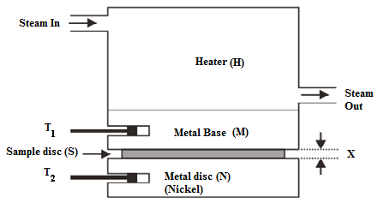
Procedure: Lees’ Disc
Construct a Lee’s Disc Apparatus
Brass, steam generator, and steam chamber
http://pubs.sciepub.com/ajme/2/4/3/figure/2

Slide 9
Procedure: Recording Data
Program Arduino to record time-temperature data with the Steinhart-Hart Equation
Finds temperature based on resistance and other values constant to thermistor type
http://blog.skytee.com/2012/01/temperature-sensor/

Slide 10
Progress

Slide 11
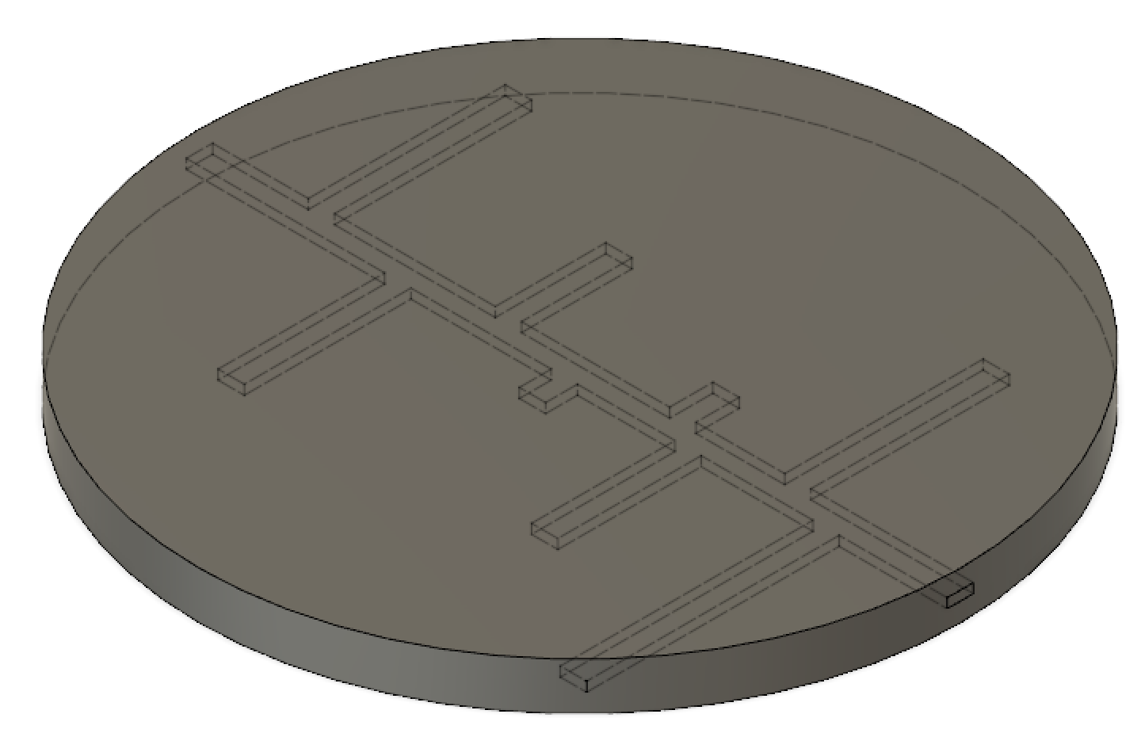
Disc Template
Randomly selected positions along 1 inch increments
7mm channels

Slide 12
Lees’ Disc Apparatus
Presented to Monroe and began collaboration
Aluminum cylinder and brass discs delivered last week to Welding students
Capping the cylinder and drilling in/out holes to make a steam tank
Started assembling the apparatus
Drilling holes in the brass to hang up and for temperature probes

Slide 13
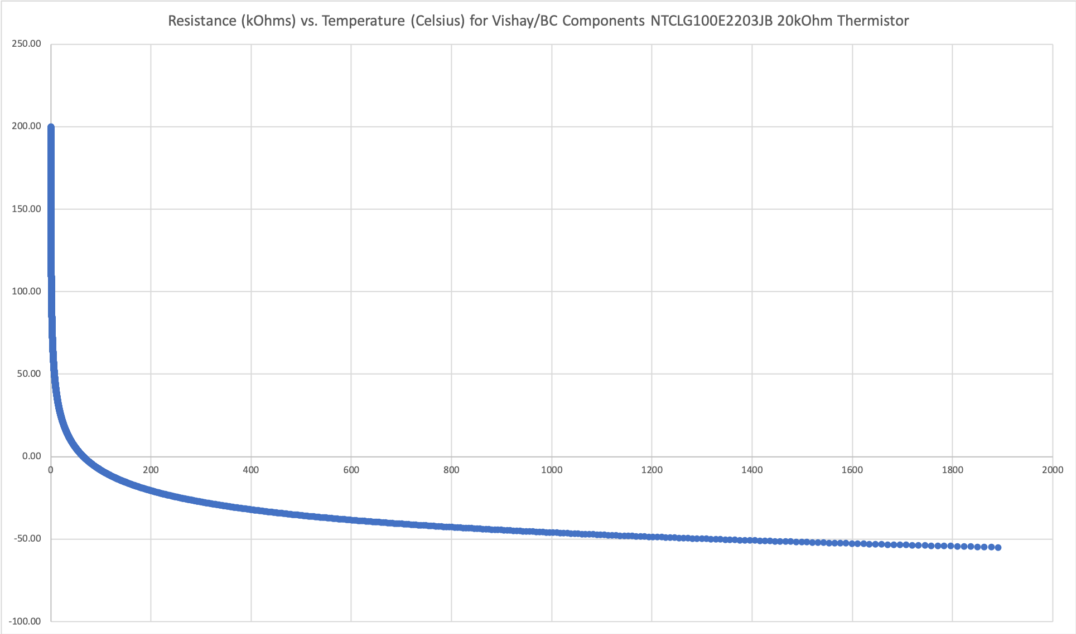
Thermistors (1)
Tested for coefficients
Constructed a temperature and resistance curve specific to the model

Slide 14
Thermistors (2)
Programmed and wired the Arduino to record several temperatures in Serial
Sample temperature distribution for 4 thermistors
Taped circuit connections for insertion in the print

Slide 15
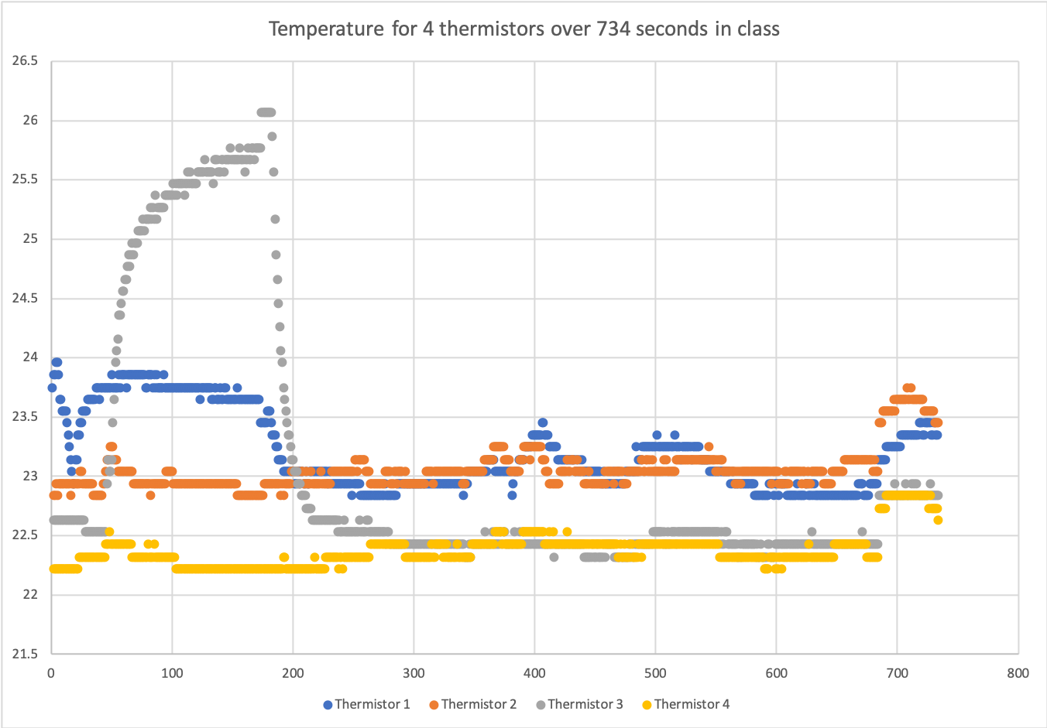

Slide 16
Simulation
Looking for CFD software to run thermal analyses on each model
New engineering research PC?

Slide 17
Future Goals
Finish the Lees’ Disc Apparatus and test
Simulations
Main issue: no working 3D printers big enough
Need a printer with a bed at least 8.5 x 8.5 inches, but the Series 1 Pro that we have is broken
Ordered a new 3D printer (Raise3D Pro2) with a 12” x 12” x 11.8” build space

Slide 18
References
Deng, C., Kang, J., Shangguan, H., Hu, Y., Huang, T., Liu, Z. (2018). Effects of hollow structures in sand mold manufactured using 3D printing technology. Journal of Materials Processing Technology, 255, 516-523. doi:10.1016/j.jmatprotec.2017.12.031
Larkin, B. K. & Churchill, S. W. (1959). Heat transfer by radiation through porous insulations. AIChE Journal, 5(4), 467-474. doi:10.1002/aic.690050413
Kim, D. M. & Viskanta, R. (1984). Heat transfer by conduction, natural convection, and radiation across a rectangular cellular structure. International Journal of Heat & Fluid Flow, 5, 205-213. doi:10.1016/0142-727X(84)90053-5

