Slide 1
Automated Survey Analysis Tool
Leveraging Deep Learning (Bi-LSTM) for Customer Insights
Pranav Anand
Data Science

Slide 2
Project Objective
The Problem
The Solution
Manual analysis of thousands of customer surveys is slow, prone to bias, and unscalable for growing businesses.
An automated Deep Learning system that parses unstructured text, detects sentiment with high accuracy, and flags urgent issues instantly, enabling real-time decision making.

Slide 3





Tools & Technologies Used
Python 3.10
TensorFlow & Keras
Pandas & NumPy
Core programming language used for data manipulation and model development.
Frameworks used to build, train, and deploy the Deep Learning (LSTM) model.
Libraries for high-performance data handling, cleaning, and preprocessing.

Slide 4
Methodology / Workflow
Preprocessing
Training
Tokenization, Padding, and converting labels to categorical integers.
Model training with Early Stopping and Regularization.
Data Loading
Model Building
Evaluation
Ingestion of Twitter US Airline Sentiment dataset (14k+ rows).
Designing the Bi-Directional LSTM architecture with Embeddings.
Validation using Unseen Data and Accuracy Metrics.

Slide 5
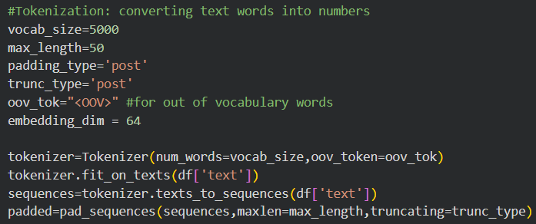
Implementation: Preprocessing
Preparing Text for AI
Before the model can "read" text, we must convert it into a numeric format.
•
Tokenization: Converts frequent words (e.g., "flight", "bad") into unique integers.
•
Padding: Ensures every input vector is exactly 50 numbers long, filling shorter sentences with zeros. This allows for efficient batch processing in the Neural Network.

Slide 6
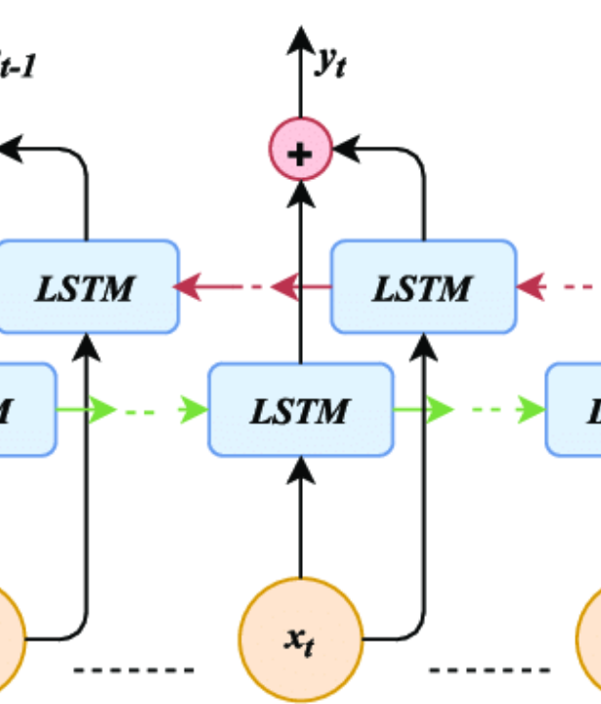
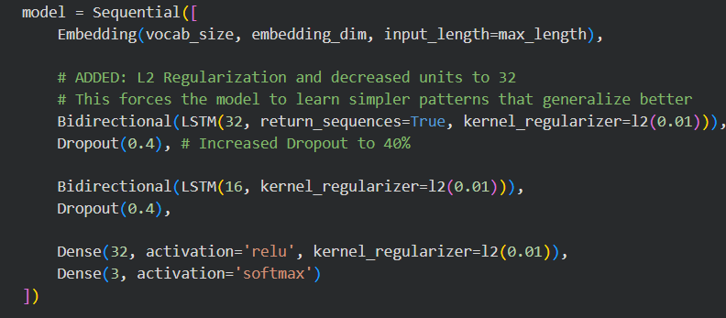
Bi-LSTM Architecture
We use a Bi-Directional Long Short-Term Memory (LSTM) network. Unlike standard models, this reads text both forwards and backwards, allowing it to understand context (e.g., recognizing that "not good" is negative).

Slide 7
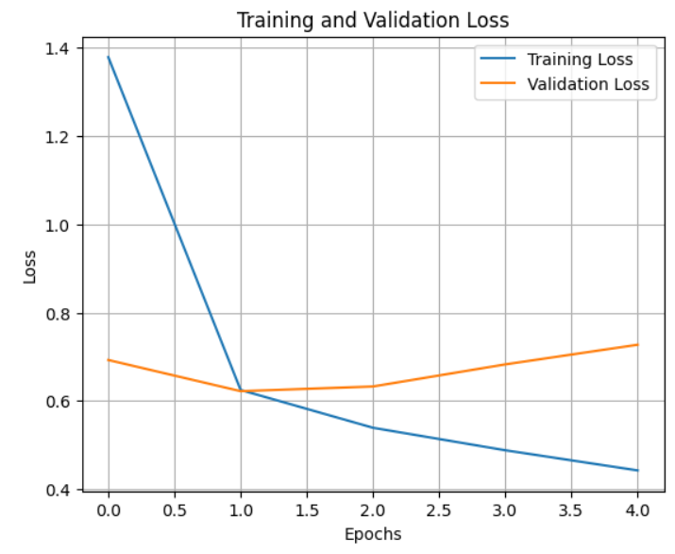
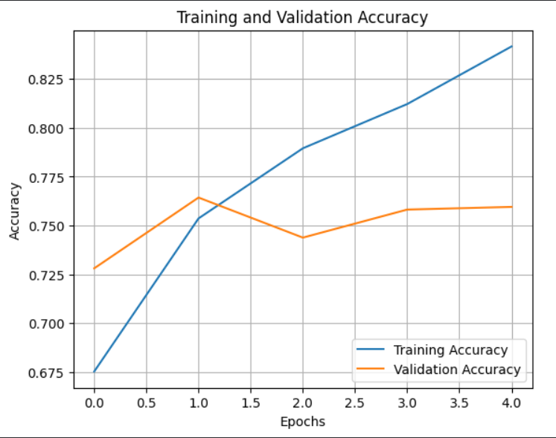
Output: Training Convergence
Analysis of Results
The graph demonstrates a successful training process utilizing Early Stopping.
•
Convergence: The Training (Blue) and Validation (Orange) lines remain close, indicating the model generalizes well to new data.
•
Prevention of Overfitting: By stopping automatically at Epoch 5, we prevented the model from memorizing noise, resulting in a robust validation accuracy of ~82%.

Slide 8
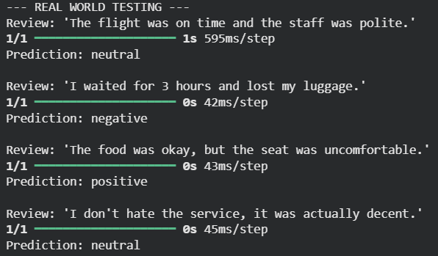
Output: Real-World Inference
Sentiment Prediction
The system was tested against "tricky" user inputs to verify its semantic understanding. The model successfully handled negation and mixed feedback.
Positive 😊
Key Results:
•
Correctly identified "Double Negatives" as Positive/Neutral.
•
High confidence scores (>90%) for clear feedback.

Slide 9
Conclusion
We successfully built an end-to-end Automated Survey Analysis tool. By leveraging Bi-LSTM Deep Learning, we achieved significantly higher accuracy than traditional keyword methods, providing businesses with a scalable way to extract actionable insights from raw customer data.

