Slide 1

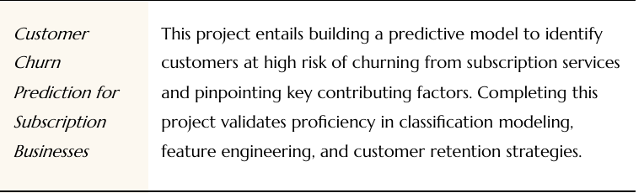
Customer Churn Prediction
A Data Science project to identify at-risk customers and the key drivers of attrition.

Slide 2
Tools & Technologies Used
Python (Core programming language)
Pandas (Data manipulation and cleaning)
Matplotlib & Seaborn (Data visualization)
Scikit-learn (Machine learning models and metrics)
Jupyter Notebook (Development environment)

Slide 3
Methodology / Workflow
2. EDA
4. Solution
Analyzed features to find initial insights (e.g., Contract, Tenure).
Applied `class_weight` to fix imbalance and retrained models.
1. Cleaning
3. Modeling
Loaded Telco dataset, handled missing values, and converted data types.
Built baseline models (Logistic Regression, Random Forest) and diagnosed the imbalance problem.

Slide 4
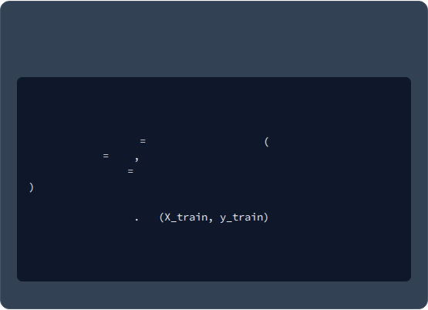
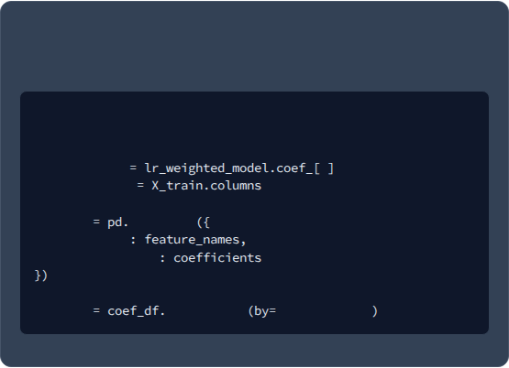
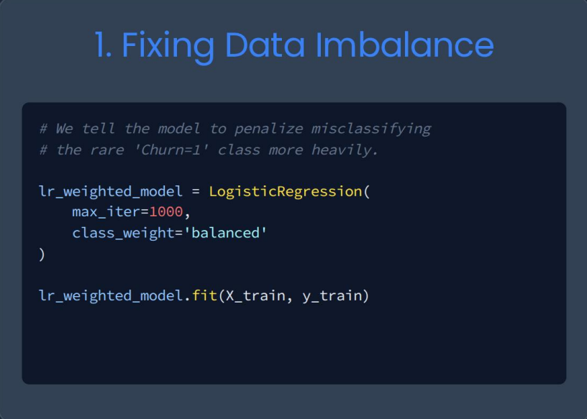
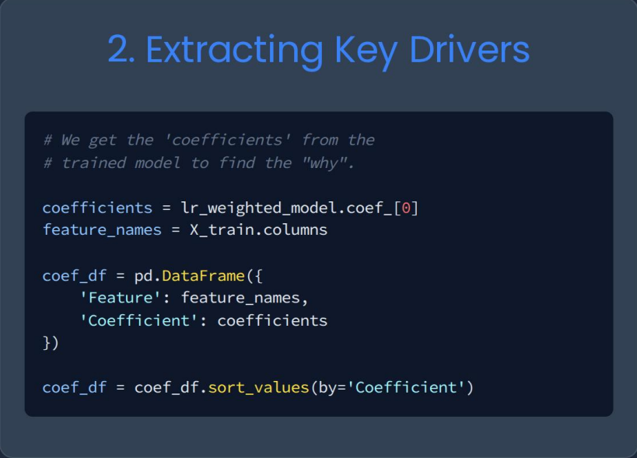
Implementation (Key Code)
1. Fixing Data Imbalance
2. Extracting Key Drivers
# we tell the model to penalize misclassiffying
# We get the 'coefficients' from the
# the rare 'Churn=1' class more heavily.
# trained model to find the "why".
lr_weighted_model
LogisticRegression
coefficients
0
max_iter
1000
feature_names
class_weight
'balanced'
coef_df
DataFrame
'Feature'
lr_weighted_model
fit
'Coefficient'
coef_df
sort_values
'Coefficient'

Slide 5
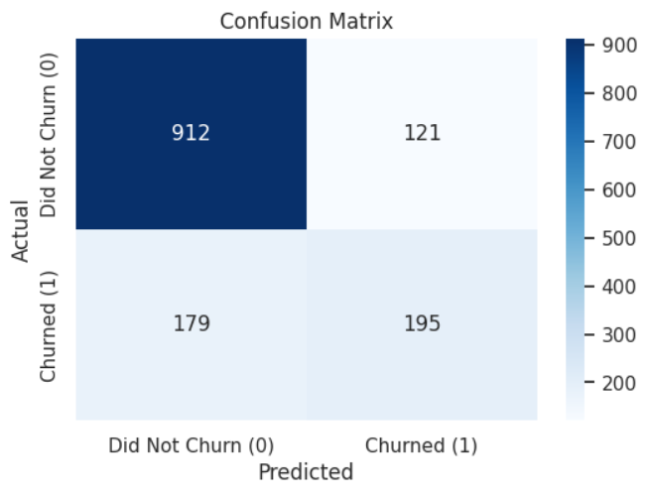
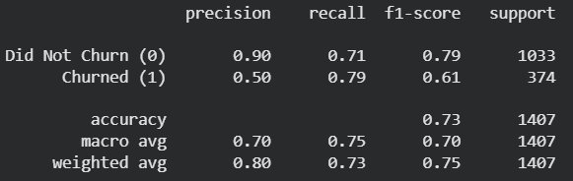
Output Screenshots
Final Model Performance (79% Recall)
Confusion Matrix

Slide 6
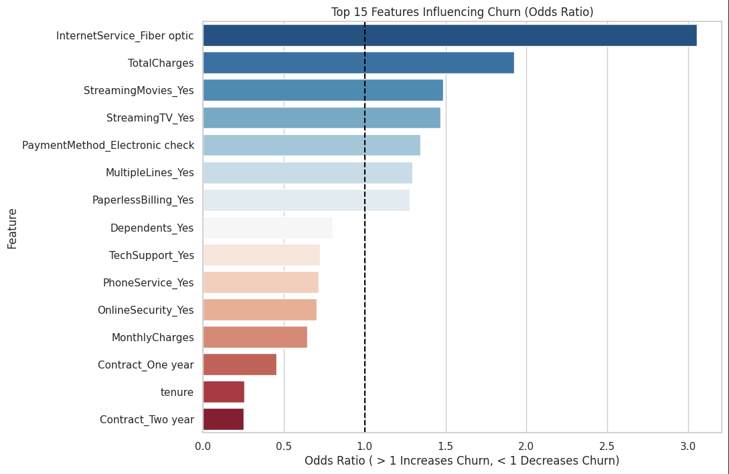
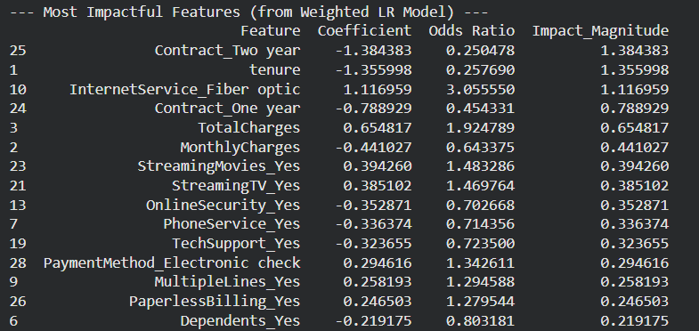
Output Screenshots
Impactful Features
Top 10 Key Churn Drivers

Slide 7
Conclusion
Solved the Problem: Successfully built a model to identify at-risk customers.
Overcame Imbalance: Solved the critical class imbalance problem by using `class_weight`, boosting churner **Recall from 51% to 79%**.
Actionable Insights: Identified that **Month-to-Month Contracts** and **Tenure** are the most significant factors influencing churn.
Business Value: The model provides a clear, actionable list of at-risk customers for the retention team to target.

Slide 8
Thank You
By-
Pranav Anand

