Slide 1
Text Analysis of U.S. Presidential Debate 2016

Slide 2
INTRODUCTION
The 2016 United States presidential election debates were a series of debates held for the 2016 U.S. presidential general election
Recent U. S. Presidential Elections had 3 rounds of debates between Republican Candidate Donald Trump and Democratic Candidate Hillary Clinton
Various issues were spoken about during the debates by both the candidates in all the 3 debates
Both had different opinions on the question asked by the public and the debate host.

Slide 3
OBJECTIVES
Analyze the whole debate and get some inferences out of it.
Understand the candidate’s attitude using sentiment analysis.
Analyzing the debate to find out which candidate focuses on what topic using WordCloud.
Count the number of interventions for each speaker.
Determine the number of common words used by both the candidates to analyze their speeches.
Analyze the audience reactions.

Slide 4
Dataset
Dataset is obtained from debate transcripts.
There are 4 columns in the dataset,
Line: Line number for each transcript
Speaker: Trump, Clinton, Holt, Audience, Candidates(Trump & Clinton together)
Text: Text from the transcripts for each speaker respectively
Date: Dates of debate (2016-09-26, 2016-10-09, and 2016-10-19) to distinguish events.

Slide 5
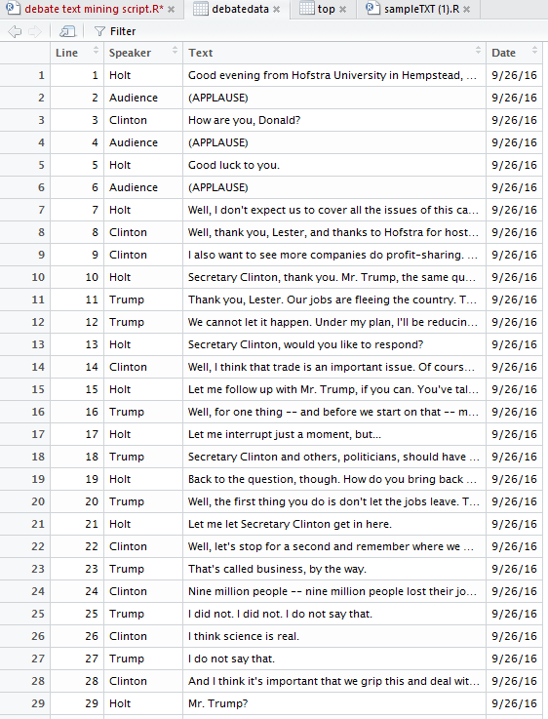
Dataset

Slide 6
Pre-Processing
To prepare the data for analyzing, some pre- processing steps need to be followed
Stop-Word Removal
Stemming
Remove Punctuation
Remove Numbers
Remove White Spaces

Slide 7
Results
Interventions
Number of time each speaker interrupted the debate.
Sentiment Analysis
Determined the attitude of speaker during debate.
WordCloud
Term Frequency of words spoken by each speaker.
Most Common Words
Determined the words spoken by both the speakers and analyzed it on the basis of frequency of the words.
Audience Reactions
Captured the audience responses in the debate.

Slide 8
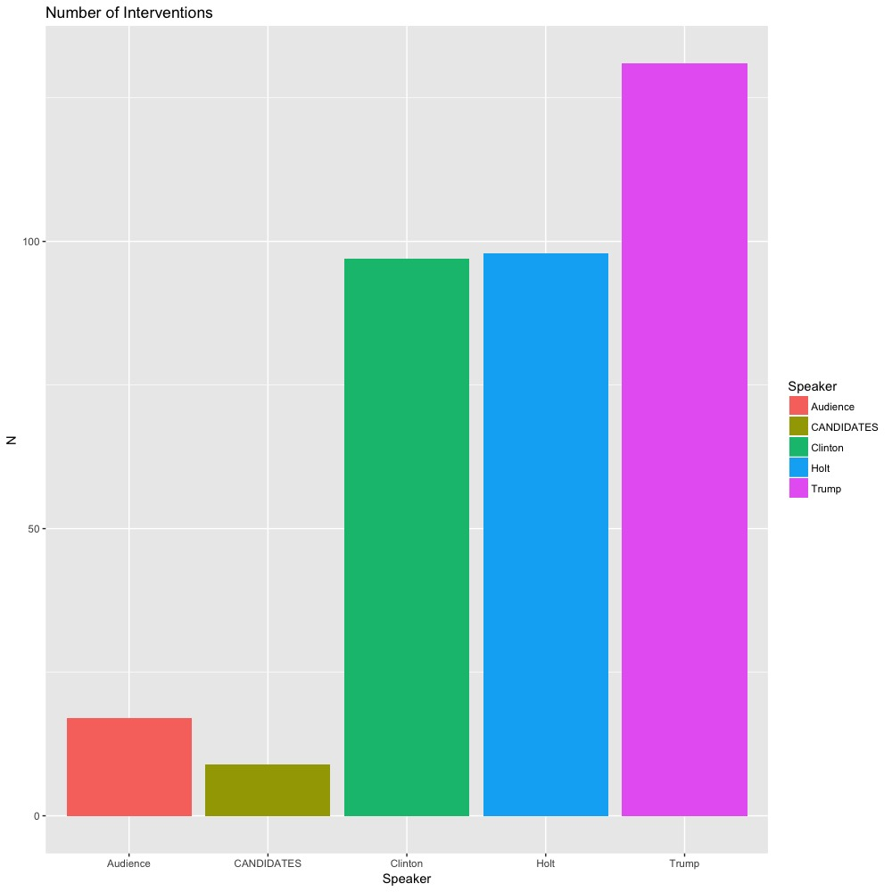
Interventions
:

Slide 9
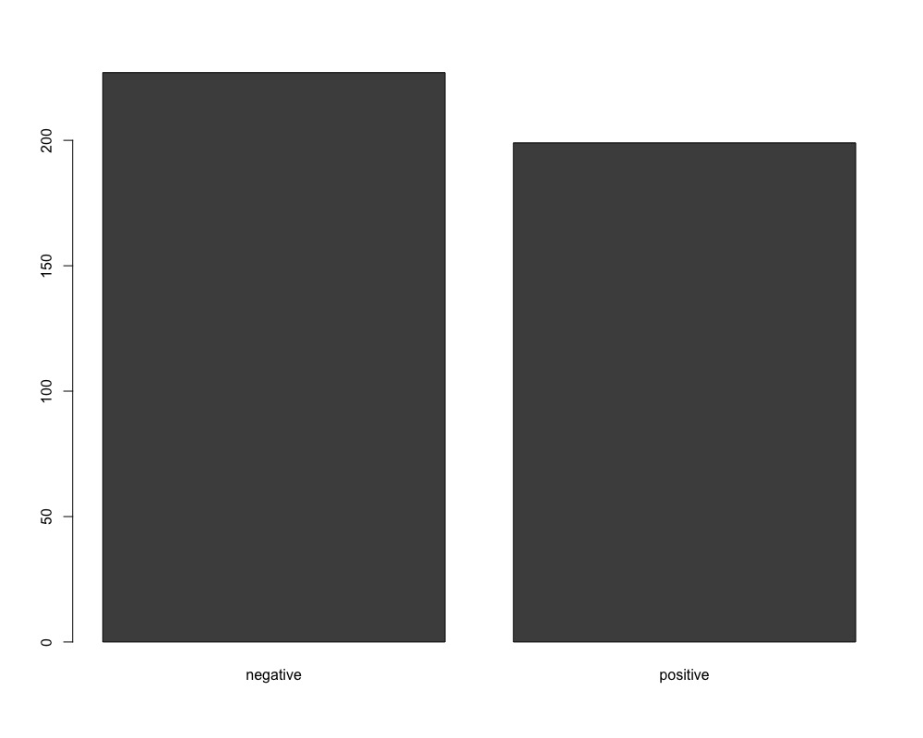
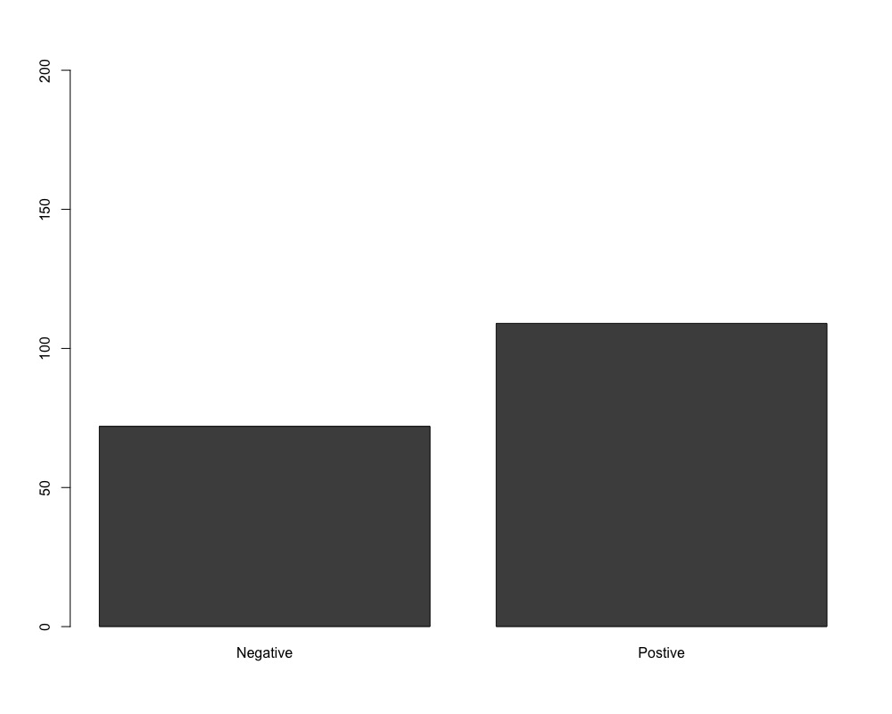
Sentiment Analysis
:
Donald Trump
Hillary Clinton
Notes:
Trump----- negative positive[1,] 227 199
Clint----- Negative Postive[1,] 72 109

Slide 10
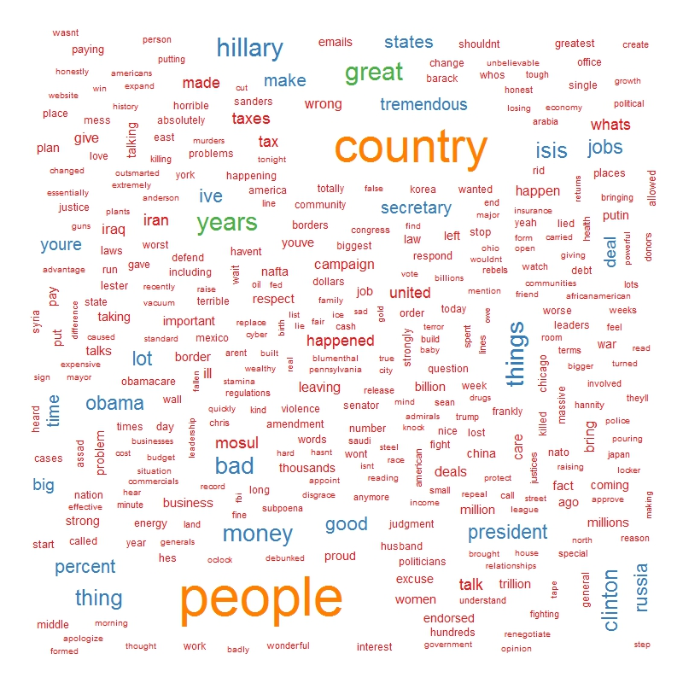
WordCloud (Donald Trump)

Slide 11
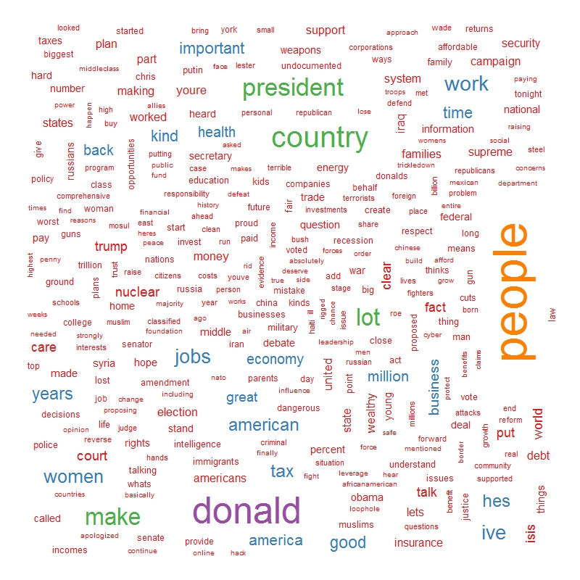
WordCloud (Hillary Clinton)

Slide 12
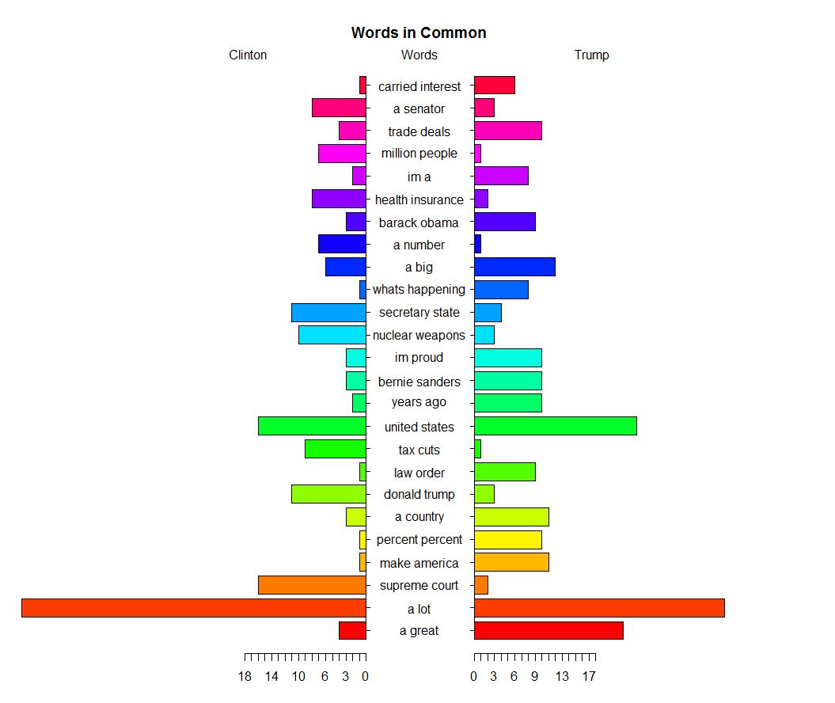
Most Common Words

Slide 13
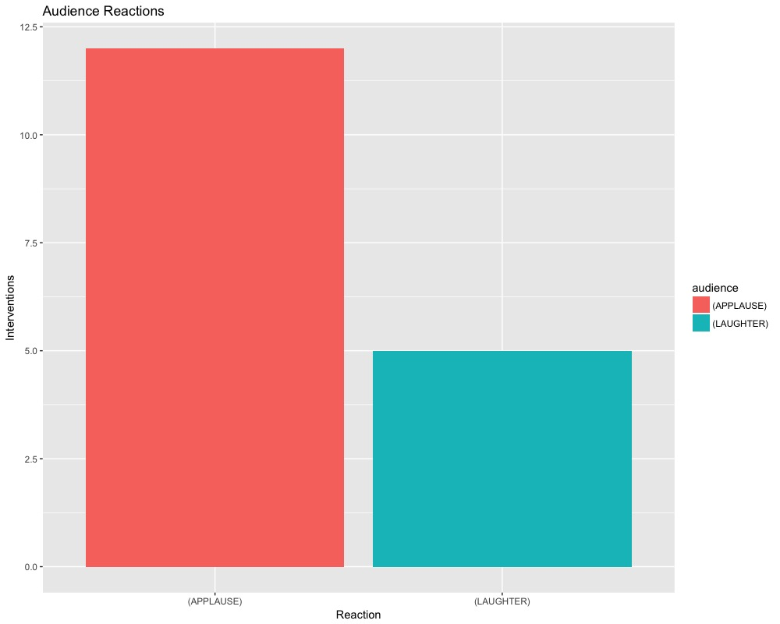
Audience Reactions

Slide 14
Any Questions?

Slide 15
Thank you!

