Slide 1
CONTINUOUS AND INTEGRATED SOFTWARE DEVELOPMENT USING DEVOPS
TECHNICAL SEMINAR ON
Presented by :
Pranav N Rao
1BG16CS076
Under the guidance of :
Sajitha N
Assistant professor
Dept. of CSE

Slide 2
OVERVIEW
Introduction
Problem Statement
Literature Survey
System Architecture
Result analysis
Conclusion
References

Slide 3
INTRODUCTION
Devops is the process or the methodology of using various tools for solving problems between Developers and Operation team, hence the term “Dev-Ops”. It is a continuous process – continuous development, testing, integration, deployment and monitoring.
With DevOps, there is no wait time to deploy the code and getting it tested. Hence, the developer gets instantaneous feedback on the code, and therefore can close the bugs, and can make the code production ready faster.

Slide 4
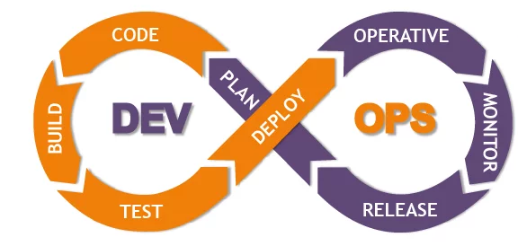
CONTD.
Devops life-cycles

Slide 5
PROBLEM STATEMENT
To accelerate development cycles and reduce the infrastructure costs using devop tools and make software development reliable and fast with continuous integration and continuous deployment.

Slide 6
LITERATURE SURVEY
1. Aayush Agarwal, Continuous and Integrated Software Development using DevOps, 2018 IEEE - International Conference on Advances in Computing and Communication Engineering (ICACCE-2018) Paris, France 22-23 June 2018
Continuous Delivery (CDE), Continuous Deployment (CD) is a key practice for making software development process reliable and faster.
The feedbacks from the Production and Operations team are made available to the developer at frequent stages facilitating improvement and automation..

Slide 7
CONTD.
It is great approach for quick development and deployment of applications. It is clear descriptive process gives clarity on product development and delivery.
Each container might take more amount of space separately in certain devop tools.
Lack of DevOps knowledge could be a problem in continuous integration of automation projects.

Slide 8
CONTD.
2. Boyuan Chen, Improving the software logging practices in DevOps, 2019 IEEE-ACM 41st International Conference on Software Engineering (ICSE-Companion)
DevOps is a software development methodology that intends to automate the process between software development and IT operations.
The goal is to reduce the time between committing a change to a system and placing it to production. Software logging in the context of DevOps refers to the practices of developing and maintaining logging code and analyzing the resulting execution logs.

Slide 9
CONTD.
At every function/process of the software, details of the particular work is logged.
Helpful information for diagnose the future. Tracking each and every operation in details.
Consume extra space on disk. Consume extra computational speed and cost.

Slide 10
CONTD.
3. DVSR Krishna Koilada, Business model innovation using modern DevOps, 2019 IEEE Technology & Engineering Management Conference (TEMSCON)
Utilizing modern DevOps technologies and principles, organizations are fostering toward high-performers category with rapid continuous-delivery and continuous-deployments of applications.
The time-gap factor between releases and deployments qualifies whether the organization is in the high-performer zone.

Slide 11
CONTD.
It responds faster to the market changes to improve business growth.
It escalate business profits by decreasing the software delivery time and transportation cost. Improves customer experience and satisfaction.
Adopting new DevOps technology into the industries is hard to cope in short span of time.

Slide 12
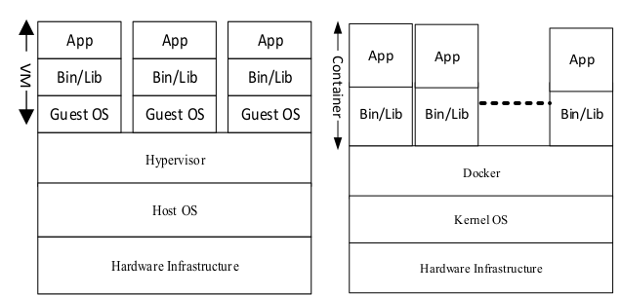
CONTD.
Virtual machines versus Docker containerization.

Slide 13
SYSTEM ARCHITECTURE
Automatic Commit and deploy with Jenkins. It builds and tests your software projects continuously making it easier for developers to integrate changes to the project, and making it easier for users to obtain a fresh build.
Automated Testing using Selenium which provides several benefits like we can trigger them to perform at a particular timing; they manage report generation, and reduce mistakes.
Version control using git, which allows user to maintain repositories to maintain the program which is going to be deployed.

Slide 14
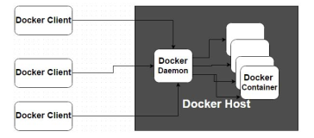
CONTD.
Containerization with Docker

Slide 15
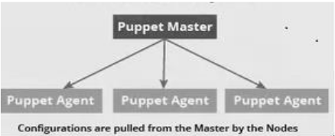
CONTD.
Configuration Management using Puppet and Chef

Slide 16
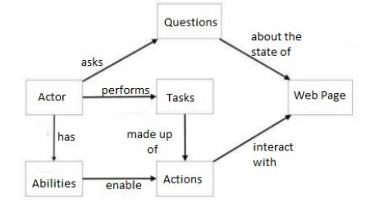
CONTD.
The proposed statement used for a result comparison,

Slide 17
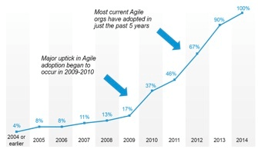
RESULT ANALYSIS
There are some tests performed on usage of devops after it took control over every operations of multi million dollar companies. The result of it’s growth is given in the following graph,

Slide 18
CONTD.
There was a comparison between a Selenium approach and a proposed approach (using devop tool).
Devop tool is more reliable to use and the relationship between operations and developer department will be integrated.
There were certain parameters considered for an approach and the test was conducted like time complexity, success ratio, etc.
In almost every factors the devop tools performance was better when compared to the proposed approach which you will see that in the next slide.

Slide 19
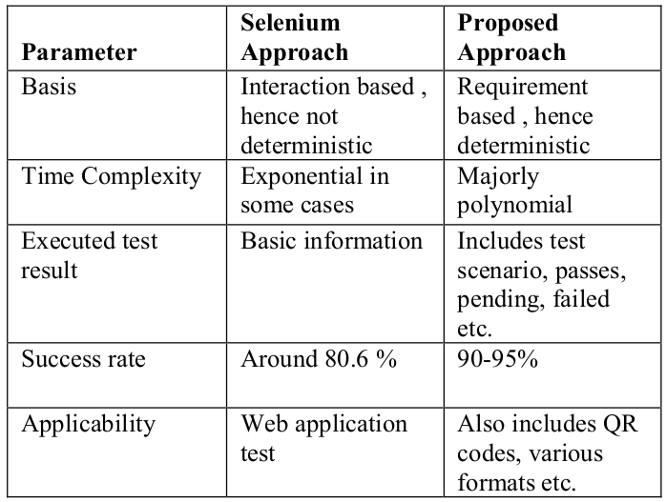
CONTD.

Slide 20
CONCLUSION
To provides an empirical investigation on several tools and challenges encountered during the adoption of continuous practices in Software develops using DevOps.
DevOps is fundamentally changing how dev and ops are done today. And it will change how security is done, too. It requires new skills, new tools, and a new set of priorities. It will take time and a new perspective. So the sooner you get started, the better.

Slide 21
REFERENCES
J. Mojtaba Shahin, Muhammad Ali Babar, Mansooreh Zahedi, Liming Zhu on “Beyond Continuous Delivery: An Empirical Investigation of Continuous Deployment Challenges,” In Proceedings of 11th international Symposium on Empirical Software Engineering and Measurement (ESEM), Toronto, Canada.
Lianping Chen on “Continuous Delivery: Overcoming adoption challenges” , The Journal of Systems and Software 128 (2017) 72–86, Science Direct.
https://puppet.com/resources/whitepaper/state-of-devops-report State of devop report.
https://www.opscale.io/post/docker-ship-better-software-faster Use of devop tools in the industry.

