Slide 1


Data Visualization in Different graphs
Big Data – Project Presentation
Presented By: Group-13
Harshaanjaneyavarma Samanthapudi
Pranava Sree Pottipati
Sana Reddy Gaddam
Vijaya Raghava Ponnaganti
Ravi Chandra Polavarapu
Rishik Pendurthi
This Photo by Unknown author is licensed under CC BY-NC-ND.

Slide 2
Introduction
The focus of this project is on using graph representation or basic data visualization techniques to examine large amounts of data.
We performed this experiment using open-source data files, such as the Iris dataset that was utilized in the seminal 1936 paper by R.A. Fisher.
It includes details on the traits of each bloom and three species of iris, each with fifty samples. It is possible to divide one species of flower linearly into the other two, but not the other way around.
We attempted to add some additional data to the data files with the existing samples because 50 samples is a very little number of records to examine the data.
The information includes the length, width, length, and width of the petals of three different flower species: Iris setosa, Iris versicolor, and Iris virginica.

Slide 3
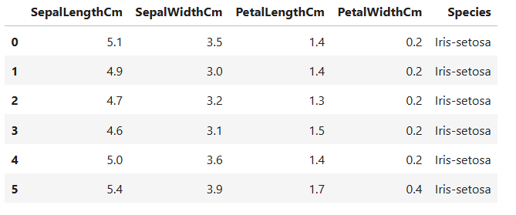
Sample Data
As you can see, the data file entries vary in terms of sepal and petal length and width for three different species.
Only the first six records from the data file are shown above.

Slide 4

Visualization Techniques Used
You may create the conditions required to make your future vision a reality by using the visualizing process.
By using creative imagery, you may educate your brain to focus on the things that are most important to you. should exercise selective attention as well.
We have represented our IRIS data using the following methods:
Histogram
Boxplot
Distributed Chart
Graphical Correlations

Slide 5
Visualization Techniques Used
Histogram:
A histogram displays the frequency values of a variable as bucketed ranges.
A histogram is similar to bar chat except that it organizes the data into continuous ranges.
The number of values that fall inside that range is represented by the height of each bar in a histogram.
Box Plot:
Boxplots are used to determine the degree of data distribution uniformity within a set. Out of the data set, three quartiles are produced.
This graph displays the data set's minimum, maximum, median, first quartile, and third quartile.
It is also useful for comparing the distribution of data across data sets by making boxplots for each data set.
Boxplots can be created in R using the boxplot() function.

Slide 6
Visualization Techniques Used
Scatter Plot:
Scatterplots display a large number of points on the Cartesian plane.
Every single point displays the values of two distinct variables.
There is a distinct variable on the horizontal and vertical axes.
The simple scatterplot is created using the plot() method.
Correlation Graph:
A correlogram is a representation of a correlation matrix and is used to highlight the variables in the data table that are most heavily related.
Each correlation coefficient in this picture has a color that matches its value.
The degree to which two variables are related can also be used to reorder the correlation matrix.

Slide 7
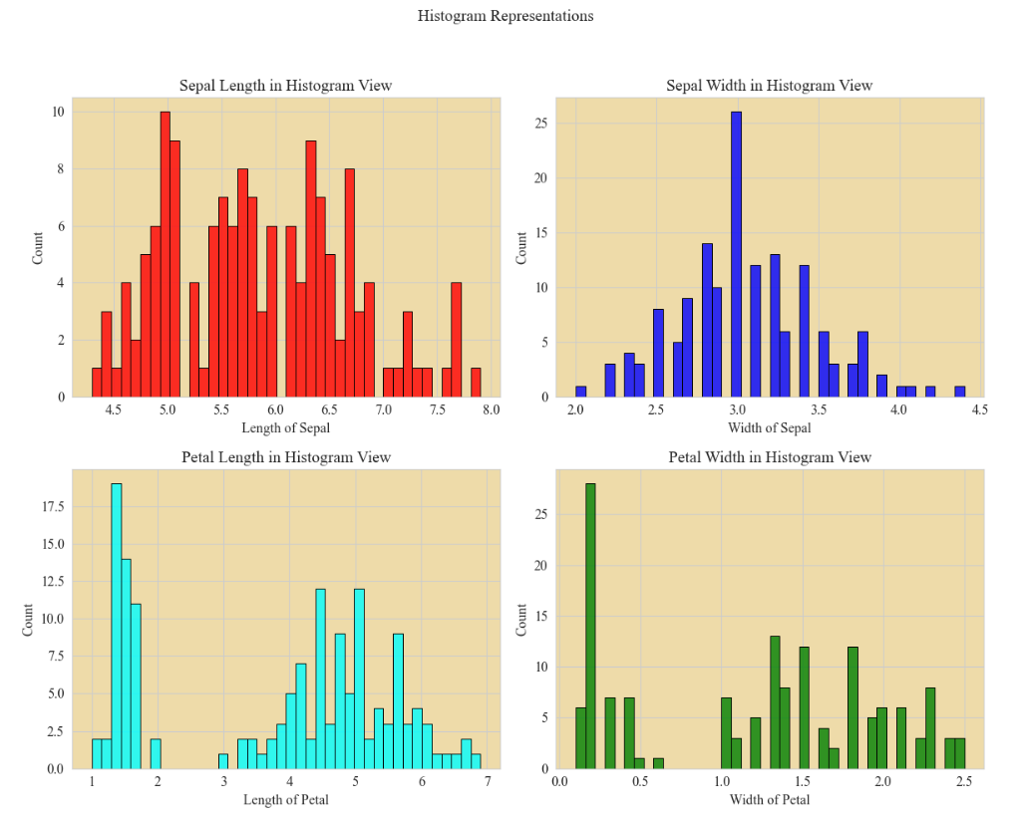
Analysis in Histogram View
Histogram view was our first go-to visual aid for simple visualization.
The x-axis of the figure represents the records in the data set.
The y-axis shows the total number of records in the data set.
Every graph in the data set has a representation for every column.
The colors red, blue, and green correspond to the length, width, and length of the sepal, petal, and tube, respectively.

Slide 8
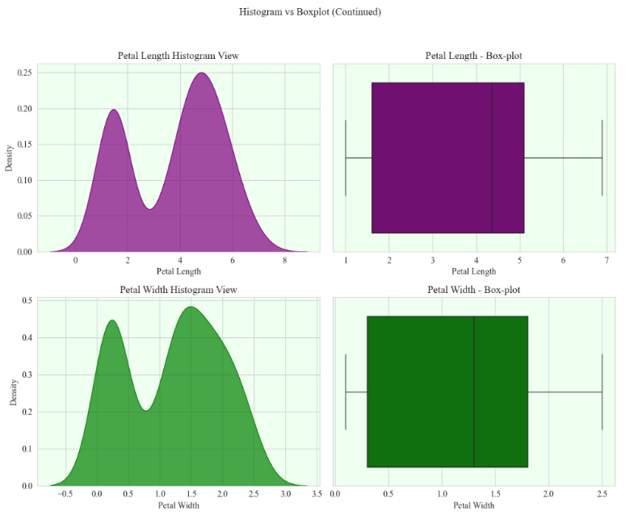
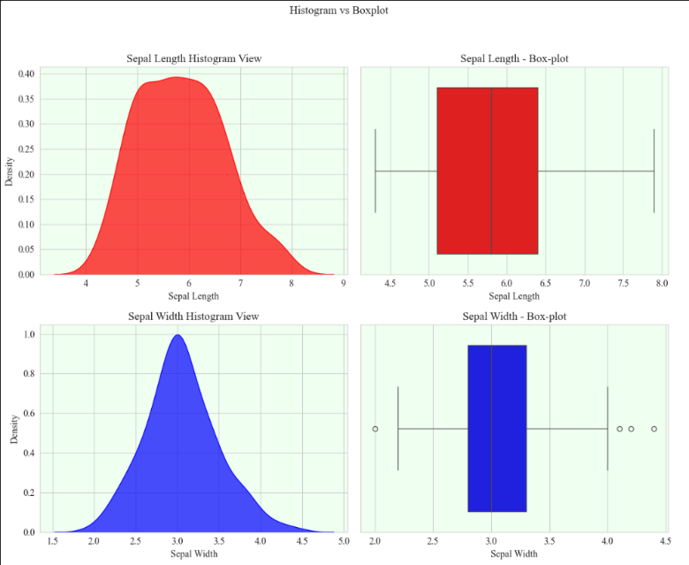
Analysis in Histogram View
We also attempted to use a box plot and a histogram to assess the same set of data.
This depiction differs from the previous one in that density is being used for analysis in both the box plot and the histogram.
An attribute in the data set versus density is the relationship between the x and y axes.

Slide 9
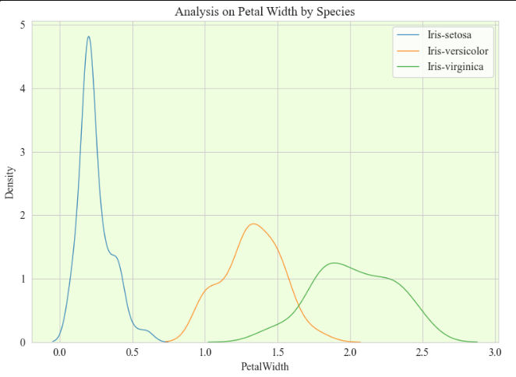
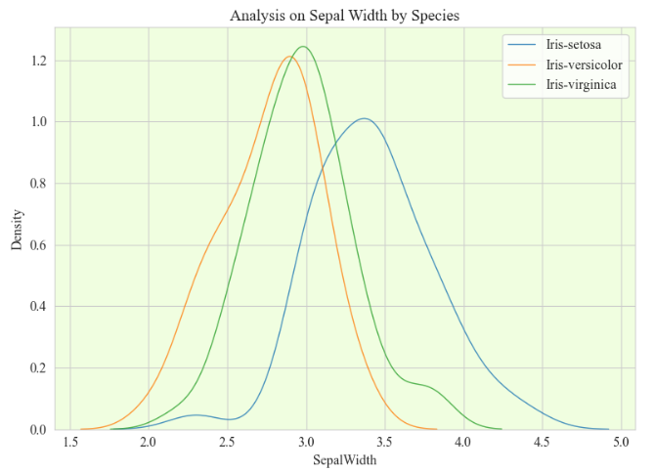
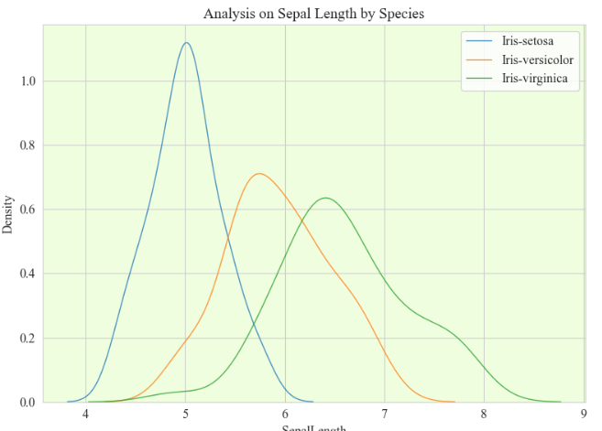
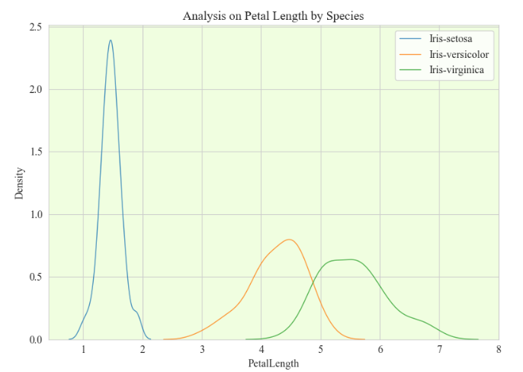
Analysis in Histogram View
Here we representing each attribute in different graph with differentiating species as well.
As you can see the title of the graphs analysis is on Petal length, Sepal width, petal width and sepal length.
we have made different colors for each species.
From the graphs we can see that Iris Setosa has highest in all aspects except in Sepal width.

Slide 10
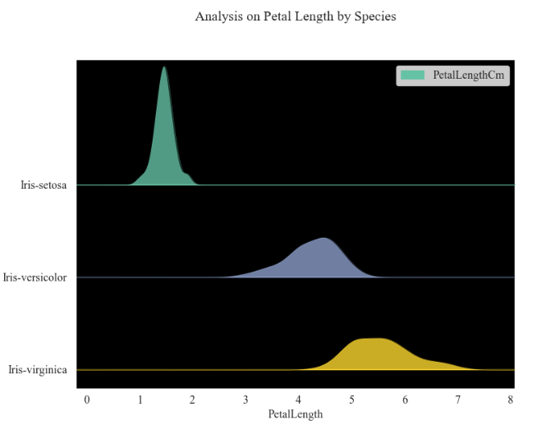
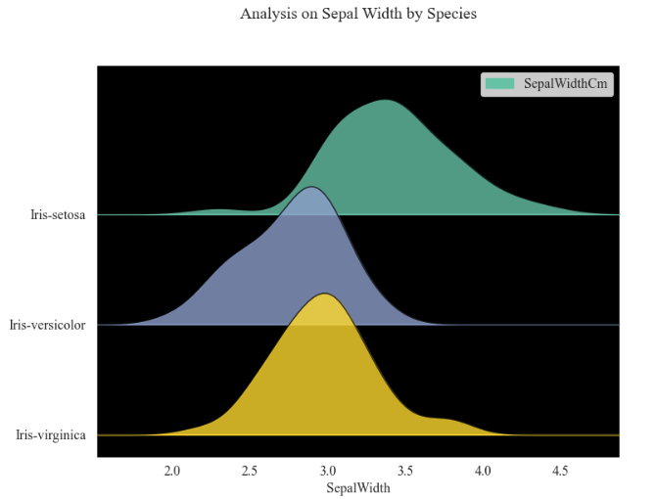
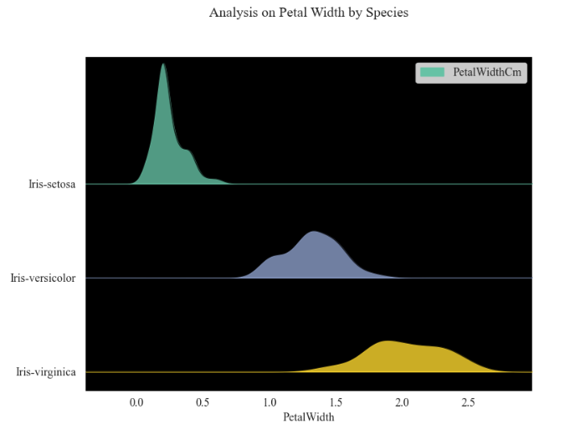
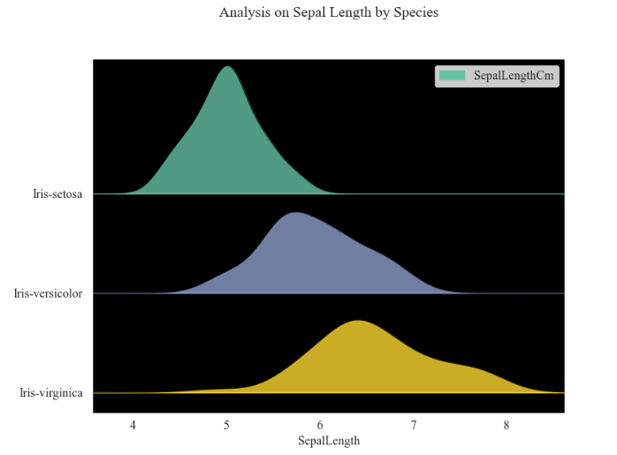
Analysis in Ridge Line
We are displaying the species analysis with ridgeline in this representation.
The examination of a numerical variable's distribution over several groups is made possible by the ridgeline graphic.
The graph indicates that there isn't a single instance where all three species come together in one area.

Slide 11
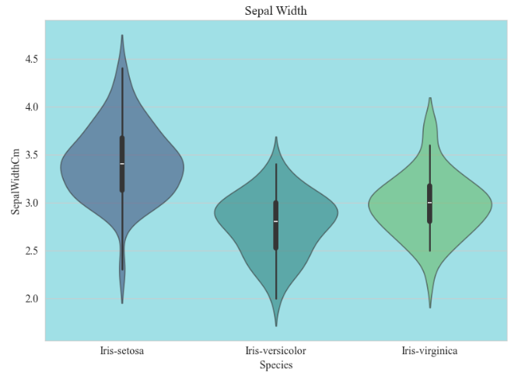
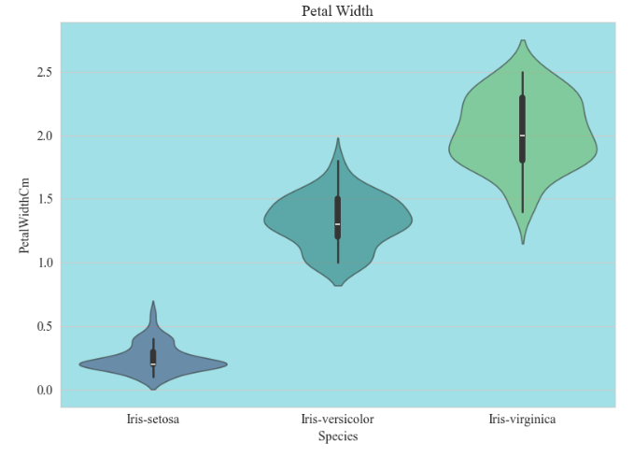
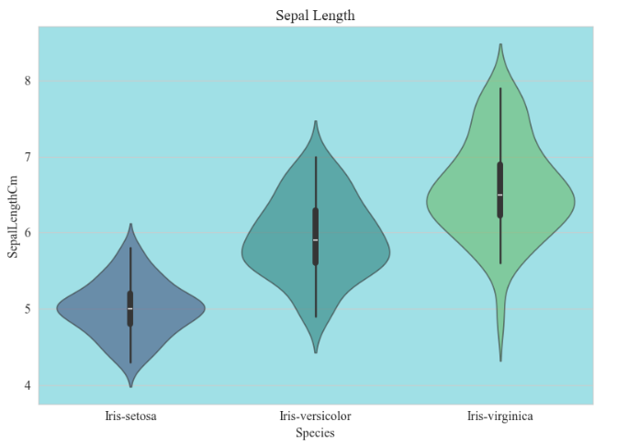
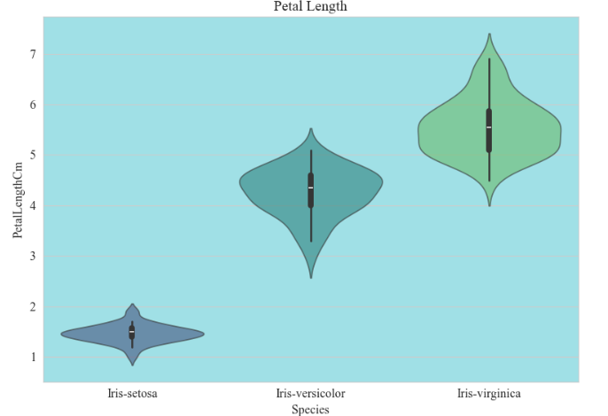
Box Plot
Violine View: The data set's violine view representation is displayed in this graph. Each species' difference is displayed in full for every record. Only the dataset's records and values cover the density. The representation in violine view with box plot will be shown on the following slide.

Slide 12
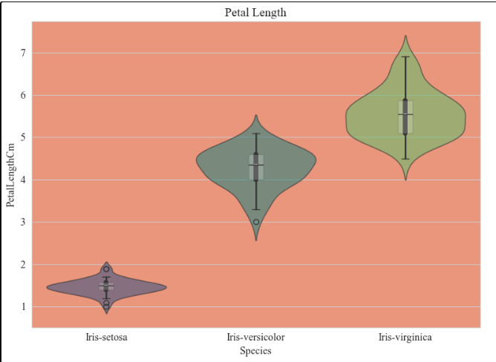
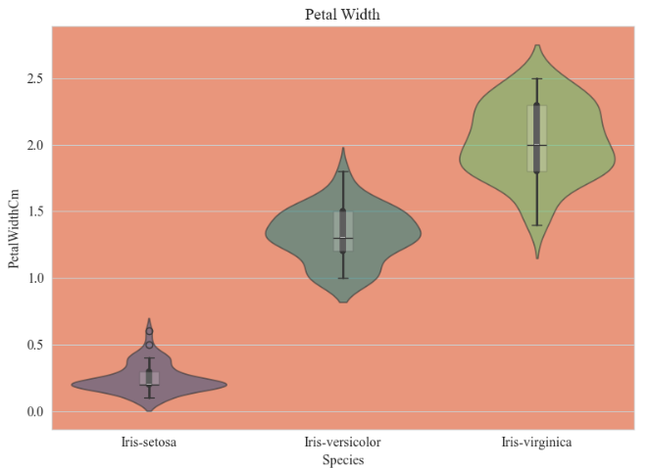
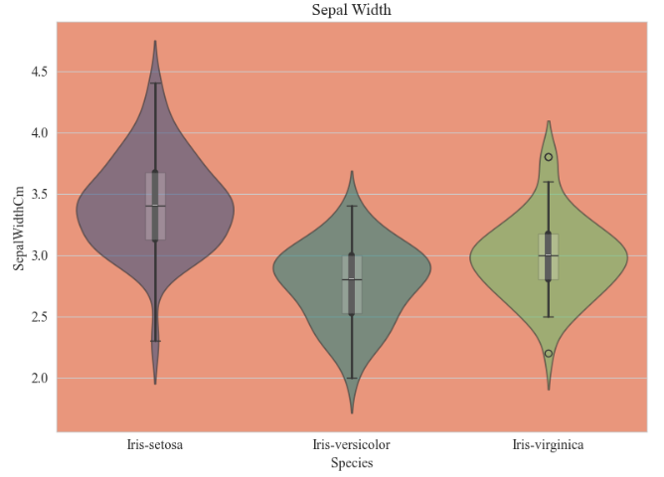
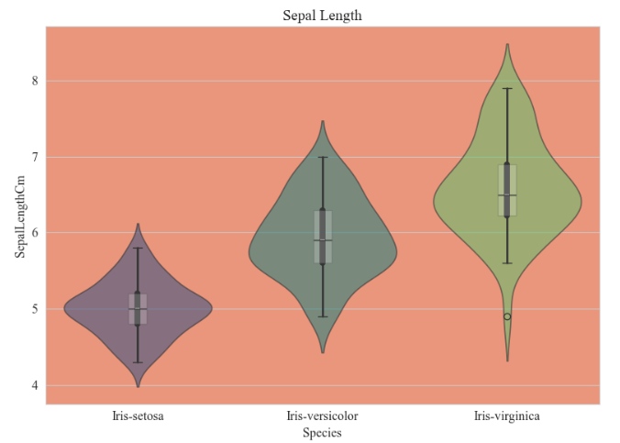
Box Plot
We combined the box plot and violine view because the box plot provides the precise density of the data values, whereas the violine view provides the range of values from tiny to large. ​
For instance, the sepal width (1st figure) for Iris setosa shows that values with less records have only a thin line ranging from tiny to big values, while the major density is represented in a box plot.

Slide 13
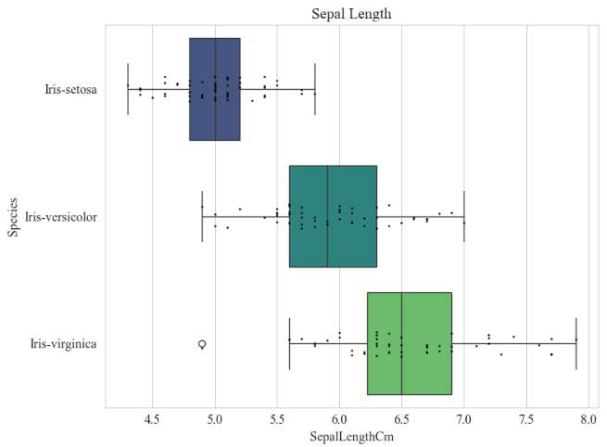
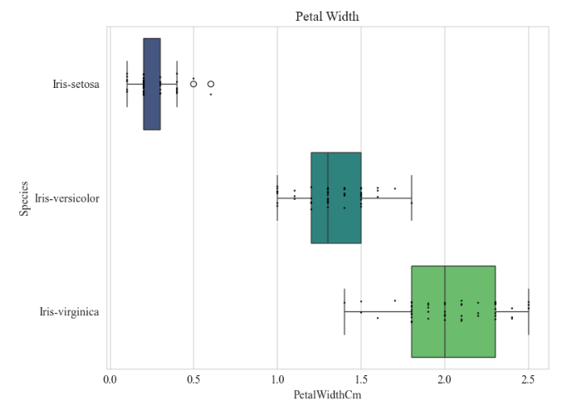
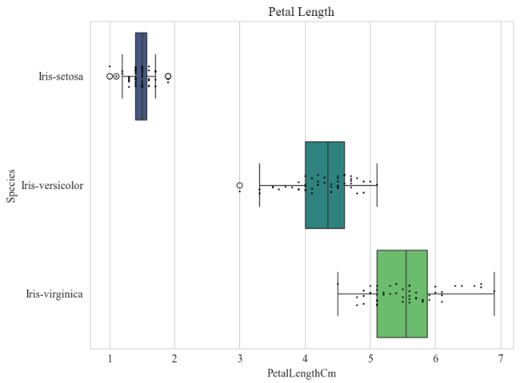
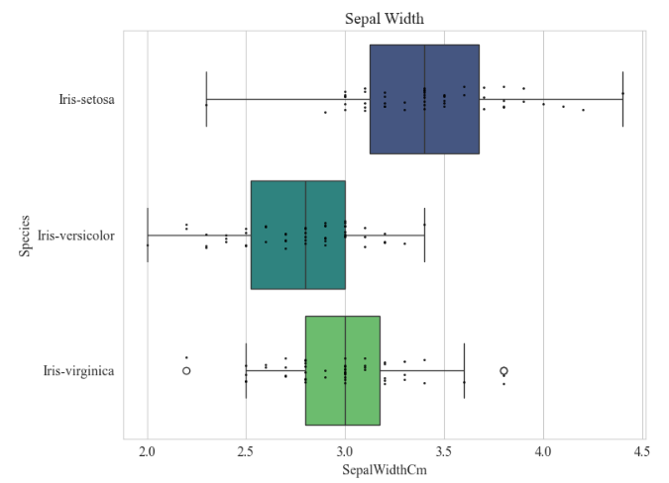
Box Plot
We are now working with actual box plots for each species' characteristic.
Each species' range is visible in terms of sepal breadth, length, petal length, and petal width.
Every representation ranges in value for every species attribute from low to high.

Slide 14
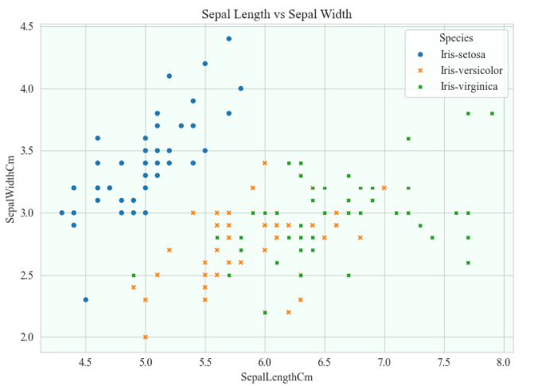
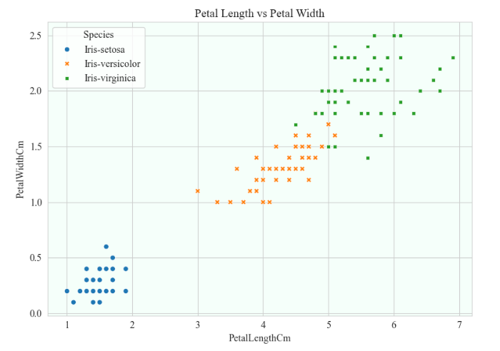
Scatter Plot
The relationship between each species' petal length and width and its sepal length is represented.
Figure 1 shows that only a small percentage of each species' records fall between five and six.
There are no records in Figure 2 where every record is located in a specific area.
The purpose of this analysis is to simply determine how the three species relate to one another in terms of petals and sepals.

Slide 15
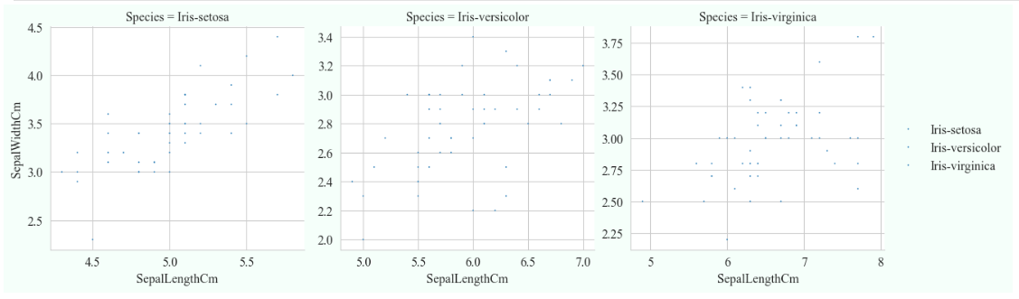
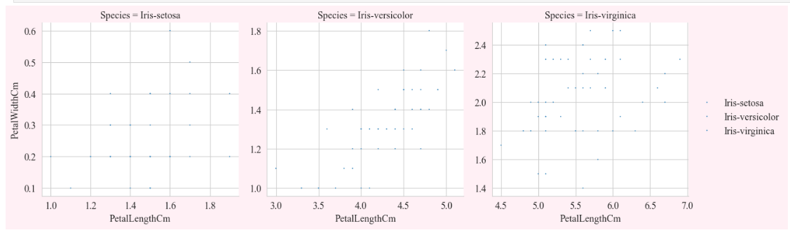
Scatter Plot
Analysis on Sepal Length and Width of Species
Analysis on Petal Length and Width of Species

Slide 16
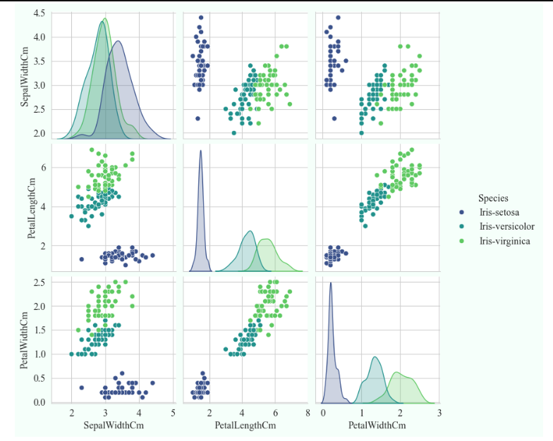
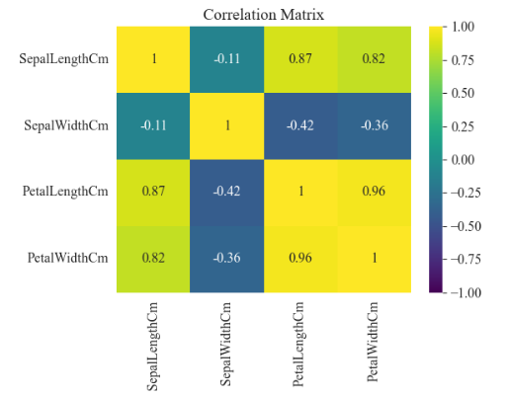
Correlation Plot
Our work on the correlation graph was solely intended to demonstrate how the data was represented there.
This demonstrates a visualization strategy that will improve our project.
In this, we have made a comparison between every attribute in the provided data collection.

Slide 17
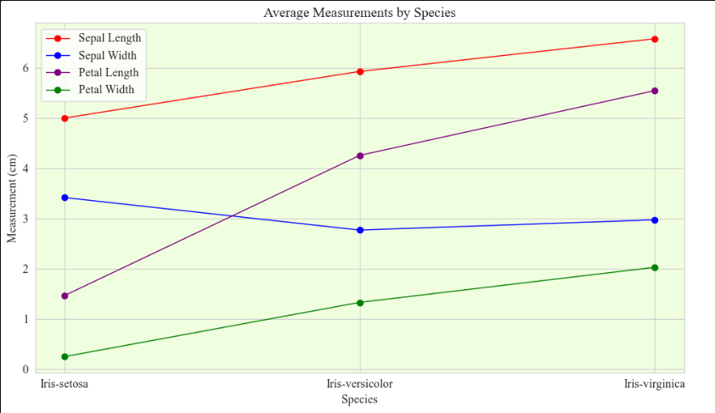
Additional Graph Representation
Line Graph - Average Measurements by Species
Displays average measurements (Sepal Length, Sepal Width, Petal Length, Petal Width) for each species.
Highlights differences, such as Iris-setosa having smaller petal measurements compared to Iris-virginica.
Each line represents a different measurement, with markers showing mean values.

Slide 18
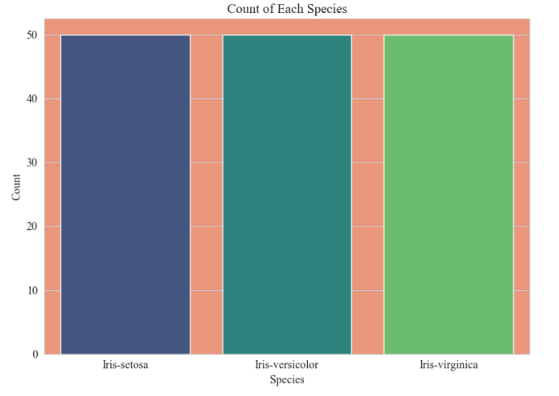
Bar Graph - Count of Each Species
Confirms the dataset is balanced, with 50 records per species.
Shows the count of records for each species in the Iris dataset.
Each bar represents a species, with height indicating the number of records.

Slide 19
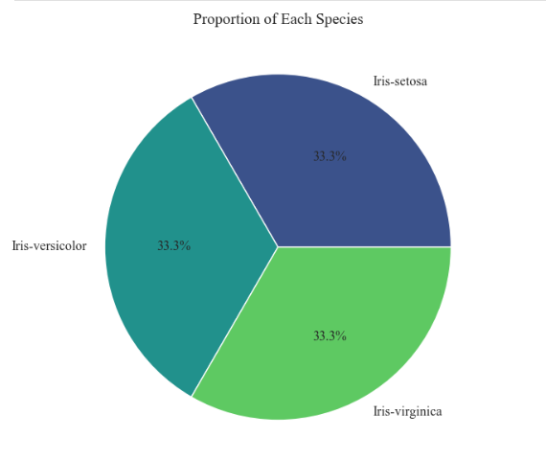
Pie Chart - Proportion of Each Species
Illustrates the proportion of each species as a percentage of the total dataset.
Each slice represents a species, with percentages labeled (approximately 33.3% each).
Reinforces the balanced distribution of the three species in the dataset.

Slide 20
Conclusion
Comparing the three species, we may conclude that the IRIS Setosa species has the nicest petals and sepals.
When compared to the other two species, the sepal breadth of Iris Setosa is nearly same.
The length, width, and length of the petals of Iris Setosa are all good.
We have portrayed the species in terms of size and form to make the analysis easier to understand.

Slide 21

Future Work
We can use the data we have to analyze with other species.
A couple more visualization approaches will allow us to analyze every species in even greater detail.
In order to further our future work, we can also experiment with various machine learning approaches.

Slide 22

THANK YOU

