Slide 1

AIRBNB Hotel Booking Analysis
Pranav B
INTERNSHIP_172663295366ea53f910591

Slide 2

PROBLEM STATEMENT
Airbnb has transformed the hospitality industry by connecting travelers with unique lodging options. However, with increasing listings and diverse host practices, understanding booking trends, pricing strategies, guest preferences, and host performance is essential. This project focuses on analyzing Airbnb’s open data to uncover insights that can guide hosts in optimizing their offerings and improving the overall guest experience.

Slide 3
Project Description
This project involves end-to-end data analysis of Airbnb open data. The steps include data preprocessing, cleaning, exploratory analysis, visualization, and answering key business questions related to property types, neighborhood demand, pricing correlations, reviews, and host practices. Using Python libraries and visualization tools, we aim to deliver actionable insights that help improve decision-making for both Airbnb hosts and the platform itself

Slide 4

WHO ARE THE END USERS?
Airbnb Hosts – to optimize pricing, improve responsiveness, and maximize bookings.
Travelers/Guests – to identify the best neighborhoods, room types, and amenities based on preferences.
Airbnb Platform/Company – to enhance algorithms, improve guest satisfaction, and highlight high-performing hosts.
Hospitality Analysts/Researchers – to study booking patterns, trends, and performance metrics for industry insights.
Local Authorities/Policymakers – to understand the impact of Airbnb activity in neighborhoods and make data-driven decisions.

Slide 5

Technology Used
Python (Data Analysis & Visualization)
Pandas, NumPy (Data Handling & Preprocessing)
Matplotlib, Seaborn (Charts & Graphs)
Missing no (Missing Data Visualization)
Google Collab (Cloud-based execution environment)
Excel Dataset as input source

Slide 6
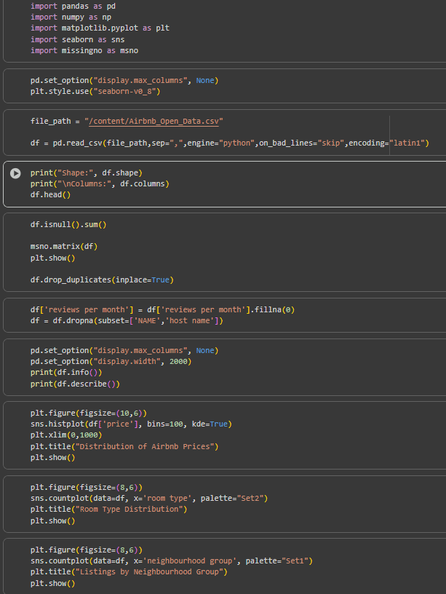
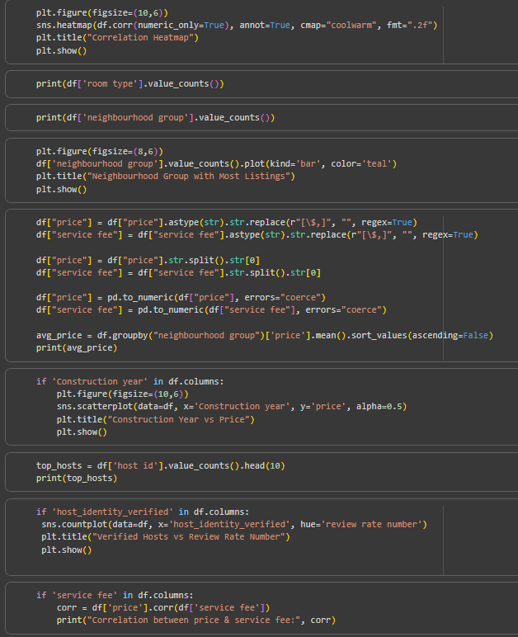
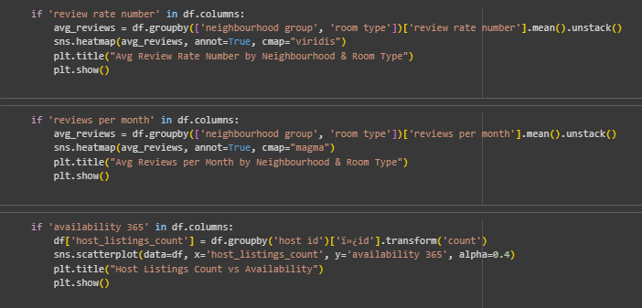
CODE

Slide 7
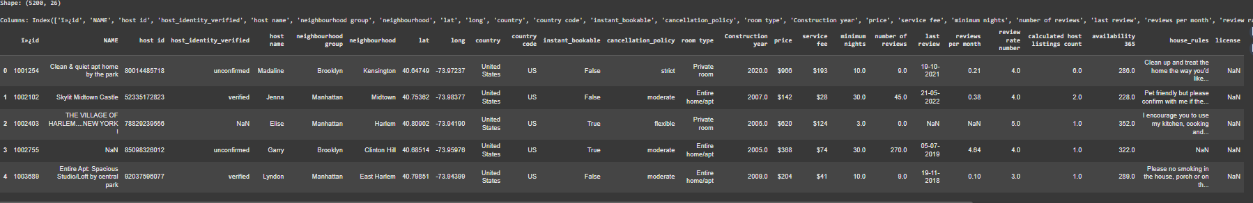
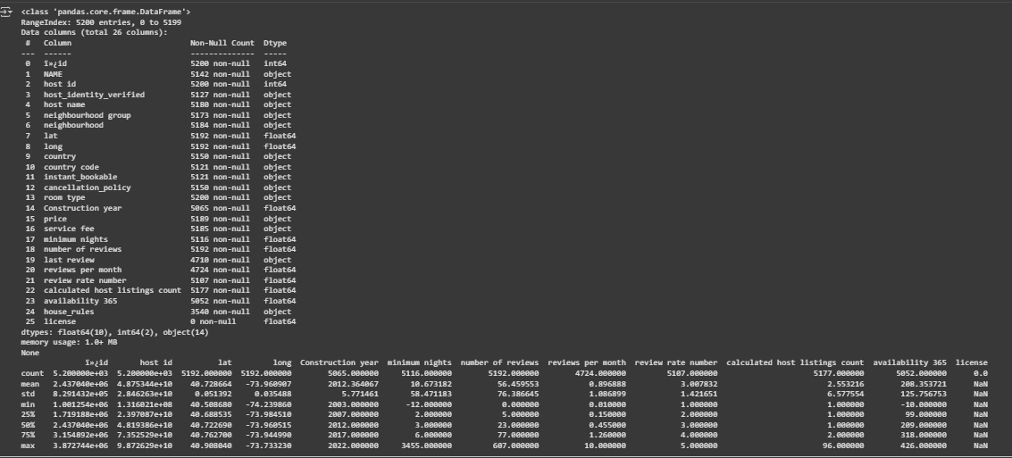
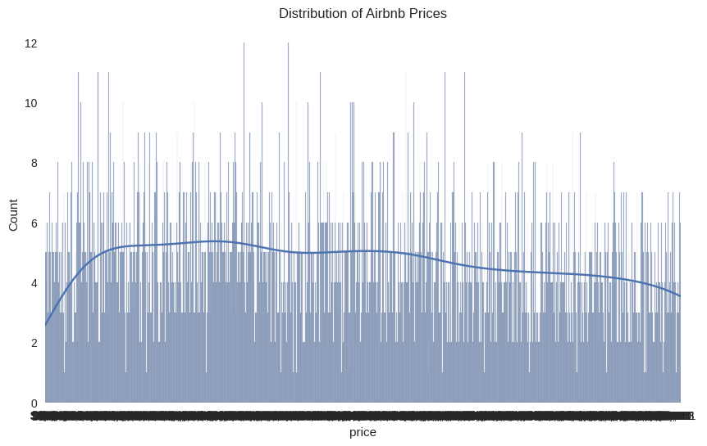
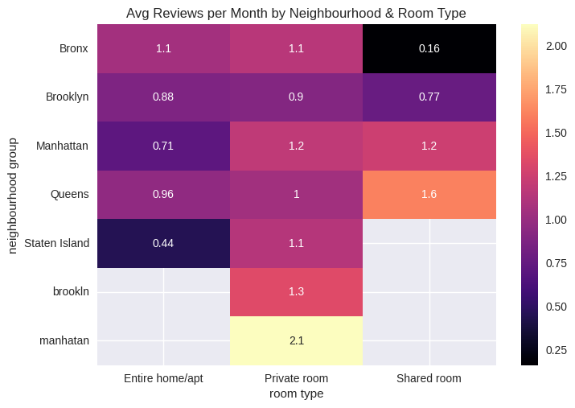
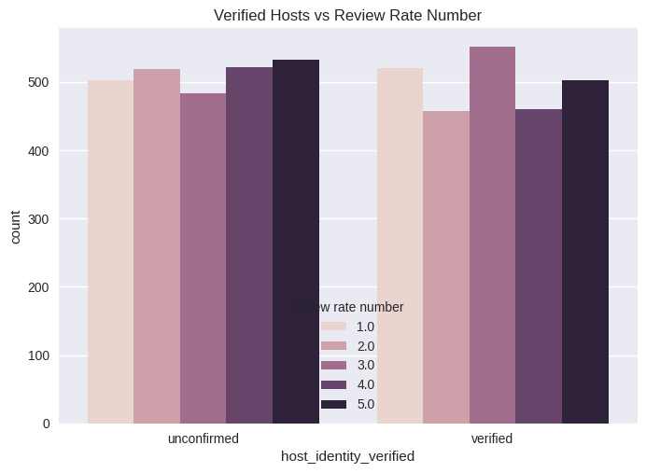
RESULTS1

Slide 8
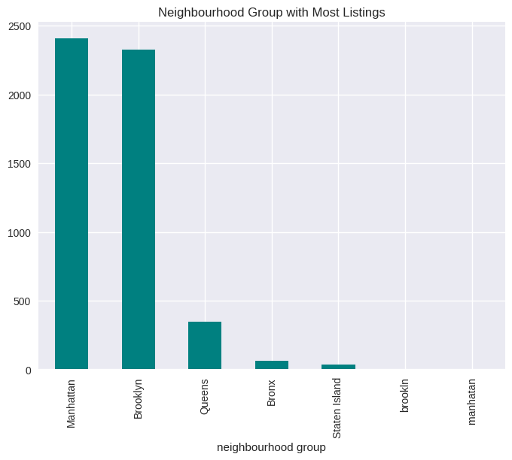
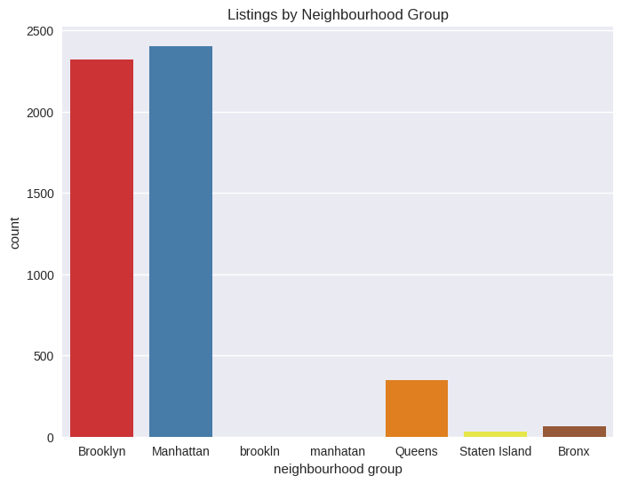
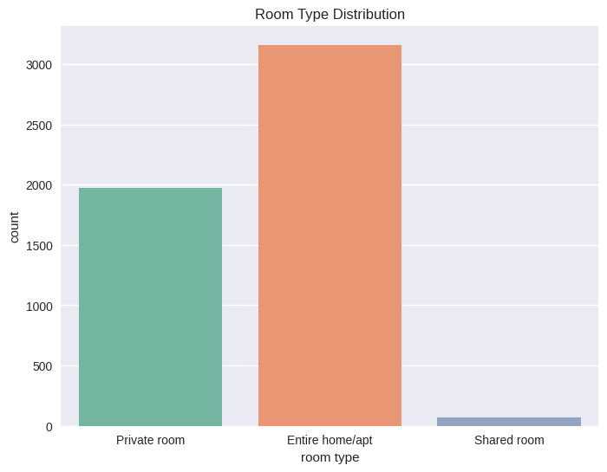
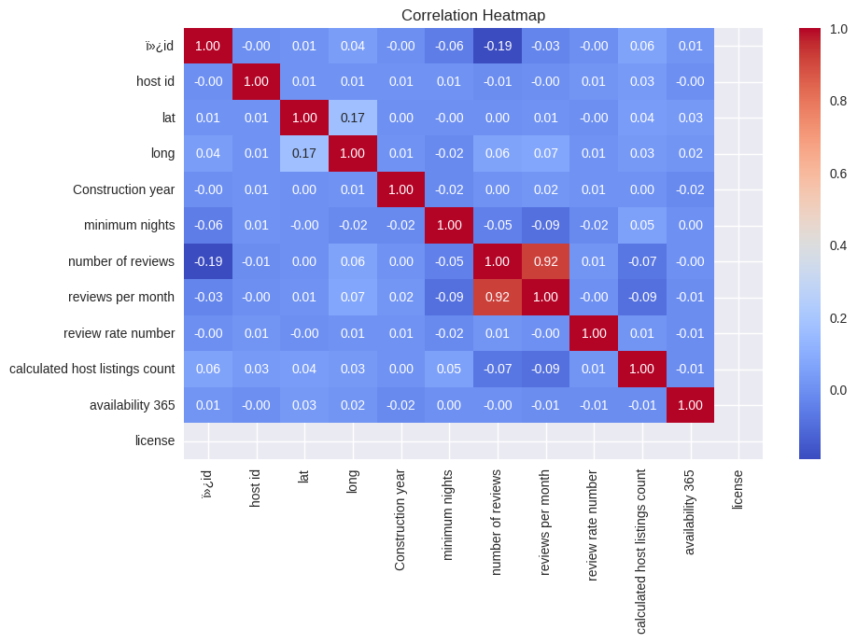
RESULTS2

Slide 9
GitHub repository
https://github.com/pranavb200/VOIS_AICTE_Oct2025_Pranav_B

Slide 10
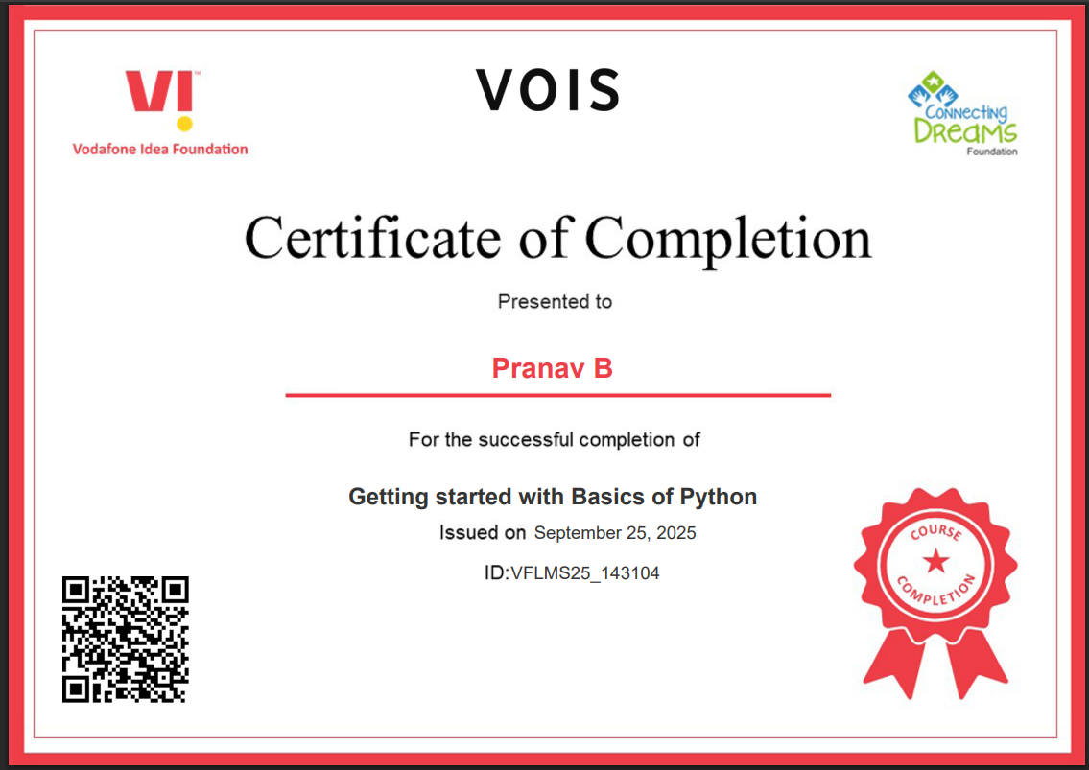
Getting started with Basics of Python Certificate

Slide 11
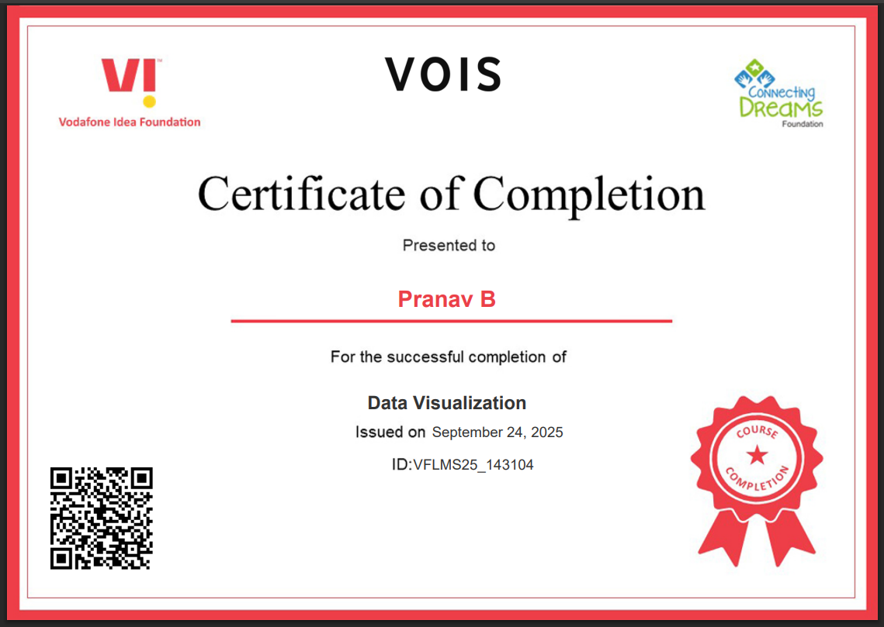
Data Visualization Certificate
[Paste your Certificate Here]

Slide 12
Thank you
.
.

