Slide 1

Project Title:- Seasonal Agriculture Performance Analysis
[Student Name:- Pranav Suresh Bagad
College Name:- R.C.Patel College Of Engineering And Polytechnic, Shirpur]
AICTE STU ID:- STU6a108d60539081779469664

Slide 2

PROBLEM STATEMENT
Agricultural activities are influenced by seasonal variations in environmental conditions, farming practices, resource availability and market conditions.
As a result, agricultural performance may differ from one season to another.
However, raw agricultural data does not clearly explain how agricultural performance changes across seasons or what patterns can be observed in different seasonal conditions.
The problem is to analyze the given agricultural dataset and investigate seasonal differences in agricultural performance by identifying meaningful patterns, trends, relationships and variations within the available data.

Slide 3
Project Description
Analyzes agricultural performance across different seasons, crops, and regions.
Studies yield, production, environmental conditions, resources, and economic performance.
Cleans and prepares the dataset before analysis.
Uses visualization, correlation, and statistical analysis to identify patterns and differences.
Provides findings and recommendations for better agricultural planning and decision-making.

Slide 4

WHO ARE THE END USERS?
Farmers – to understand seasonal crop performance and improve farming decisions.
Agricultural Planners – to plan crops and resources according to seasonal patterns.
Agricultural Officers – to study regional and seasonal agricultural performance.
Agriculture Researchers – to analyze crop, environmental, and resource-related trends.
Agribusinesses – to understand production and economic performance for better planning.

Slide 5

Technology Used
Python – Data analysis and processing
Google Colab – Project development and execution
Pandas – Data cleaning and data manipulation
NumPy – Numerical calculations
Matplotlib – Data visualization
Seaborn – Statistical charts and correlation heatmap
Scikit-learn / SciPy – Statistical analysis and testing
CSV Dataset – Source data format

Slide 6
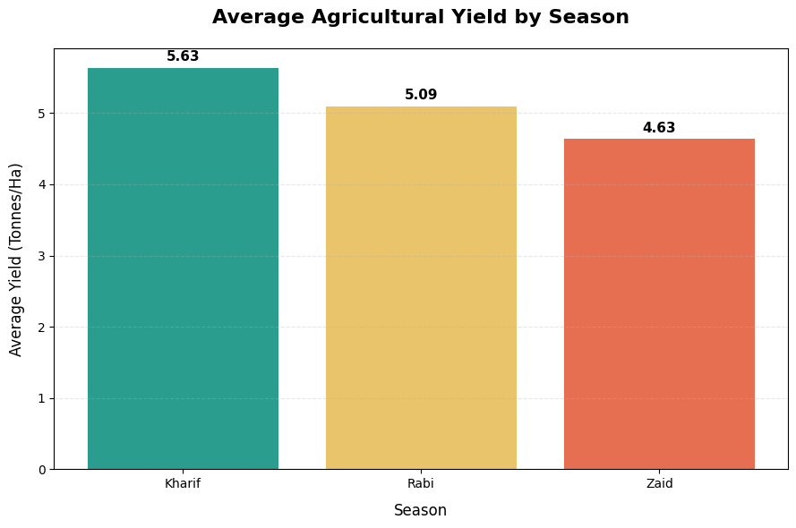
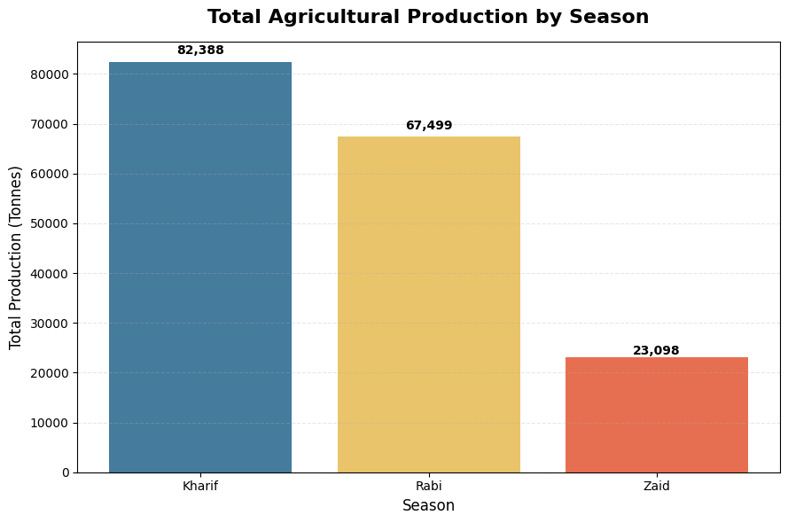
RESULTS
Kharif recorded the highest average yield, while Zaid had the lowest.
Kharif had the highest total production, followed by Rabi and Zaid

Slide 7
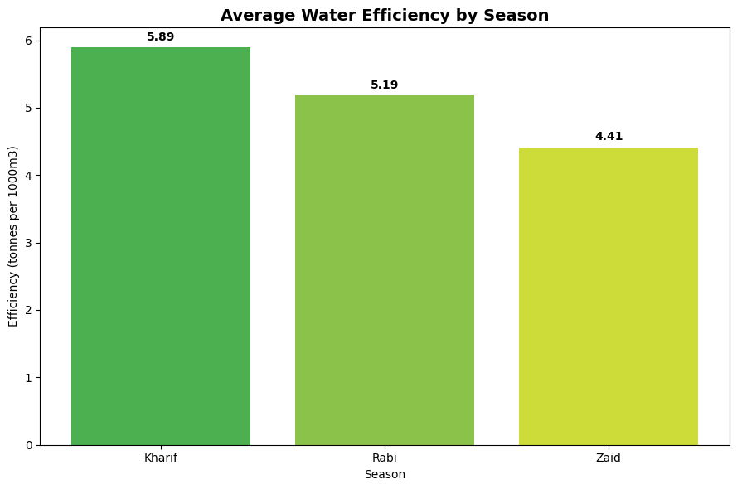
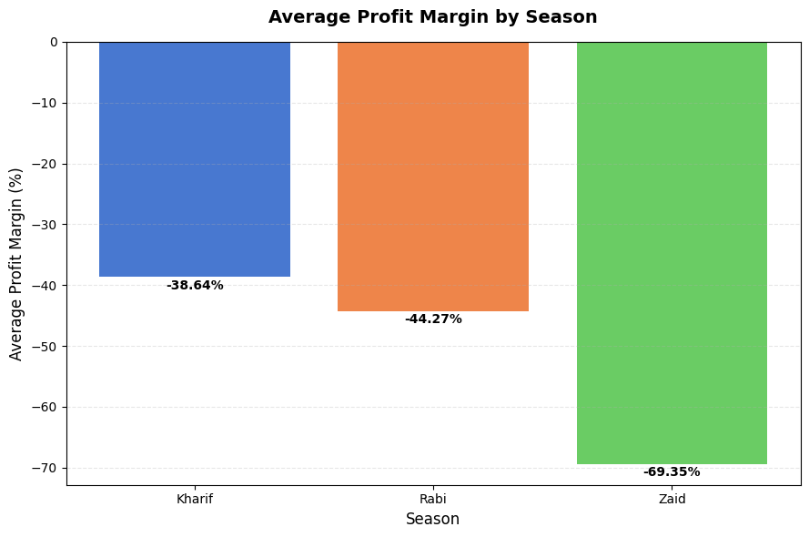
RESULTS
Kharif showed the highest water efficiency, while Zaid showed the lowest.
Profit margins were negative in all seasons, with Kharif performing better than Rabi and Zaid.

Slide 8
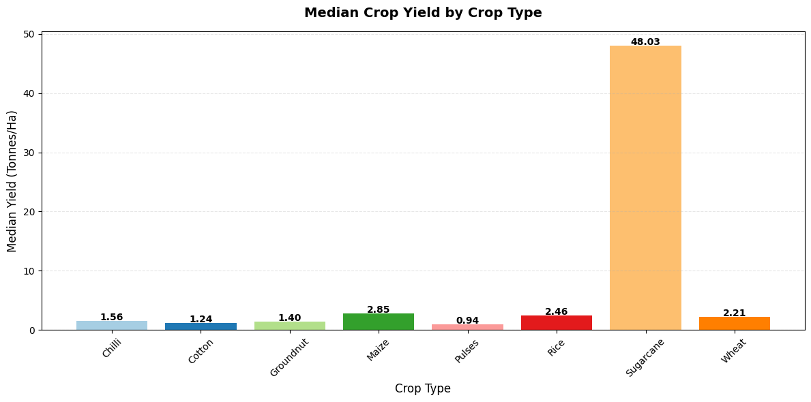
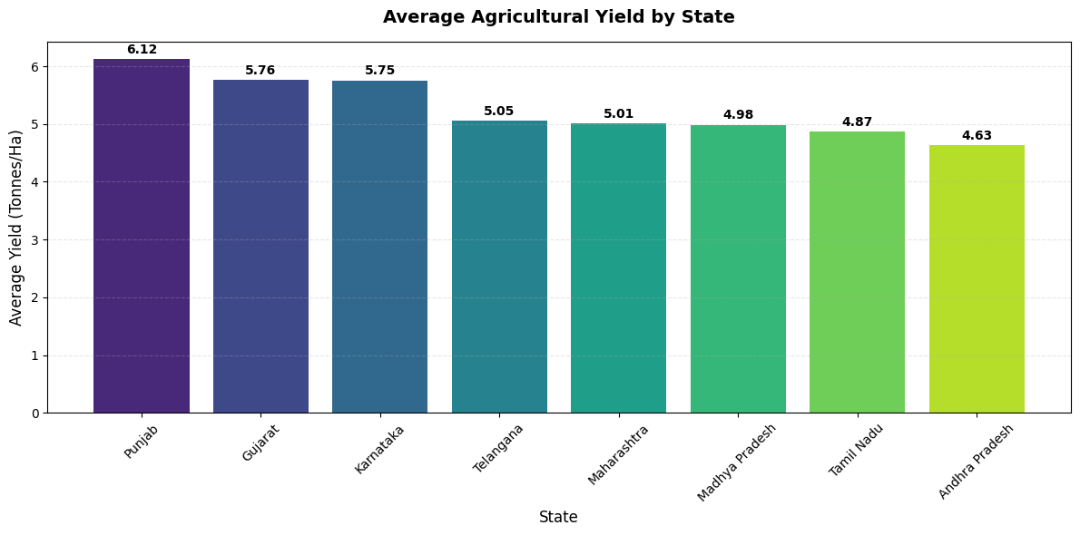
RESULTS
Sugarcane showed a much higher median yield than the other crops, while Pulses had the lowest.
Punjab recorded the highest average yield among the states, while Andhra Pradesh recorded the lowest.

Slide 9
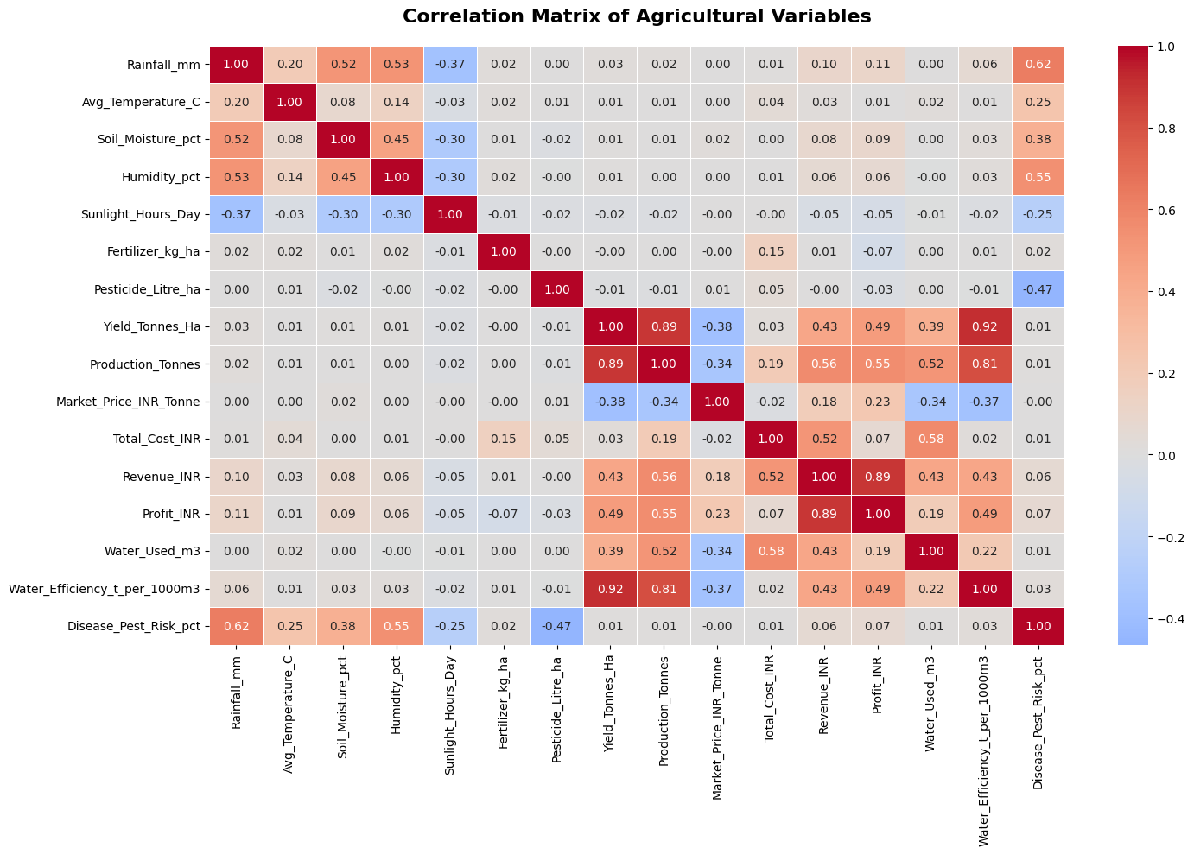
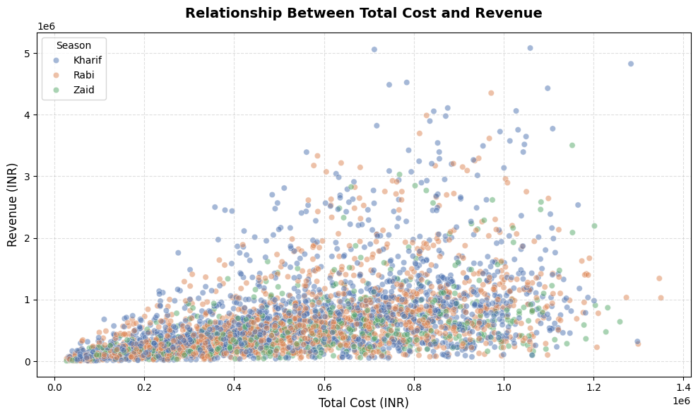
RESULTS
Water efficiency showed a strong positive correlation with yield, while market price showed a negative correlation.
Revenue generally increased with total cost, showing a positive relationship between production costs and revenue.

Slide 10
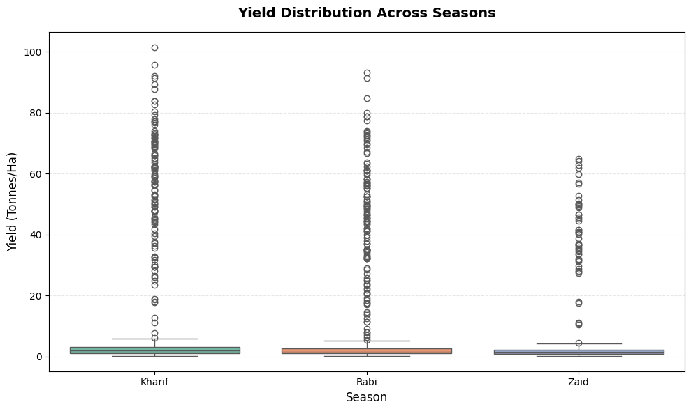
RESULTS
Shows the variation in yield across different seasons.

Slide 11
Future scope
Add real-time agricultural data for better analysis.
Include weather and market price forecasting.
Expand analysis to more crops, regions, and years.
Develop interactive dashboards for easier decision-making.
Use machine learning for yield and crop performance prediction.
Provide crop and resource planning recommendations based on data.

Slide 12
GitHub Link

Slide 13
VOIS Course completion certificate - Course name- Data Visualization

Slide 14
Thank you
.
.

