Slide 1
WOLF
Machine Learning WOrk FLow Management Framework
By: Pranav Bahl
Advisors: Dr. Luke Huan
Dr. Fengjun Li
Dr. Bo Luo

Slide 2
Background
Machine learning
High demand of machine learning systems
Transformation from Artificial Intelligence (AI) to Automated Intelligence (AI)
Rise in need of automation

Slide 3
Introduction
Automation is the fuel that drives WOLF
Impact on wider audience
Ease the process of searching optimal solution
Supports classification problems
Easily extensible

Slide 4
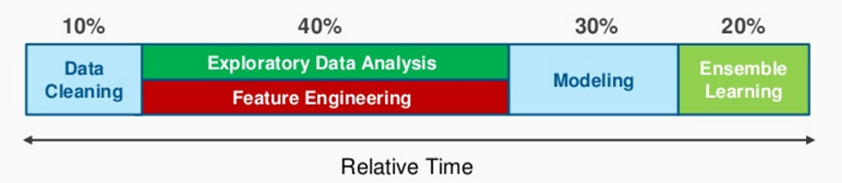
Motivation
Online data science competition
Manually searching for optimal combination of best algorithm and its parameters
Help novices attaining solutions without any prior knowledge
Ease the process of grid search for researchers

Slide 5
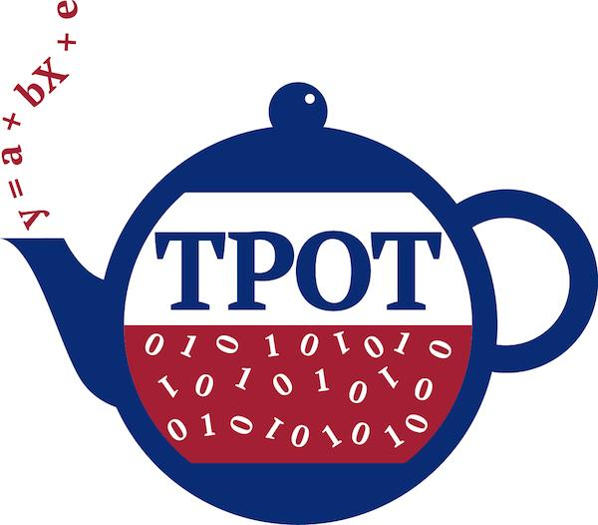

Literature Survey
Auto-Weka
Consists of classification algorithms only
Use Bayesian approach to perform grid search
TPOT
Only takes user data file as input
Available as python library
DataRobot
Complete package of data science
Proprietary software

Slide 6
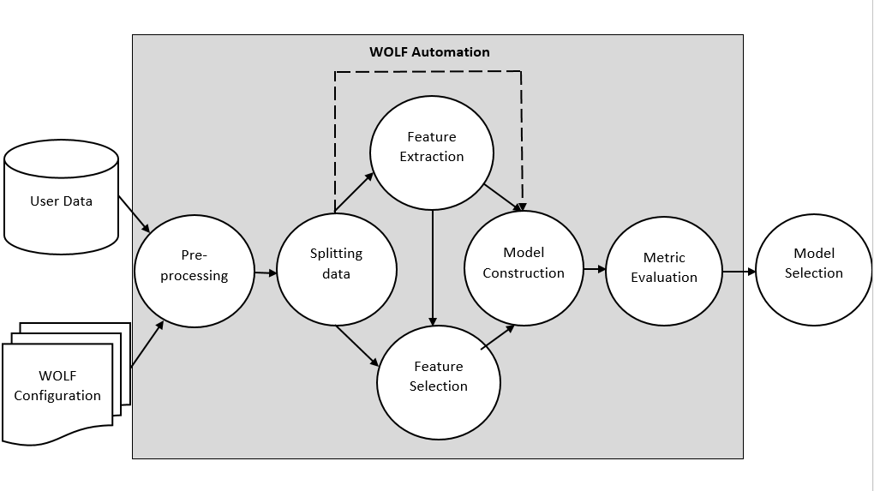
WOLF Architecture

Slide 7
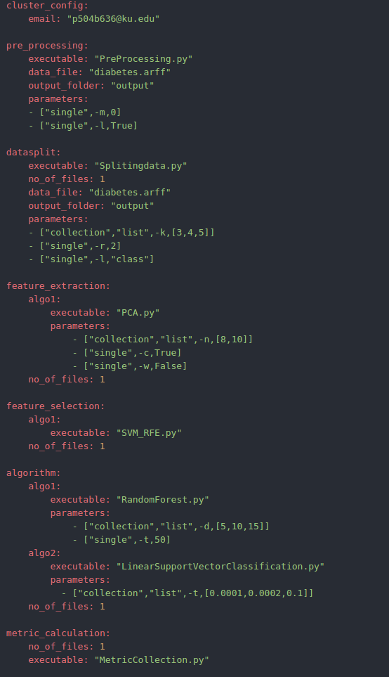
The Protocol
Restricts the keywords
Three categories
Transaction names
Transaction variables
Parameter values

Slide 8
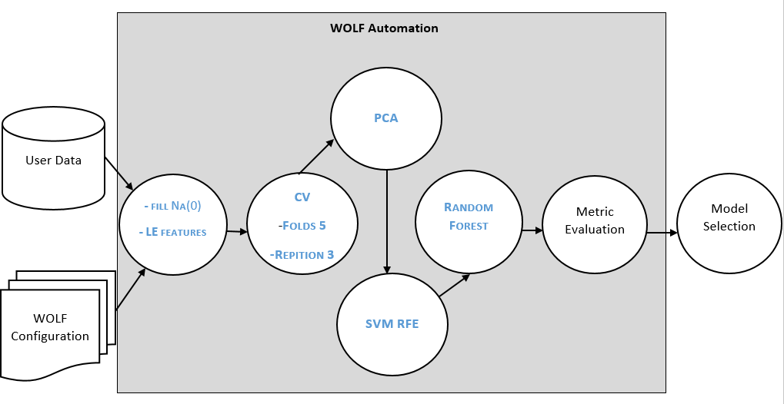
WOLF pipeline sample
&
LSVM
&
LSVM

Slide 9
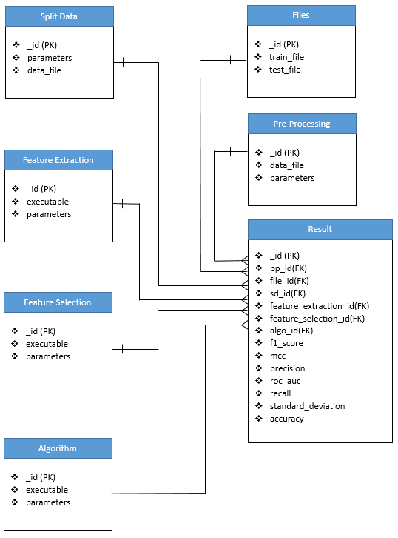
Database Management
Integrated with all the transactions
No-SQL, because all transactions parameters varies from each other
Keep track of user configurations and results
Ease the process of decision making

Slide 10
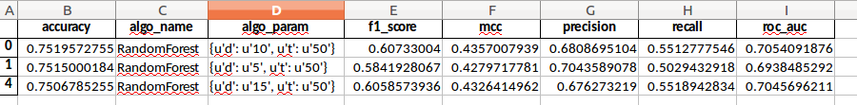
Results
Individual Algorithm best
All algorithms’ comparison
Visualizations, comparing algorithms performance
Cumulative
Results
Individual
Results
Best
solution
Results

Slide 11
Future Work
Adding regression problems
Web Interface
WOLF extension

Slide 12
Questions?
Citations:
[1] http://scikit-learn.org/stable/index.html [2] https://rhiever.github.io/tpot/ [3] https://www.datarobot.com/ [4] http://www.cs.ubc.ca/labs/beta/Projects/autoweka/

