Slide 1

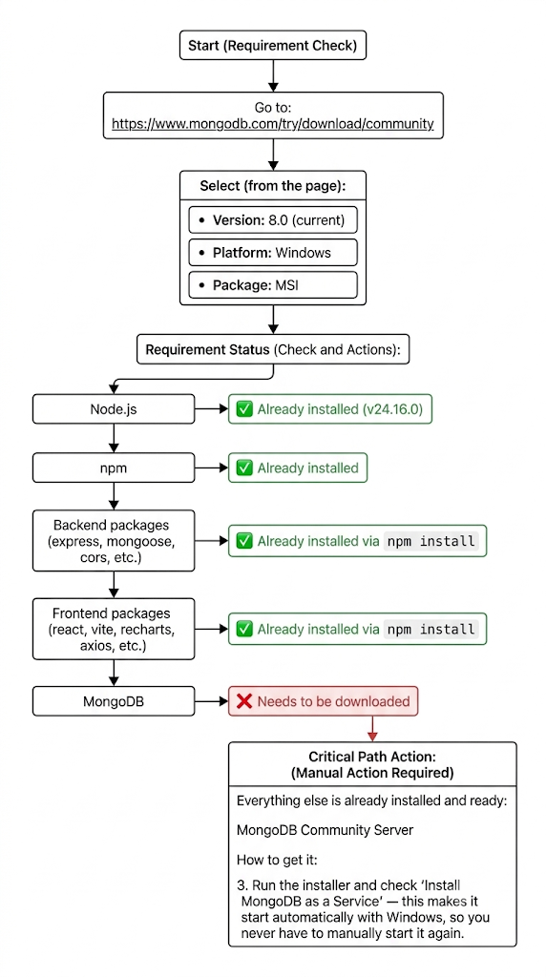
RV College of Engineering, Bengaluru – 560059.
Go, change the world
Title: MERN Tracker: Real-Time Personal Expense Analytics
Pranav Bhavimani | Rohan G | Rohan Kumar P | Nithish Prakash
1RV25CS128 | 1RZ25CS139 | 1RZ25CS140 | 1RV25CS116
Introduction
Tools used
In an era of digital finance, managing personal daily spending efficiently is a crucial life skill. The Personal Expense Tracker is a modern, full-stack web application engineered to bridge the gap between complex financial tracking and user-friendly design. Built from the ground up using the robust MERN stack (MongoDB, Express.js, React, and Node.js), this application provides users with real-time analytics, seamless CRUD operations, and an interactive visual dashboard to monitor their financial habits effortlessly.
Frontend: React (Vite), JavaScript (ES6+), Axios, Recharts, and CSS3 / Tailwind CSS.
Backend: Node.js, Express.js, and Cors.
Database & Persistence: MongoDB (Local Windows Service), Mongoose (ODM), and MongoDB Compass (GUI).
Development & Automation: Custom JavaScript Data Seeding Script (seed.js), dotenv, and nodemon.
Problem Definition
Individuals lack an intuitive, real-time tool to effortlessly track, categorize, and analyze their daily spending habits, leading to poor financial visibility and budgeting discipline.
Traditional manual record-keeping is tedious and fails to provide actionable feedback, making personal financial management difficult. This project bridges that gap with a full-stack MERN dashboard that automates data persistence, real-time analytics, and visual tracking. It empowers users to effortlessly monitor spending patterns, compute daily and monthly averages, and make informed financial decisions.
Results
Seamless Data Persistence: Successfully established a RESTful API with MongoDB, ensuring immediate, reliable CRUD operations for all transaction records.
Automated Data Seeding: Generated 50 realistic historical mock expenses across a 90-day period using a custom seed.js script to instantly validate analytics.
Real-Time Analytics Engine: Implemented client-side calculation logic that dynamically computes total spending, daily averages, and monthly financial metrics without delay.
Interactive Data Visualization: Rendered dynamic category spending breakdowns using Recharts pie charts for quick visual pattern recognition.
Responsive Dual-View UI: Created a user-friendly dashboard with a toggleable full-history table featuring instant, zero-latency category filtering.
Objectives
Automate Storage: Build a MERN REST API to seamlessly store, update, and fetch expense records.
Calculate Averages: Dynamically compute real-time metrics for total spend, daily average, and monthly average.
Visualize Habits: Design an interactive React dashboard with category pie charts and filterable tables.
Methodology
Conclusions
Project Success: Successfully developed and deployed a fully functional, end-to-end MERN personal expense tracker that bridges the gap between data persistence and user-friendly financial management.
Core Impact: Automated real-time analytics and dynamic visual categorization empower users to effortlessly monitor daily and monthly spending habits.
Future Scope: The application provides a solid foundation for future enhancements, such as user authentication (JWT), budget goal alerts, and multi-currency support.
Outcome of the work
Fully Functional Full-Stack Architecture: Successfully integrated a complete MERN (MongoDB, Express, React, Node.js) stack, establishing reliable communication between the client interface and the database.
Automated Data Seeding & Management: Developed a custom automated script (seed.js) that populates realistic historical expense data, ensuring the app is instantly testable and fully populated upon launch.
Real-Time Financial Metrics: Enabled dynamic client-side calculations that instantly compute total spending, daily averages, and monthly averages as users add or modify records.
References
[1] MongoDB, Inc., "MongoDB Compass Guide & CRUD Operations," MongoDB Documentation. [Online]. Available: https://www.mongodb.com/docs/compass/. [Accessed: Oct. 2026].
[2] Recharts Community, "Recharts: A composable charting library built on React components," Recharts Library. [Online]. Available: https://recharts.org/. [Accessed: Oct. 2026].

