Slide 1

Tutorial
Pranav Kulkarni
Theoretical Neuroscience Lab, IISER Pune
pranavcode@gmail.com

Slide 2
Everything Git!
1. Introduction
2. Installation
3. Configuration & First repo
4. File Status Lifecycle
5. Staging
6. Undo
7. Log
8. Remote
9. Branching
10. Tagging

Slide 3
1. Introduction
Applications
  Backups, Collaboration, Organization
Benefits
  Speed
  Simple design
  Parallel branches
  Fully distributed
Example project using Git.
Found at – git-scm.com

Slide 4
2. Installation
Linux
  # apt-get install git
  # yum install git
Mac
  # brew install git
Windows
  Installer from git-scm.com

Slide 5
3. Configuration & First repo
$ git config --global user.name “Name”
$ git config --global user.email “e-mail-id”
$ git config --global core.editor “emacs -nw”
$ git config --global color.ui true
$ git config --global credential.helper cache
$ git init first-repo
$ git clone repo-remote-url

Slide 6
4. Staging
$ git status
$ echo “First file.” > README
$ git diff
$ git add README
$ git rm README
$ git diff –cached
$ git commit -m “commit message”

Slide 7
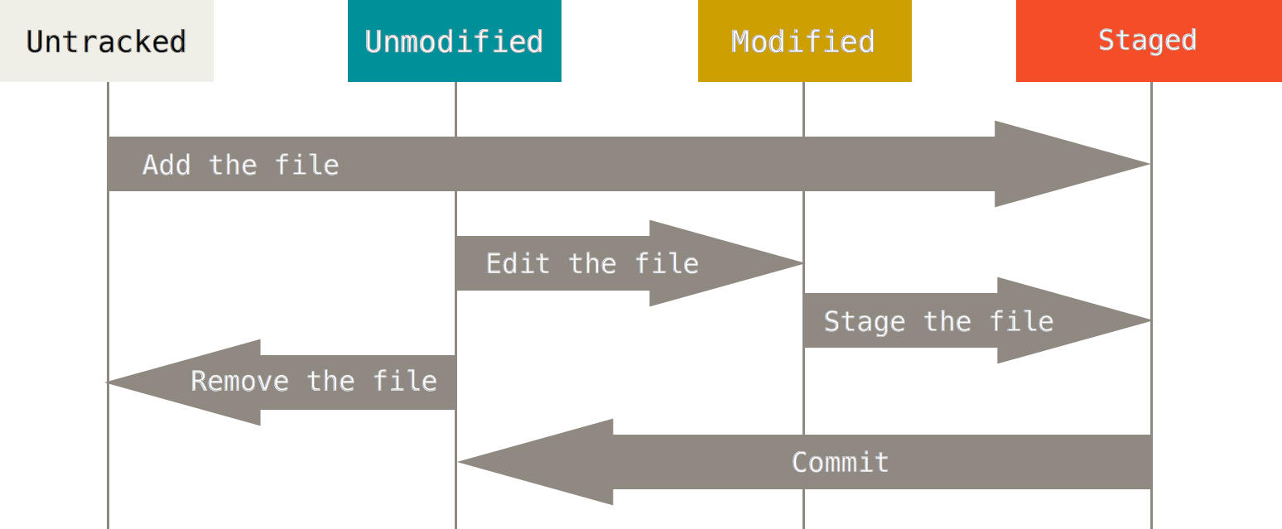
5. File Status Lifecycle
Image Source: http://git-scm.com/book/en/v2/book/02-git-basics/images/lifecycle.png

Slide 8
6. Undo
$ git commit --amend
$ git reset HEAD
$ git reset HEAD file
$ git checkout file

Slide 9
7. Log
$ git log
$ git log --author='name'
--pretty=oneline
--graph
--oneline
--decorate
--all
$ git show

Slide 10
8. Remote
$ git remote add origin
$ git push -u origin master
$ git pull origin master
$ git fetch
$ git merge

Slide 11
9. Branching
$ git branch -b branch-name
$ git checkout branch
$ git checkout -b branch-name
$ git push origin branch-name
$ git branch -d branch-name
$ git push origin --delete branch-name

Slide 12
10. Tagging
$ git tag -a tag-name -m “message”
$ git push --tags
$ git show tag-name
$ git checkout tag-name
$ git tag -d tag-name
$ git push origin :refs/tags/tag-name

Slide 13
Thank you!

