Slide 1

Malayalam to Telugu Translation
NLP Project - Project Progress
Student Name: Pranav Deep. I
Course Instructor: Dr. Himangshu Sarma

Slide 2
Total Work
Data Procurement
Data Pre-processing (Scripting + Manually)
Data Loading - Tokenization - Word Embeddings etc.
Built a transformer Model using ONMT
Model results
BERT Score

Slide 3
Challenges
There are many challenging aspects of Machine Translation:
Matras problem
Sentence alignment
Unwanted symbols like _,@ being added
No proper tokenization tool. (Even iNLTK isn’t performing as well as expected)*
Notes:
To refresh your memory

Slide 4
Overcoming Challenges
There are many challenging aspects of Machine Translation:
Using an encoder - decoder type network solves the matras problem to an extent
Sentence alignment - Used semi processed dataset of IIITH
Unwanted symbols like _,@ being added - Manually separated (Took about 1 week to do this). Since the symbols were very unpredictable, it wasn’t scriptable
No proper tokenization tool. (Even iNLTK isn’t performing as well as expected)* -
Used iNLTK and then processed it again.
Notes:
To refresh your memory

Slide 5
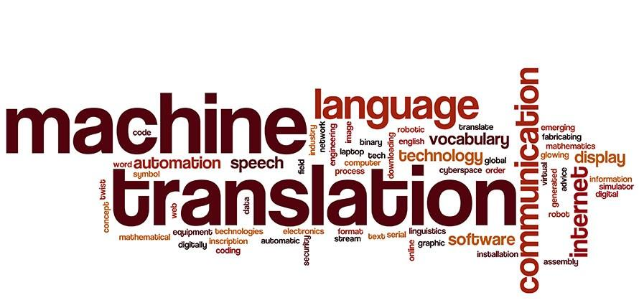
Datasets[8]
Press Information Bureau Corpus
PM Mann ki baat data set
MultiIndicMT Dataset

Slide 6
Libraries Used
iNLTK - Specialized library for Indic Languages. Used for tokenization and word embeddings
Torchtext - to build fields
Torch - Build the model*
ONMT - Building the model
Sent2vec vectorizer
Other regular libraries

Slide 7

PM’s Mann ki Baat(MKB)
MKB is a transcribed source of our honorable PM’s speeches across 12 Indian languages
These translations can be considered as expert translations and are fluent by
nature as the speeches are addressed to people across India speaking many languages.
Telugu - Malayalam parallel corpus ~ 3k sentences
This corpus is to be used as test set
Sentence aligned translation

Slide 8
Dataset Stats
Sample Set Name | Malayalam (Sample Size) | Telugu (Sample Size)
Training Set | 6707 | 6707
Validation Set | 1677 | 1677
Test Set | 2096 | 2096

Slide 9
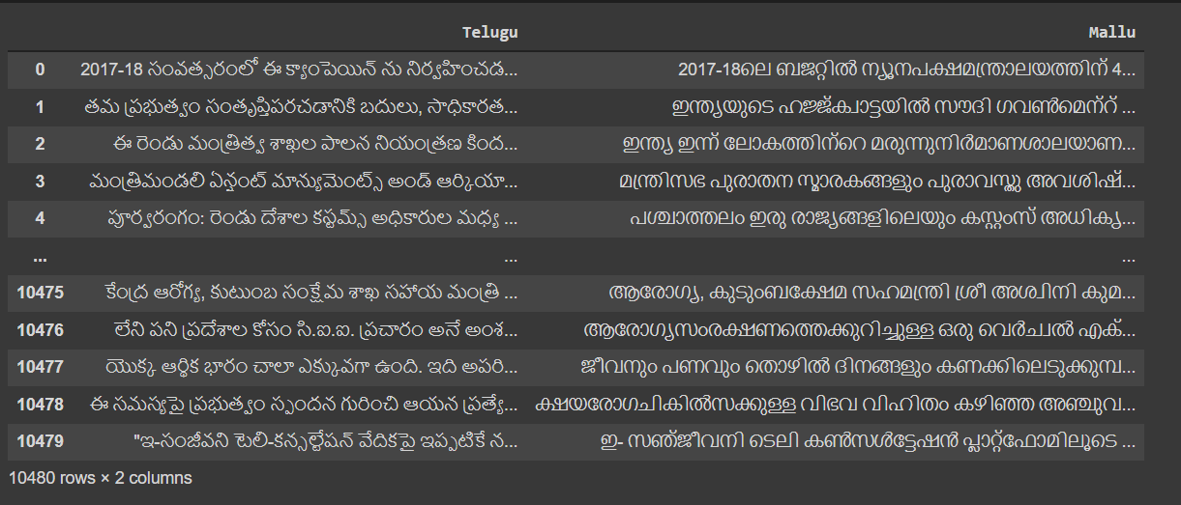
Parallel Corpus

Slide 10
Model - Transformers
(0): TransformerEncoderLayer
MultiHeadedAttention
PositionwiseFeedForward
TransformerEncoderLayer
PositionwiseFeedForward
(1)(2)(3)(4)(5): TransformerEncoderLayer
MultiHeadedAttention
PositionwiseFeedForward
Normalization and Drop out Layers
(1)(2)(3)(4)(5) : TransformerDecoderLayer
MultiHeadedAttention
PositionwiseFeedForward
Layer Norm, MultiHeadedAttention

Slide 11
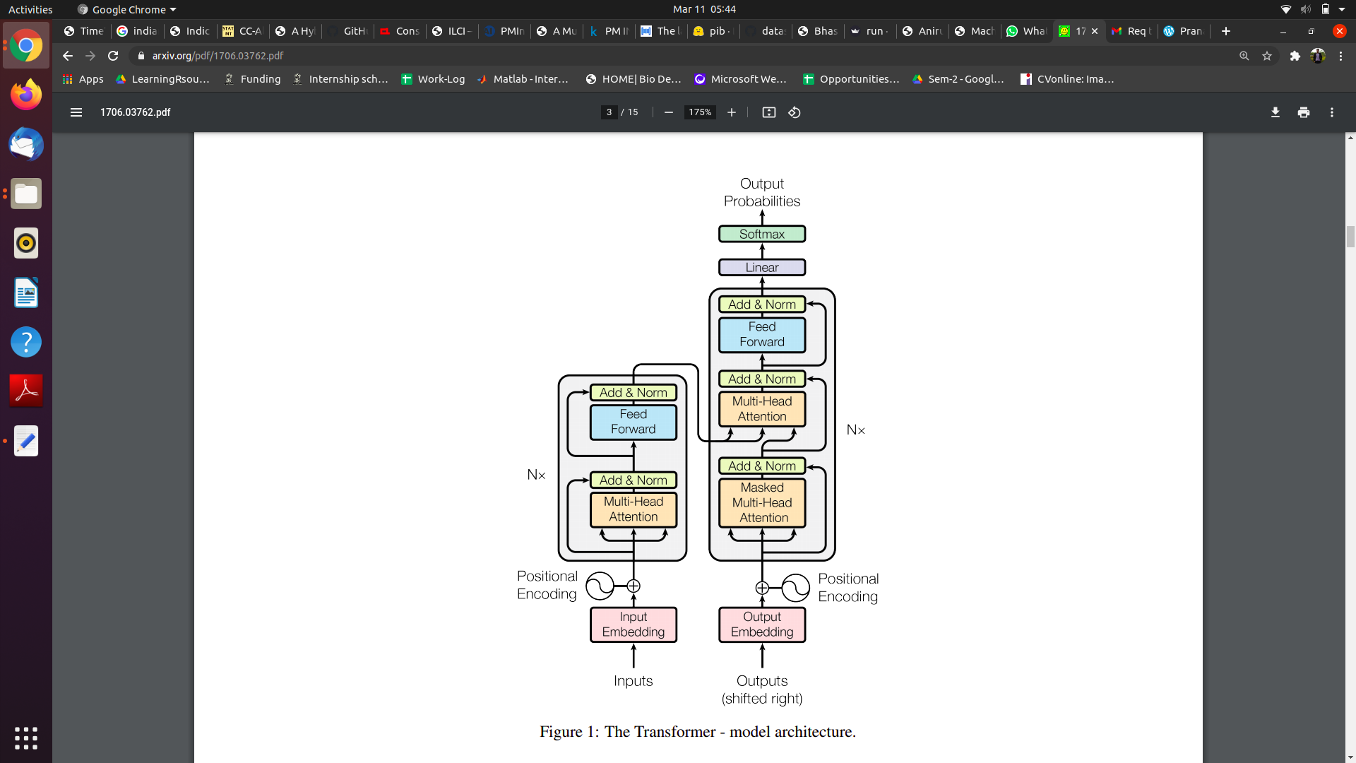
Experimented Methodology
Transformers [1] :

Slide 12
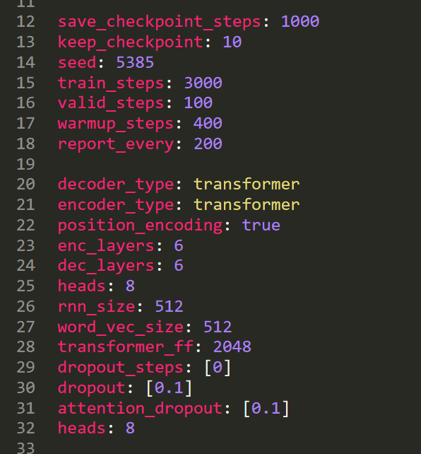
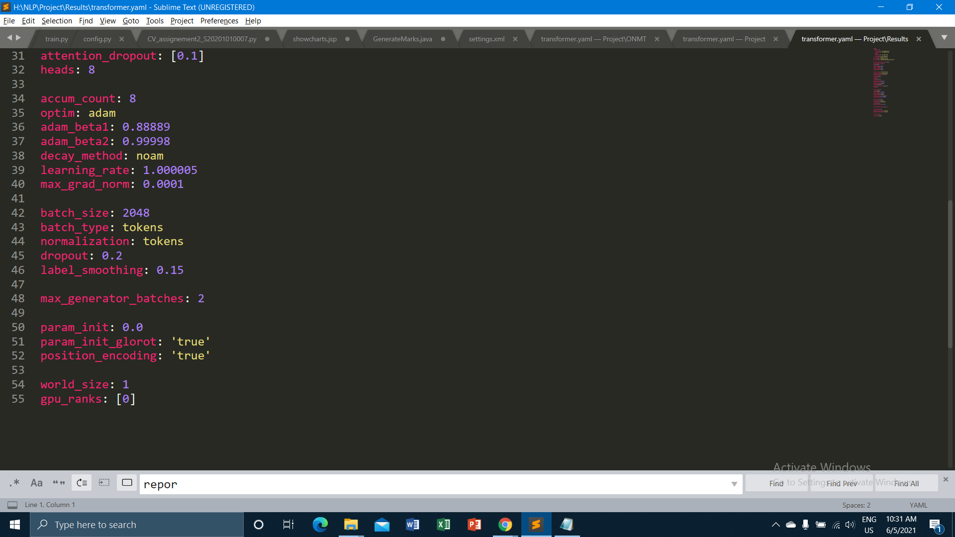
Model Parameters

Slide 13
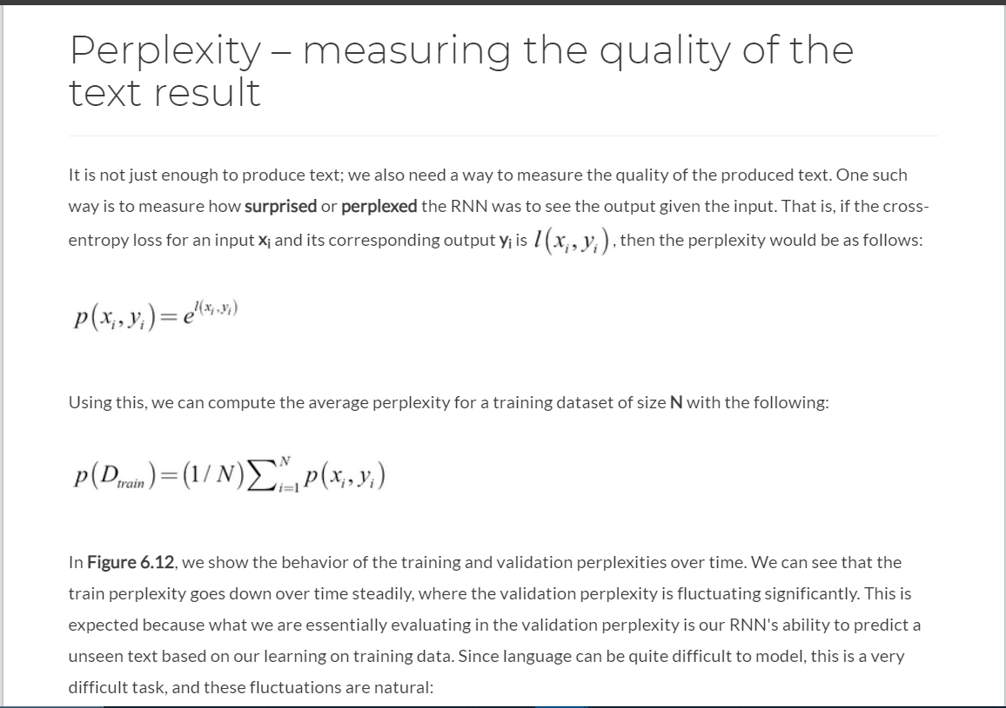
Perplexity
Source

Slide 14
Model Results
Step Size | Validation Accuracy | Validation Perplexity
1000 | 14.9236 | 10531.8
3000 | 16.3008 | 8088.52
6000 | 16.3216 | 8317.28
9000 16.4287 8273.33

Slide 15
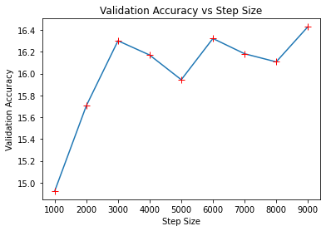

Slide 16
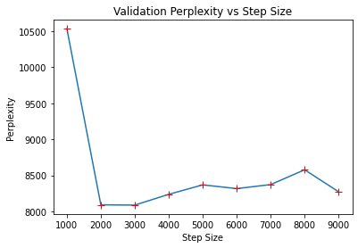

Slide 17
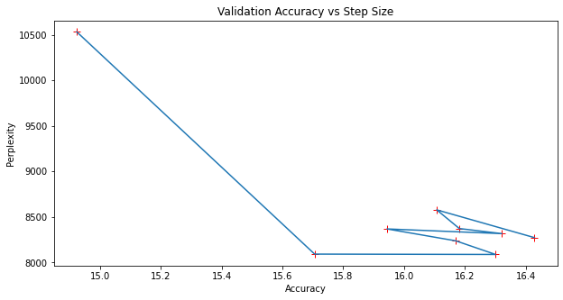

Slide 18
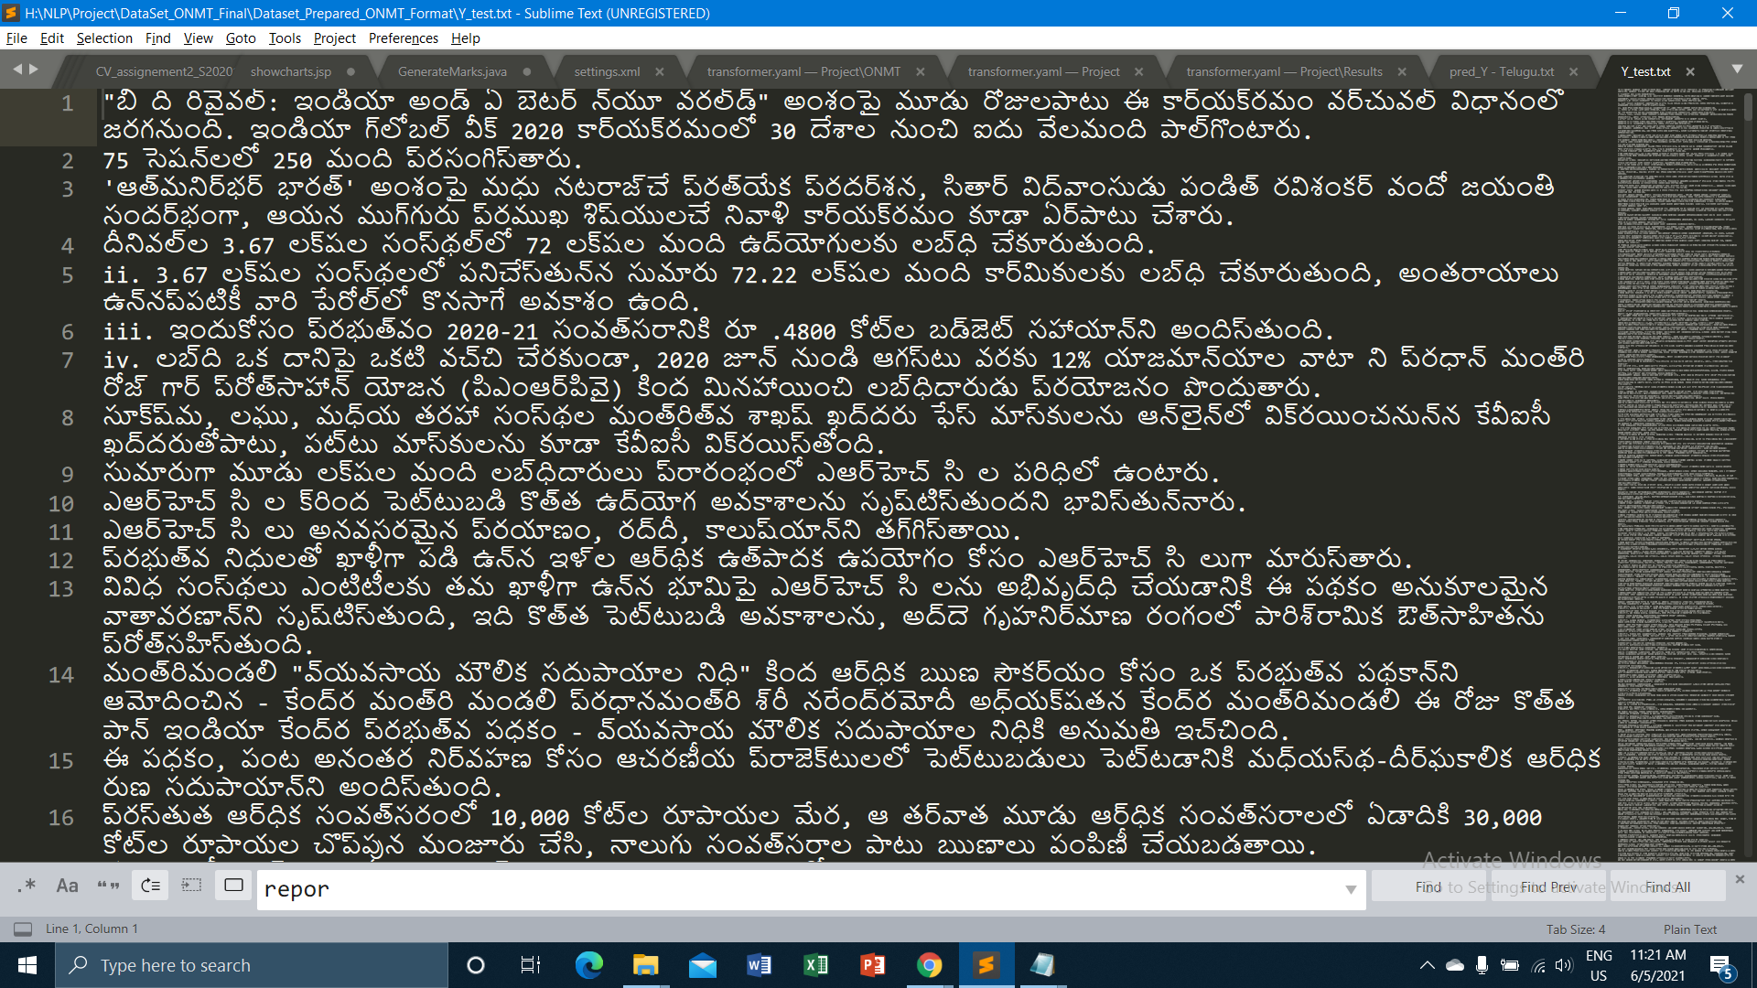
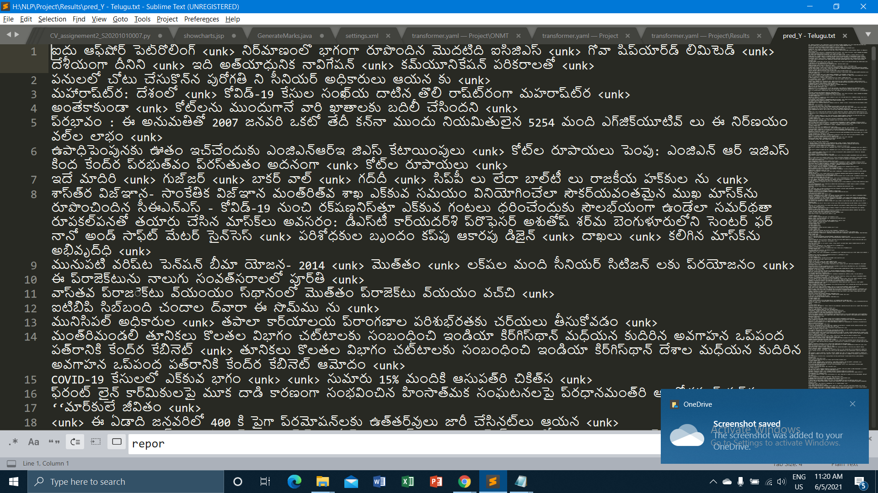
Test Sample
Predicted Sample

Slide 19
Similarity Check
Measure Type | Score | Comments/Remarks
BERT Score (Average) | 0.128 | On only 100 sentences
BLEU Score (Average) | 0.0203 | On Full Corpus

