Slide 1

Malayalam to Telugu Translation
NLP Project - Project Progress
Student Name: Pranav Deep. I
Course Instructor: Dr. Himangshu Sarma

Slide 2
Challenges
There are many challenging aspects of Machine Translation:
Matras problem
Sentence alignment
Unwanted symbols like _,@ being added
No proper tokenization tool. (Even iNLTK isn’t performing as well as expected)*
Notes:
To refresh your memory

Slide 3
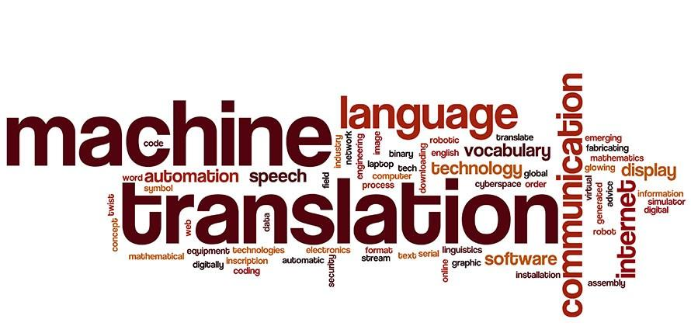
Datasets[8]
Press Information Bureau Corpus
PM Mann ki baat data set
MultiIndicMT Dataset

Slide 4
Work done so far
Data Procurement
Data Pre-processing
Data Loading - Tokenization - Word Embeddings etc.
Building Model(In Progress)

Slide 5
Libraries Used
iNLTK - Specialized library for Indic Languages. Used for tokenization and word embeddings
Torchtext - to build fields
Torch - Build the model*

Slide 6

PM’s Mann ki Baat(MKB)
MKB is a transcribed source of our honorable PM’s speeches across 12 Indian languages
These translations can be considered as expert translations and are fluent by
nature as the speeches are addressed to people across India speaking many languages.
Telugu - Malayalam parallel corpus ~ 3k sentences
This corpus is to be used as test set
Sentence aligned translation

Slide 7
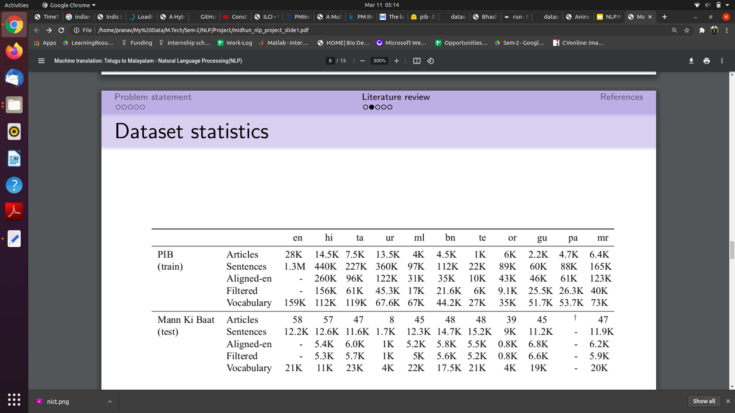
Dataset Stats

Slide 8
Work In Progress
Model Building

Slide 9
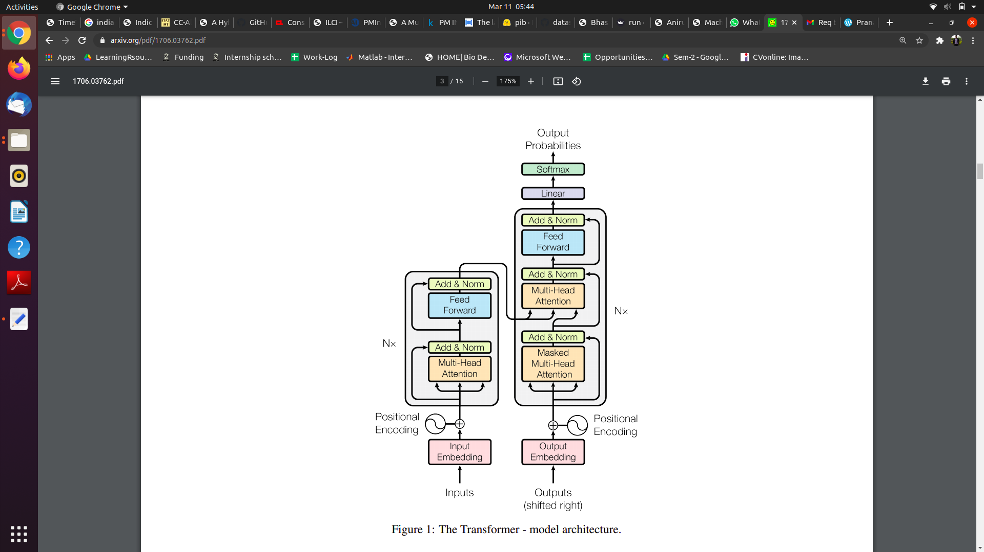
Proposed Methodology
Transformers [1] :

Slide 10
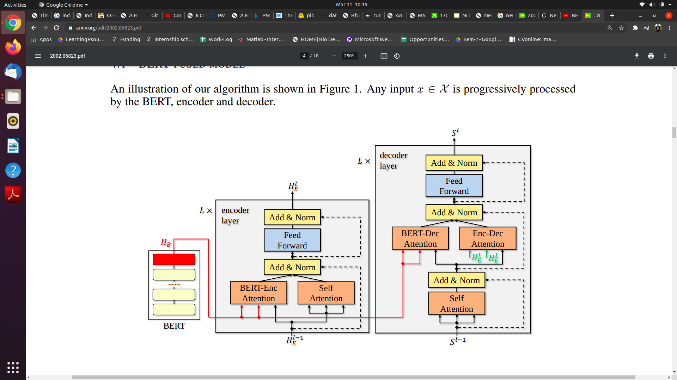
Proposed Methodology
3) BERT-fused model for NMT [3]:
BERT is first used to extract inputs for an input sequence.
Then, the representations are fused with each layer of the encoder and decoder of the NMT model through attention mechanisms.
Compared to standard NMT, in addition to BERT, there are two extra attention modules, the BERT-encoder attention and BERT-decoder attention.

