Slide 1
Pedestrian Detection in Aerial Images
Project Report
By: Pranav Deep . I

Slide 2
Contents
Motivation
About Data Set
Traditional CV
Harris Corner Detection
ORB
Keypoint Matching
Machine Learning - SVM
Deep Learning - Custom model
Experiments & Results
Bibliography

Slide 3
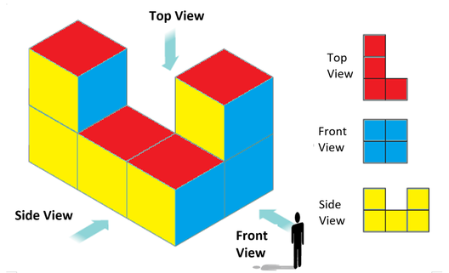
What are Aerial Images?
The term aerial imagery refers to all imagery taken from an airborne craft which can include drones, balloons or airplanes.
In traditional photography, we get the FRONT VIEW of the object while in aerial imagery, we get the TOP VIEW of the object

Slide 4
Motivation
India ranks 89th in disaster management according to World Risk Index (WRI) 2020, even lower than Sri Lanka, Bhutan & Maldives.
Search and Rescue Missions (SAR) missions in India is generally limited to Coast Guard or military operations only. (ISRO’s intervention in SAR missions has been a very recent trend, but mostly in case of high profile military operations like Indo-China border rescue missions etc.)
Local bodies(say Municipality) which has more statistics and information about the region has very limited resources and/or access to execute SAR missions during calamities or otherwise.
But all is not gloomy, as the procurement & setup cost of UAVs has significantly decreased.
However, automation in this domain is more/less not explored(Indian context).
To start with, I want to detect persons in aerial images in imagery that has been captured during calamity like scenario.

Slide 5
Challenges
There are many challenging aspects of aerial images:
Huge Image size (4000 * 3000), making it complex to load
Improper alignment of Label and Train images (Some images were missing in labels, some were missing in testing, improper naming, Length of characters of same set of images were different
Too many Shadows, object intersection, mirages etc.
Needed a lot of data preparation time

Slide 6






Heridal Dataset
Positive and Negative Samples
Image Size : 81 * 81
Channels : 3
+ve Images : ~29,000
-ve Images : ~32,000
Images are taken with a high resolution camera on the DJI Phantom 3, vertically at a 50 m altitude with the selected
Bigger Image Size : 3000*4000 (Used for feature matching)
+1
0
+1
+1
0
+1
Source

Slide 7
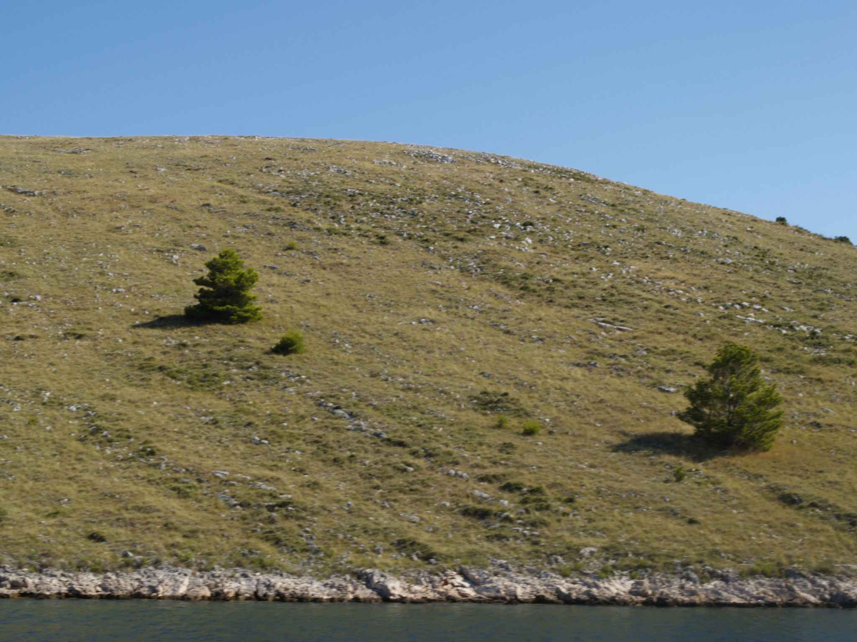
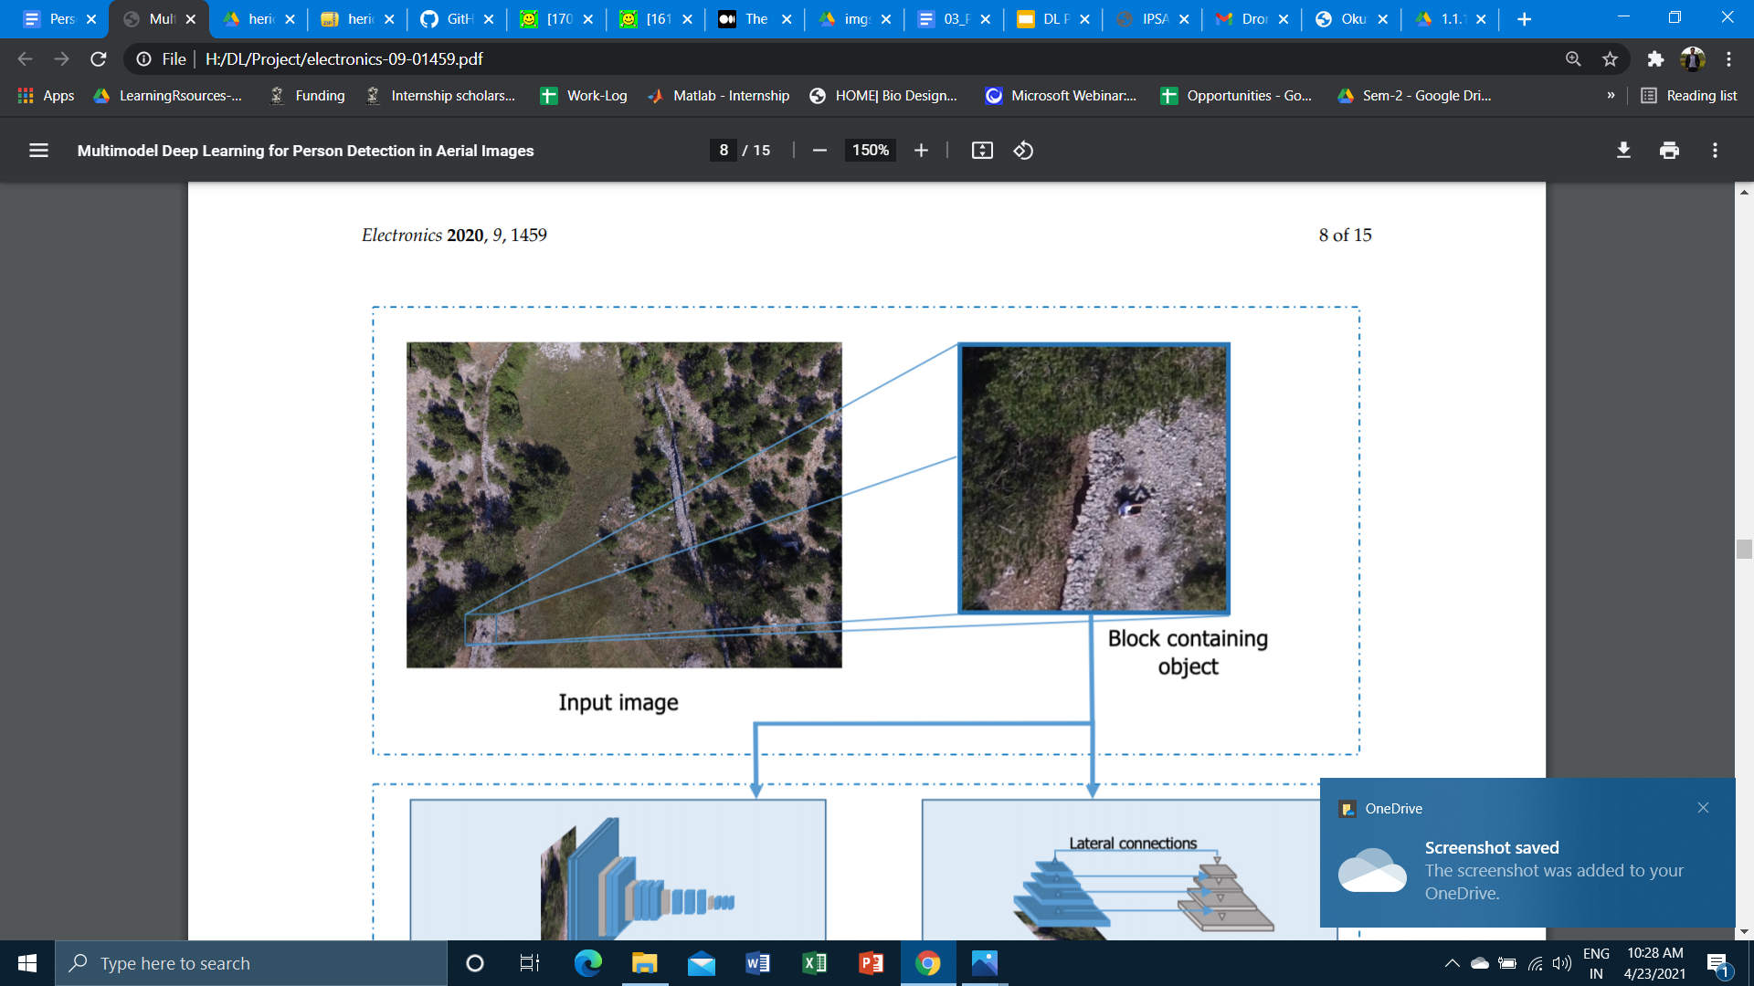
Heridal Dataset_{[5]}

Slide 8
My Experiments
Data Preprocessing (Cropping, Resizing, Matching Labels and Images etc, Dataset preparation according to each model)
Traditional Computer Vision Techniques
Classification (using Patch Data) a) Machine Learning - SVM b) Deep Learning - Custom Network
Detection a) Faster RCNN b) YOLO v5

Slide 9
Traditional Computer Vision Techniques
Harris Corner Detection - Detects accurate corners [11] - Feature Extraction [11]
Oriented FAST and Rotated BRIEF (ORB) - Feature Extraction - Keypoint matching (In horizontally flipped images) - Person Detection based on Keypoint matching [12]
Experiments done with the aside mentioned methods

Slide 10
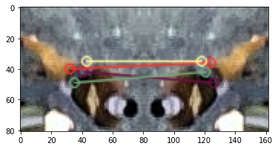
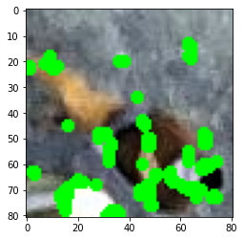
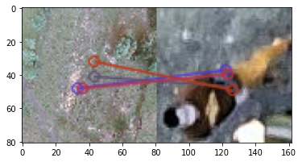
Keypoint Matching of horizontally flipped images
Harris Corner Detection
Feature Extraction from original images using keypoints of ORB Matcher
Source - [3]

Slide 11
Machine Learning Techniques
SUPPORT VECTOR MACHINE
Linear Kernel [4]
Radial Basis Function Kernel [5]
Polynomial Kernel [5]
Performed Classification
Experiments done with the aside mentioned methods

Slide 12
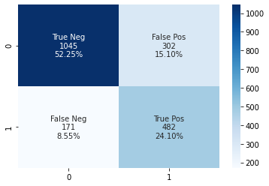
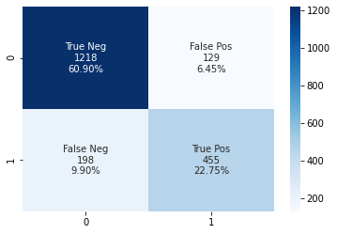
Confusion Matrices
Linear SVM
Polynomial SVM

Slide 13
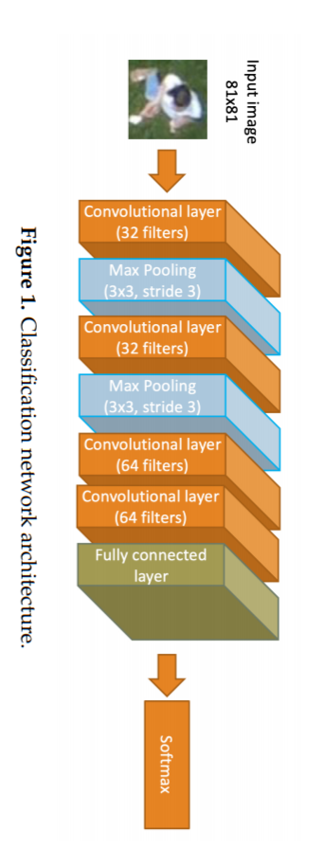
Deep Learning Classifier
Model Architecture
Changed final Activation fn. To sigmoid instead of softmax
Trainable params: 522,561
Epochs = 20
Batch Size = 32
Loss Fn. = Binary Cross Entropy
Optimizer = Adam
Used Dropout Layer - 0.5
Source [1]

Slide 14
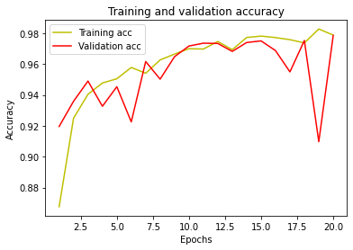
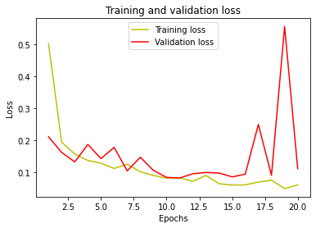
DL Model’s Accuracy and Loss plots

Slide 15
Results
Linear SVM
Polynomial SVM
DL Classifier
Training Accuracy | 100% | 96.7 % | 98.769 %
Validation Accuracy | NA | NA | 98.86 %
Testing Accuracy | 76.35 % | 83.65 % | 98.7611 %
Precision | 61.5 % | 77.9 % | 98.68 %
Recall | 73.8% | 69.7 % | 97.36 %

Slide 16
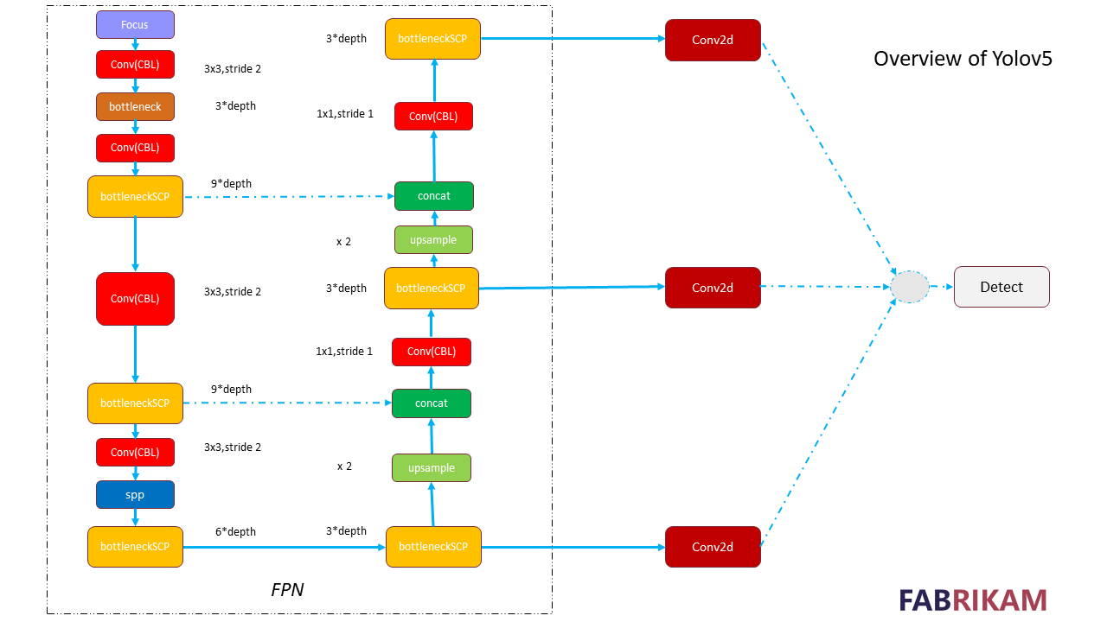

Slide 17
Hyperparameters
Learning Rate | 0.01
No. of Epochs | 200
Batch_Size | 16
Optimizer | SGD (+Momentum)
Momentum | 0.937
Weight Decay | 0.0005

Slide 18
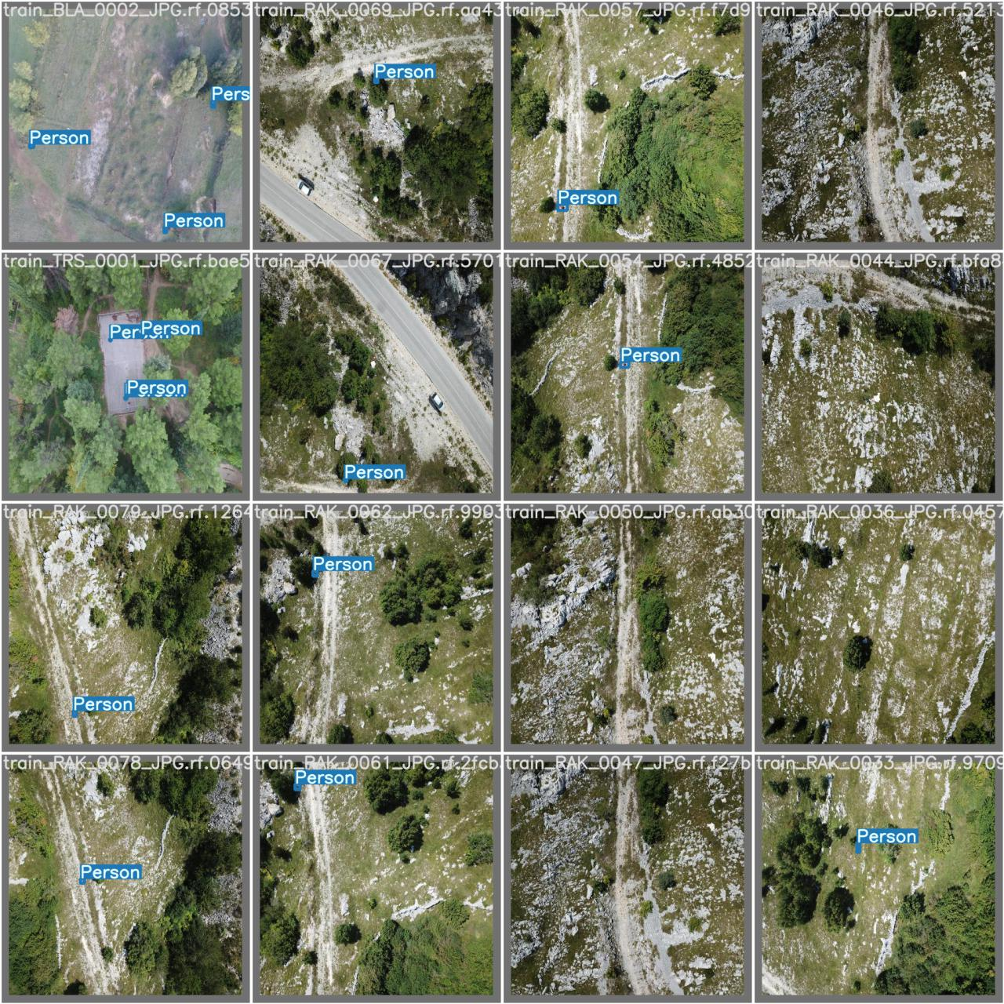
Results

Slide 19
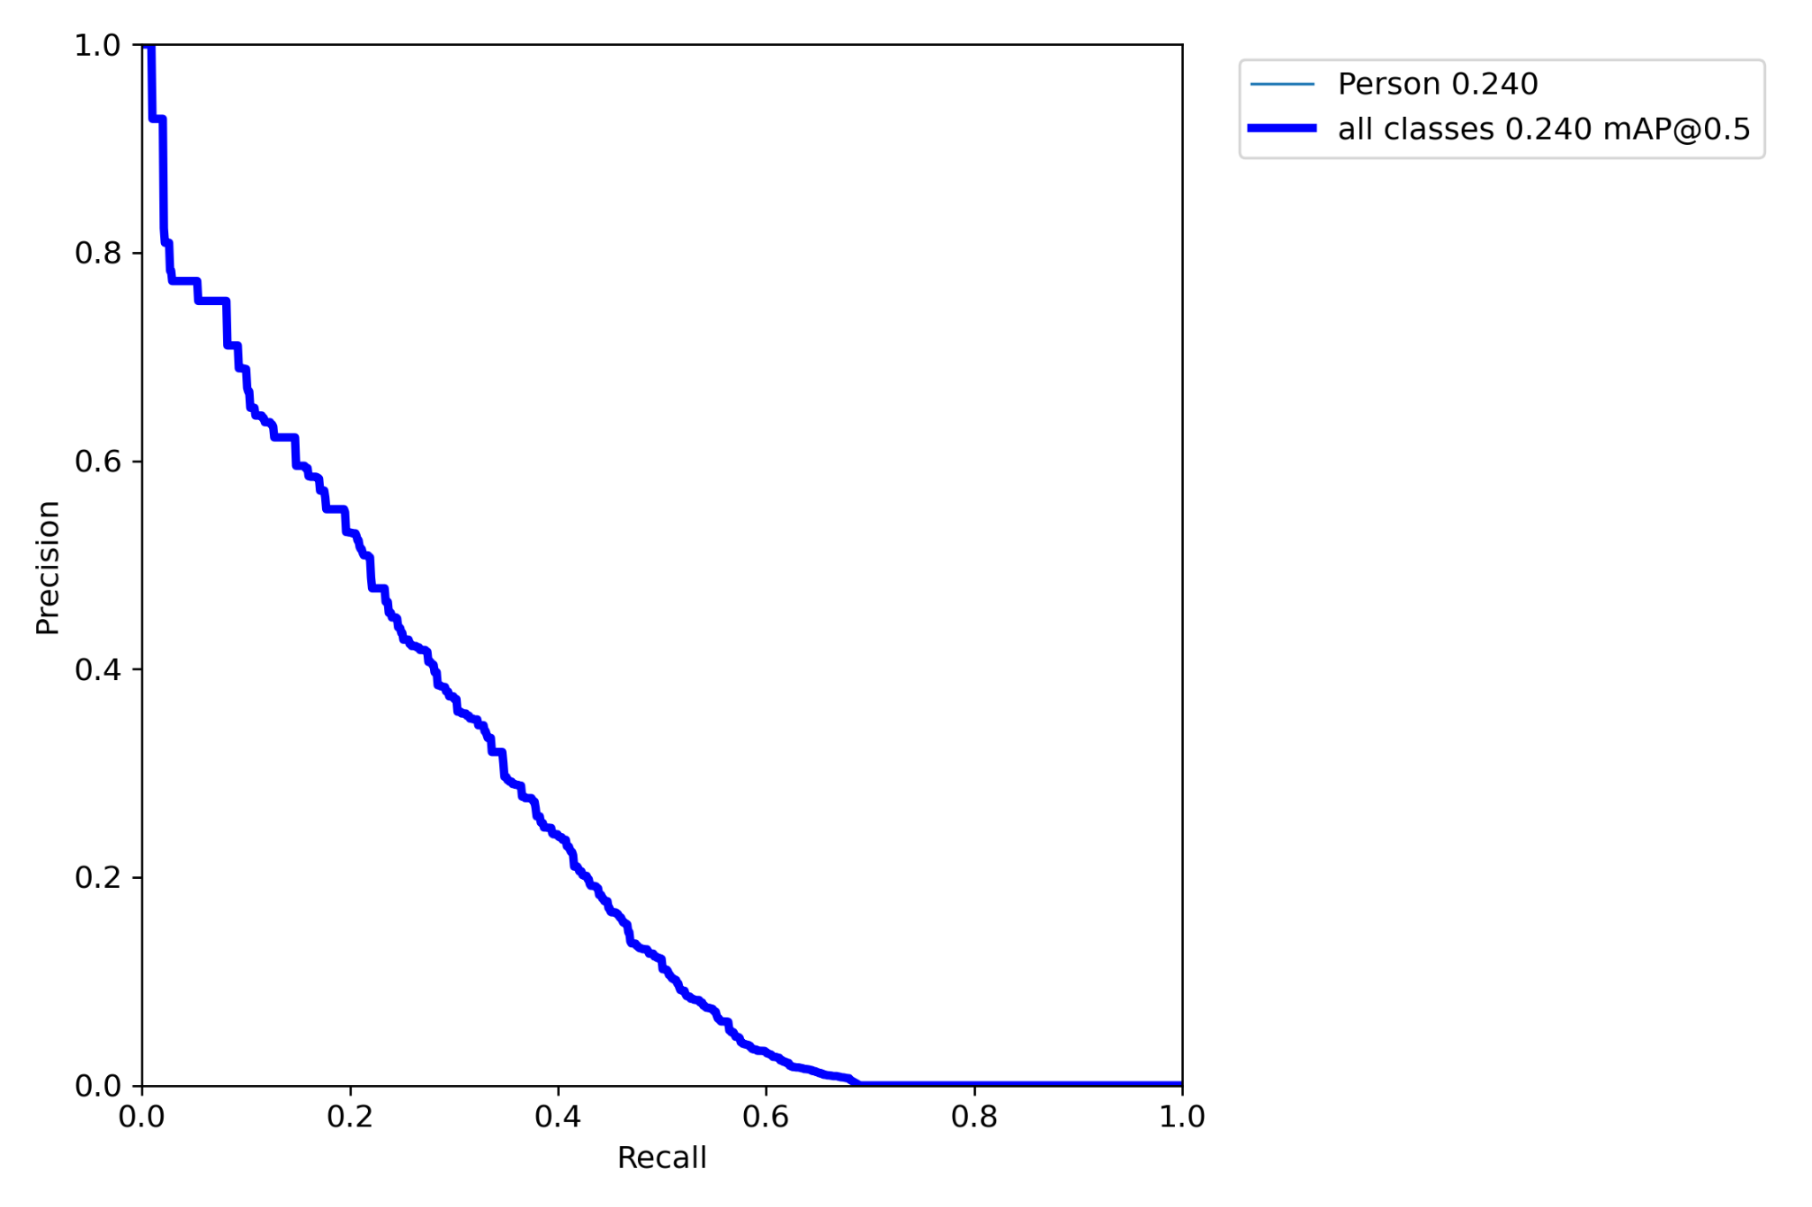
Results

Slide 20
Future Scope
Find a method to work around such large image (Eg : Dividing the image into 4 or 8 blocks) etc.
Implement state of the art methods (Eg: RetinaNET etc.) to improve Precision/Recall

Slide 21
Bibliography(1/2)
[1] Kundid Vasić, M.; Papić, V. Multimodel Deep Learning for Person Detection in Aerial Images. Electronics 2020, 9, 1459. https://doi.org/10.3390/electronics9091459
[2] 2017 ICCV] [RetinaNet] Tsung-Yi Lin, Priya Goyal, Ross Girshick, Kaiming He, Piotr Dollár
“Focal Loss for Dense Object Detection” - Link
[5] Dunja Božić-Štulić, Željko Marušić, Sven Gotovac: Deep Learning Approach on Aerial Imagery in Supporting Land Search and Rescue Missions, International Journal of Computer Vision, 2019.
[6] A. Robicquet, A. Sadeghian, A. Alahi, S. Savarese, Learning Social Etiquette: Human Trajectory Prediction In Crowded Scenes in European Conference on Computer Vision (ECCV), 2016.
[7] Okutama-Action: An Aerial View Video Dataset for Concurrent Human Action Detection. M. Barekatain, M. Martí, H. Shih, S. Murray, K. Nakayama, Y. Matsuo, and H. Prendinger. The IEEE Conference on Computer Vision and Pattern Recognition (CVPR) Workshops, 2017, pp. 28-35

Slide 22
Bibliography(2/2)
Credits for intuition and overall problem statement:
[3] Medium Blog : The intuition behind RetinaNet
[4] Medium Blog : Sampling Stanford drone dataset - Link
[8] Chenfan Sun, Wei Zhan, Jinhui She, Yangyang Zhang, “Object Detection from the Video Taken by Drone via Convolutional Neural Networks”", Mathematical Problems in Engineering, vol. 2020, Article ID 4806359, 1 page, 2020.
[9] Sambolek, Saša & Ivašić-Kos, Marina. (2020). Person Detection in Drone Imagery. 1-6. 10.23919/SpliTech49282.2020.9243737.
[10] Hung, G.L., Sahimi, M.S.B., Samma, H. et al. Faster R-CNN Deep Learning Model for Pedestrian Detection from Drone Images. SN COMPUT. SCI. 1, 116 (2020). - Link
[11] Han, Yuanfeng & Chen, Peijiang & Meng, Tian. (2015). Harris Corner Detection Algorithm at Sub-pixel Level and Its Application. 10.2991/iccse-15.2015.23. - Link
[12] Rublee, Ethan & Rabaud, Vincent & Konolige, Kurt & Bradski, Gary. (2011). ORB: an efficient alternative to SIFT or SURF. Proceedings of the IEEE International Conference on Computer Vision. 2564-2571. 10.1109/ICCV.2011.6126544. - Link

Slide 23
Review
Please let me know how I can improve my coding, presentation and report writing skills or any other feedback?

