Slide 1


Mr. Piyush Pransukhka
Mathematics and Computing
Indian Institute of Technology (BHU)
Varanasi - 221 005
Mr. Shrey Gupta
Mathematics and Computing
Indian Institute of Technology (BHU)
Varanasi - 221 005

Slide 2

Introduction and Motivation
Binary Classification
Sequential Models
Recurrent Neural Network (RNN)
Gated Recurrent Unit (GRU)
Long Short Term Memory (LSTM)
Tokenizer
Word Embeddings
Exploratory Data Analysis
Creating Training Data
Creating the Model
Results on Training Data
Results on Testing Data
Conclusion
Improvements and Future scope

Slide 3
Sentiment analysis is an approach to natural language processing (NLP) that identifies the emotional tone behind a body of text.
Twitter has become an important communication channel in times of emergency. The ubiquitousness of smartphones enables people to announce an emergency they’re observing in real-time. But, it’s not always clear whether a person’s words are actually announcing a disaster.
We will build a ML model to predicts which Tweets are about real disasters and which one’s aren’t. It can be easily seen that this is a Binary Classification task along with some concepts of NLP (Natural Language Processing).

Slide 4

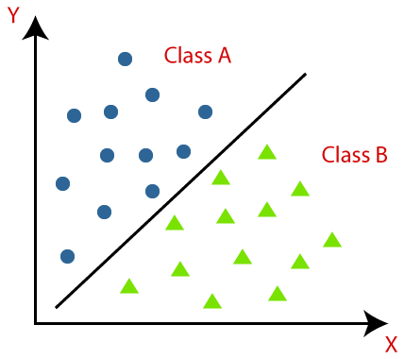
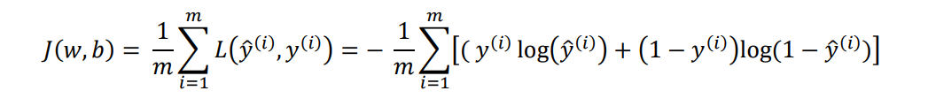
Binary classification is the task of classifying the elements of a set into two groups on the basis of a classification rule. Logistic Regression is used for binary classification.

Slide 5
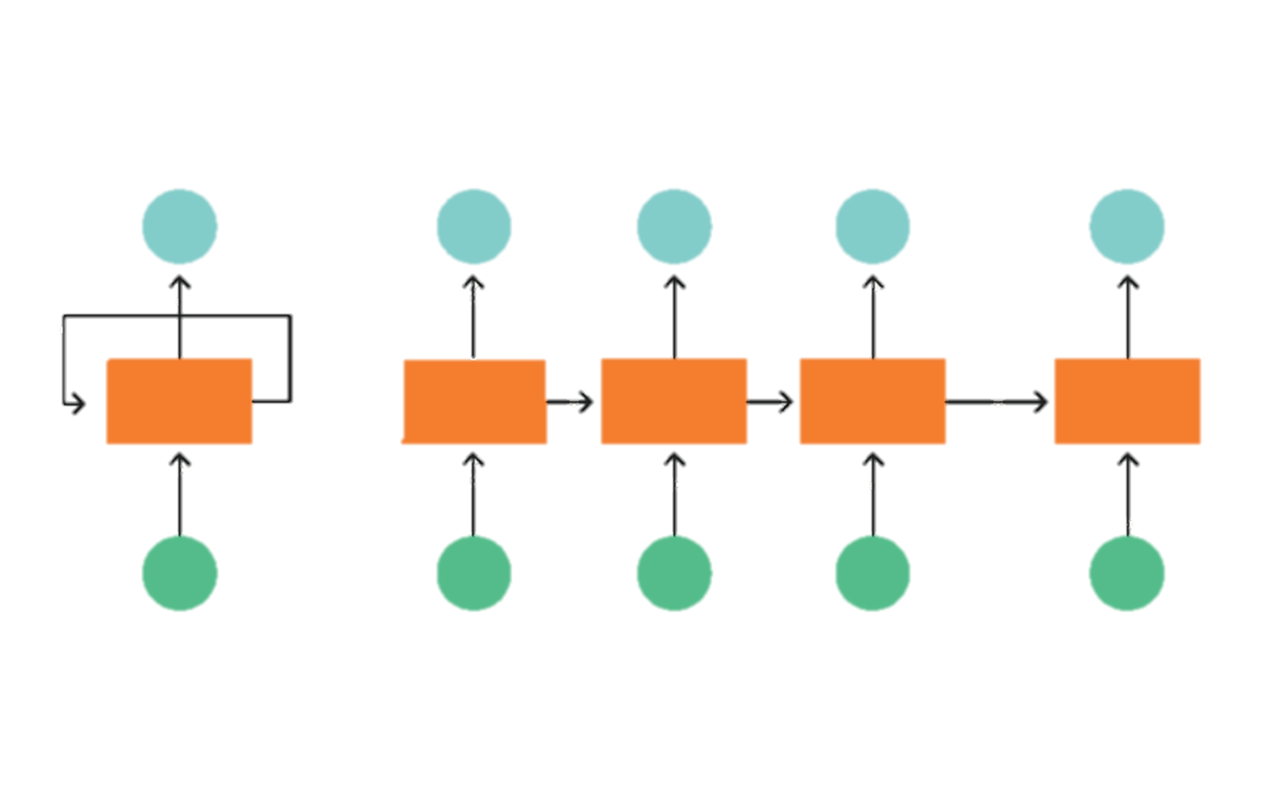
Sequential models are the machine learning models that input or output sequences of data. Sequential data includes text streams, audio clips, video clips, time-series data and etc.
We can implement such sequential models using :-
RNNs
GRUs
LSTMs

Slide 6
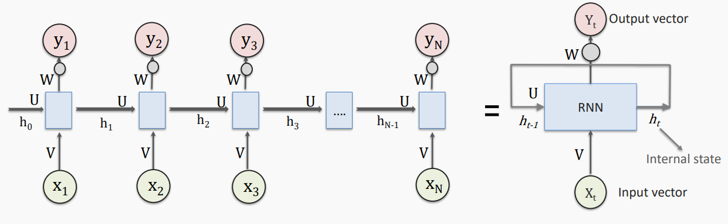
RNNs are governed by a recurrence relation applied at every time step for a given sequence.

Slide 7
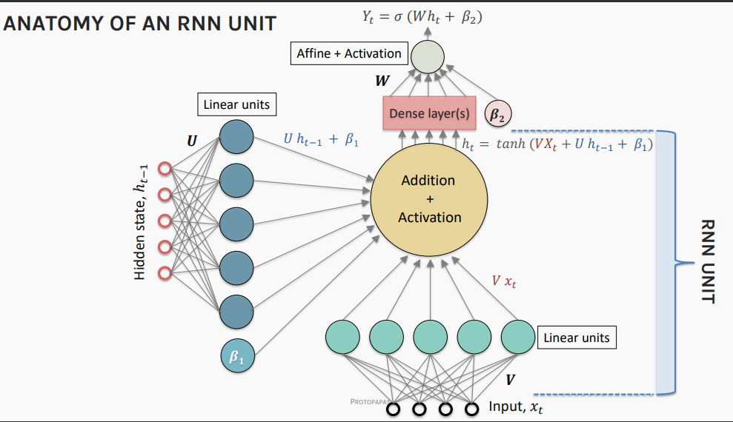

Slide 8
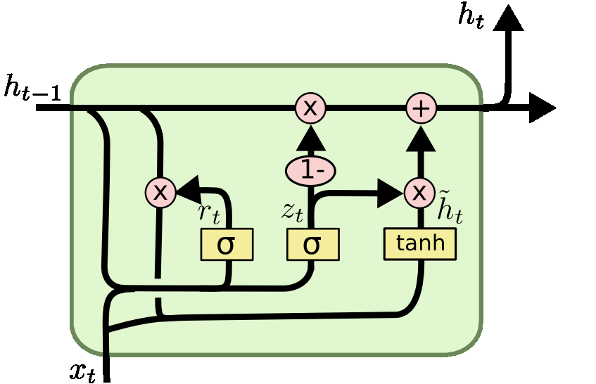
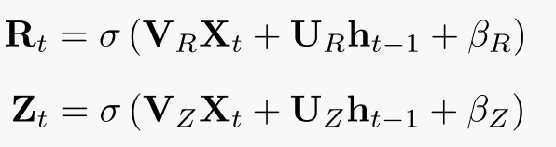
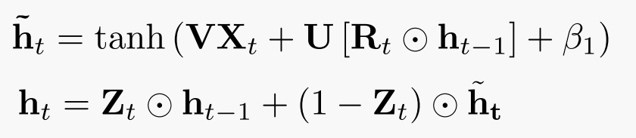
A gated neural network uses processes known called update gate and reset gate. This allows the neural network to carry information forward across multiple units by storing values in memory. When a critical point is reached, the stored values are used to update the current state.

Slide 9
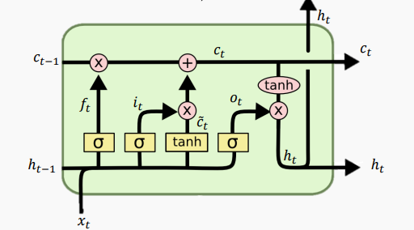
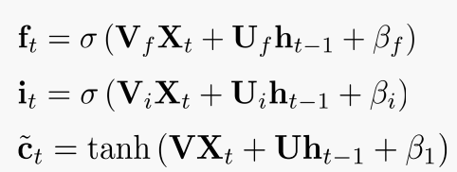
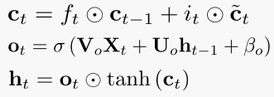
LSTM is a variety of recurrent neural networks (RNNs) that are capable of learning long-term dependencies, especially in sequence prediction problems. It uses three gates - input gate, output gate and forget gate.

Slide 10

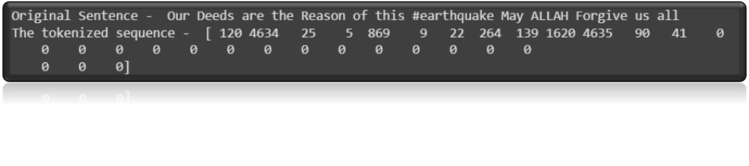
Tokenization is a way of separating a piece of text into smaller units called tokens. Here, tokens can be either words, characters, or subwords.
Given a sentence or paragraph, space tokenizer tokenizes into words by splitting the input whenever a white space in encountered.
The tokenizer in Tensorflow tokenizes the sentence as well as assign a unique number to each token.
An example of a sentence being tokenized and padded with zeros is:

Slide 11

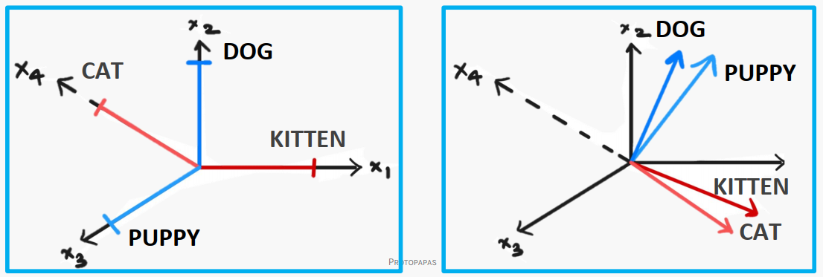
Word embedding is a representation of a word. The embedding is used in text analysis. Typically, the representation is a real-valued vector that encodes the meaning of the word in such a way that words that are closer in the vector space are expected to be similar in meaning.

Slide 12
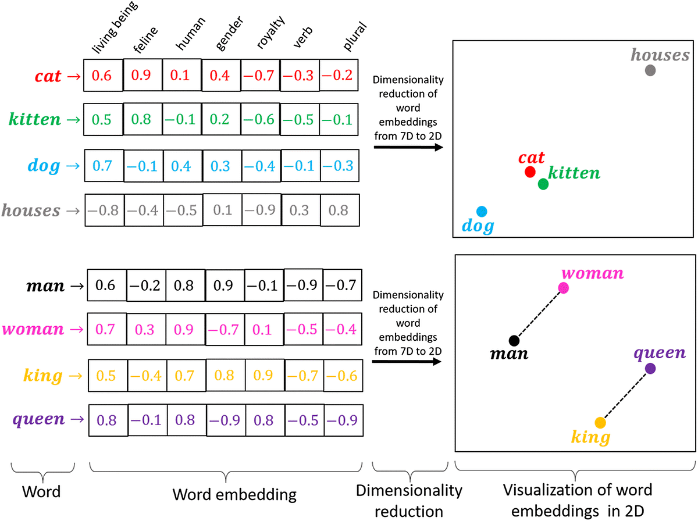

Slide 13

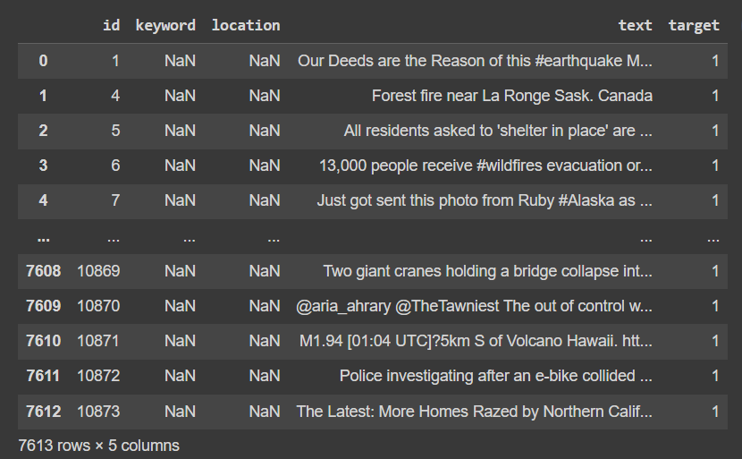

Slide 14
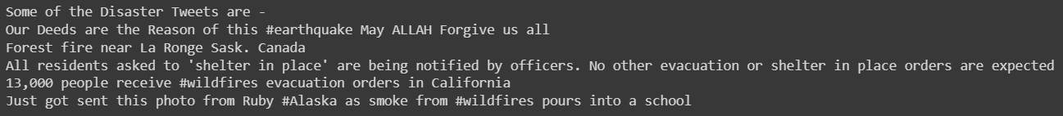
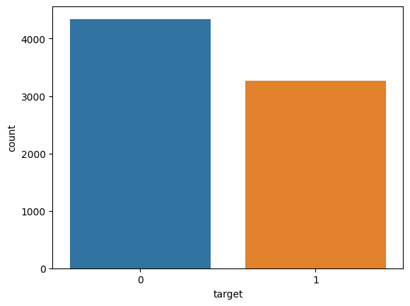
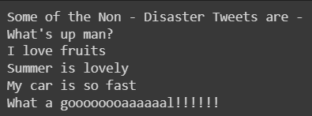

Slide 15

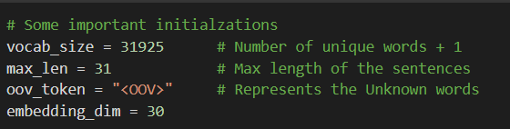
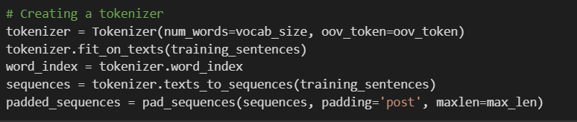

Slide 16
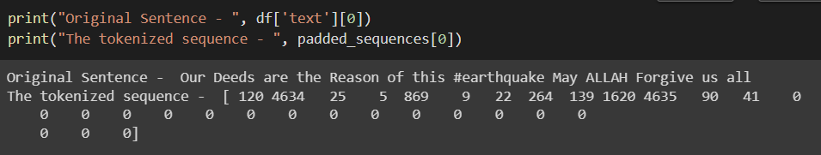
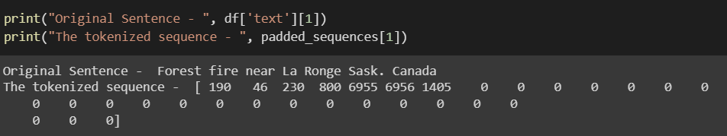

Slide 17
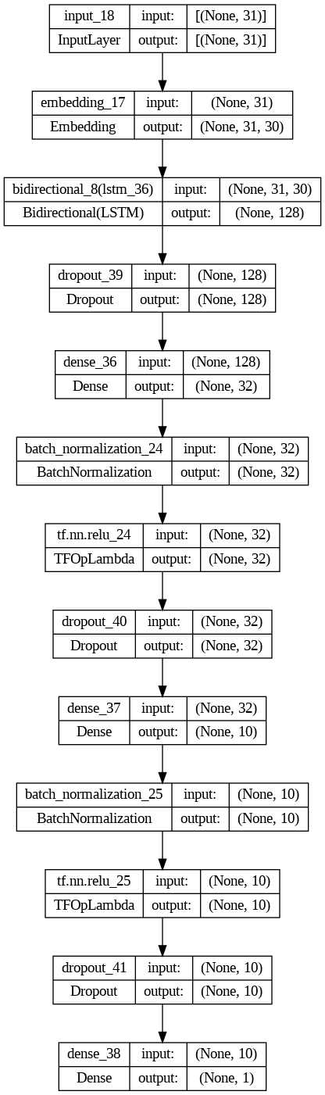



Slide 18

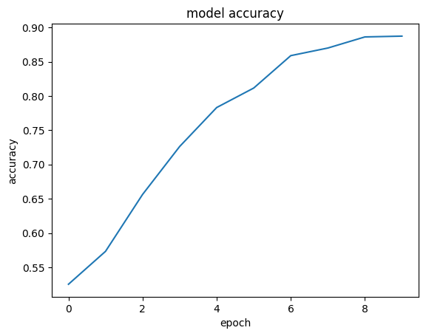
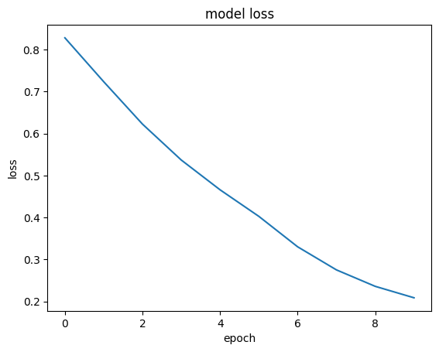

Slide 19

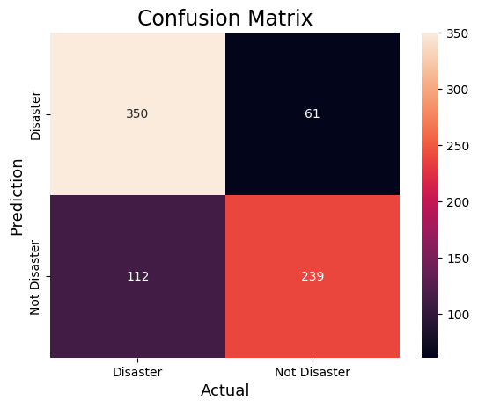


Slide 20

We studied the concepts of regression and binary classification. Then we studied some concepts of Natural Language Processing including RNNs, GRUs and LSTMs, word embeddings.
We trained a sequential model using Tensorflow on the training data and achieved a high accuracy of around 95%.
On the test data also, we were able to get a good accuracy of around 78% which is much higher than benchmark accuracy.

Slide 21

We can use different tokenizers and some pre-trained tokenizers which can definitely improve the results.
We can clearly see that the model is undergoing overfitting, so we can use some techniques like early stopping, remove some layers, some regularization methods etc. to remove overfitting.
We can use pretrained word embeddings like GLove, Word2Vec, etc.
Some state of the art models like BERT transformer can be used.

Slide 22


