Slide 1
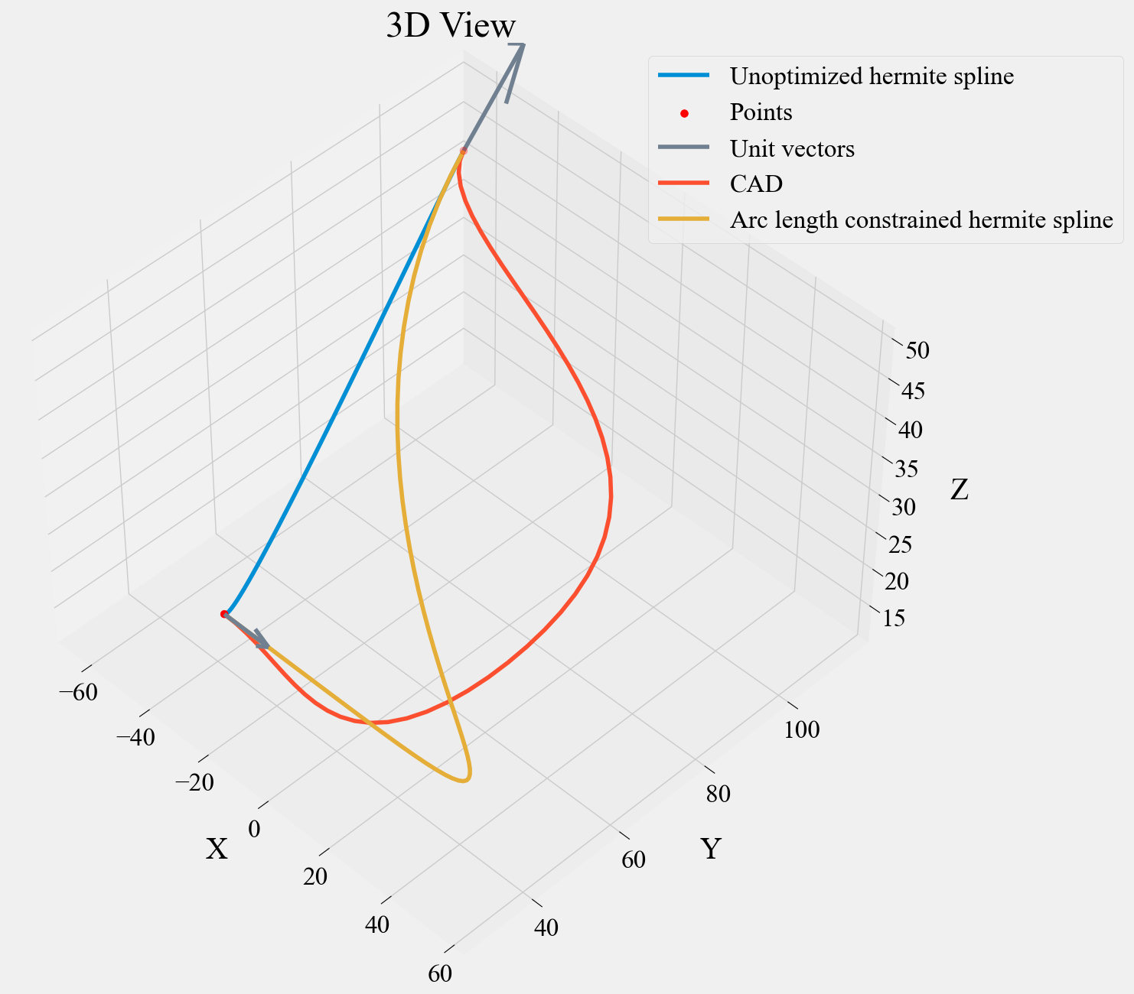
Case 01
Length of CAD Spline: 196.622
Given target spline length: 259.700
Length of Hermite Spline: 78.627
Achieved length of Hermite spline: 259.667
Computed Magnitude (X): 518.034

Slide 2
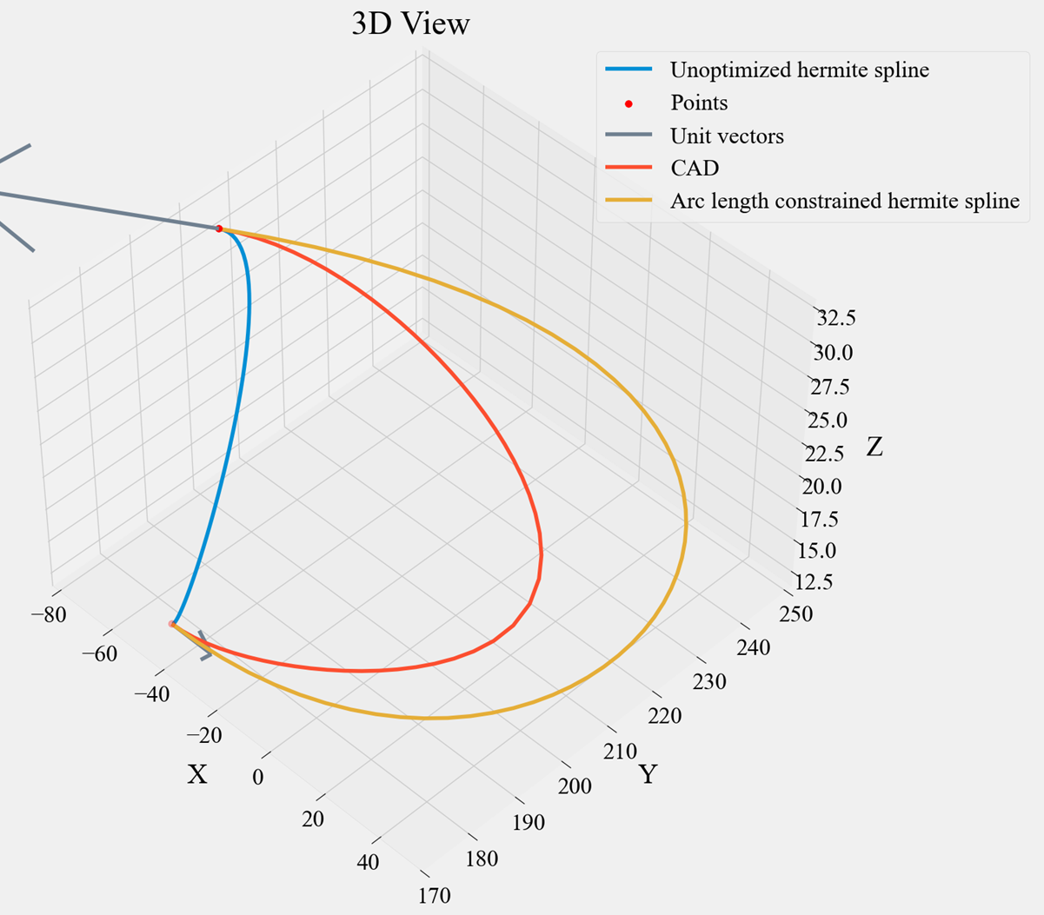
Case 02
Length of CAD Spline: 186.578
Given target spline length: 259.700
Length of Hermite Spline: 50.251
Achieved length of Hermite spline: 259.657
Computed Magnitude (X): 481.245

Slide 3
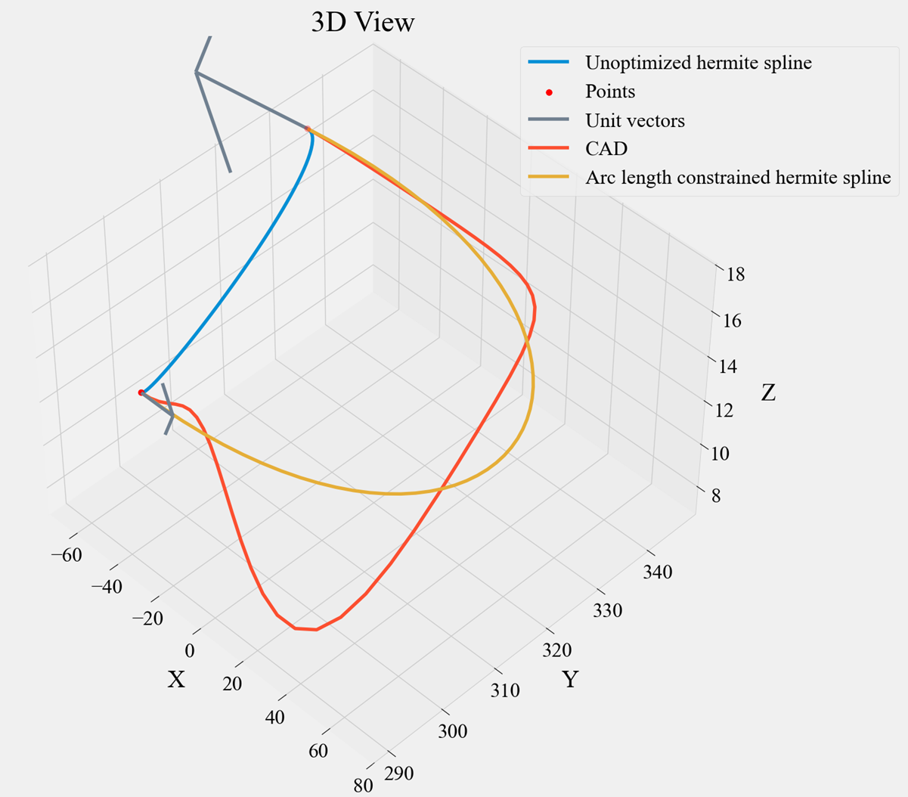
Case 03
Length of CAD Spline: 218.982
Given target spline length: 259.700
Length of Hermite Spline: 47.536
Achieved length of Hermite spline: 259.672
Computed Magnitude (X): 498.172

Slide 4
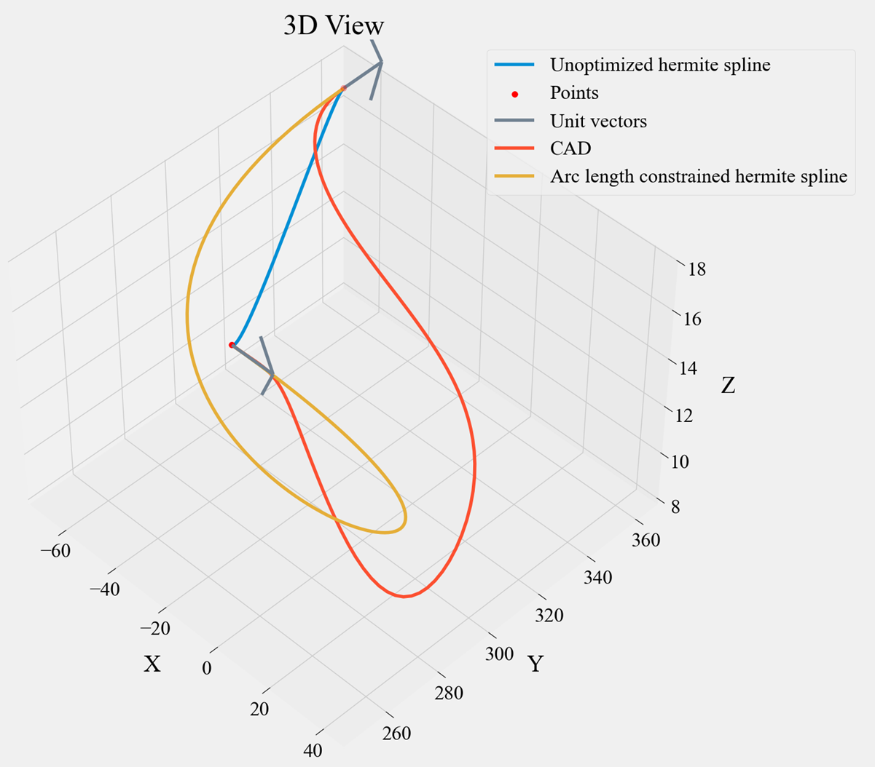
Case 03v1
Length of CAD Spline: 218.959
Given target spline length: 282.000
Length of Hermite Spline: 70.129
Achieved length of Hermite spline: 282.000
Computed Magnitude (X): 600.091

