Slide 1
TO DO LIST
Om Sehgal-18csu145
Pranav Goel- 18csu158
Puru Behl- 18csu162
Raksha Rawat-18csu166

Slide 2
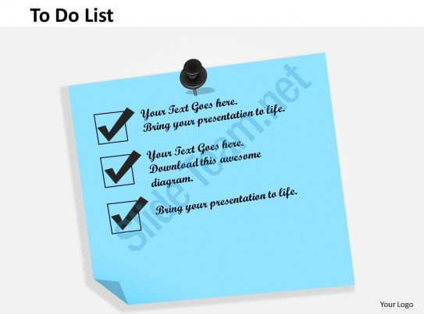
PROBLEM STATEMENT
TO DO LIST APP: A JAVA Application to display a To do list where we can add update and delete the to do items in the list

Slide 3
Key features
Login details
Menu options
Storage of data
Directory structure
Properties files
Appender and logger file

Slide 4
Program Layout
Add
Signup options
Enter new to-do list
1.Signup
2.Login
Menu
Update
Login options
Print to do list
Delete

Slide 5
PROGRESS REPORT DAY 1

Slide 6
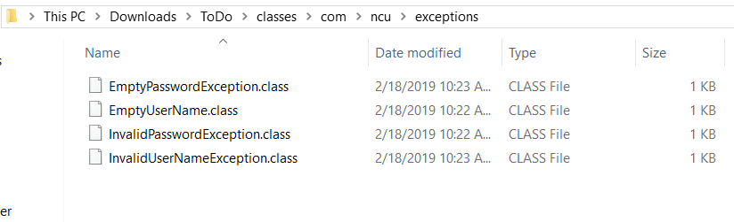
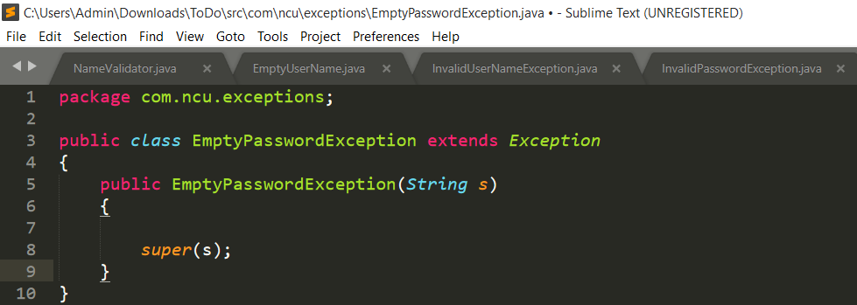
EXCEPTIONS Related TO DONE 1:

Slide 7
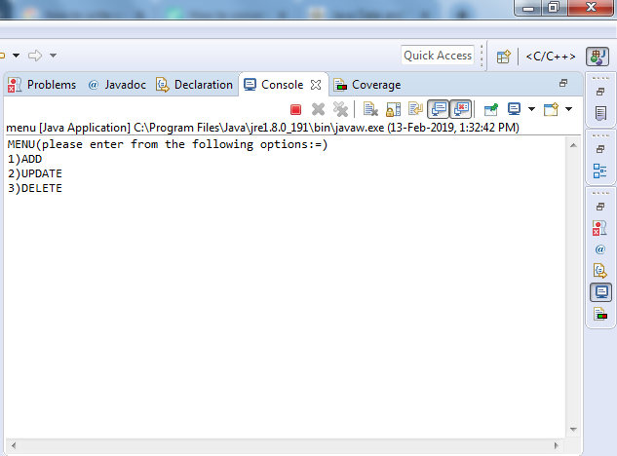
Main Menu

Slide 8
This main menu is used to add data , update data , delete data
Add function can add data in program such as s.no,venue,time,details and will create a todo.txt file.
Update function is used to update and data from the list which we have entered earlier
Delete function can delete the whole file related to list.

Slide 9
PROGRESS REPORT DAY 2

Slide 10
Done 2(Completed)
Add function
Delete function
Update function

Slide 11
Now the user can perform and modify the todo.txt according to his/her needs.
Now user can choose any of the choices from the menu . What he/she really wants to perform.

Slide 12
Done 3
completed
remaining
Delete function
Display function
Add function
update function

Slide 13
PROGRESS REPORT Day 3

Slide 14
DONE 3(COMPLETED)
Add function
Update function
Open function
Create function

Slide 15
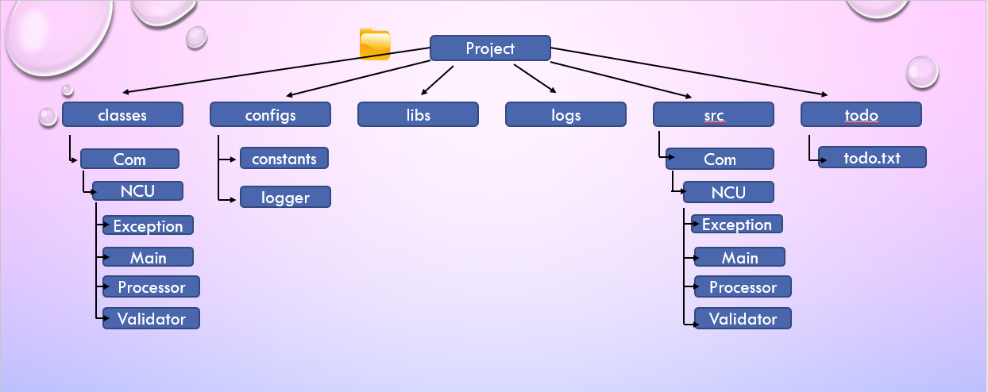
Done 4(Directory structure)

Slide 16
Folder structure
Configs: constants – exception.properties
logs – logger.properties
Libs : log4j-1.2.17 is installed

Slide 17
Day 4
Final compiling and running of the programs with proper intendation and comments.

Slide 18
Individual work distribution on project
Puru behl – add function,loggin
Raksha rawat – delete function. menu
Pranav goel- display,menu
Om sehgal – update function,loggin

