Slide 1
PATIENT CASE SIMILARITY
PIP2001 Capstone Project
Review-1
Batch Number: CAI-G24
Under the Supervision of,
Dr. Mohammadi Akheela Khanum
Professor
School of Computer Science and Engineering
Presidency University
Roll Number | Student Name
20211CAI0062 | Pranav Ganesh
20211CAI0063 | Prerna Kakade
20211CAI0069 | Bhuvana V
20211CAI0085 | Nida Aiyman
Name of the Program: B.Tech
Name of the HoD: Dr. Zafar Ali Khan
Name of the Program Project Coordinator: Dr. Afroz Pasha
Name of the School Project Coordinators: Dr. Sampath A K / Dr. Abdul Khadar A / Mr. Md Ziaur Rahman

Slide 2
Introduction
Patient Case Similarity is used in healthcare systems, particularly in clinical decision support systems, to give similarity scores between the new and old patients.
In this project, we are comparing a new patient’s data with a historical patient. The data is gathered from electronic health records (EHRs) and various research papers.
This is done to identify similar patterns and predict the disease. Further, we can also recommend treatment options based on the patterns.
The main goal is to cluster patients based on heart diseases, diabetes and other diseases.
After which we will improve the diagnostic accuracy, predictive models and optimize treatment plans for the patients.

Slide 3
Literature Review
Use abstracted patient-specific features to assist an information-theoretic measurement to assess similarity between medical cases – 2008
Patient Similarity: Emerging Concepts in Systems and Precision Medicine – 2016
Patient similarity for precision medicine: A systematic review – 2018
A patient-similarity-based model for diagnostic prediction – 2019
Measurement and application of patient similarity in personalized predictive, modelling based on electronic medical records – 2019
Measuring Patient Similarities via a Deep Architecture with Medical Concept Embedding – 2019
Patient-Case Similarity - 2020
Patient similarity: methods and applications – 2020
Patient similarity analytics for explainable clinical risk prediction – 2021
A Novel Patient Similarity Network (PSN) Framework Based on Multi-Model Deep Learning for Precision Medicine – 2022
Deep Dynamic Patient Similarity Analysis: Model Development and Validation in ICU – 2022
Patient Case Similarity - 2024

Slide 4
Existing method Drawback
i. Use abstracted patient-specific features to assist an information-theoretic measurement to assess similarity between medical cases – 2008:-
The limitations include focus on only four feature types and the lack of contextual information in weighing features. Future research should explore the impact of additional features and contextual factors on similarity measures to enhance their applicability.
ii. Patient Similarity: Emerging Concepts in Systems and Precision Medicine – 2016:-
Complexity of algorithms – many of the proposed algorithms are not yet optimized for real-world clinical use due to their complexity and reliance on high-end computing infrastructure.
iii. Patient similarity for precision medicine: A systematic review – 2018:-
Lack of Deep Learning Exploration - This paper has minimal discussion on deep learning approaches, which are becoming increasingly important in handling high-dimensional medical data and patient similarity analysis. This could be a missed opportunity to explore advanced methods.
iv. A patient-similarity-based model for diagnostic prediction – 2019:-
Low Success Percentage - The model's success percentage (the percentage of patients for whom diagnoses were correctly predicted) is low (19%).

Slide 5
v. Measurement and application of patient similarity in personalized predictive, modelling based on electronic medical records – 2019 :-
The models didn’t include specific exclusion criteria when choosing patients for the study. This could affect the accuracy of the predictions because not all patients may be equally relevant for the predictive task
vi. Measuring Patient Similarities via a Deep Architecture with Medical Concept Embedding – 2019:
Electronic Health Records are complex, and patient records contain sparse and high-dimensional data.
vii. Patient-Case Similarity – 2020:
The use of machine learning models leads to overfitting, where the model performs well on training data but fails to generalize new or unseen data.
viii. Patient similarity: methods and applications – 2020:-
During data transformation and integration, particularly in early integration strategies, there is a risk of losing valuable patient information.

Slide 6
ix. Patient similarity analytics for explainable clinical risk prediction – 2021:
Incomplete Variable Set - The model does not include all relevant variables like gender, race, diet, and lifestyle, which are associated with diabetes, hypertension, and hyperlipidemia (DHL) complications. The absence of such data limits the model's comprehensiveness​.
x. A Novel Patient Similarity Network (PSN) Framework Based on Multi-Model Deep Learning for Precision Medicine – 2022
Data Heterogeneity and Dimensionality - The combination of diverse static and dynamic clinical data, including both structured and unstructured formats, presents difficulties in accurate modeling. Handling this high-dimensional, heterogeneous data is challenging and can lead to loss of information during data reduction processes such as those using autoencoders​.
Information Loss During Encoding: The use of autoencoders for dimensionality reduction may result in accuracy loss.
xi. Deep Dynamic Patient Similarity Analysis: Model Development and Validation in ICU – 2022
Need for Clinical Protocol - The model requires a clinical protocol for practical implementation, which hasn't been discussed in this research
xii. Patient Case Similarity – 2024: Prescription Recommendation Accuracy: The system shows lower accuracy in prescription recommendations (61.27%), indicating room for improvement in this area.

Slide 7
Proposed Method
Data collection and Preprocessing
Feature Engineering
Model Development
Training and Evaluating the model
Clusters and Similarity Score
Web Development

Slide 8
Objectives
To develop a patient similarity model.
To integrate multi-modal data by utilizing diverse data sources.
Implementing advanced machine learning algorithms such as CNN, LSTM, and BERT to extract meaningful features and reduce the complexity of patient data.
Enhancing risk predictions - Improving predictive models by analyzing patient similarities, allowing accurate diagnosis across a variety of diseases, not limited to heart diseases and diabetes.
Providing a system which facilitates data driven clinical decision making. This gives insights on patients with similar symptoms and provides treatment accordingly.

Slide 9
Methodology/Modules
Data collection and Preprocessing: Using libraries such as pandas, numpy and scikit learn.
Feature Engineering: Using the transformer library and converting text to embeddings which can be used as features.
Model Development: Exploring models such as CNN and LSTM with the help of libraries such as tensorflow or keras.
Training and Evaluating the model: Training the model using test/train sets and for evaluation using metrics such as accuracy, precision, recall and F1 score.
Clusters and Similarity Score: Creating clusters by using clustering algorithms such as K-means and DBSCAN and finding the similarity scores based on the type of diseases.
Web Development: Frontend interface will help in visualizing results and allow user interactions.

Slide 10
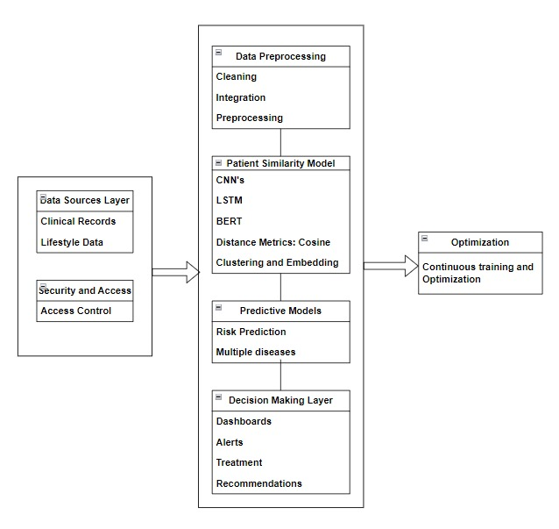
Architecture

Slide 11
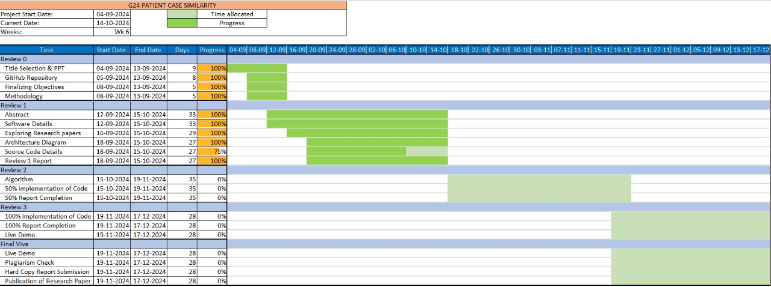
Timeline of Project

Slide 12
Hardware/Software components
Hardware:-
Laptop (11th Gen Intel(R) Core(TM) i5-11320H @ 3.20GHz 2.50 GHz, 16 GB RAM)
Software:-
i. Operating System:Windows
ii. Programming Language: Python 3.7 or higher - The primary language for machine learning and deep learning development.
iii. Deep Learning Libraries and Frameworks:TensorFlow with Keras API for ease of use and model building.
iv. Machine Learning Libraries:
•Scikit-learn: For classical machine learning algorithms, data preprocessing, and basic model evaluation.
•NumPy, Pandas: For data manipulation and analysis.
•Matplotlib, Seaborn: For data visualization.
v. Database Systems:SQL Database - for structured patient data storage.
vi. Jupyter Notebooks: For running interactive Python code and sharing results with the research team.
vii. Git: For version control and collaboration.

Slide 13
Expected Outcomes
To diagnose diseases accurately by comparing old and new patient data.
To have successfully created a web application that allows doctors to access patient data easily and view the similarity scores while patients have easy access to the treatments.

Slide 14
Conclusion
Our project is mapped to SDG-3, that is, Sustainable Development Goals of Good Health and Well-Being.
Our project combines advanced machine learning techniques and web applications to create a system for patient case similarity.
Each area of healthcare can be iteratively improved based on performance metrics which helps achieve our goal of accurate similarity scores.

Slide 15
Github Link
Patient Case Similarity

Slide 16
References
Use abstracted patient-specific features to assist an information-theoretic measurement to assess similarity between medical cases – 2008: https://www.sciencedirect.com/science/article/pii/S1532046408000440
Patient Similarity: Emerging Concepts in Systems and Precision Medicine – 2016: https://www.frontiersin.org/journals/physiology/articles/10.3389/fphys.2016.00561/full
Patient similarity for precision medicine: A systematic review – 2018: https://doi.org/10.1016/j.jbi.2018.06.001
A patient-similarity-based model for diagnostic prediction – 2019: https://doi.org/10.1016/j.ijmedinf.2019.104073
Measurement and application of patient similarity in personalized predictive, modelling based on electronic medical records – 2019: https://doi.org/10.1186/s12938-019-0718-2
Measuring Patient Similarities via a Deep Architecture with Medical Concept Embedding – 2019: https://arxiv.org/pdf/1902.03376
Patient-Case Similarity – 2020: https://www.researchpublish.com/upload/book/Patient%20Case%20Similarity-8606.pdf
Patient similarity: methods and applications – 2020: https://arxiv.org/pdf/2012.01976
Patient similarity analytics for explainable clinical risk prediction – 2021: https://bmcmedinformdecismak.biomedcentral.com/articles/10.1186/s12911-021-01566-y
A Novel Patient Similarity Network (PSN) Framework Based on Multi-Model Deep Learning for Precision Medicine – 2022: https://doi.org/10.3390/jpm12050768
Deep Dynamic Patient Similarity Analysis: Model Development and Validation in ICU – 2022: https://www.sciencedirect.com/science/article/pii/S0169260722004151
Patient Case Similarity - 2024: https://www.doi.org/10.56726/IRJMETS48246

Slide 17

Project work mapping with SDG
Our project is mapped to SDG-3,that is, Good health and Well Being.
Our main goal is to cluster patients based on heart diseases, diabetes and other diseases and give similarity scores between old and new patients.
This will help in improving the diagnostic accuracy, predictive models and optimize treatment plans for the patients.

Slide 18
Thank You

