Slide 1
MATH 7343 Applied Statistics
Prof. (Aidong) Adam Ding

Slide 2
Last time: Statistical concepts
Today, we continue to go over the notes, and introduce more concepts.

Slide 3
More concepts.
Random sampling: A method for selecting a sample from a population such that every member of the population has an equal chance of being selected.
A sample is a random sample form a population if
(1) Each data value is selected in a manner totally unrelated to the other data values in the sample (independence).
(2) Each data value is selected from a set of values that is the same as those in the population (identically distributed).

Slide 4
Concepts Example 1. Political polling. (Cont’d)
To ensure the sample is a random sample, a table of random digit is used. (Or more likely, a computer algorithm generating random numbers is used.) Could see chapter 22 if you are interested in more sampling theory.
An example of Non-random sample could be that the first 376 names in the phone directory being chosen. We would then be stuck with all persons with the last name starts with an “A”. This could leads to many people from the same racial group or even the same family and rendering any conclusion from the sample useless for the general population.

Slide 5
Data Collection
Targeted Population
Sampled
Population
Sample
Descriptive
Statistics
Draw Conclusions
Parameters
(Numerical characteristics
Of Population)
Statistics
(Numerical characteristics
Of Data)
Statistical inference

Slide 6
Association is NOT Causation
Association: There is a relationship between two random variables X and Y.
For example, “owning an iPhone in 2016” is associated with “having higher income” according to this paper.
==================================
Researchers find that owning an iPhone or iPad is the number-one way to guess if you’re rich or not
Kif Leswing
Jul. 8, 2018, 11:00 AM AP
====================================
Causation: Changes in one variable X directly causes changes in another variable Y.
Would buying an iPhone in 2016 cause you to have higher income?

Slide 7
Association is NOT Causation
You may also read the following paper “Association, correlation and causation” (https://www.nature.com/articles/nmeth.3587)
Do we need a causation result? Is associative result ok?
(Answer: depends on the study objective: marketing research? Scientific study? ….)
Can we use statistical studies to infer if X is associated Y or X causes Y?
Association can be judged statistically if the study is properly designed (random sampling).
To infer causation, we need controlled study design.

Slide 8
Controlled study versus Observational study
In a controlled experiment the allocation of “treatment” to subjects is done at random. Randomization eliminates biases and enables the inference of causation.
In an observational study the “treatment” is a characteristic of the subject which we merely observe. It is usually not possible to eliminate biases and we can only infer association.

Slide 9
Example 4. Controlled vs. Observational
Question: What is the effect of forest fires on the density of oak seedlings in a national forest?
Experiment: Count the number of oak seedlings in a 10 square meters plot in the forest.
Controlled experiment Observational Study
1. Select sites to study. 1. Select the sites to study such
2. Choose half of sites that some are burned and some
at random and burn them. are not.
3. Return later to count the 2. Count the seedlings at the
seedlings at the sites. selected sites.

Slide 10
Example 5. Video display terminals and miscarriage.
Question: Does exposure to video display terminals increase risk of miscarriage?
Target population: All pregnant women in the U.S. over next several years.
Sample: 1583 pregnant women who attended one of the three Boston area hospitals.
Statistics: Difference in miscarriage rates between women exposed to VDTs and women not exposed.
Conclusion:

Slide 11
Example 6. Polio Vaccine effectiveness.
In 1950s, a Polio vaccine was tested on all elementary school children whose parent gave consent.
Target Population: All children in the US over next several years.
Sample: The 400,000 plus children in the trial.
Statistics:
Vaccine group: 33 of 200,745 developed paralysis. Rate 16/100000
Placebo group: 115 of 201,229 developed paralysis. Rate 57/100000
Conclusion:

Slide 12
What is the relevant sample size?
Experimental Unit: The largest unit to which a single treatment is applied.
Sampling Unit: The largest unit on which measurements are made.
(Variance among treatments can only be reflected through variance among different experimental units. If sampling units are different from experimental units, measurement variance and treatment variance need careful distinction.)

Slide 13
Example 7 popcorn taste rating
The Professor pops two bags of regular and two bags of gourmet popcorn. One bag of each type has been stored at room temperature, while the other has been frozen. He passes the popped corn around the class, and each student takes a handful and consumes them.
Experimental unit: a bag of popcorn.
Sampling unit: a handful of popcorn.
How many experimental units here?
How many sampling units here?
Is it possible to distinguish the treatment effect, with large number of sampling units in each experimental units?

Slide 14
Example 8 fertilizer testing
A farmer puts five experimental fertilizers (including one control) on ten different plots in a field. Each fertilizer is placed on two plots. He then plants corn on each of the plots.
(a) At the end of the growing season, he selects ten plants from each plot and weighs them individually.
experimental unit: a plot of corn.
sampling unit: an individual corn plant.
(b) At the end of the growing season, he harvests and weighs all the corn on each plot.
experimental unit: a plot of corn.
sampling unit: a plot of corn.

Slide 15
Type of Data
Quantitative data are measurements or counts that have meaningful numerical values.
Qualitative data are attributes such as gender, occupation or the responses to a yes/no question that do not have inherent numerical values. Usually represented as nominal, ordinal or ranked data.
Continuous data are measurements that could in principle be made arbitrarily precise. For example, weight or temperature.
Discrete data belong to distinct classes and are usually counts or qualitative.

Slide 16
Basic statistical concepts. End of Module 1
Statistical inferences is about drawing conclusions of the parameter (of population) using the statistics (of sample). Random sampling is important to get a representative sample of the population.
Inferential statistics is only a part of the process of statistical analysis.
Association is not causation. To infer causation, we need controlled study design.

Slide 17
Next topic: Descriptive Statistics
How to summarize data, as a few numbers or graphs.

Slide 18
Data Collection
Targeted Population
Sampled
Population
Data
Descriptive
Statistics
Draw Conclusions
Parameters
(Numerical characteristics
Of Population)
Statistics
(Numerical characteristics
Of Data)
Statistical inference

Slide 19
Descriptive Statistics
Ex 1. A marketing consultant observed 50 consecutive shoppers at a grocery store. Here are the amounts that each shopper spent (in dollars).
It is really hard to get any information staring at a data set like this. We have to summary the data somehow.
18.71 | 32.82 | 37.52 | 33.26 | 6.90
31.99 | 39.28 | 69.49 | 19.55 | 12.66
27.07 | 63.85 | 34.76 | 20.89 | 16.55
23.85 | 30.54 | 40.80 | 52.36 | 15.01
14.35 | 14.52 | 20.58 | 33.80 | 13.72
36.22 | 29.15 | 43.97 | 45.58 | 15.33
21.13 | 14.55 | 13.67 | 61.57 | 18.30
20.91 | 64.30 | 11.34 | 18.22 | 17.15
2.32 | 26.04 | 28.76 | 8.04 | 9.45
19.54 | 11.63 | 6.61 | 12.95 | 10.26

Slide 20
Descriptive Statistics
(1) Frequency table. We could separate the range of the data into several intervals and count how many cases in each interval.

Slide 21
Descriptive Statistics
(2) Stem-and-leaf plot. Table served as a graph also.
Category Stem & leaf
0<=x<10 26689
10<=x<20 0112233444556788899
20<=x<30 136789
30<=x<40 012334679
40<=x<50 035
50<=x<60 2
60<=x<70 1449
18.71 | …
31.99 | …
27.07 | …
23.85 | …
14.35 | …
36.22 | …
21.13 | …
20.91 | …
2.32 | …
19.54 | …

Slide 22
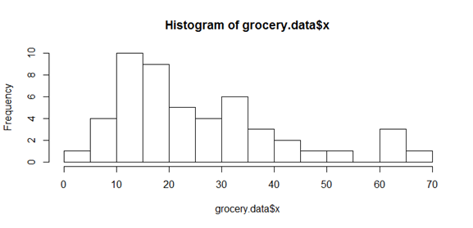
Descriptive Statistics
(3) Histogram.

Slide 23
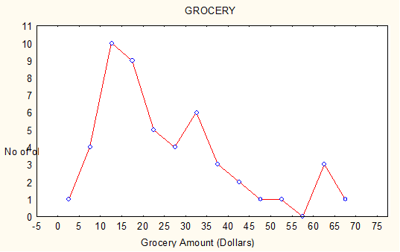
Descriptive Statistics
(4) Frequency Polygons

Slide 24
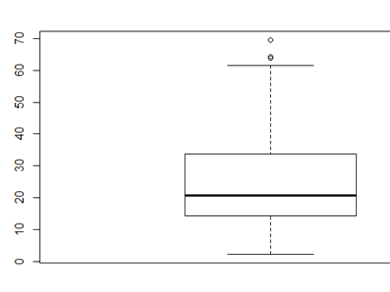
Descriptive Statistics
(5) Box Plot.
Lines in middle: Mean & Median
Box height: Interquartile range (IQR)
i.e. 25th to 75th percentile
Circles: Outliers, i.e. data
points 1.5 IQR away from the box.
The line down below is the minimum value or 1.5IQR below box, the line above is the maximum or 1.5IQR above.

Slide 25
An Example: Response times
From A webpage that measure your response time

Slide 26
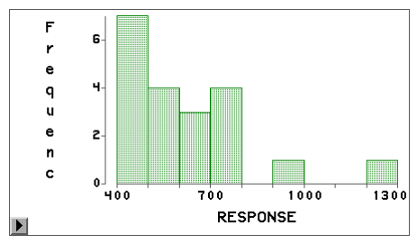
Histogram of Response times
Judging from the data set, would the following response time be considered ordinary, too small or too large?
580 Ok
490 Ok
20 Too small
2000 Too big
750 Ok
1060 A little big, Ok.

Slide 27
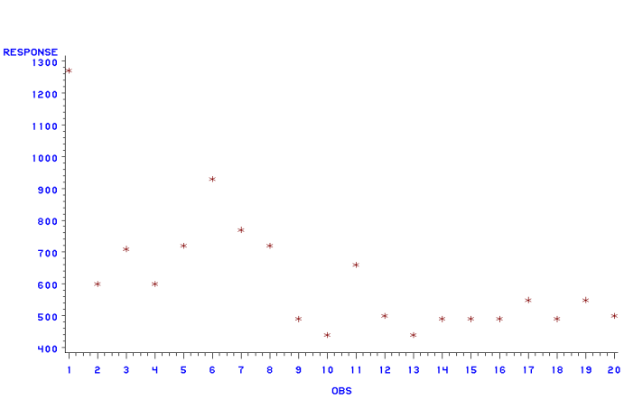
Scatter plot of Response times
The two-way plot (time versus order) shows a pattern not observable in histogram: first try is very slow, then response gets faster and stabilizes.

Slide 28
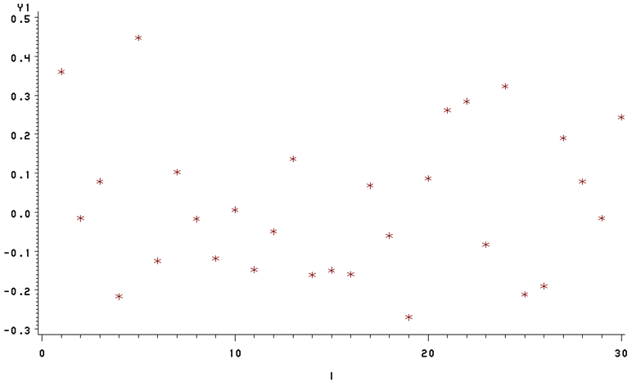
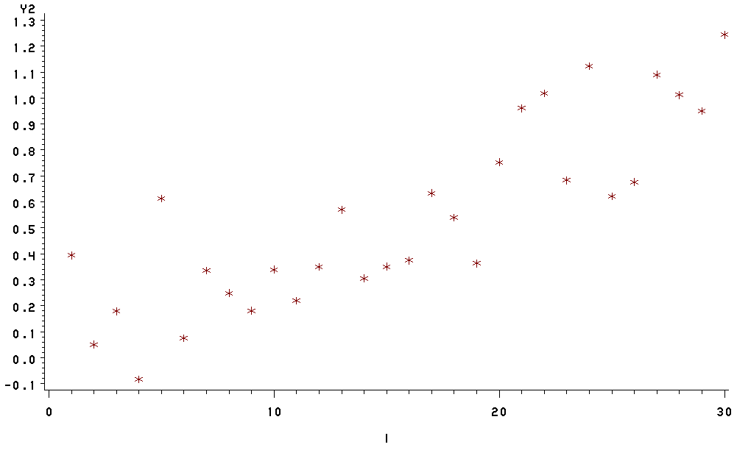
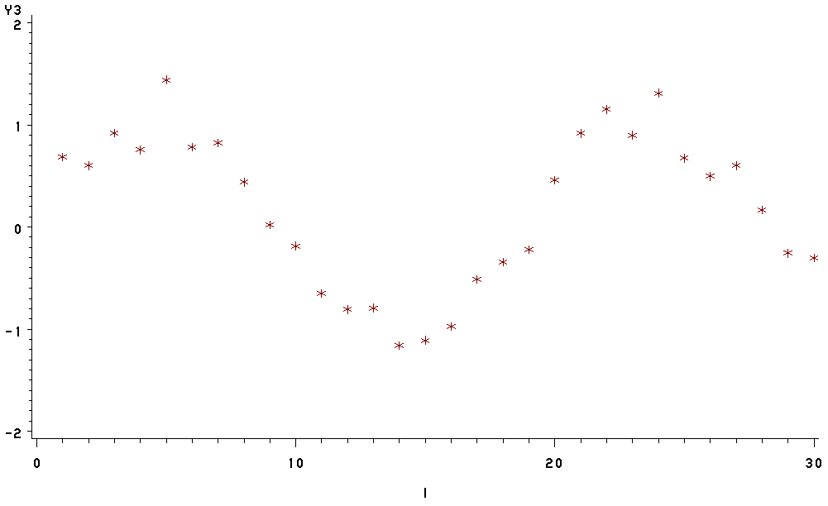
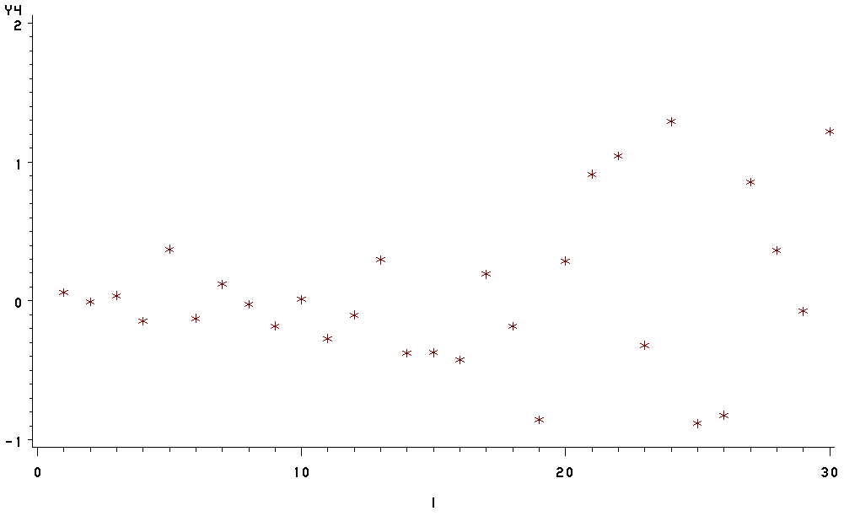
Some patterns from scatter plots
Random stationary linear increasing
Periodical increasing variance

Slide 29
Data visualization
Above are some very basic common plots to display data. Nowadays, data visualization itself is an important evolving research topic. People are inventing new ways to display high-dimensional data so that we can visualize patterns. The techniques (e.g. heatmap) are continuously invented and then programmed into common statistical software such as R. You are encouraged to read and learn about those techniques on your own. The idea is to display data to provide intuition with the available computational capability.
Following is an example by Professor Boeing to visualize the distribution of city street orientations.
(https://geoffboeing.com/2018/07/comparing-city-street-orientations/)

Slide 30
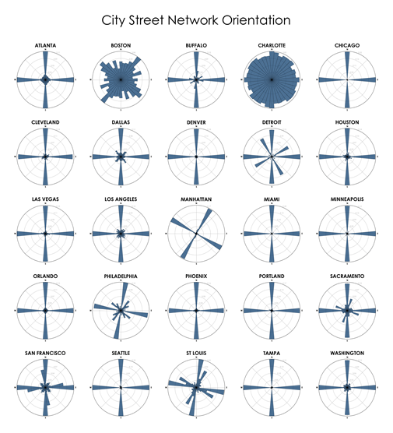
Polar histogram
Most cities’ streets are
organized in grids,
concentrate in two
directions.
Boston and Charlotte
are two exceptions.

Slide 31
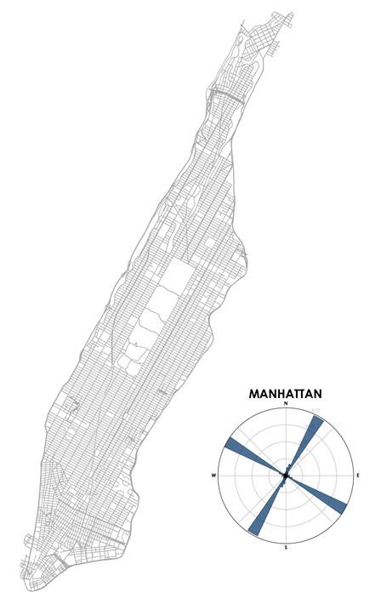
Polar histogram
Most cities’ streets are
organized in grids,
concentrate in two
directions.
Boston and Charlotte
are two exceptions.

Slide 32
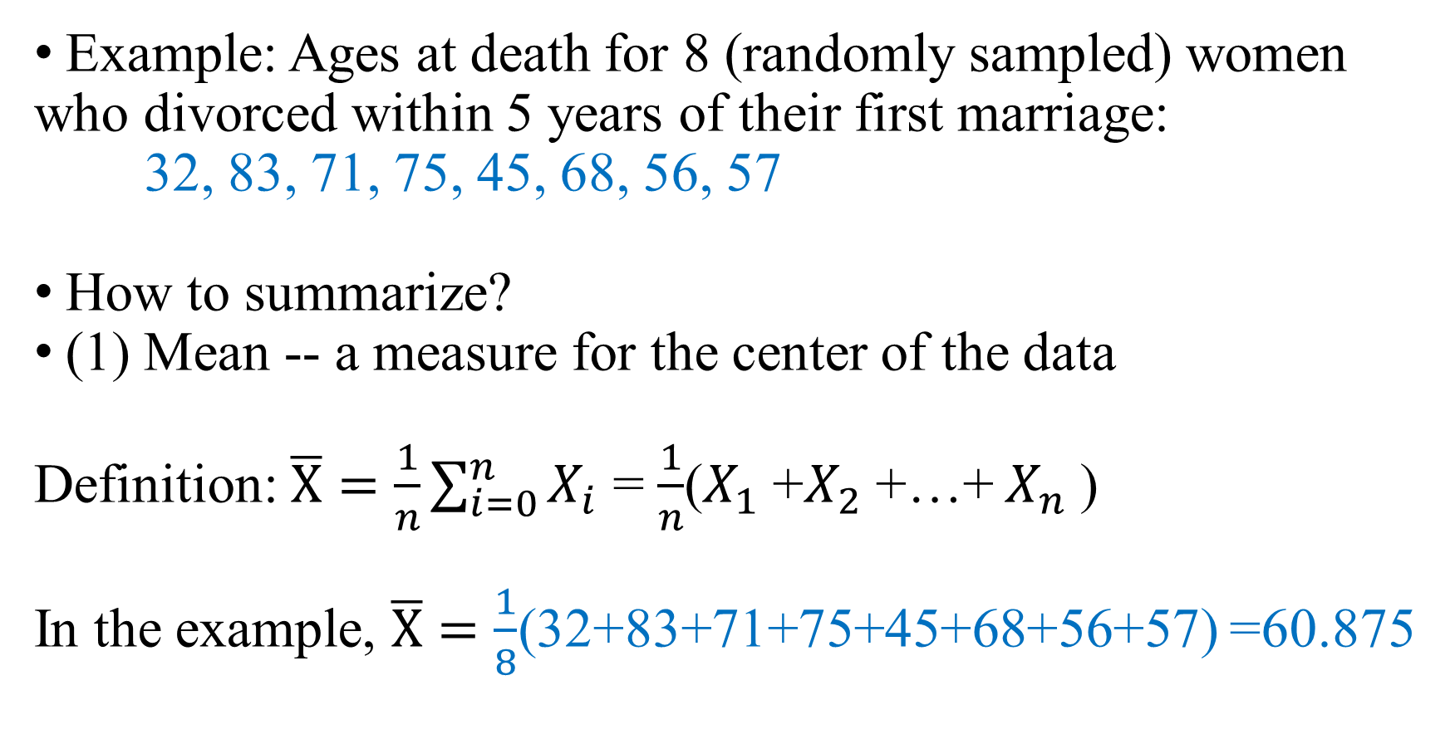
Descriptive Statistics: Numerical summary
Example: Ages at death for 8 (randomly sampled) women who divorced within 5 years of their first marriage:
32, 83, 71, 75, 45, 68, 56, 57
How to summarize?
(1) Mean -- a measure for the center of the data
Definition: $\overline{X}=\frac{1}{n}\sum_{i=0}^{n}{X_{i}}$ = $\frac{1}{n}$($X_{1}$+$X_{2}$+…+ $X_{n}$)
In the example, $\overline{X}=\frac{1}{8}$(32+83+71+75+45+68+56+57) =60.875

Slide 33
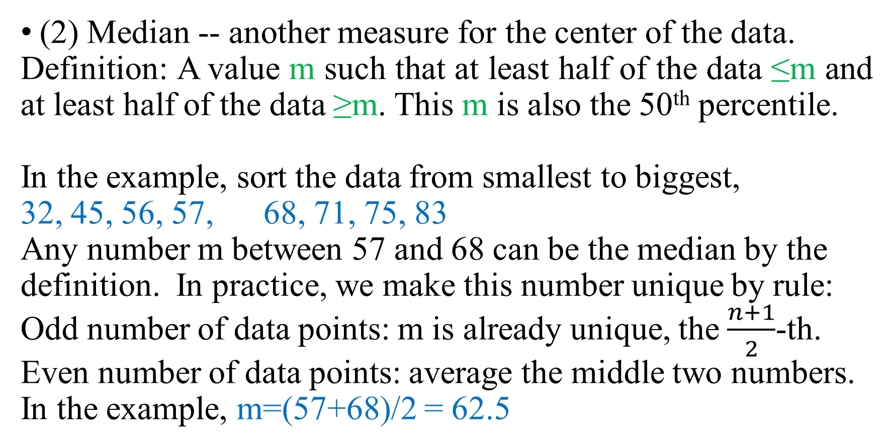
Descriptive Statistics: Numerical summary
(2) Median -- another measure for the center of the data.
Definition: A value m such that at least half of the data ≤m and at least half of the data ≥m. This m is also the 50th percentile.
In the example, sort the data from smallest to biggest,
32, 45, 56, 57, 68, 71, 75, 83
Any number m between 57 and 68 can be the median by the definition. In practice, we make this number unique by rule:
Odd number of data points: m is already unique, the $\frac{n+1}{2}$-th.
Even number of data points: average the middle two numbers.
In the example, m=(57+68)/2 = 62.5

Slide 34
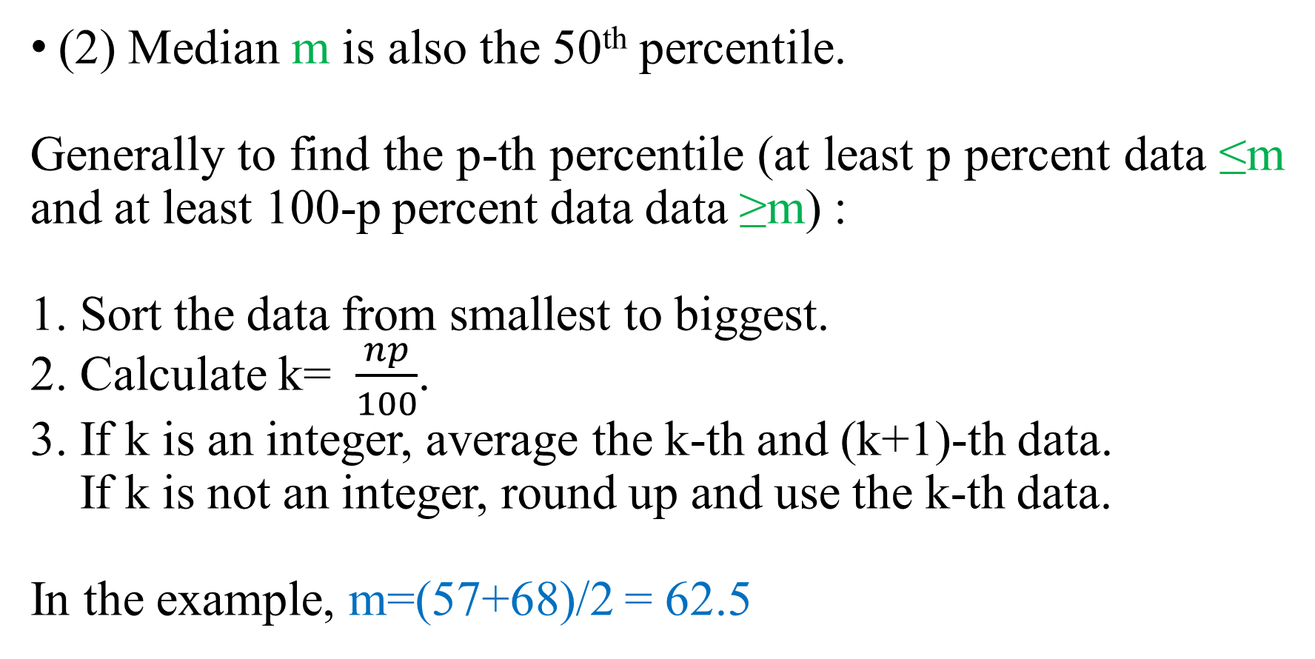
Descriptive Statistics: Numerical summary
(2) Median m is also the 50th percentile.
Generally to find the p-th percentile (at least p percent data ≤m and at least 100-p percent data data ≥m) :
1. Sort the data from smallest to biggest.
2. Calculate k= $\frac{np}{100}$.
3. If k is an integer, average the k-th and (k+1)-th data.
If k is not an integer, round up and use the k-th data.
In the example, m=(57+68)/2 = 62.5

Slide 35
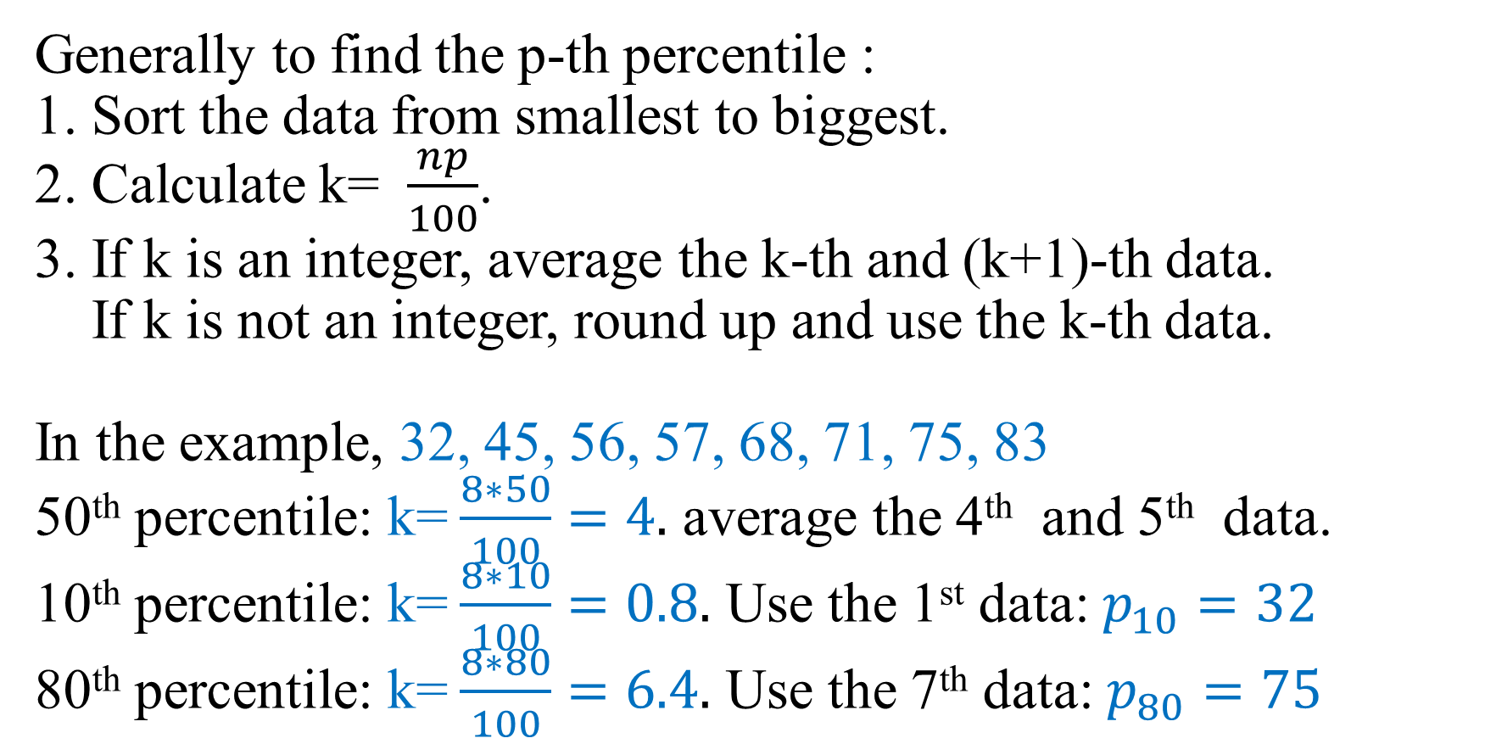
Descriptive Statistics: Numerical summary
Generally to find the p-th percentile :
1. Sort the data from smallest to biggest.
2. Calculate k= $\frac{np}{100}$.
3. If k is an integer, average the k-th and (k+1)-th data.
If k is not an integer, round up and use the k-th data.
In the example, 32, 45, 56, 57, 68, 71, 75, 83
50th percentile: k= $\frac{8∗50}{100}=4.$ average the 4th and 5th data.
10th percentile: k= $\frac{8∗10}{100}=0.8.$ Use the 1st data: $p_{10}=32$
80th percentile: k= $\frac{8∗80}{100}=6.4.$ Use the 7th data: $p_{80}=75$

Slide 36
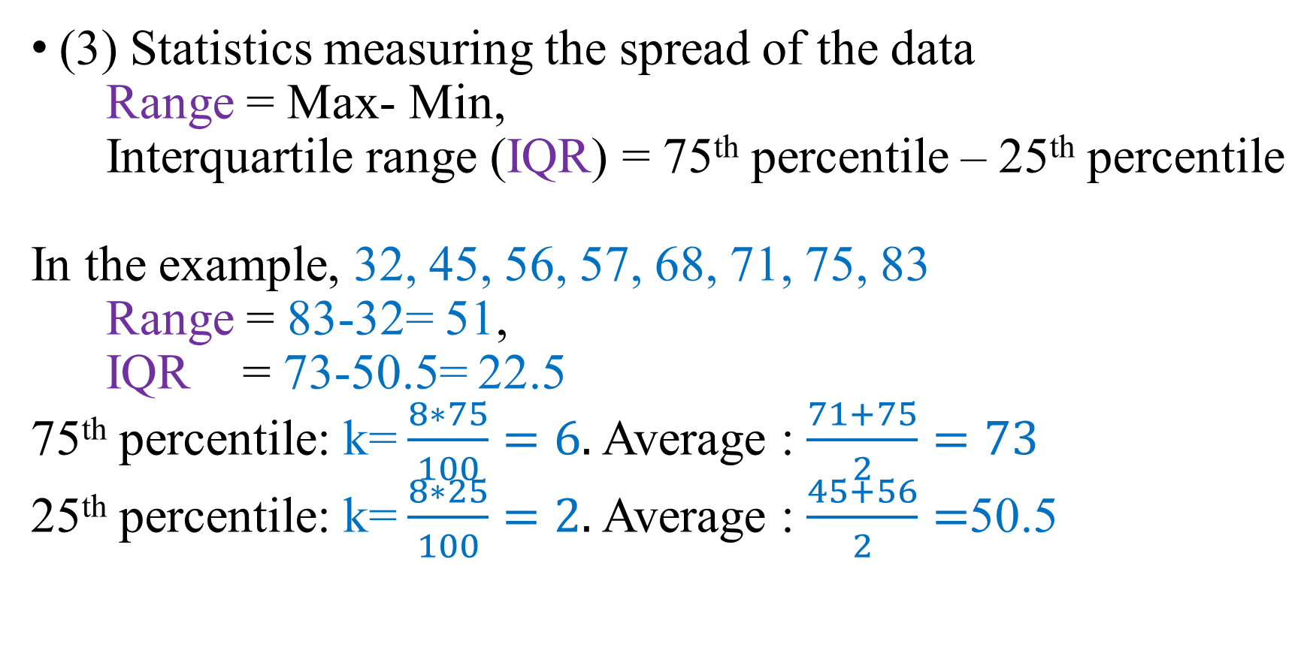
Descriptive Statistics: Numerical summary
(3) Statistics measuring the spread of the data
Range = Max- Min,
Interquartile range (IQR) = 75th percentile – 25th percentile
In the example, 32, 45, 56, 57, 68, 71, 75, 83
Range = 83-32= 51,
IQR = 73-50.5= 22.5
75th percentile: k= $\frac{8∗75}{100}=6.$ Average : $\frac{71+75}{2}=73$
25th percentile: k= $\frac{8∗25}{100}=2.$ Average : $\frac{45+56}{2}=$50.5

Slide 37
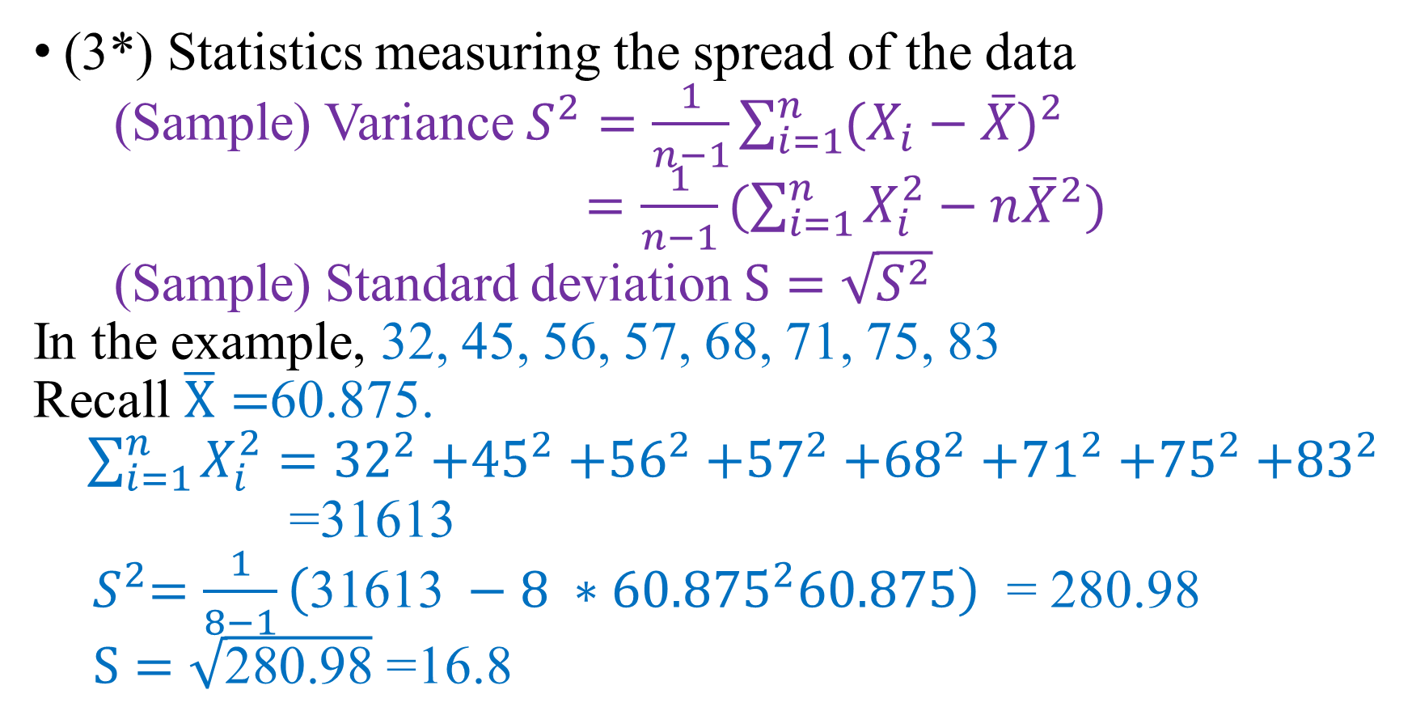
Descriptive Statistics: Numerical summary
(3*) Statistics measuring the spread of the data
(Sample) Variance $S^{2}=\frac{1}{n−1}\sum_{i=1}^{n}{{(X_{i}−\overline{X})}^{2}}$
$=\frac{1}{n−1}(\sum_{i=1}^{n}{X_{i}^{2}−n{\overline{X}}^{2}})$
(Sample) Standard deviation $S=\sqrt{S^{2}}$
In the example, 32, 45, 56, 57, 68, 71, 75, 83
Recall $\overline{X}=$60.875.
$\sum_{i=1}^{n}{X_{i}^{2}}={32}^{2}{+45}^{2}$ ${+56}^{2}$ ${+57}^{2}$ ${+68}^{2}$ ${+71}^{2}$ ${+75}^{2}$ ${+83}^{2}$
=31613
${ S}^{2}=\frac{1}{8−1}\left(\text{31613} −8 ∗{60.875}^{2}60.875\right)$ = 280.98
$S=\sqrt{\text{280.98}}$ =16.8

Slide 38
Descriptive Statistics
Summary the data graphically or numerically.
Technically easy: Histogram, scatter plot, boxplot, range, IQR, mean, median, variance, etc.
Still need to consider: are we using statistics properly? We will continue next lecture.

