Slide 1
EDA Mini project Pranav Godse
PGP – Data Science and Engineering
Mumbai June 2021 batch

Slide 2
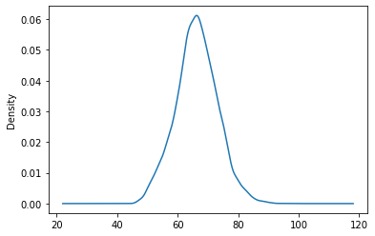
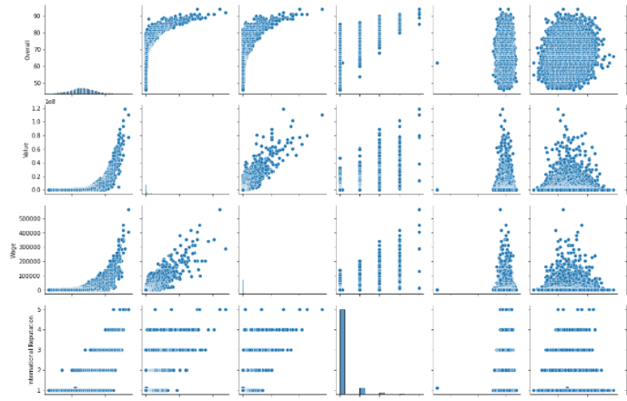
Distribution of overall rating for all players: Pair plots : Overall, Value, Wage, International Reputation, Height, Weight, Release Clause
The distribution of the overall ratings for all players is slightly positively skewed having a skewness of 0.067185.

Slide 3
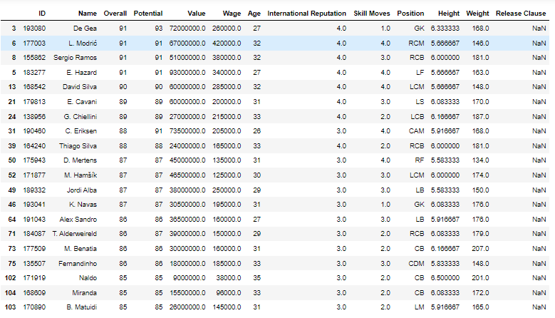
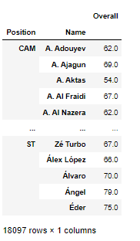
Table containing the top 20 players ranked by overall score and whose contract expires in 2020:
Table containing the top 5 players by overall rating for each unique position
The average wage of top 20 players by overall rating is 205450.0
The average age of top 20 players by overall rating is 30.65
There is a correlation between the Overall rating and Value for these players, it is 0.627085

