Slide 1
Illegal Mining Detector
Finding new mining disturbance from satellite images, and checking it against legal concessions
Sentinel-2 imagery | machine learning | Streamlit app
Notes:
Introduce the project: a tool that compares two satellite dates and flags new mining ground, then labels each site legal, disputed or illegal.

Slide 2
Illegal mining is hard to watch
1
2
3
Remote and large
Changes fast
Needs a legal check
Mining areas sit in forests and highlands that rangers cannot patrol often.
New pits and clearings can appear between two site visits.
A detection only matters if you know whether the land is licensed.
Satellites revisit every few days for free. The tool turns two images into a short, checkable list of alerts.

Slide 3
How it works: five steps
1
2
3
4
5
Fetch
Prepare
Detect
Compare
Report
Two cloud-free Sentinel-2 scenes, a year apart
Clean the bands and compute spectral indices
Learn mining from public footprint labels
Keep ground that is mining now but was not before
Check licences, then export GeoJSON, CSV and HTML
Offline demo: about 10 seconds on synthetic data. Real example: about 30 seconds.

Slide 4
Five objectives, each a module
O1
Data acquisition
Find, read and clean two scenes
O2
Mining detection
Learn from labelled examples; compare models
O3
Change detection
Find ground that changed between the dates
O4
Legal status
Legal, disputed or illegal against concessions
O5
Alert export
GeoJSON, CSV and a one-page HTML report

Slide 5
Detection: honest model selection
Features
Spectral indices from the Sentinel-2 bands, each date normalized on its own.
Labels
Public Global Mining Footprint polygons (weak, coarse labels).
Models
Logistic regression, random forest, SVM and gradient boosting compared on a validation split.
Split
Three-way spatial blocks. The test set is scored once, so scores are not tuned on it.

Slide 6
Result on the real example area
11
15.9 ha
0.985
new disturbance alerts
total new area
test F1 (held-out blocks)
Selected model: gradient boosting. Test precision 0.984 and recall 0.987, from a spatial hold-out inside one area. This says nothing about other terrain, so it is not a claim of accuracy elsewhere.

Slide 7
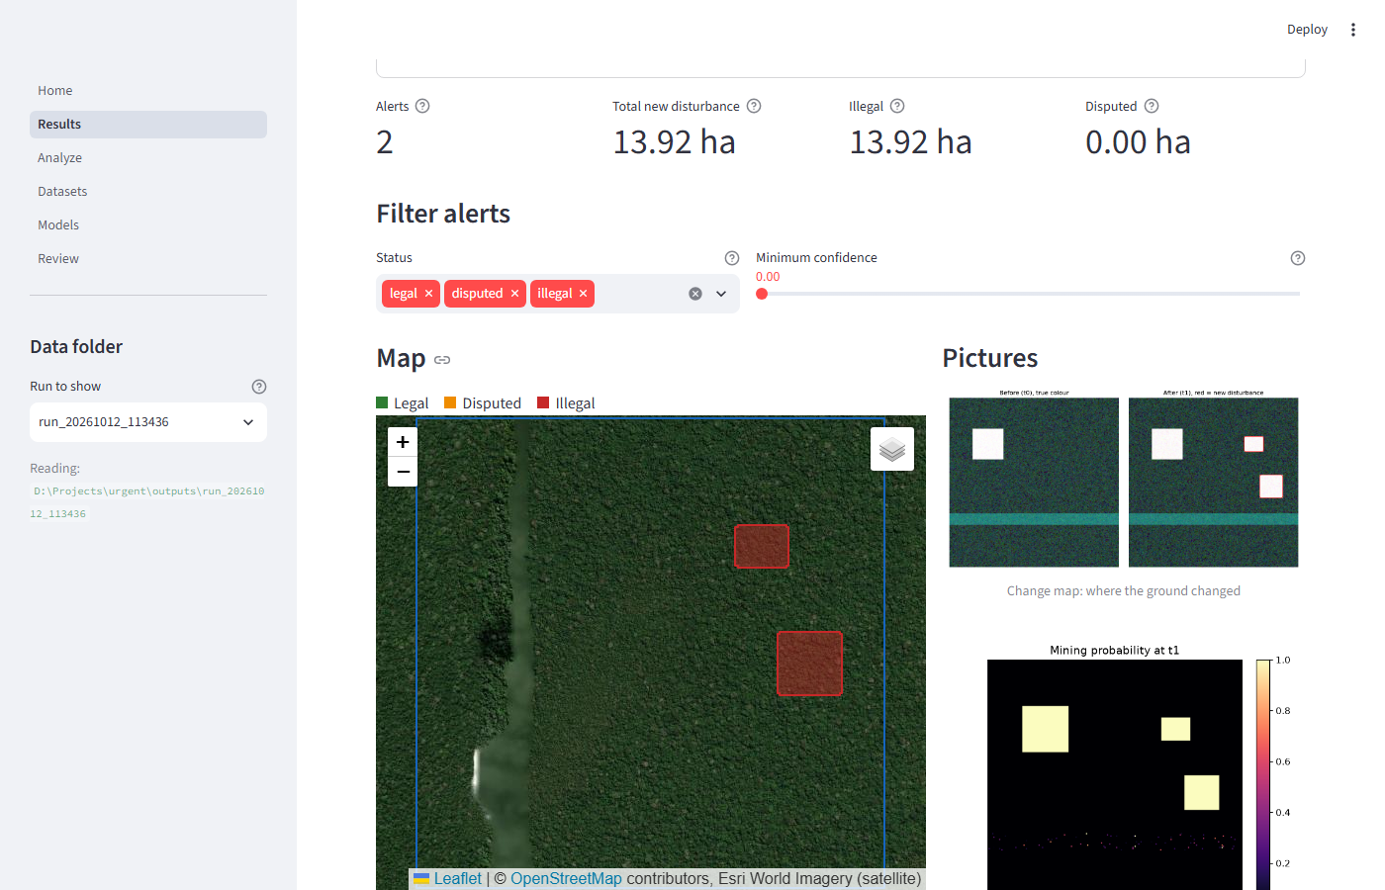
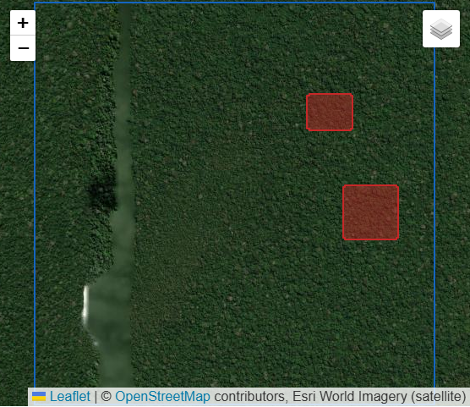
The app: no GIS skills needed
Analyze, Results, Review, Models and Datasets pages. Downloads: GeoJSON, CSV, HTML report.

Slide 8
Each alert gets a legal status
Legal
Disputed
Illegal
Inside a valid concession
Overlaps a boundary or an unclear licence
No concession covers it
Alerts are leads to investigate, not legal findings. Confirm against official concession records.

Slide 9
Honest limitations
Labels are public and coarse; expect noise.
Scores come from one area; no claim for new regions.
Roads, quarries, farms and burn scars can look like mining.
Small patches can be missed (cloud masking, 0.5 ha minimum).
Deep-learning models were trained on synthetic data only.

Slide 10
Next steps
Real deep models
1
Train on the Open-Pit dataset once it is available; the page then reports real scores.
More regions
2
Add labelled sites from other terrain and validate with field checks.
Cut false alarms
3
Add a look-alike class for roads, quarries and farms.

Slide 11
Thank you
Run it: scripts\run_app.bat | python -m mining_detector live --example
Data: Copernicus Sentinel-2; Global Mining Footprint (Maus et al., 2022, CC BY-SA 4.0)

