Slide 1
MPCA LAB MINI PROJECT
PROJECT TITLE: Water tank level detector
SECTION: F1
STUDENTS NAME: Pranav R. Hegde & Pratheek P
SRNs: PES1UG19CS343 & PES1UG19CS348

Slide 2
PROBLEM STATEMENT
Our project aims to create a fully automated water tank system.

Slide 3
INTRODUCTION
Through this project we aim to build a fully automated water tank that notifies you when your water tank fills up. An ultrasonic distance sensor takes note of the water level in a water tank at every instance and displays it on the serial monitor, and when the water level crosses a particular level(limit), the piezo buzzer goes on and the motor stops fetching water.

Slide 4
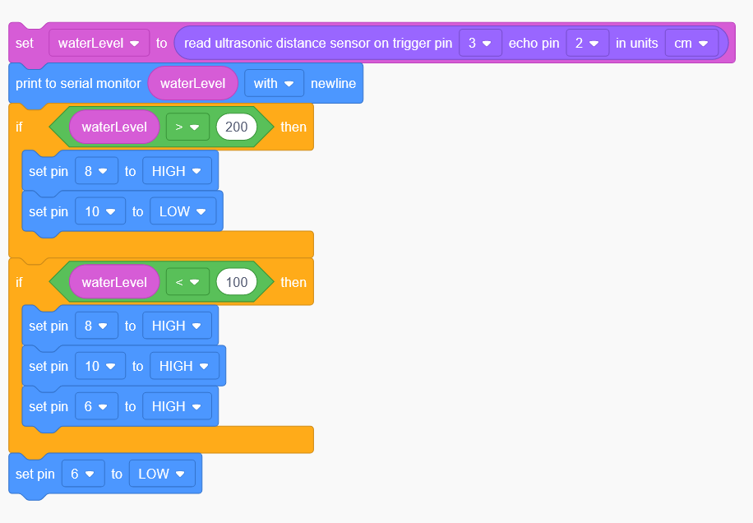
BLOCK DIAGRAM

Slide 5
REQUIRED COMPONENTS
The components used in this project are:
• Ultrasonic distance sensor
• Piezo buzzer
• Arduino Uno R3
• DC motor
• L239D H motor bridge driver
• Bread board and wires

Slide 6
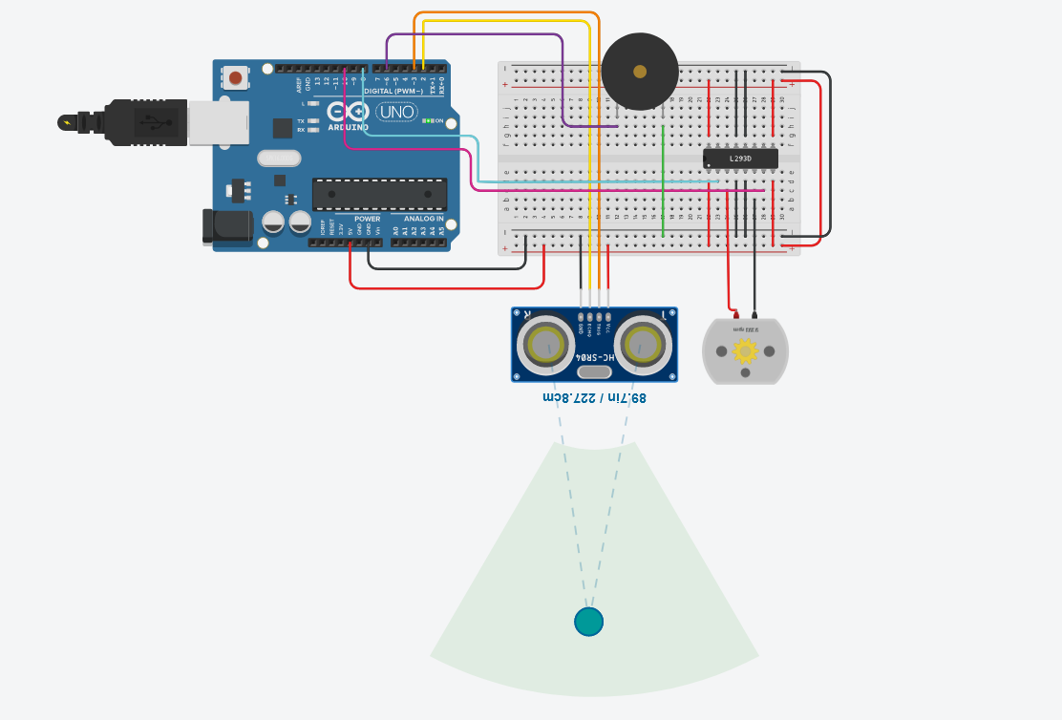
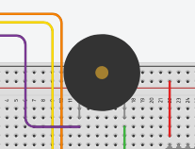
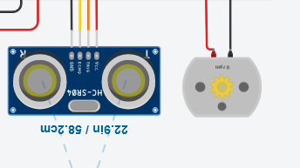
PROJECT DESCRIPTION/DEMONSTRATION

Slide 7
APPLICATIONS
Can be used in modern households to save huge amounts of water.
Can be used in farms and fields for watering the plants.

Slide 8
REFERENCES(Website links, Books etc.)
Reference video on water tank level detector:
https://www.youtube.com/watch?v=nmb4qhOKgso
• TinkerCad basics via TinkerCad YouTube channel:
https://youtube.com/tinkercad
• Working with sensors and other TinkerCad components by MPCA Lab
faculty:
https://www.instructables.com/Water-Level-Indicator-Using-Arduino-in-TinkerCad
• TinkerCad project demo video by seniors:
https://drive.google.com/file/d/1Yt-koNVotj5KRSpaso-_2C-4saZrLsZx/view?usp=drive_web

Slide 9
THANK YOU

