Slide 1

Walchand College of Engineering
(Government Aided Autonomous Institution)
Vishrambag, Sangli, 416415
Department of Computer Science & Engineering
Presentation on
1947
“Sustainable Caching Integration for Monolith API Framework”
AY:2023-24
Team Member:
2020BTECS00040: Pranav Dilip Hingankar
Under the guidance of
Prof. Siddharaj Pujari
Mr. Raunak Mali, NICE Systems
Date: 01/03/2024

Slide 2
AGENDA
Problem statement
Objectives
Methodology
Flow chart
Architecture Diagram
Outcomes
Technology stack
Conclusion

Slide 3
Problem statement
•To introduce sustainable caching to alleviate strain, particularly for frequently accessed APIs, aiming to enhance overall system performance.

Slide 4
Objectives
Implement efficient caching in the Monolith API.
Create POCs for diverse caching strategies.
Align caching mechanisms with architectural goals.
Evaluate caching solutions' performance and scalability.
.

Slide 5
Methodolgy
Identify Performance bottlenecks
Implement various caching techniques
Using techniques such as Write-Through, Cache-Aside etc
Using Redis Pub/Sub features
Determines optimal caching strategies based on real-time data
Notes:
Dataset - DeepFake Detection Challenge, FaceForensic++, CelebDF
ResNext o/p 2048 dimensional feature vector
1 LSTM layer with 2048 latent dimension and 2048 hidden layer with 0.4 dropout rate.

Slide 6
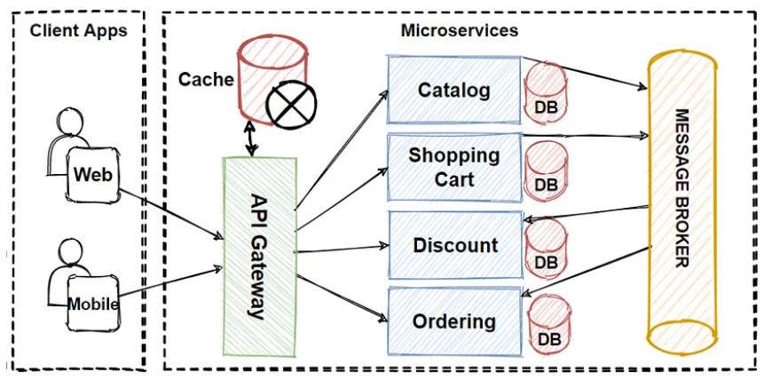
Architecture Diagram

Slide 7
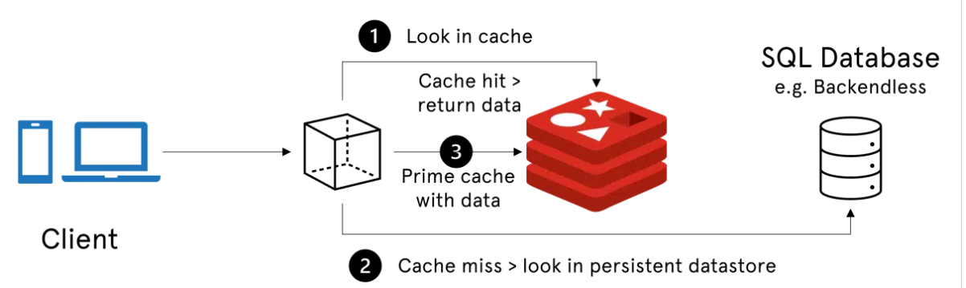
Diagram

Slide 8
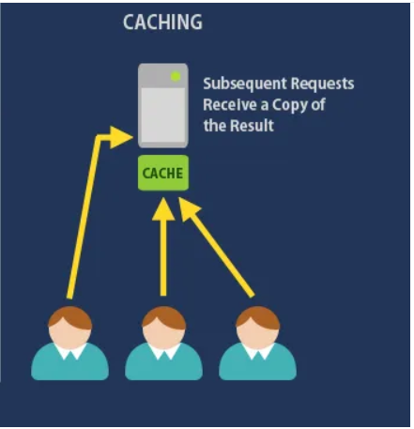
Ambiguity
Notes:
Dataset - DeepFake Detection Challenge, FaceForensic++, CelebDF
ResNext o/p 2048 dimensional feature vector
1 LSTM layer with 2048 latent dimension and 2048 hidden layer with 0.4 dropout rate.

Slide 9
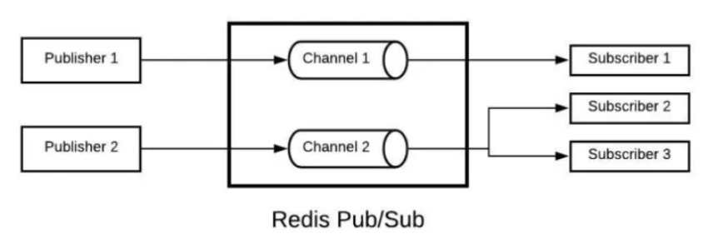
Diagram

Slide 10
Outcomes
Improved System Performance
Reduced Server Load
Optimized Resource Utilization
Scalability and Flexibility

Slide 11
Technology Stack
SOFTWARE & HARDWARE SPECIFICATION
C# Microsoft SQL server Redis Cache Jira

