Slide 1




SMART INDIA HACKATHON 2026
  Problem Statement ID – 26102
  Problem Statement Title - Development of an AI-Powered System to Detect Anomalies, Fraud, and Inefficiencies in MPLAD Scheme Implementation
  Theme - Smart Automation
  PS Category - Software
  Team ID - 160741
  Team Name - CODEHOLICS

Slide 2
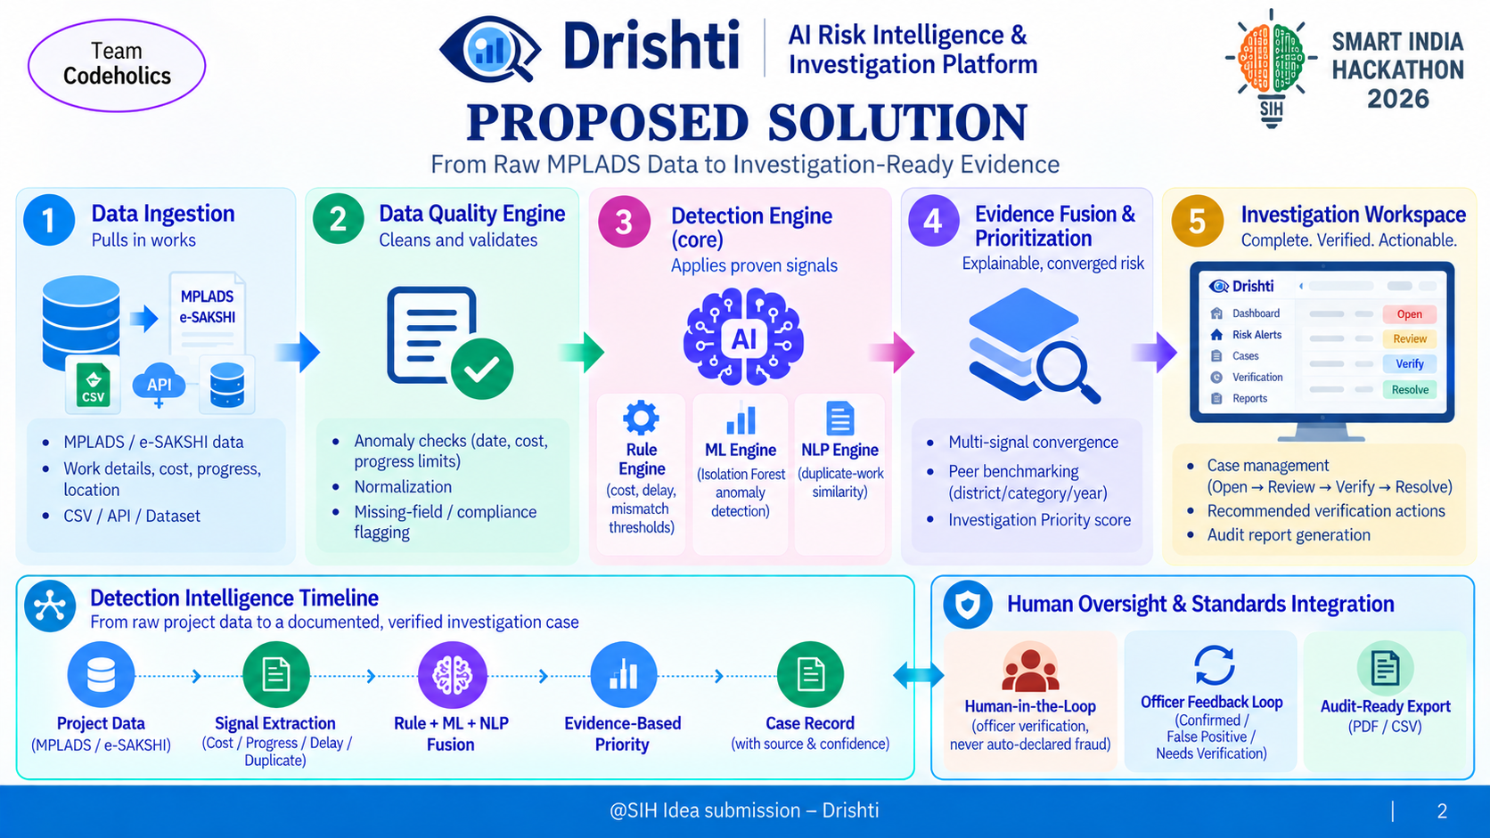

Slide 3
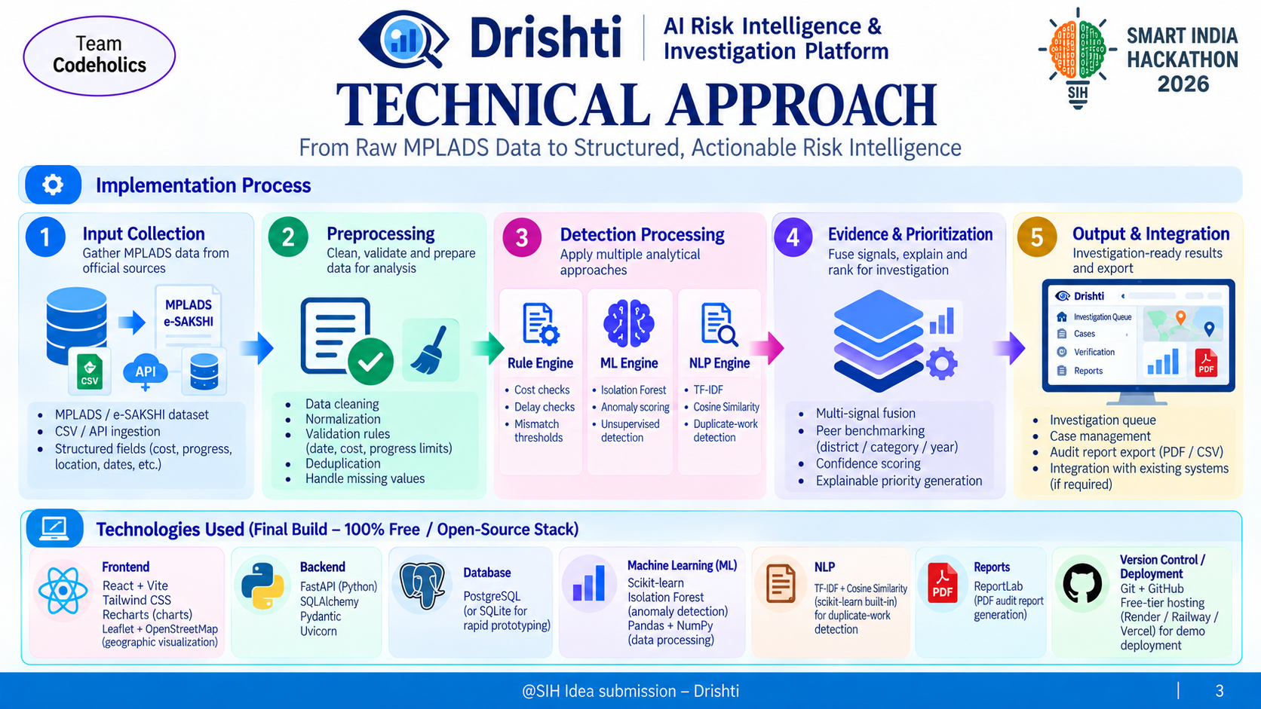

Slide 4
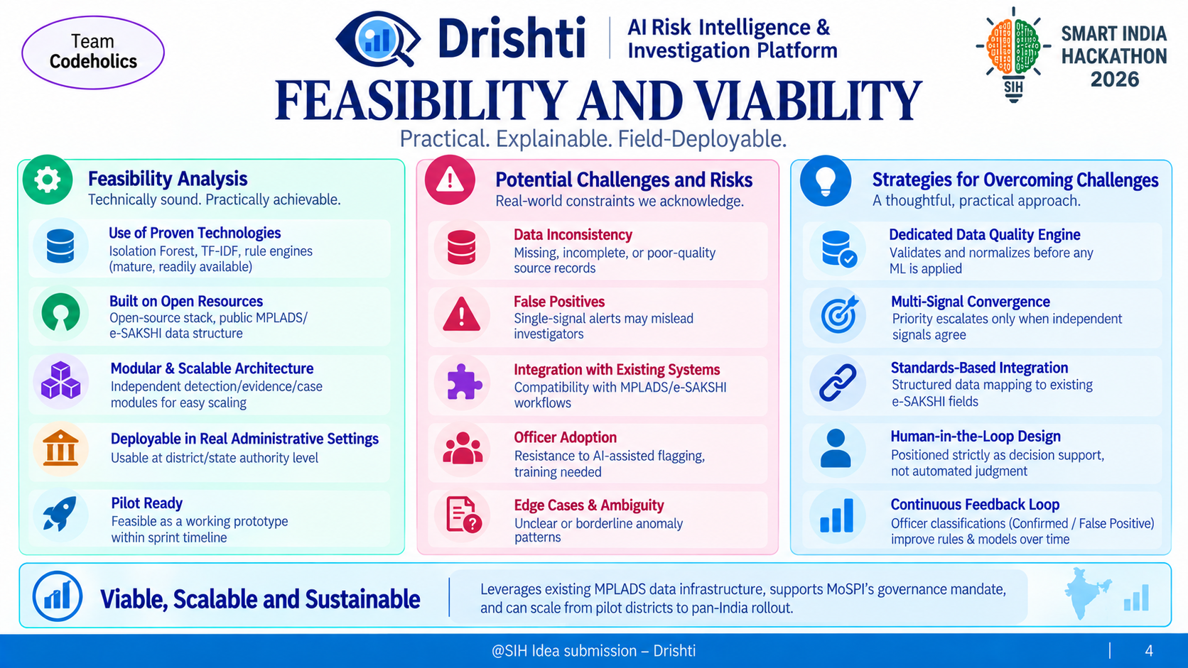

Slide 5
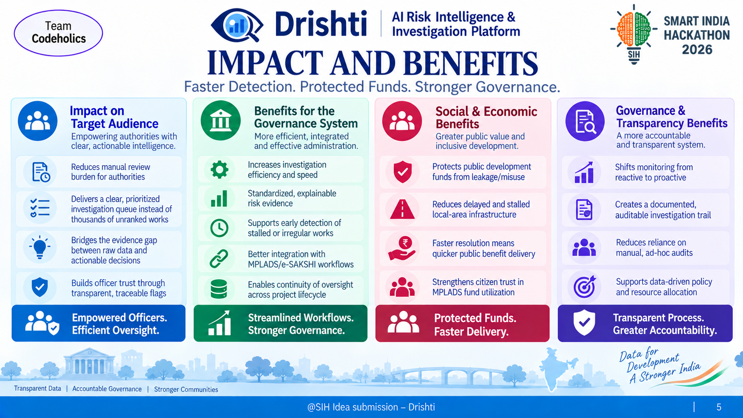

Slide 6
RESEARCH AND REFERENCES
Team
Codeholics
Detection Methodology
  Isolation Forest — scikit-learn docs:
https://scikit-learn.org/stable/modules/generated/sklearn.ensemble.IsolationForest.html
  Original Isolation Forest paper (Liu, Ting & Zhou, 2008):
https://cs.nju.edu.cn/zhouzh/zhouzh.files/publication/icdm08b.pdf
  TF-IDF + Cosine Similarity (duplicate-work detection):
https://scikit-learn.org/stable/modules/feature_extraction.html#tfidf-term-weighting
Domain & Dataset
  MPLADS Dataset / Dashboard (official, PS-provided):
https://mplads.mospi.gov.in/digigov/dashboard.html
  MPLADS Scheme Guidelines (MoSPI): https://mplads.gov.in
Audit Standard (rule-library grounding)
  CAG Audit Reports: https://cag.gov.in/en/audit-report
Project Related Links
  YouTube video :
  Github repo :
@SIH Idea submission- Template
6

