Slide 1




REAL TIME AIR QUALITY INDEX FROM VARIOUS LOCATIONS Source: https://www.data.gov.in/ Dataset: Real time air quality index from various locations Email: pranavisreeja05@gmail.com Github : https://github.com/pranavi-sreeja LinkedIn : www.linkedin.com/in/pranavi-mannava-5905982b4
Indian Government Dataset Analysis
Pranavi Sreeja Mannava

Slide 2
Introduction
This presentation provides an analysis of the air-quality index of various locations in India.
- Pollution levels of different states
- Dangerous pollutants
- Pollution levels in different cities
- Comparison of pollution levels across various cities
- Key insights and conclusions

Slide 3
Initial Analysis of the Dataset
Dataset Overview:
* The dataset contains 3,312 rows and 11 columns.
* It records the pollution levels across various states and cities in India.
* The dataset has 196 missing values.
* The data types include text (categorical) and numerical values.
Key Analysis:
*The dataset contains pollution data from various cities and monitoring stations across India.
*Some states and cities have higher concentrations of specific pollutants than others.
*The dataset includes pollutants like PM10, NO2, CO, OZONE, and NH3.
*PM10 and NO2 are among the most frequently recorded pollutants.
*Pollution levels vary by state and city, possibly due to industrial activity, vehicle emissions, and population density.

Slide 4
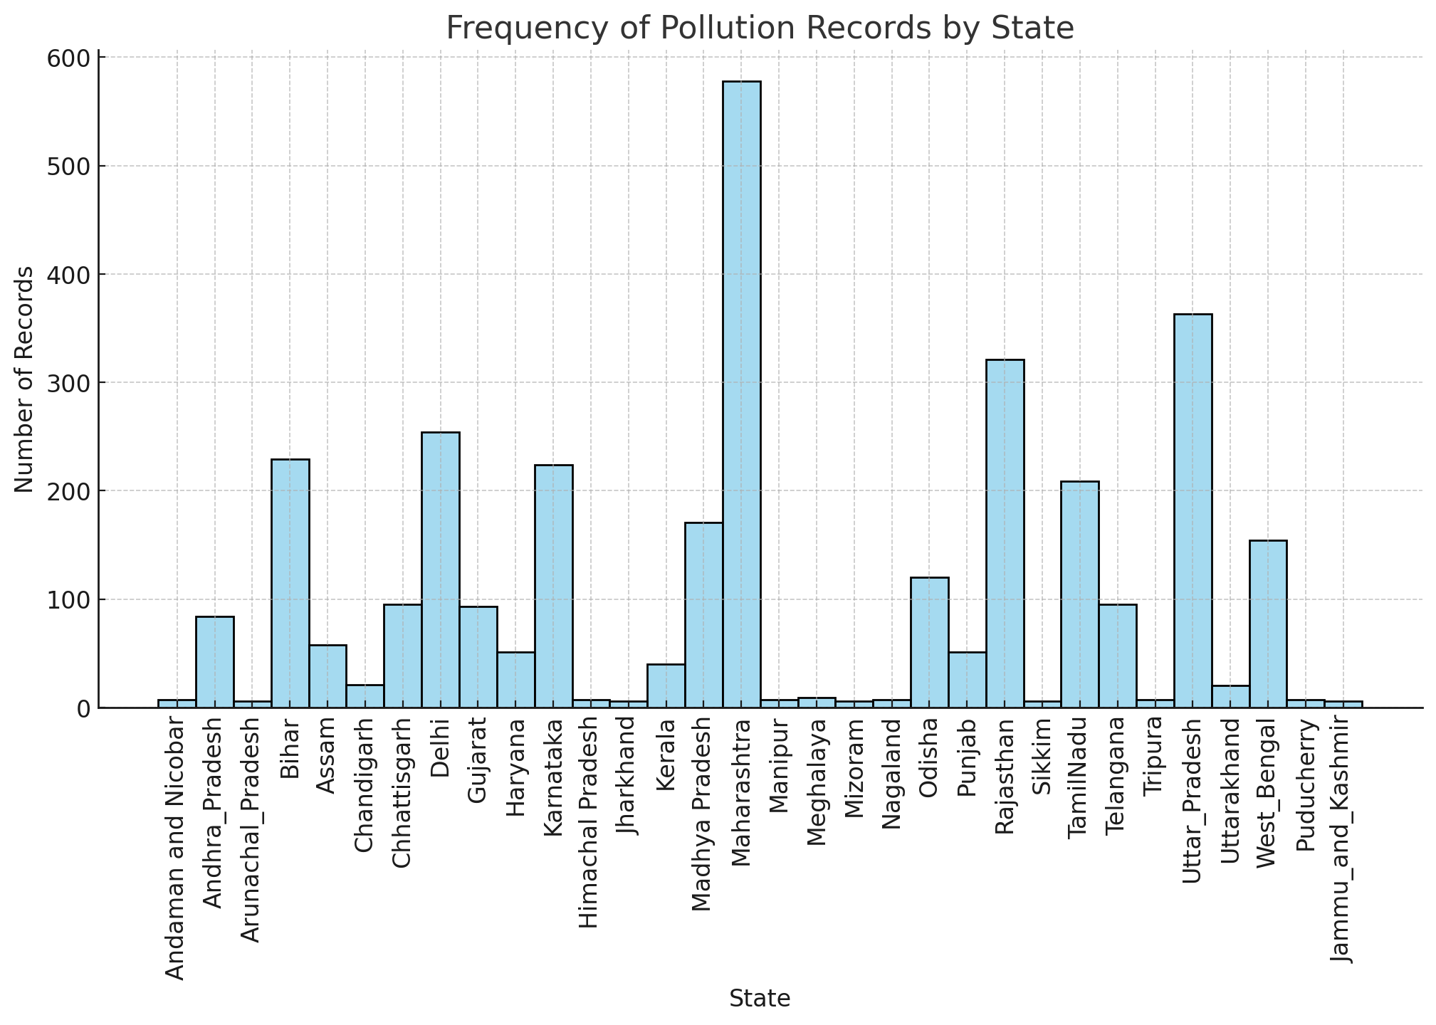
Frequency of pollution records by state
The histogram shows the pollution levels across different states and Maharashtra is recorded the highest

Slide 5
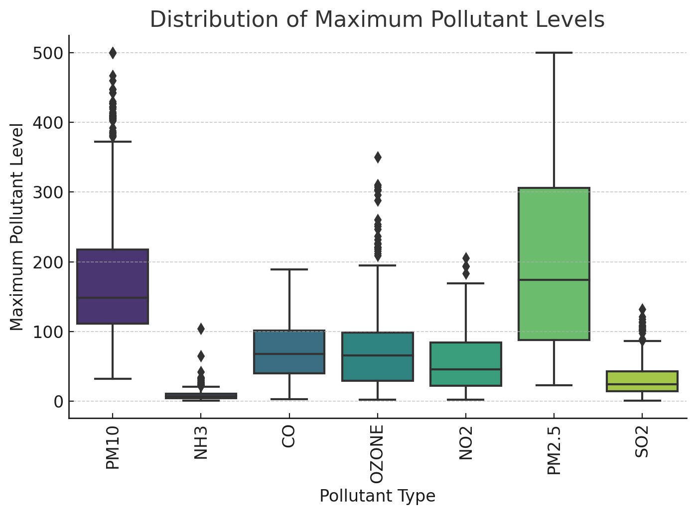
Distribution of Maximum Pollutant Levels
The boxplot shows that there is high variation in pollution levels across different pollutants.

Slide 6
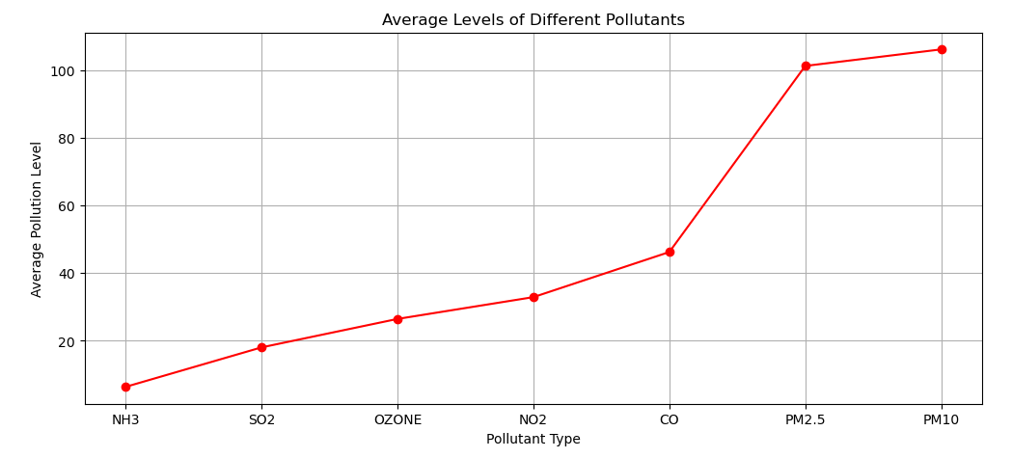
Different Pollutant Levels
This line plot visualizes different pollutant types and their concentration
It reveals that PM10 is the most dangerous pollutant

Slide 7
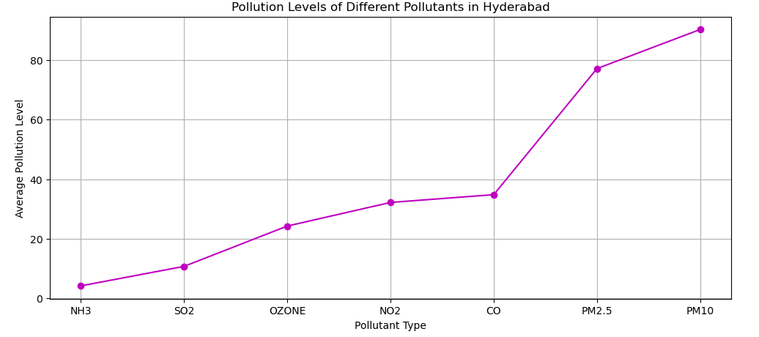
Different Pollutants in Hyderabad
This line plot shows the different pollutants affection Hyderabad
It reveals that PM10 pollutant which is dangerous is affecting the air-quality of Hyderabad mostly.

Slide 8
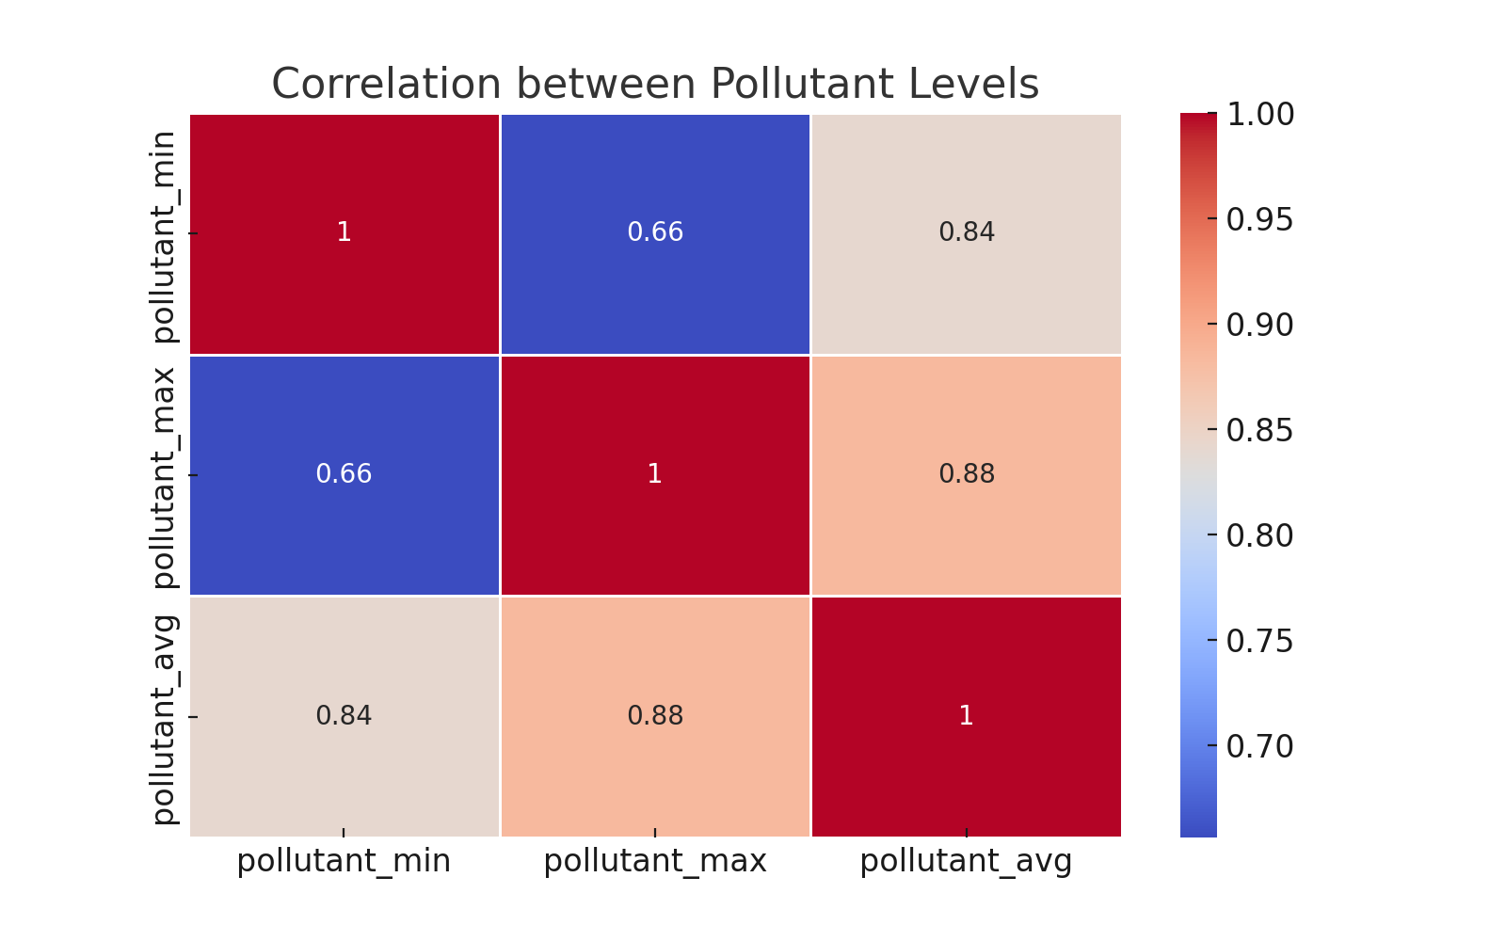
Heatmap of Pollutant Levels
This heatmap represents the correlation between different pollutant levels: pollutant_min, pollutant_max, and pollutant_avg.
The average pollution level is most strongly affected by the maximum pollution level.

Slide 9
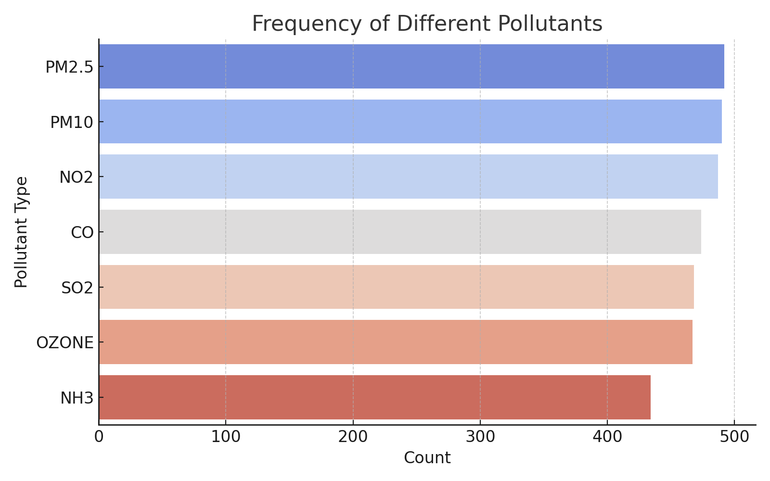
Frequency of Different Pollutants
NH3 (Ammonia) appears to be the most frequently recorded pollutant, followed closely by OZONE and SO2.
PM2.5 and PM10 (Particulate Matter) are also highly frequent pollutants, indicating concerns about air quality due to fine particulate matter.

Slide 10
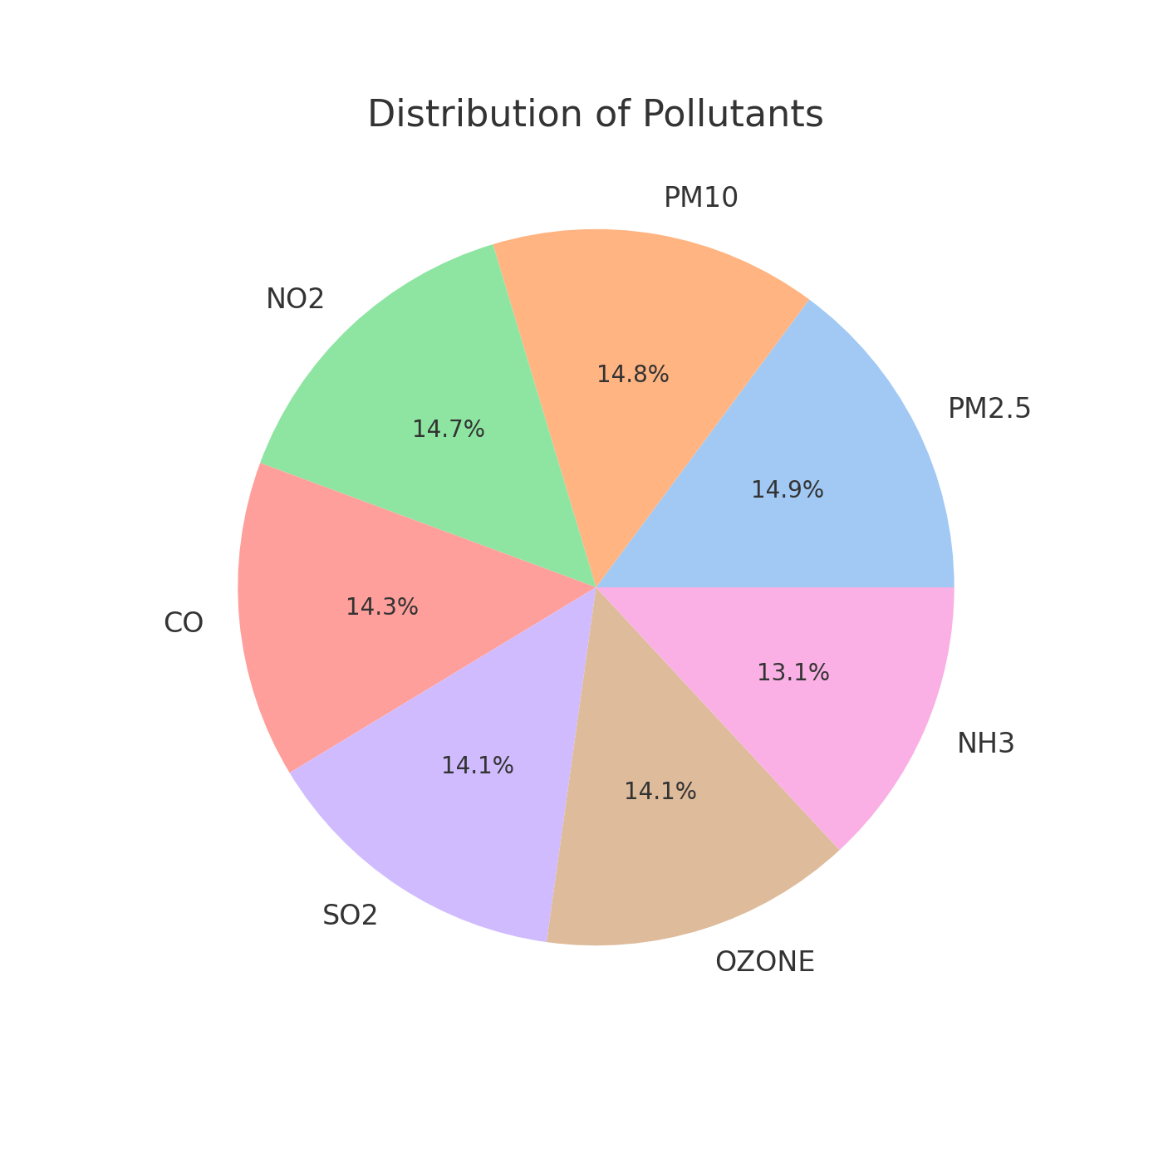
Pollutants Distribution
This pie chart displays the pollutants and their percentage levels affection the air quality
It shows that PM2.5 is dangerous pollutant

Slide 11
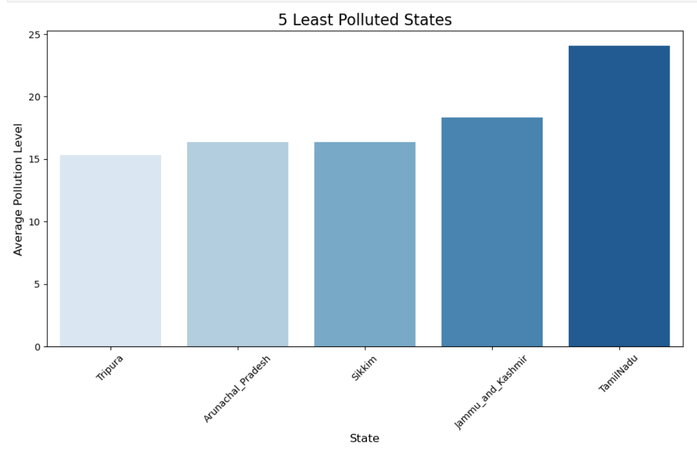
Least Polluted States
This bar plot shows the least polluted states
It draws the conclusion that Tripura is the least polluted state

Slide 12
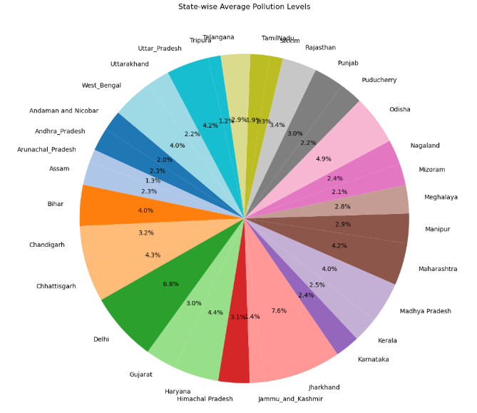
State-wise Pollution levels
This pie-chart displays the pollution levels of all the states
The pie chart depicts that JHARKHAND is the highest polluted state The lowest polluted state is TRIPURA

Slide 13
Dataset Observation
1. Date Range & Missing Data:
- The dataset has 196 missing values
- The missing values are replaced with median for better efficiency
2. High Pollution in Major Cities:
- Cities like Delhi, Mumbai, Hyderabad, and Kolkata have consistently high pollution levels due to heavy traffic and industrial activities.
3. Dominant Pollutants:
- PM10 and NO2 are the most common pollutants, indicating that vehicle emissions and construction activities are major contributors to pollution.
- Some cities show higher levels of NH3, likely due to agricultural activities and waste processing.

Slide 14
Dataset Observation
4. Statistical Insights:
- The T-test confirmed that PM10 and NO2 levels are significantly different, meaning they may come from different sources.
- The Chi-Square Test showed no significant relationship between the type of pollutant and the city, meaning pollution sources are common across multiple cities.
5. Pollution Spikes in Urban Areas:
- Metropolitan areas experience frequent pollution spikes, while smaller cities show more stable pollution levels.

Slide 15
Conclusion
The analysis of the air quality data gave important insights into pollution levels across different cities in India.
After cleaning and organizing the data, it was clear that big cities like Delhi, Mumbai, and Hyderabad have higher pollution levels because of traffic and factories.
Pollution levels were higher in winter due to more emissions and less air movement, while they dropped during the rainy season as rain helped clear the air.
the analysis suggests that pollution in big cities is mainly due to traffic and industrial activities.
To improve air quality, stricter pollution control measures, better traffic management, and cleaner industrial practices are needed.

