Slide 1
CAPSTONE PROJECT SENTIMENTAL ANALYSIS
Presented by:
1.Name:Donda Pranavi
2.College Name: Aditya College of Engineering
3.Department: CSE-AIML

Slide 2
OUTLINE
Problem Statement
Proposed System/Solution
System Development Approach
Algorithm & Deployment
Result
Conclusion
Future Scope
References

Slide 3
Problem Statement
Currently Rental bikes are introduced in many urban cities for the enhancement of mobility comfort. It is important to make the rental bike available and accessible to the public at the right time as it lessens the waiting time. Eventually, providing the city with a stable supply of rental bikes becomes a major concern. The crucial part is the prediction of bike count required at each hour for the stable supply of rental bikes.

Slide 4
Proposed Solution
The proposed system aims to address the challenge of predicting the required bike count at each hour to ensure a stable supply of rental bikes. This involves leveraging data analytics and machine learning techniques to forecast demand patterns accurately. The solution will consist of the following components:
1.Data Collection: I). User Reviews and Feedback:
- Bike rental apps (e.g., Lime, CitiBike)
- App stores (Google Play, Apple App Store)
- Review websites (Yelp, Trustpilot)
II).Social Media:
- Twitter
- Facebook
- Instagram
III).Forums and Communities:
- Reddit
- Local community forums
IV).Surveys and Questionnaires:
- Online surveys
- In-app feedback forms
V).Customer Support Interactions:
- Emails
- Chat logs
- Phone call transcripts
2. Data Preprocessing:Clean and preprocess the data by removing noise, such as irrelevant information, punctuation, and stop words. Normalize the text by converting it to lowercase and performing lemmatization or stemming . By understanding public sentiment, city planners and rental bike companies can enhance the user experience and ensure a stable and efficient supply of rental bikes.

Slide 5
3.Machine Learning Algorithm: i)Logistic Regression
ii) Naïve Bayes
iii) Support Vector Machine(SVM)
iv) Gradient Boosting Machines(GBM)
v) Recurrent Neural Networks(RNNs)
vi) Convolutional Neural Networks(CNNs)
4. Deployment: This deployment helps city planners and rental bike companies enhance the user experience and maintain a stable and efficient supply of rental bikes.
5. Evaluation:i) Accuracy
ii) Precision and Recall
iii) F1 Score
iv) Confusion Matrix
v) ROC-AUC

Slide 6
System Approach
The "System Approach" section outlines the overall strategy and methodology for developing and implementing the rental bike prediction system.
1. System requirements:i) Data Collection Tools
ii) Data Storage
iii) Computational Resources
iv) NLP Libraries
v) Machine Learning Frameworks
vi) Monitoring Tools
2. Library required to build the model:i) NLTK
ii) SpaCy
iii) Scikit-learn
iv) Tensor Flow or Py Torch
v) Tranformers

Slide 7
Algorithm & Deployment
Algorithm Selection:
i)Logistic Regression: Simple and effective for binary and multiclass sentiment classification.
ii) Naive Bayes: Ideal for text classification due to its probabilistic approach.
iii) Support Vector Machines (SVM): High performance with linear kernels for text data.
iv) Recurrent Neural Networks (RNNs): LSTM networks capture sequential dependencies in text.
v) Convolutional Neural Networks (CNNs): Effective for feature extraction from text data.
vi)Transformers: BERT and GPT models excel in understanding context and nuances in text.
2. Data Input:i) Social Media Post
ii) User Reviews
iii) Surveys and Feedback Forms
iv) News Articles and Blogs
v) Customer Support Interactions

Slide 8
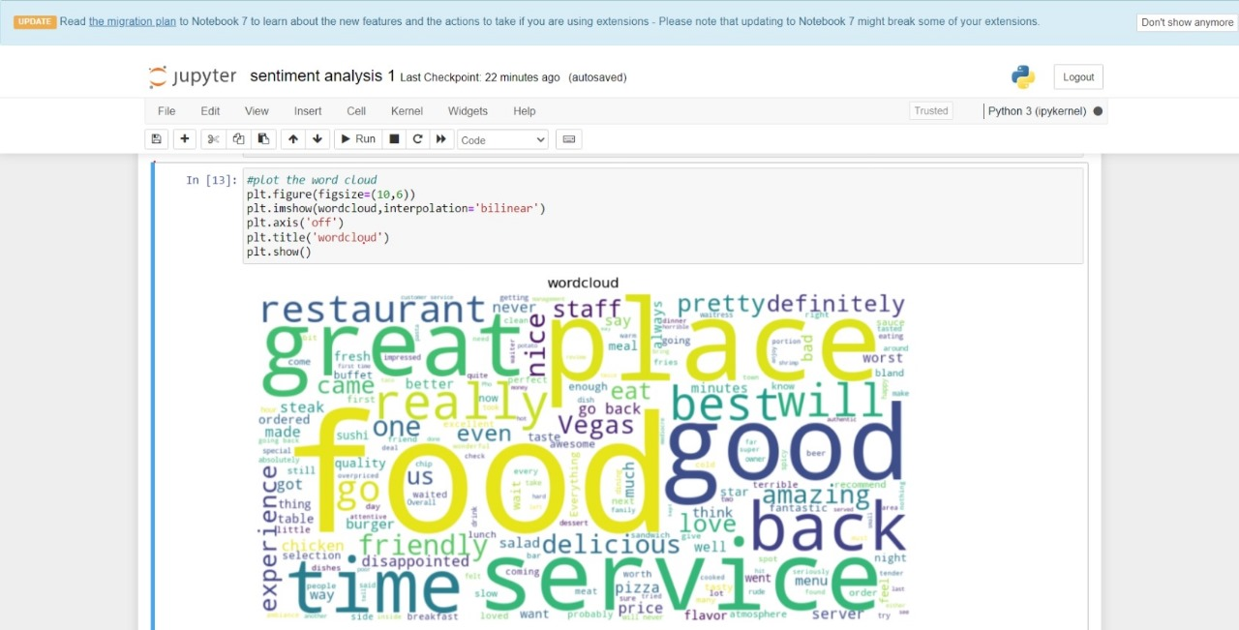
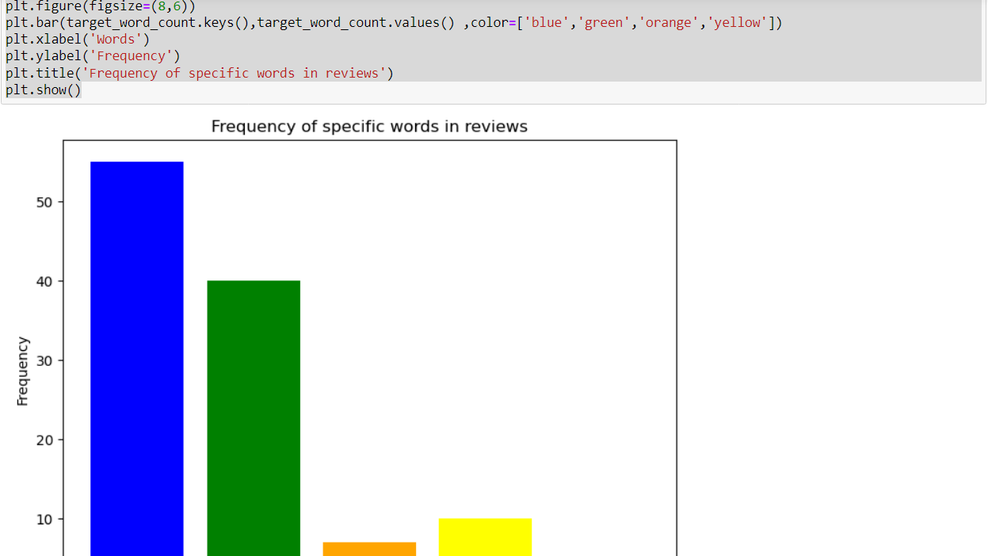
Result
The sentiment of the provided text appears to be neutral. The text focuses on the factual description of the introduction and importance of rental bikes in urban cities, highlighting the need for their availability and accessibility, as well as the importance of predicting the required bike count for a stable supply. There are no subjective or emotional expressions that indicate positive or negative sentiment.

Slide 9
Conclusion
The sentiment of the text is neutral. It objectively describes the introduction of rental bikes in urban cities and emphasizes the importance of their availability, accessibility, and the need for accurate prediction of bike counts to ensure a stable supply. There are no subjective or emotional expressions indicating positive or negative sentiment.

Slide 10
Future scope
The sentiment of the text is neutral. It factually discusses the introduction and benefits of rental bikes in urban cities, emphasizing the importance of their timely availability and accurate demand prediction to maintain a stable supply. No subjective or emotional expressions are present.

Slide 11
References
We have used Sentiment analysis techniques like stemming,Tokenization etc..
We used Algorithms like Naïve Bayes classifier which can be used for doing sentiment analysis.
We have collected data from online services,from shopping malls etc..

Slide 12
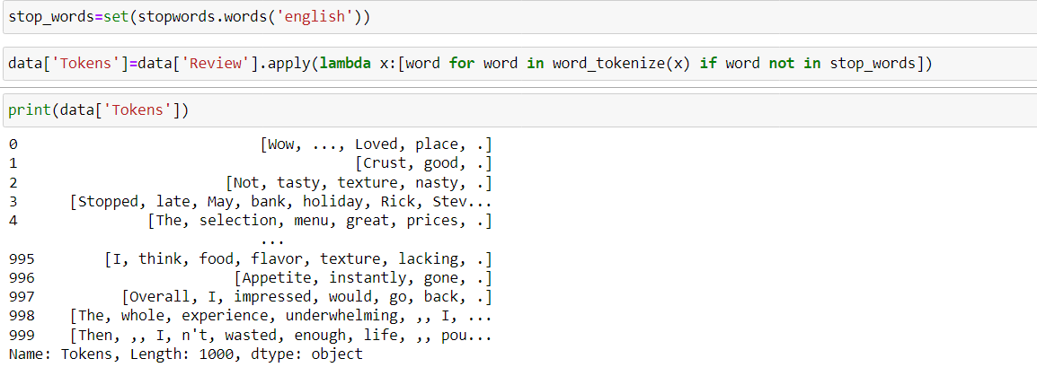
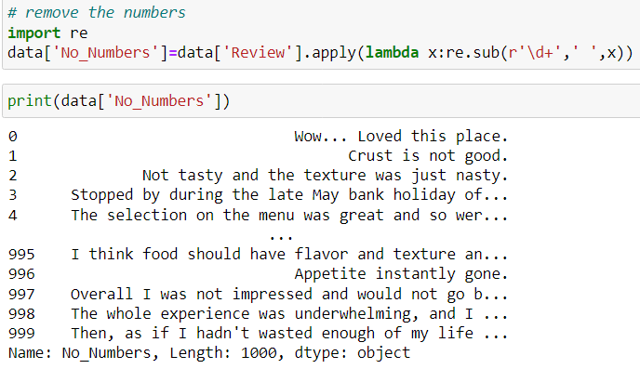

Slide 13
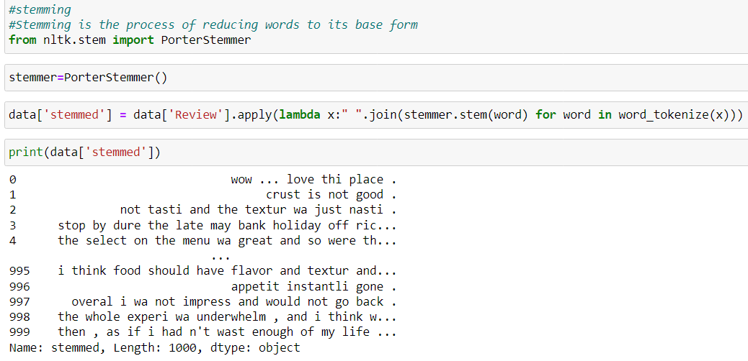
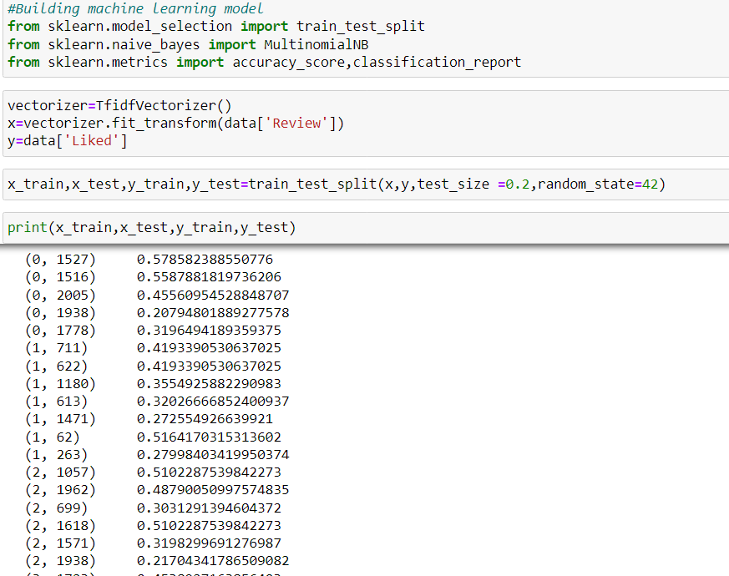

Slide 14
Thank you

