Slide 1
Neural Retail Networks
Retail Sales Analytics & Business Intelligence System
Transforming 500K+ Retail Transactions into Actionable Business Insights
Presented By
Role
Organization
Pranavi Chelumala
Data Analyst Intern
Amdox Technologies
Technologies Used:
Power BI
DAX
Python
Excel
Power Query
EDA

Slide 2
Problem Statement & Introduction
Why this project was built and what it addresses
PROBLEM STATEMENT
SOLUTION & INTRODUCTION
Retail businesses generate millions of transactions — manual analysis is time-consuming and error-prone
Built an end-to-end Power BI Business Intelligence system on 500K+ retail transactions
No centralized visibility into sales trends, product performance, and customer behaviour
12 interactive dashboards covering sales, products, customers, geography and inventory
Tracking KPIs across regions and time periods requires hours of manual Excel work
Python used for data cleaning, EDA and customer segmentation (RFM clustering)
Business decisions made without data — leading to inventory risks and missed opportunities
Transforms raw transactional data into real-time, decision-ready business insights
Neural Retail Networks | Pranavi Chelumala | Data Analyst Intern | Amdox Technologies
Confidential

Slide 3
Project Objectives
What this Business Intelligence system was designed to achieve
01
02
Analyse retail sales and customer data across 500K+ transactions to uncover business trends
Develop 12 interactive Power BI dashboards for real-time business performance monitoring
03
04
Track 10+ KPIs including revenue, orders, customers, quantity sold and average order value
Identify top and bottom performing products across 3,631 unique SKUs by revenue and quantity
05
06
Analyse customer purchasing patterns using RFM segmentation across 4,304 customers
Support data-driven business decisions through geographic, seasonal and inventory risk analysis
Neural Retail Networks | Pranavi Chelumala | Data Analyst Intern | Amdox Technologies
Confidential

Slide 4
Project Workflow & Architecture
End-to-end data pipeline from raw data to business intelligence
01
02
03
04
05
06
Data Collection
Data Cleaning
Data Transformation
EDA & Analysis
Dashboard Dev
Business Insights
500K+ retail transaction records
CSV/Excel format
Remove duplicates, null values
Standardize formats
Power Query + Python
Calculated fields & KPIs
Python — trends, patterns
RFM customer segmentation
12 Power BI dashboards
DAX measures & visuals
Actionable recommendations
for business decisions
Neural Retail Networks | Pranavi Chelumala | Data Analyst Intern | Amdox Technologies
Confidential

Slide 5
Dataset Information
Structure and scope of the retail transaction dataset used
DATASET ATTRIBUTES
KEY COLUMNS USED
Dataset Type
UK-based Retail Sales Transactions
InvoiceNo
Records
~500,000+ transaction records
StockCode
Description
Key Columns
8–10 primary features
Quantity
Date Range
January 2010 – December 2011
InvoiceDate
UnitPrice
Countries
Multiple countries — UK dominant
CustomerID
File Format
CSV / Excel
Country
TotalPrice (Calculated)
Neural Retail Networks | Pranavi Chelumala | Data Analyst Intern | Amdox Technologies
Confidential

Slide 6
Data Preparation & Processing
Steps taken to clean, transform and prepare the dataset for analysis
Removed Duplicates
Handled Null Values
Standardized Formats
Identified and eliminated duplicate invoice records to ensure data integrity and accuracy
Managed missing CustomerID and Description fields using appropriate imputation and filtering strategies
Normalized date formats, text casing, and numeric fields for consistent analysis across all records
Data Transformation
KPI Measures (DAX)
Table Relationships
Created TotalPrice = Quantity × UnitPrice as a calculated field; built date hierarchies for time intelligence
Developed 10+ DAX measures including Total Revenue, Avg Order Value, Avg Revenue per Customer
Established relationships between transaction, product and customer tables in Power BI data model
Neural Retail Networks | Pranavi Chelumala | Data Analyst Intern | Amdox Technologies
Confidential

Slide 7
Dashboard Overview
12 Interactive Power BI Pages — End-to-End Retail Business Intelligence System
500K+
12
10+
4,304
Transaction Records
Interactive Dashboards
KPIs Tracked
Customers Analysed
01
Executive Summary
High-level KPIs — revenue, orders, customers & top products
07
Customer Behaviour
Purchase frequency patterns and spending distribution
02
Sales Trend Analysis
Monthly & yearly revenue patterns — Jan 2010 to Dec 2011
08
Profit & Revenue
Revenue breakdown, avg order value & monthly trends
03
Product Performance
Top/bottom products by revenue & quantity across 3,631 SKUs
09
Inventory Risk
Slow-moving vs top-selling products — risk & replenishment
04
Customer Analytics
Customer value, purchase frequency & RFM segmentation
10
Order & Transaction
Invoice-level transaction analysis and order distribution
05
Region/Country Sales
Geographic revenue & customer distribution across countries
11
Advanced Analytics
RFM clustering, demand forecasting & daily sales trends
06
Monthly & Seasonal
Time-based sales cycles and seasonal revenue analysis
12
Interactive Filter
Cross-dashboard dynamic filtering by date, country & product
Neural Retail Networks | Pranavi Chelumala | Data Analyst Intern | Amdox Technologies
Confidential

Slide 8
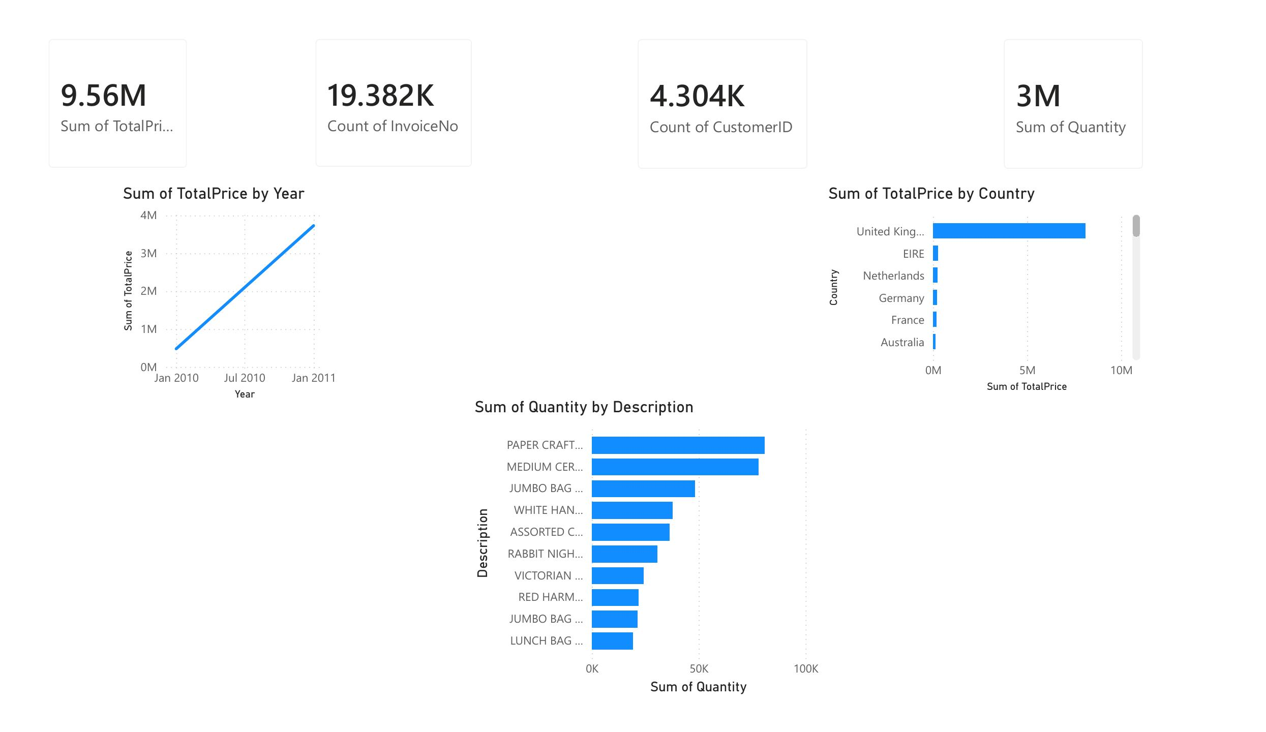
Executive Summary Dashboard
High-level business health — revenue, orders, customers & top products at a glance
£9.56M
Total Revenue
19,382
Total Orders
4,304
Total Customers
3M
Quantity Sold
KEY INSIGHTS
UK dominates sales — contributing 90.17% of total revenue (£8.12M)
PAPER CRAFT, LITTLE BIRDIE is the highest quantity sold product across all regions
Neural Retail Networks | Pranavi Chelumala | Data Analyst Intern | Amdox Technologies
Confidential

Slide 9
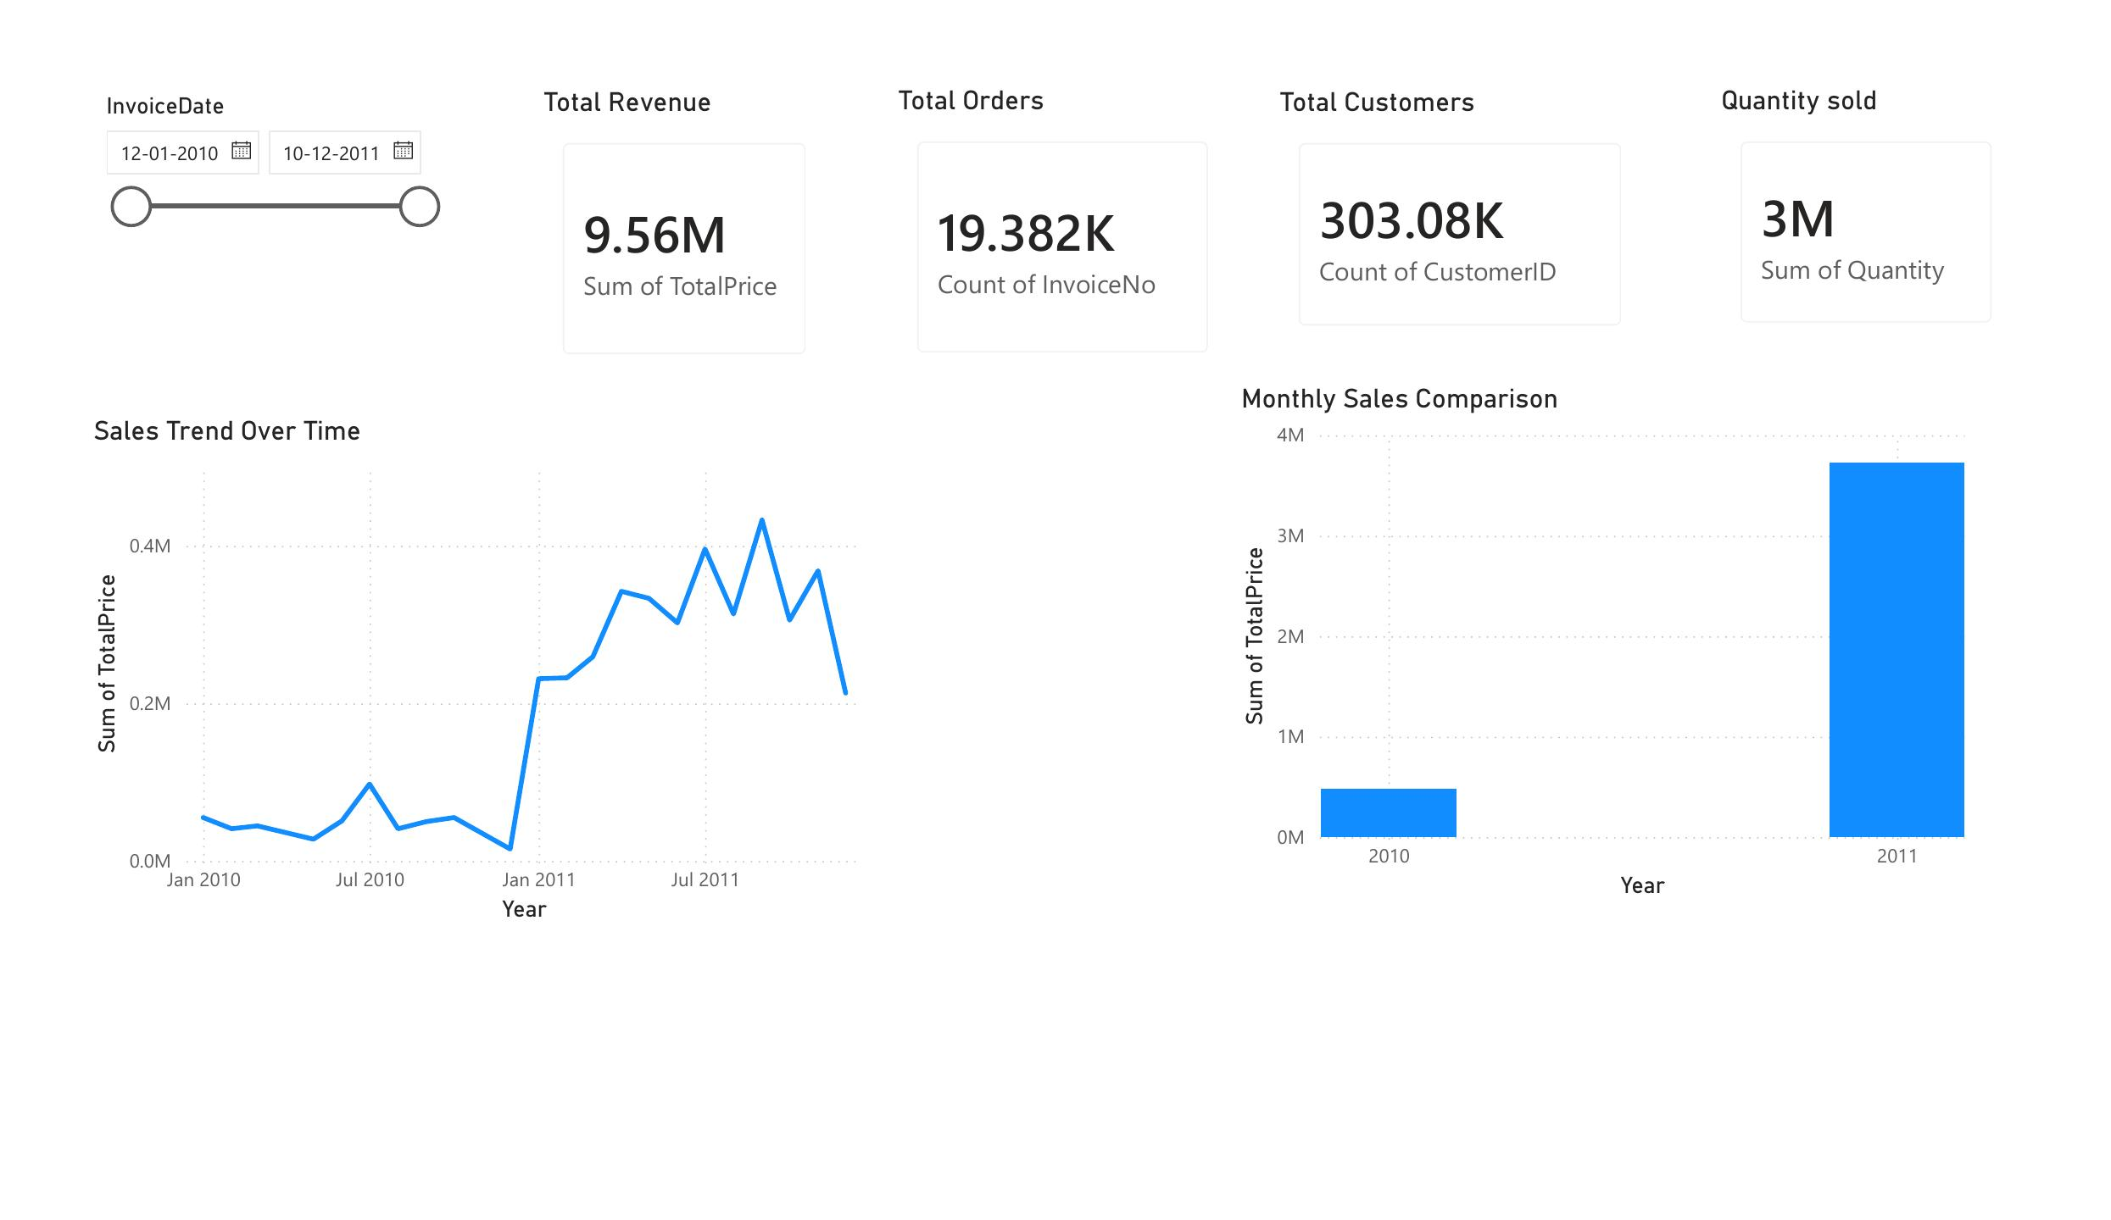
Sales Trend Analysis Dashboard
Monthly & yearly revenue patterns across Jan 2010 – Dec 2011
£9.56M
Total Revenue
19,382
Total Orders
303K
Total Transactions
3M
Quantity Sold
KEY INSIGHTS
Autumn contributes 68.64% of seasonal revenue — strongest trading season
Q4 2011 recorded highest revenue — seasonal holiday demand surge identified
2011 revenue significantly outperformed 2010 — strong YoY business growth confirmed
Neural Retail Networks | Pranavi Chelumala | Data Analyst Intern | Amdox Technologies
Confidential

Slide 10
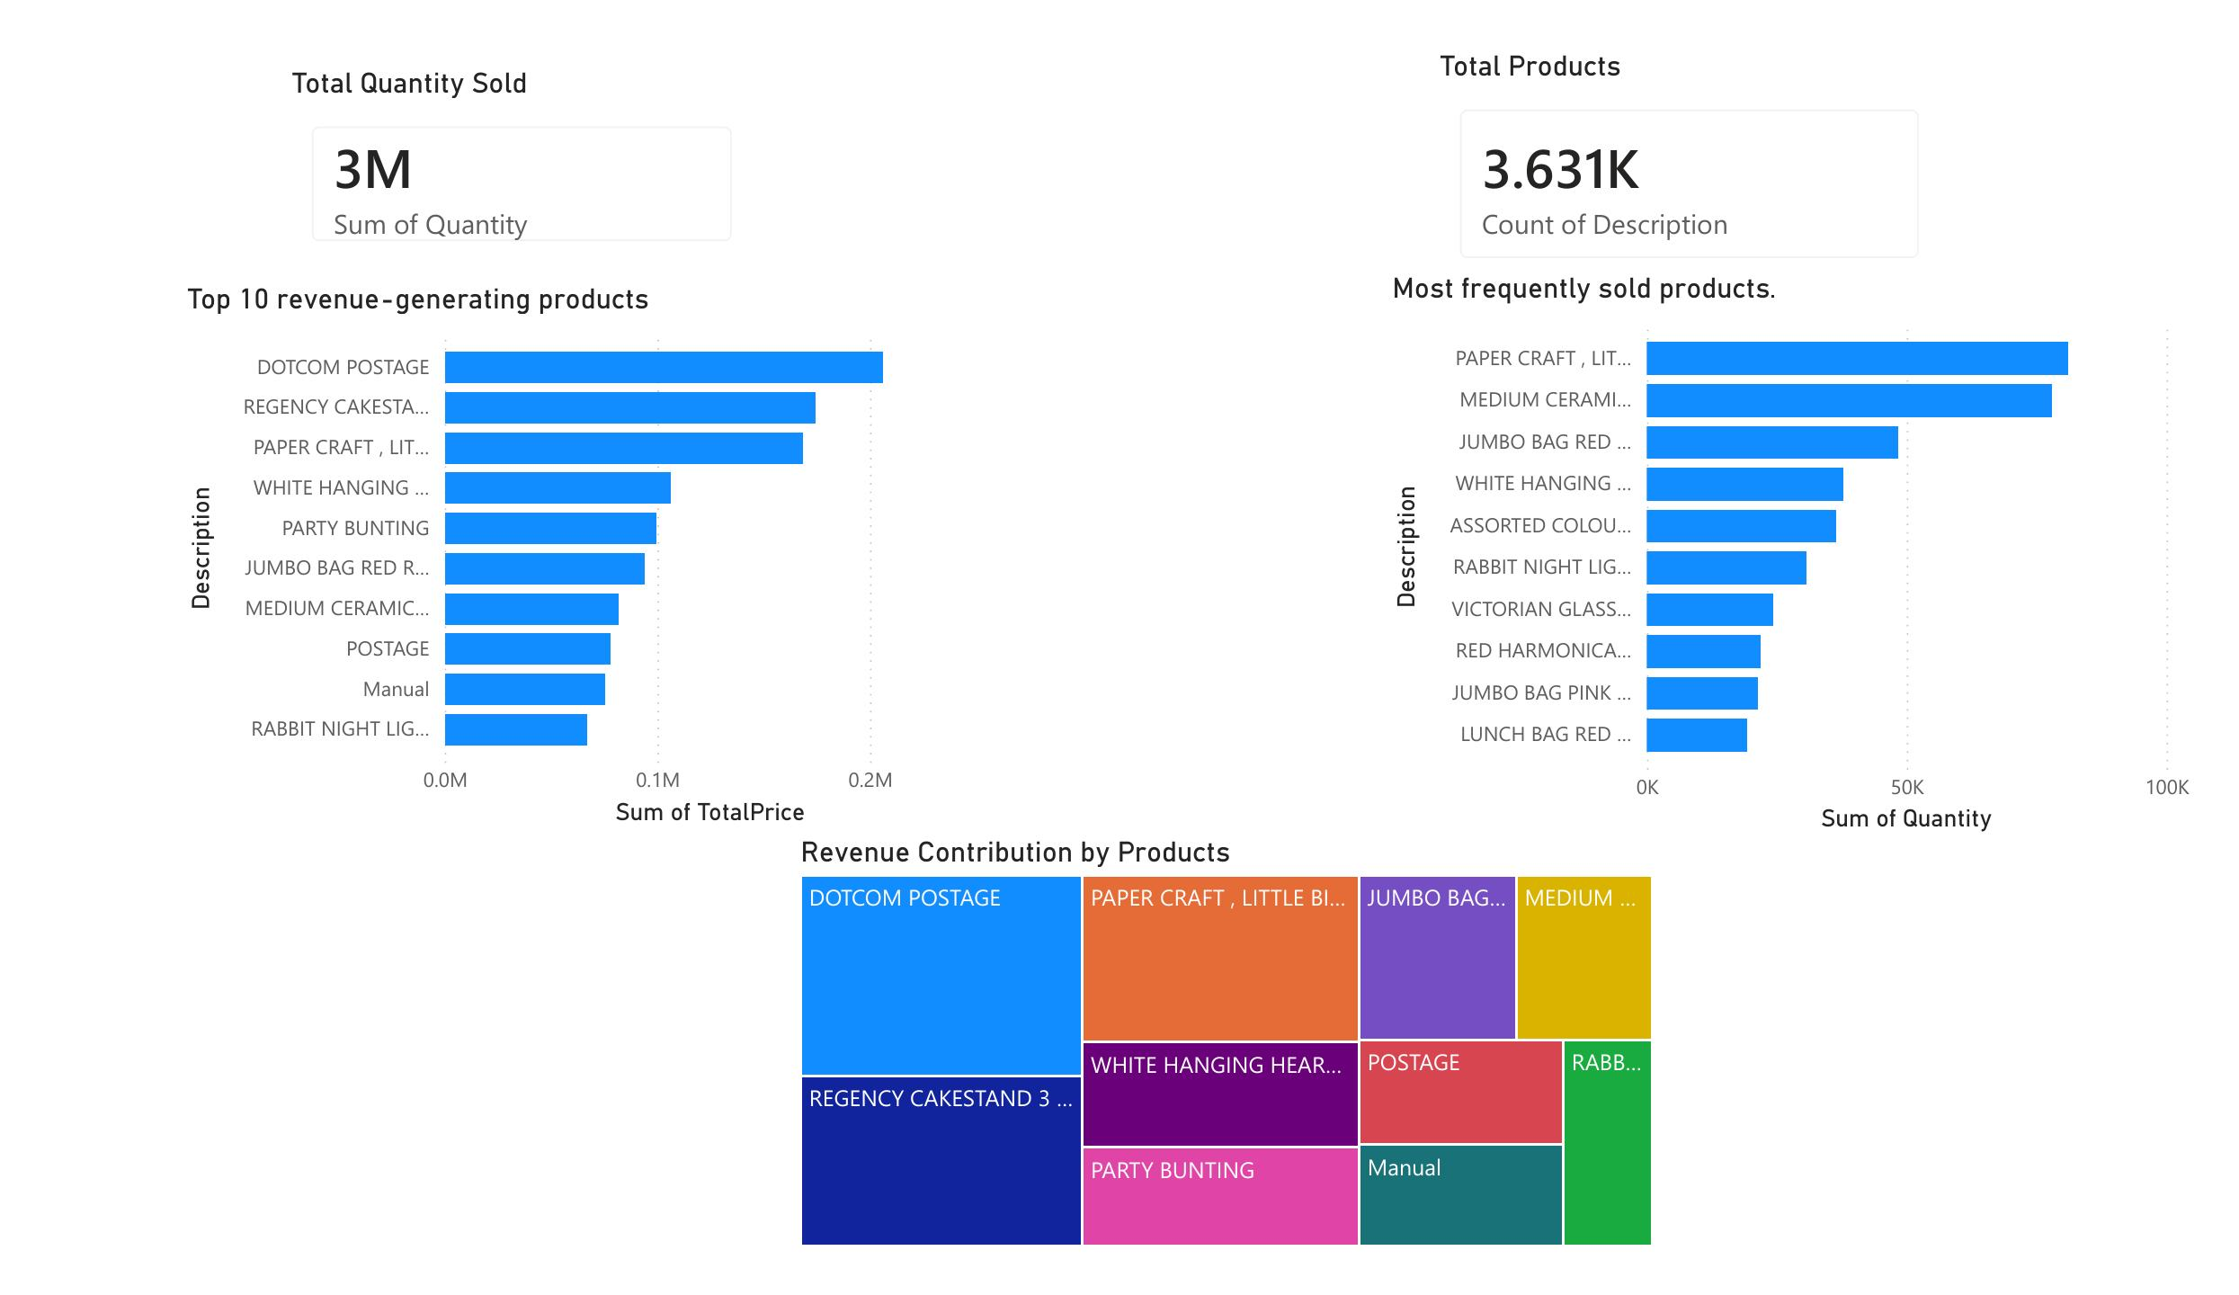
Product Performance Dashboard
Top & bottom products by revenue and quantity sold across 3,631 unique products
3M
Total Quantity Sold
3,631
Unique Products
KEY INSIGHTS
DOTCOM POSTAGE is the highest revenue-generating product
PAPER CRAFT, LITTLE BIRDIE leads in quantity sold — high volume, lower unit price
Top 10 products drive a disproportionate share of total revenue — concentration risk
Revenue contribution treemap reveals DOTCOM POSTAGE & REGENCY CAKESTAND dominate
Neural Retail Networks | Pranavi Chelumala | Data Analyst Intern | Amdox Technologies
Confidential

Slide 11
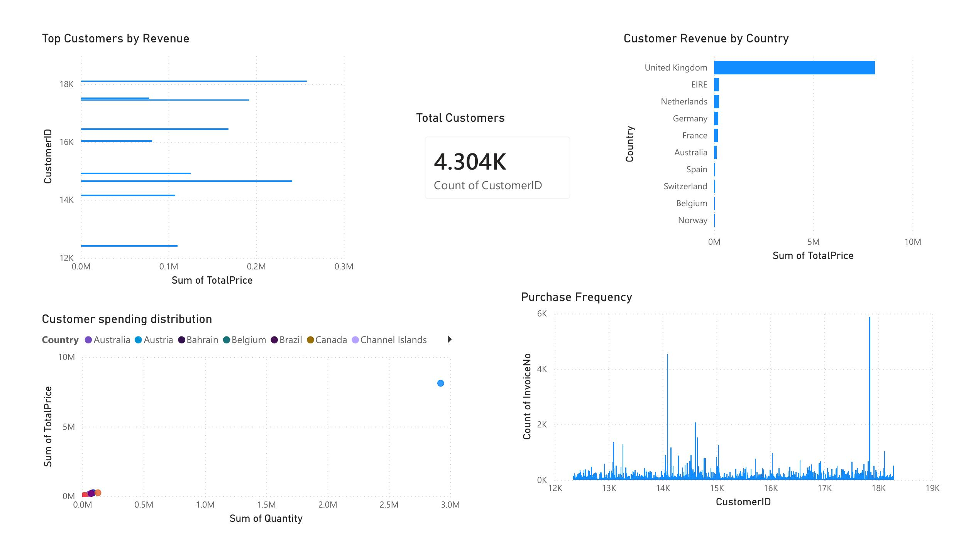
Customer Analytics & Segmentation
Customer value, purchase frequency and RFM-based segmentation across 4,304 customers
4,304
Total Customers
£2,220
Avg Revenue per Customer
8.33
Avg Quantity Purchased
KEY INSIGHTS
RFM clustering identified 4 distinct customer segments — high-value cluster shows low recency (recent buyers)
Top spenders are in CustomerID 14K–18K range, concentrated in the UK
Purchase frequency analysis reveals a small high-frequency customer group driving majority of orders
Neural Retail Networks | Pranavi Chelumala | Data Analyst Intern | Amdox Technologies
Confidential

Slide 12
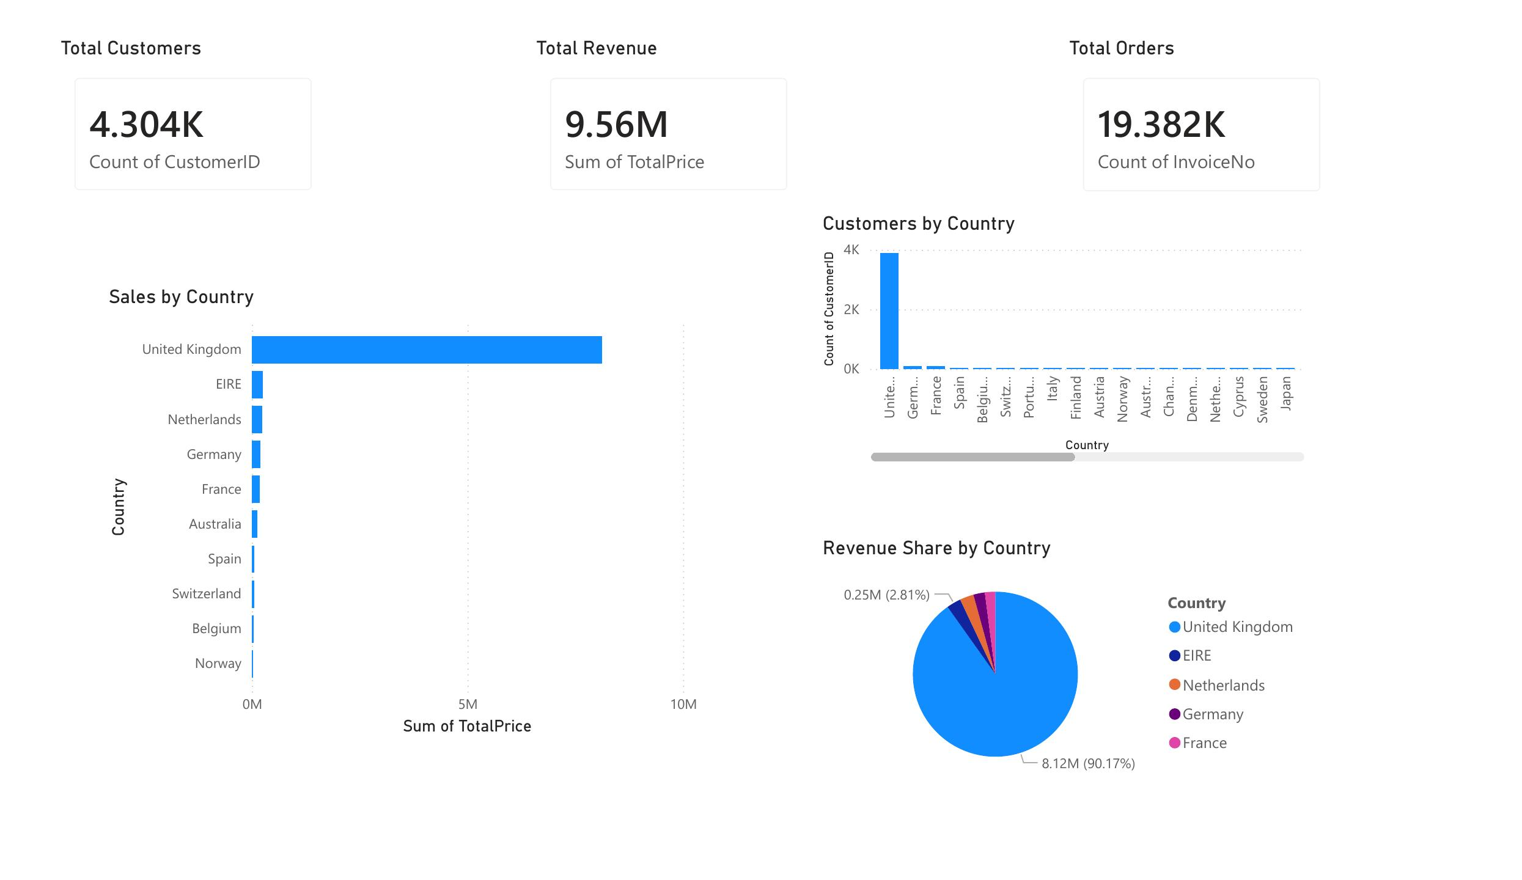
Region / Country Sales Dashboard
Geographic revenue and customer distribution across multiple countries
£9.56M
Total Revenue
19,382
Total Orders
4,304
Total Customers
KEY INSIGHTS
United Kingdom alone accounts for £8.12M — 90.17% of total revenue
EIRE (Ireland) is second at 2.81% (£0.25M), followed by Netherlands & Germany
Revenue highly concentrated — geographic diversification strategy recommended
Strong international expansion opportunity identified in underperforming markets
Neural Retail Networks | Pranavi Chelumala | Data Analyst Intern | Amdox Technologies
Confidential

Slide 13
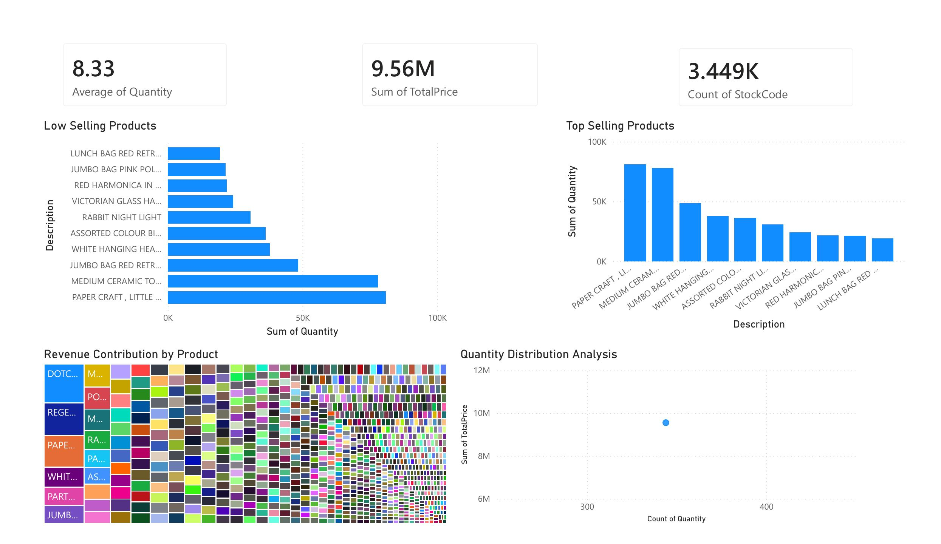
Inventory Risk Dashboard
Identifying slow-moving vs top-selling products to support inventory management decisions
8.33
Avg Quantity per Order
3,449
Total Stock Codes
£9.56M
Total Revenue
KEY INSIGHTS
LUNCH BAG RED RETROSPOT & JUMBO BAG PINK POLKADOT — lowest selling, inventory risk flagged
PAPER CRAFT, LITTLE BIRDIE leads top selling — high replenishment priority recommended
Revenue contribution treemap identifies top revenue products for strategic stocking decisions
Neural Retail Networks | Pranavi Chelumala | Data Analyst Intern | Amdox Technologies
Confidential

Slide 14
Key Findings & Business Insights
Data-driven insights from 500K+ retail transactions across 2 years
£9.56M
90.17%
Q4 2011
Total revenue across 19,382 orders — strong 2-year retail performance
UK revenue share (£8.12M) — geographic concentration risk identified
Peak revenue period — seasonal demand surge confirmed via trend analysis
4 Segments
£2,220
2 Products
RFM customer clusters identified — high-value group shows recent, high-spend behaviour
Average revenue per customer | Avg Order Value: £493
Slow-moving inventory flagged — reallocation & clearance strategy recommended
Neural Retail Networks | Pranavi Chelumala | Data Analyst Intern | Amdox Technologies
Confidential

Slide 15
Conclusion & Recommendations
Business value delivered and strategic recommendations
PROJECT DELIVERED
Built a 12-page interactive Power BI Business Intelligence system analysing 500K+ retail transactions — covering sales, products, customers, geography and inventory end-to-end using Power BI, DAX, Python, Power Query and RFM Segmentation.
KEY BUSINESS RECOMMENDATIONS
Geography
Expand into EIRE, Netherlands & Germany — reduce UK revenue dependency (90.17%)
Seasonality
Increase stock & promotions pre-Q4 — capitalise on confirmed seasonal demand surge
Customers
Target high-value RFM cluster for loyalty & retention strategy
Inventory
Clear slow-moving stock (LUNCH BAG, JUMBO BAG) — prioritise top sellers for restocking
Products
Focus marketing on DOTCOM POSTAGE & PAPER CRAFT — highest revenue & volume products
Tools Applied: Power BI · DAX · Python · Power Query · RFM Segmentation · EDA · Excel

