Slide 1
RE-IMAGINING DIGITAL BANKING
-REVENGERS

Slide 2
Our kind of re-imagination
E-statements
Offers
Digi-split
Set temporary limit to card
Geo Location

Slide 3
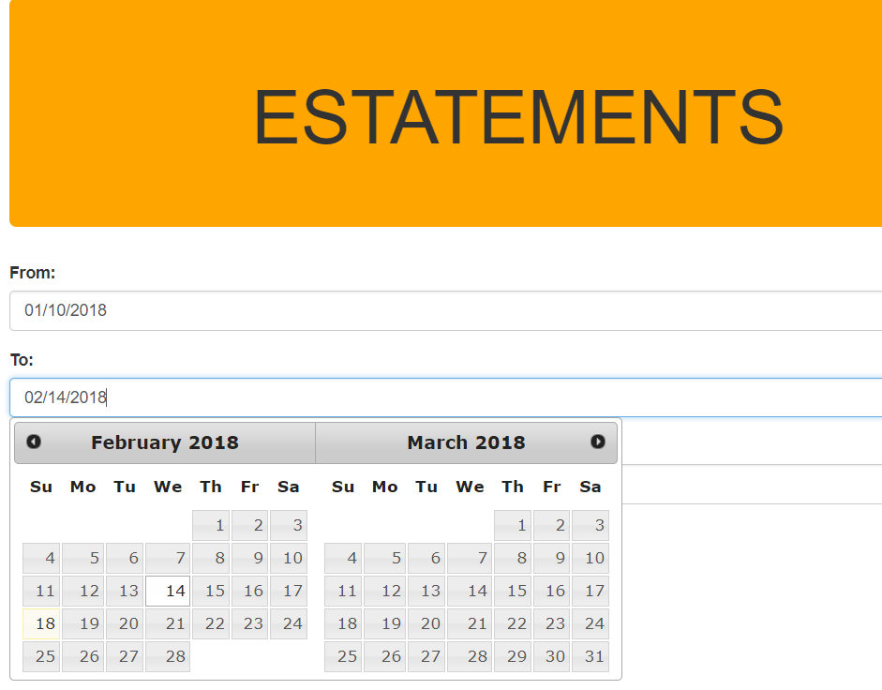
E-STATEMENTS

Slide 4
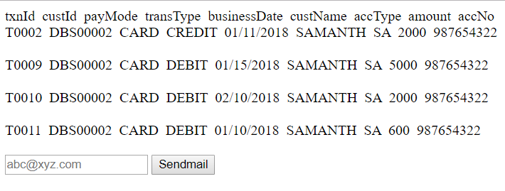

Slide 5

OFFERS

Slide 6
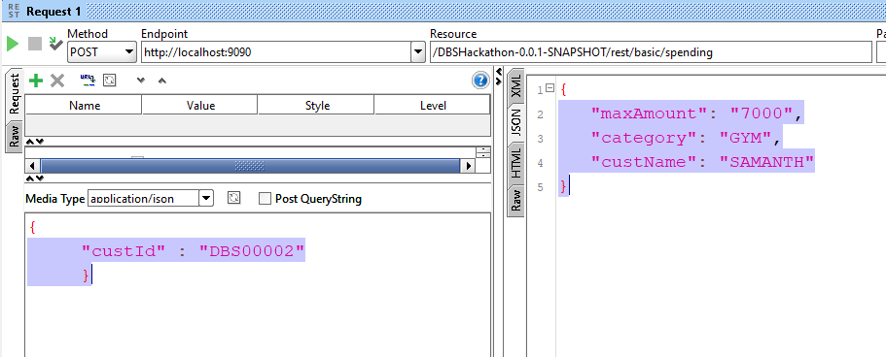

Slide 7
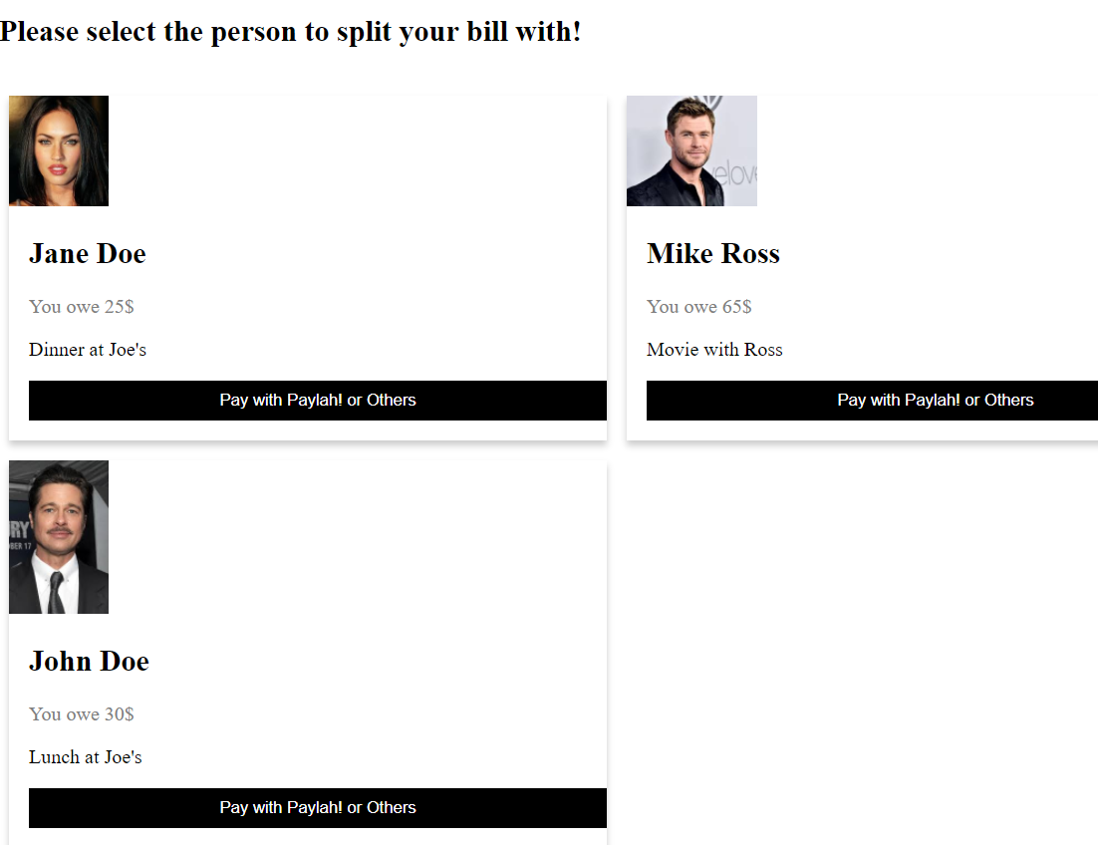
DIGI-SPLIT

Slide 8
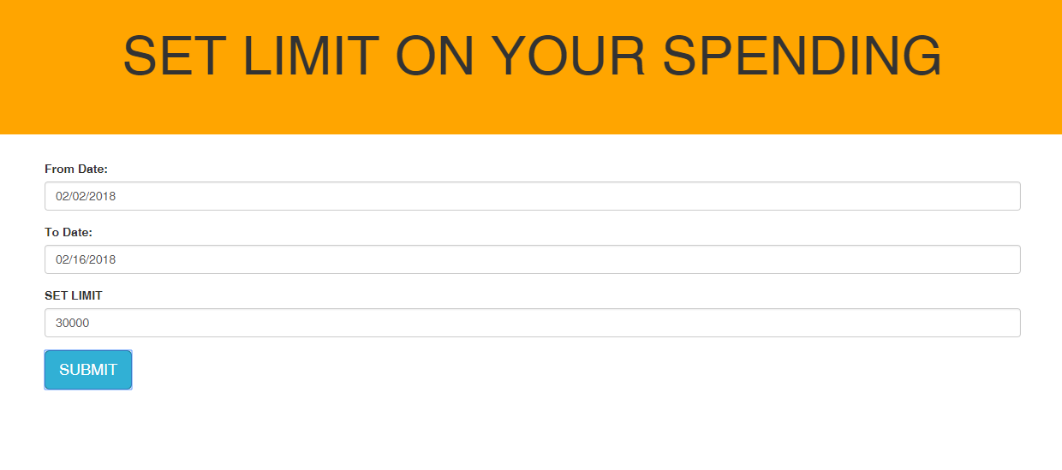
Set Limit

Slide 9
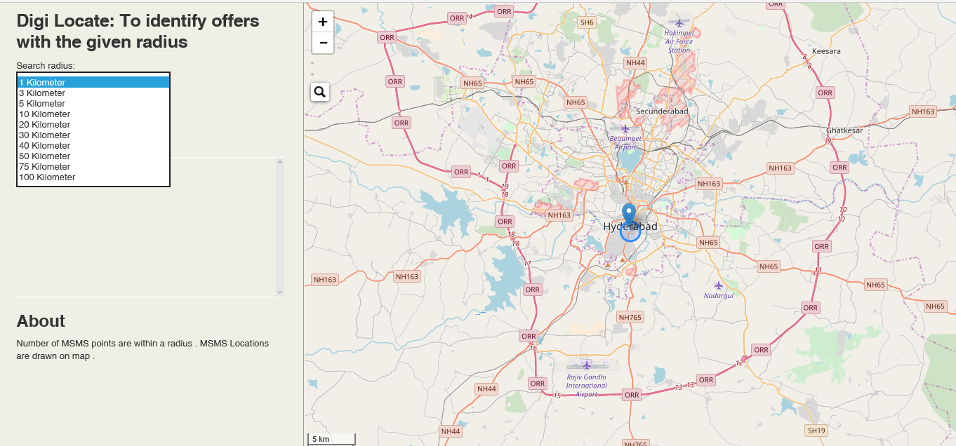
GEO LOCATION

Slide 10
THANK YOU

