Slide 1

SEABORN
Library (Visualization)

Slide 2
What is Seaborn?
Seaborn Graph
Seaborn Vs Matplotlib
Installation & Importing Seaborn
Importance of Seaborn

Slide 3
What is Seaborn?
Seaborn is a well-known Python library for data visualization. Built on top of Matplotlib and integrated with pandas data structures in Python.
Seaborn's key benefit lies in its capability to generate attractive plots with minimal coding efforts.
Seaborn offers a range of built-in statistical functions, allowing users to easily perform complex statistical analysis with their visualizations.

Slide 4
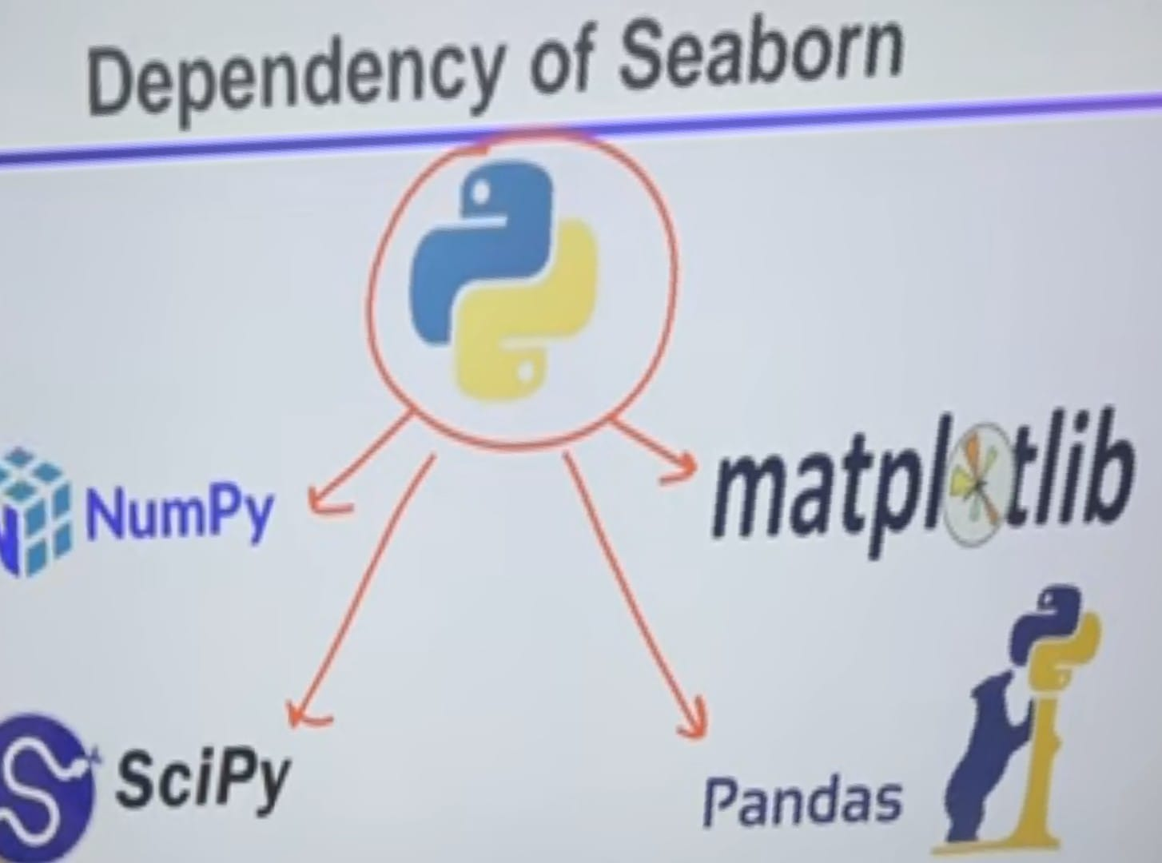
Seaborn Graph
Scatter plots
Line plots
Bar plots
Histograms
Box plots
Violin plots
Heatmaps
Pair plots
Facet grids
Swarm Plot

Slide 5
Relational plots:
Relplot, Scatterplot, Lineplot.
Distribution plots:
Histplot, KDEplot, Distplot, Displot
Categorical plots:
Catplot, Stripplot, Swarmplot, Boxplot, Violinplot, Pointplot, Barplot, Countplot.
Regression plots:
Lmplot, Regplot.

Slide 6
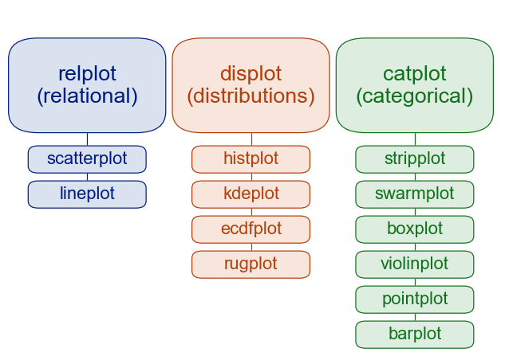
Matrix Plot:
Heatmap, Clustermap
Multi-plot grids:
Facet grids
Pairplot
Jointplot

Slide 7
Seaborn vs. Matplotlib
Matplotlib - low-level plotting library that provides a wide range of tools for creating highly customizable visualizations. Seaborn - high-level interface for creating statistical graphics. It is built on top of Matplotlib and provides a simpler, more intuitive interface for creating common statistical plots.
Matplotlib provides a limited set of default styles and color palettes, requiring users to customize their plots manually to achieve a desired look. Seaborn, on the other hand, offers a range of default styles and color palettes that are optimized for different types of data and visualizations.
Seaborn is generally better suited for creating statistical graphics and exploratory data analysis, while Matplotlib is better suited for creating highly customizable plots for presentations and publications.

Slide 8
Relational plots
Relplot:
sns.relplot(data=None, x=None, y=None, hue=None,legend='auto', kind='scatter’, **kwargs)
scatterplot() (with kind="scatter“, the default)
lineplot() (with kind="line")
Kwargs - key, value pairings
Legend - “auto”, “brief”, “full”, or False.

Slide 9
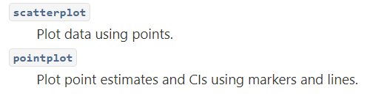
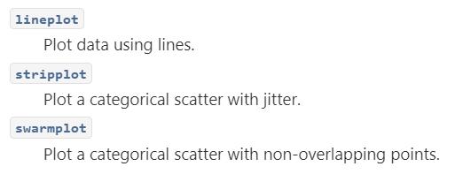
scatterplot
sns.scatterplot(data=None, *, x=None, y=None, hue=None, size=None, **kwargs)
Lineplot:
sns.lineplot(data=None, *, x=None, y=None, hue=None, size=None, **kwargs)

Slide 10
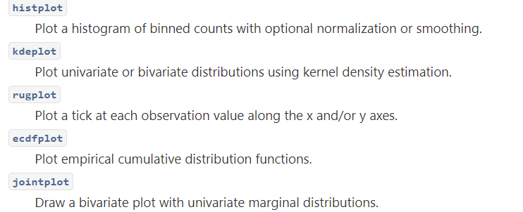
Distribution plots
displot :
sns.displot(data=None, *, x=None, y=None, hue=None, row=None, col=None, kind='hist', **kwargs)
histplot() (kind="hist"; the default)
kdeplot() (kind="kde“,shape=True)
ecdfplot() (kind="ecdf"; univariate-only)
sns.histplot(data=None, *, x=None, y=None, hue=None, **kwargs)
sns.kdeplot(data=None, *, x=None, y=None, hue=None , **kwargs)

Slide 11
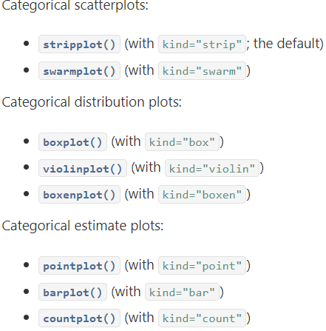
Categorical plots
sns.catplot(data=None, x=None, y=None, hue=None, kind='strip’, **kwargs)
sns.boxplot(data=None, x=None, y=None, hue=None, **kwargs)
sns.swarmplot(data=None, x=None, y=None, hue=None, **kwargs)
sns.violinplot(data=None, x=None, y=None, hue=None, **kwargs)
sns.pointplot(data=None, x=None, y=None, hue=None, **kwargs)
sns.barplot(data=None, x=None, y=None, hue=None, **kwargs)
sns.countplot(data=None, x=None, y=None, hue=None, **kwargs)

Slide 12
Regression plots
sns.lmplot(data, *, x=None, y=None, hue=None)
sns.regplot(data=None, *, x=None, y=None, x_estimator=None)
Matrix plots:
sns.heatmap(data, annot=None, fmt='.2g', square=False, **kwargs)
sns.clustermap(data, **kwargs)
Multi-plot grids:
sns.FacetGrid(data, row=None, col=None, hue=None)
sns.pairplot(data, hue=None kind='scatter’) ----------- kind{‘scatter’, ‘kde’, ‘hist’, ‘reg’}
sns.jointplot(data=None, *, x=None, y=None, hue=None, kind='scatter', **kwargs)

