Slide 1
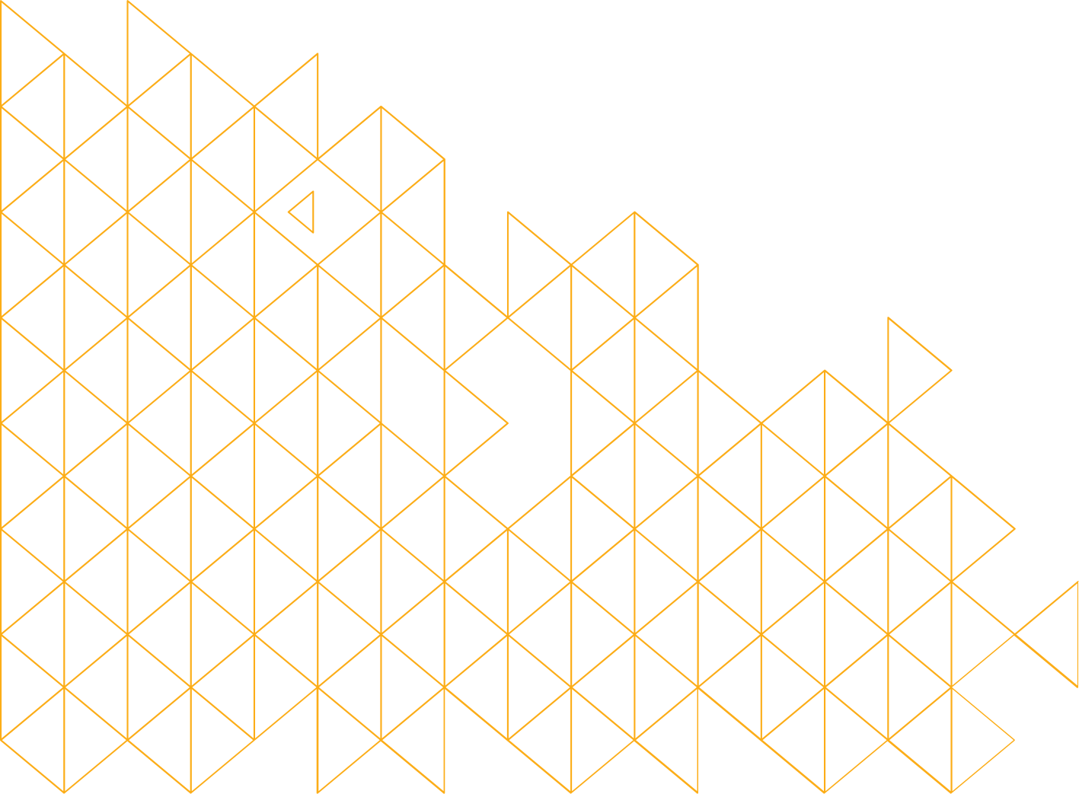
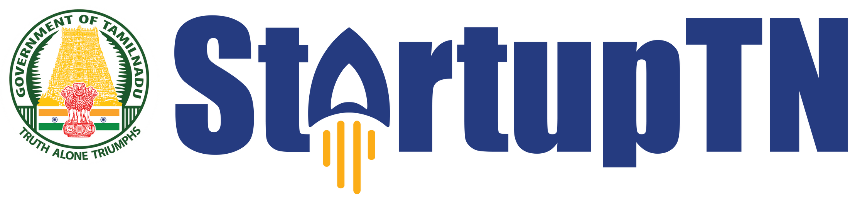
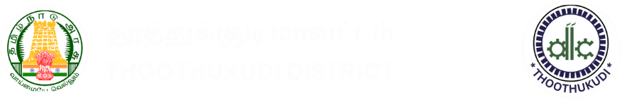
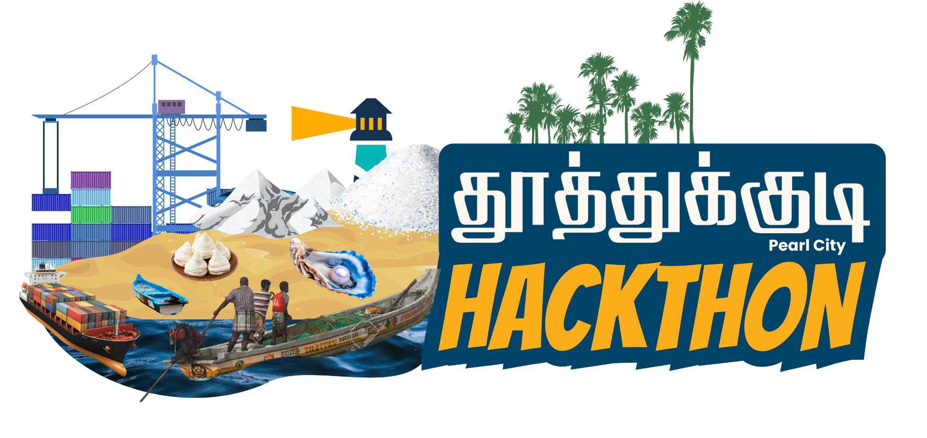
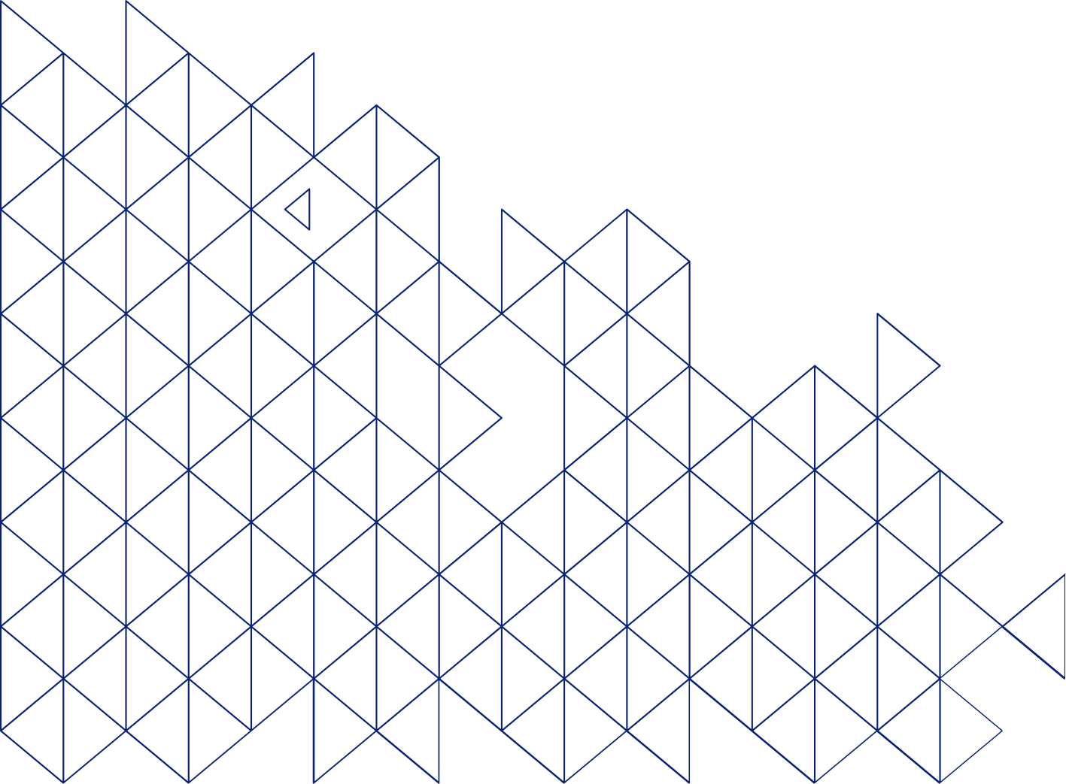
Organised by
In Association With
Name of the Idea / Startup: செம்மொழி சுடர்
Name of the
Team Members / Individual : Antony Selva Jasfer A
Priyan U
Akash Narayanan C
Kavin Raj M
IV.Pranav Moorthy
Name of the Mentor: Jothi Lakshmi S L

Slide 2

.
The Problem
Degradation: Ancient palm leaf manuscripts (பனை ஓலை) are physically decaying, taking centuries of literature, medicine, and history with them.
The Language Barrier: Ancient Sangam-era Tamil and scripts are too complex for modern readers to understand without expert scholars.
The Tech Gap: Standard cloud APIs fail at this because they are expensive, require constant internet, and pose privacy risks for sensitive historical artifacts
Locked Scientific Heritage: It’s not just poetry. Crucial knowledge about Siddha medicine, ancient architecture, and astronomy remains entirely locked away from modern researchers.

Slide 3
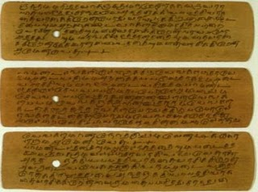
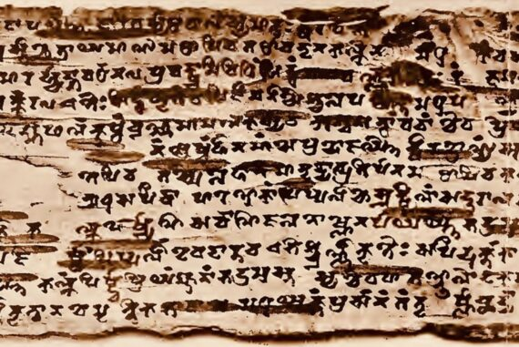
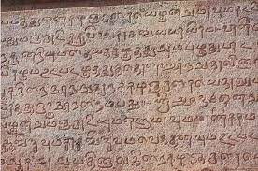
Action & Impact
Medical Breakthroughs (Siddha & Varmam
The Past: Deciphered texts (Varmam Beerangi) revived lost neuro-stimulation therapies.
The AI Impact: HeritageAI can instantly extract forgotten herbal and nanomedicine formulas to aid modern medical research.
2. Uncovering Lost History (The 2023 Crisis)
The Event: 19 rare, decaying manuscript bundles were just found in a Tuticorin temple in April 2023.
The AI Impact: What took archaeologists weeks of painstaking manual translation last year can now be digitized on Day 1.
3. Scaling Preservation (A Lifetime in Seconds)
The Legend: Scholar U.V. Swaminatha Iyer spent his entire lifetime walking across Tamil Nadu to save the Sangam epics.
The AI Impact: HeritageAI automates a lifetime of manual deciphering into a 2.5-second scan, saving history before it rots away.

Slide 4
Our Solution
Fully Online Platform: Built as a seamless, cloud-hosted web application accessible from any standard browser.
Cloud-Powered AI: Offloads the heavy "brain power" to the Gemini Generative Language API, meaning it runs
lightning-fast even on basic laptops.
Global Accessibility: Anyone, anywhere—from a museum in Chennai to a university in London—can upload
an image and get instant real-time translations.
Zero Local Setup (Frictionless): Researchers do not need to install complex Python environments, heavy machine-learning libraries, or specialized graphics cards (GPUs). They just click a link and start translating
Mobile & Field Ready: Because it runs in a standard browser, an archaeologist can snap a photo of a leaf using an iPad or smartphone right at the excavation site and get an instant translation without returning to a lab.
Massive Scalability: While offline models struggle to process one image at a time, our cloud-based API architecture can easily be scaled to process entire digital archives—thousands of leaves—simultaneously.
Always Up-to-Date: Any improvements we make to the AI prompt or the OpenCV restoration code happen centrally on the server. Users instantly get the smartest version of the AI without ever needing to download "software updates."

Slide 5
.
System Architecture
Step 1: Ingestion: User uploads a photo of the ancient manuscript.
Step 2: Vision Processing: OpenCV applies CLAHE (Contrast Limited Adaptive Histogram Equalization) and Adaptive Thresholding to extract the faded text from the dark background.
Step 3: Edge AI Inference: The restored image is securely sent to the Google Gemini 2.5 Flash Cloud API, which acts as a virtual scholar to visually analyze, extract, and translate the ancient script.
Step 4: Output: The Streamlit UI displays the restored image side-by-side with the AI Scholar's linguistic breakdown

Slide 6
The Tech Stack
HeritageAI: A dual-engine, cloud-powered AI platform.
Engine 1 (The Eyes): We use OpenCV to physically restore, clean, and enhance the degraded palm leaf images.
Engine 2 (The Scholar): We integrated Google's multimodal Gemini 2.5 Flash API to act as a virtual epigraphy scholar, visually analyzing and explaining the text in modern Tamil, English, and other global languages.
A simple horizontal 3-step flowchart graphic: Image Restoration ➡️ AI Extraction & Translation ➡️ Human Verification.

Slide 7
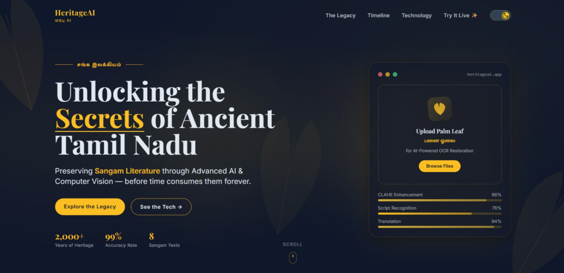
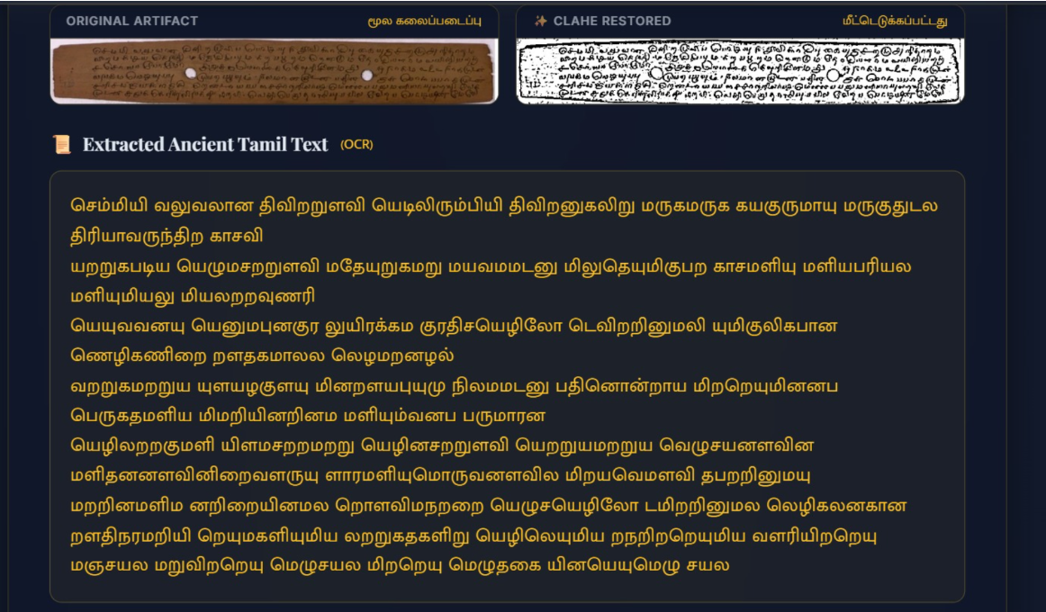
Live Demo / Results

Slide 8
Literaure Review
Reference Paper: * "Restoration of Ancient Kannada Handwritten Palm Leaf Manuscripts using Image Enhancement Techniques"
Key Findings from Existing Literature:
Traditional Focus: Existing research primarily focuses purely on the visual restoration of palm leaves using mathematical image processing (like spatial filtering, binarization, and background noise reduction).
The Goal: To make degraded, low-contrast engravings merely visible to the human eye.
The Limitations (The "Gap" in the Market):
Lack of Comprehension: Traditional image enhancement only cleans the image; it does not actually read or comprehend the ancient text.
Language Barrier: Even if a leaf is perfectly restored visually, it remains unreadable to 99% of the population because the ancient script (like ancient Tamil or Kannada) is dead or highly specialized.
Accessibility: Existing methods are standalone offline algorithms, not accessible tools for the public.
Our Innovation (How HeritageAI is Better):
End-to-End Pipeline: We don't just stop at image enhancement (our Adaptive CLAHE OpenCV pipeline).
Multimodal AI Integration: We pass the restored data directly into a multimodal LLM to perform zero-shot OCR extraction.
Global Accessibility: We bridge the final gap by translating the ancient text into modern regional languages (Hindi, Telugu, Malayalam, etc.) with Text-to-Speech capabilities in a live web app.

Slide 9
Future Scope & Impact
Automated OCR Integration: Training a custom Vision model to automatically read ancient Vattezhuttu script.
Multi-lingual Expansion: Scaling the local AI to translate ancient Sanskrit, Pali, or historical Telugu.
Global Museum Deployment: Packaging this as an offline desktop app for historians worldwide.
Unlocking Ancient Science & Culture: Decodes forgotten Siddha medical formulas for modern healthcare and preserves the classical roots of the Tamil language before they are lost to decay.
Resurrecting Lost Wisdom: Bridges the gap to our ancestors by recovering lost traditional medicine and restoring our ancient Tamil linguistic heritage.
Digital Preservation of Heritage: Prevents the extinction of ancient Tamil dialects and unlocks centuries-old, life-saving medicinal knowledge hidden in palm leaves.

