Slide 1
TeenHub
Pranav Nilesh Jain
Kedar Kishor Kale
Paresh Raju Aher
Ganesh Dhanaram Choudhary

Slide 2
1. Aim & Objective
By
Paresh Raju Aher

Slide 3
Aim & Objectives
To implement recommendation engine.
To implement a custom search engine.
To design a responsive design for the web application.
To implement a dashboard for the users to view their activities.

Slide 4
2. Problem Statement
By
Paresh Raju Aher

Slide 5
Problem Statement
Explosive growth of digital information and increase in number of visitors.
To filter, prioritize and efficiently deliver relevant information
Filter large volume of data and provide user in personalized form

Slide 6
3. Review of Literature
By
Kedar Kishor Kale

Slide 7
TF-IDF
Term Frequency - Inverse Document Frequency
It is a numerical statistic that is intended to reflect how important a word is to a document in a collection.
It is often used as a weighting factor in information retrieval, text mining, etc.

Slide 8
Item based CF
First, the system executes a model-building stage by finding the similarity between all pairs of items, such as correlation between ratings
Second, the system executes a recommendation stage. It uses the most similar items to a user's already-rated items to generate a list of recommendations.

Slide 9
Item based CF
This form of recommendation is analogous to "people who rate item X highly, like you, also tend to rate item Y highly, and you haven't rated item Y yet, so you should try it".

Slide 10
KNN
In pattern recognition, the k-nearest neighbors algorithm (k-NN) is a non-parametric method used for classification and regression.
In both cases, the input consists of the k closest training examples in the feature space.

Slide 11
Base Papers
[1] Dietmar Jannach and Simon Fischer, Recommendation-based Modeling Support for Data Mining Processes, Germany and Simon Fischer Rapid Miner GmbH, Germany, Proceedings of the 8th ACM Conference on Recommender system, pages 337-340, October 2014.
[2] Ali Heydarzadegan, Yaser Nemati, Mohsen Moradi, Evaluation of Machine Learning Algorithms in Artificial Intelligence, IJCSMC, Vol. 4, Issue. 5, May 2015, pg.278 – 286

Slide 12
[3] Tian Xia, Yanmei Chai, An Improvement to TF-IDF: Term Distribution based Term Weight Algorithm, JOURNAL OF SOFTWARE, VOL. 6, NO. 3, MARCH 2011
[4] Ramos, Juan. (2003). Using TF-IDF to determine word relevance in document queries.
[5] G. Linden; B. Smith; J. York, Amazon.com recommendations: item-to-item collaborative filtering, IEEE Internet Computing ( Volume: 7, Issue:1, Jan/Feb 2003 ), pages 76-80

Slide 13
4. Project Concept
By
Kedar Kishor Kale

Slide 14
TeenHub is a recommendation engine for movies, songs, and games.
The project also houses a custom search engine which makes navigation a lot easier.
It uses TF-IDF algorithm for the search engine and KNN and Item based CF algorithms for the recommendation system of the application.
TeenHub will rely on more than 1,00,000 real ratings. This makes sure that the overall accuracy of the system remains high.

Slide 15
5. Project Design
By
Pranav Nilesh Jain

Slide 16
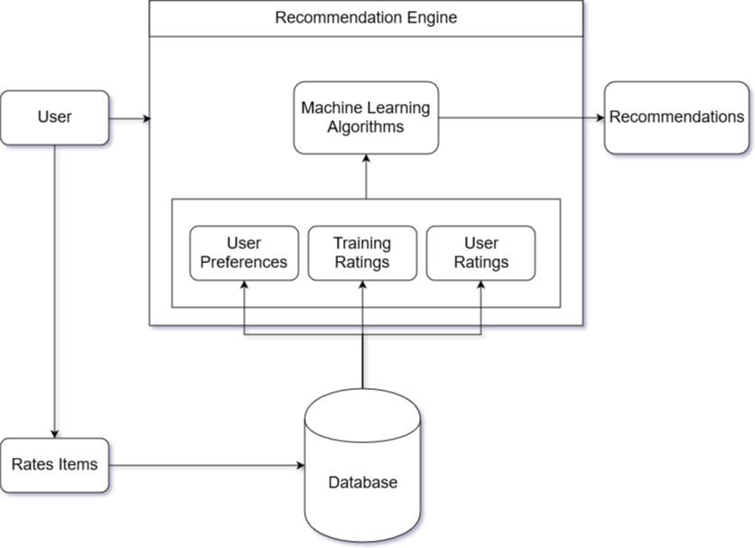

Slide 17

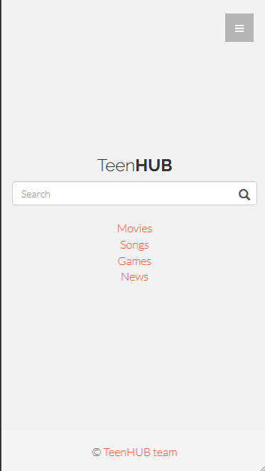
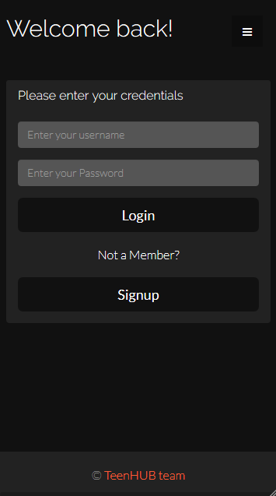
Smartphone

Slide 18
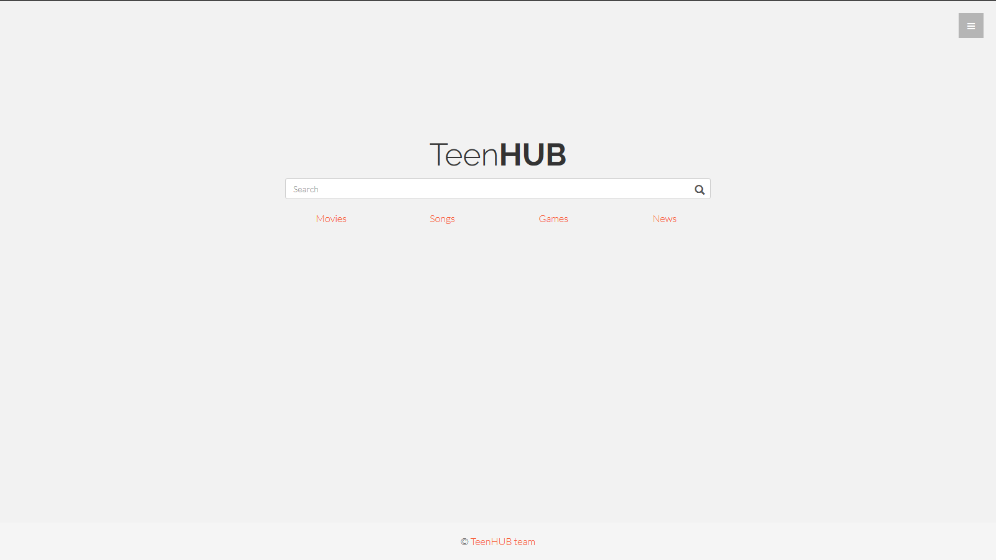
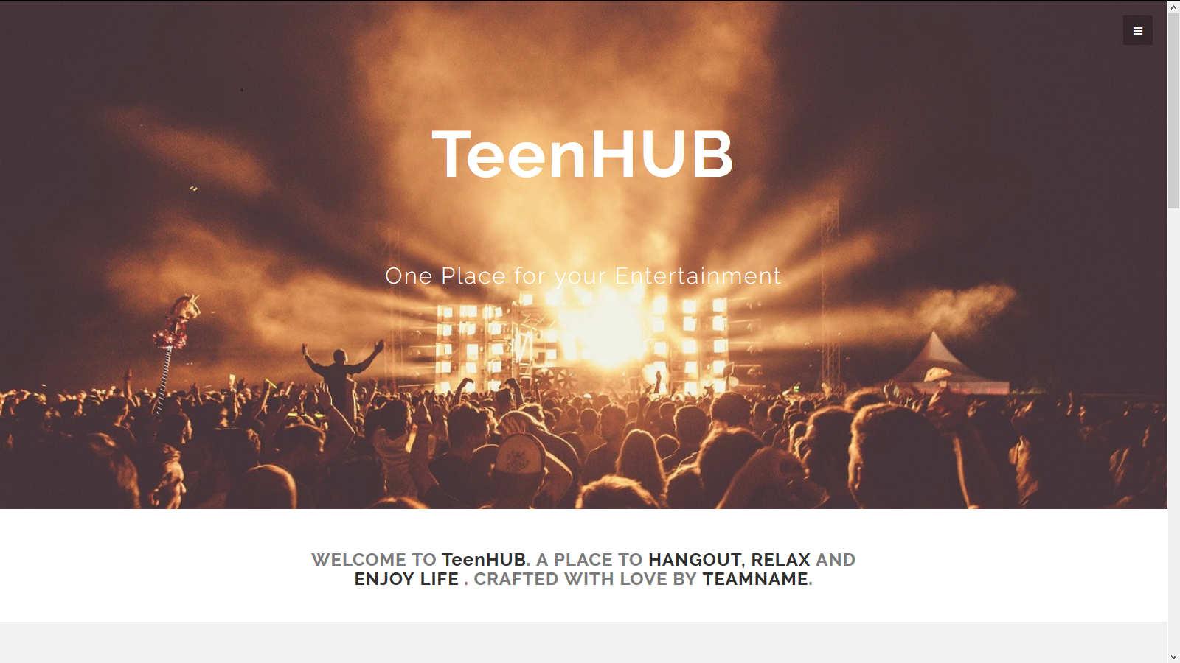
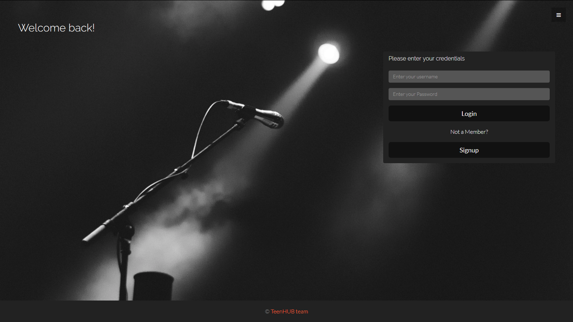
Desktop

Slide 19
6. Technical Details
By
Pranav Nilesh Jain

Slide 20
Technologies used:
Python: Core Machine Learning Algorithms
JavaScript: API calls and data visualization techniques
HTML & CSS: Front-End Design
SQL: Manipulation of data in databases
Django: Web Framework

Slide 21
Libraries used:
Numpy: Collection of high-level mathematical functions to operate on arrays
Pandas: For data manipulation and analysis in Python
Scikit-learn: For classification, regression and clustering algorithms
Chart.js: For visualizing data on interactive charts

Slide 22
Technical Requirements:
Platform Independent
Requires a browser
Requires an active Internet connection (2mbps+)
Pentium 4 or newer processor
512MB of RAM / 2G of RAM for the 64-bit version
200MB of hard drive space

Slide 23
7. Application, Limitation & Scope
By
Ganesh Dhanaram Choudhary

Slide 24
Application
Entertainment - Recommendations for movies, and Games
Content – Personalized news
Information Filtering

Slide 25
Limitation
Data Sparsity-Cells in table that do not contain actual data.
Cold Start Problem-Lack of information of users or items
Over Specialization Problem -Users are restricted to getting recommendations which resemble to those already known or defined in their profiles.

Slide 26
Scope
To cater all the entertainment focused things (like movies, songs, games and news) to users.
Future modifications are to include advanced features like predicting movie ratings which are not released based on many factors like, director, cast ratings, budget, etc.

Slide 27
7. Implementation Plan
By
Ganesh Dhanaram Choudhary

Slide 28
Implementation Plan
Testing algorithms with datasets
Designing GUI (Graphical User Interface)
Integrating algorithms with GUI
Final Testing

Slide 29
Thanks!
Any questions?
The project can be found at:
https://github.com/pranavj1001/TeenHub

