Slide 1
Multi-level logic Synthesis Dr. Chandan Karfa
CSE IIT Guwahati

Slide 2
Text Book
Chapter 6, Z. Kohavi and N. Jha, Switching and Finite Automata Theory, 3rd Ed., Cambridge University Press, 2010.

Slide 3
Objective
Introduction to Multilevel logic synthesis
Technology-independent synthesis
Factoring
Decomposition
Extraction
Substitution
Elimination

Slide 4
Two-level vs Multi-level Logic
Multi-level logic realization contains more than two levels of logic gates.
Circuits in which an arbitrary number of gates may lie on any path between a primary input and a primary output.

Slide 5
xyz + wxz + yz

Slide 6
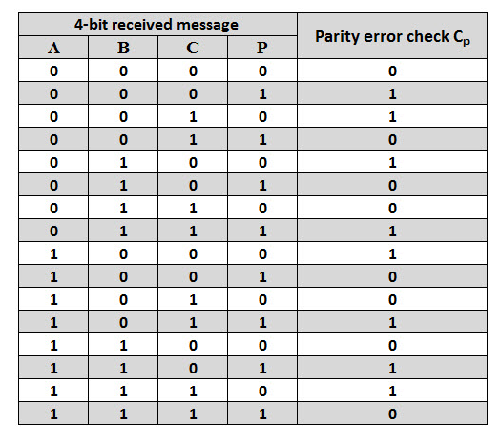
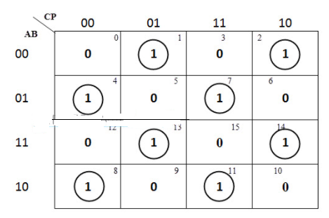
Need for Multi-level Logic Synthesis
In some cases SoP representation is impractical
Example: Parity bit generator, multiplication
Exponential number of implicants in SoP form for parity bit generator

Slide 7
Need for Multi-level Logic Synthesis
Advantage:
Multi-level logic circuits require less area and delay compared to the corresponding two-level realizations and hence are more practical.
Disadvantage:
It is difficult to obtain provably optimal multi-level realizations because of the much larger design space available for exploration.
Phases Of Multi-level Logic Synthesis
Technology Independent Synthesis
Technology Dependent Synthesis

Slide 8
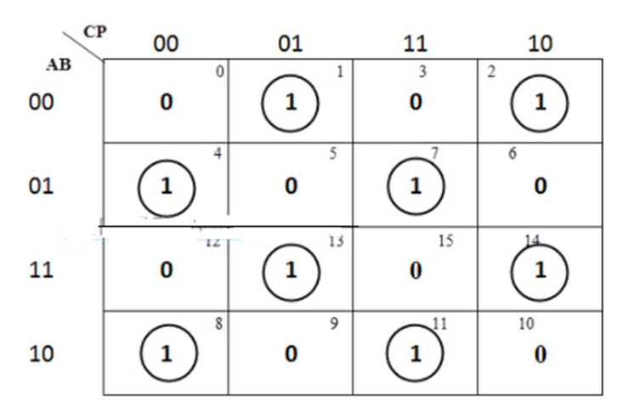
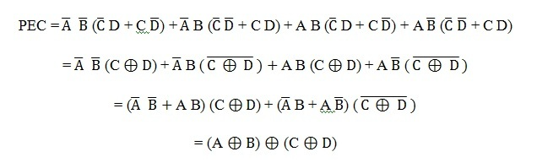
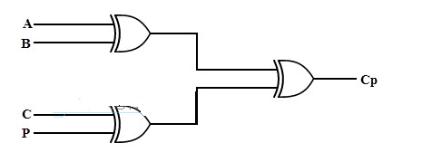
Objectives
Reduces the number of literal in expression
No of transistors is twice of no of literals
Identifying common sub-expression within an Boolean Expression (for single output) or between multiple Boolean expressions (for multiple outputs)

Slide 9
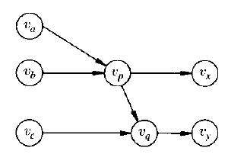
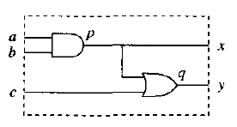
Representation
As Logic Network

Slide 10
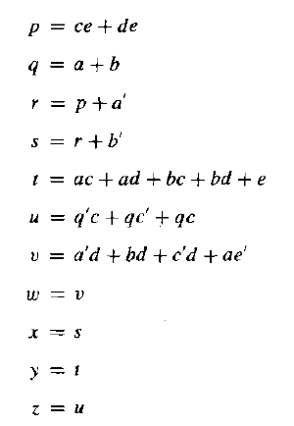
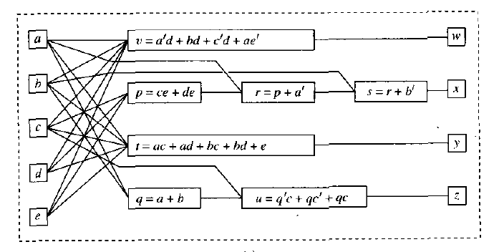
Logic Network
input variables (a, b, c, d, e)
primary output variables (w, x , y, z).

Slide 11
Technology Independent Synthesis
We design the circuit without keeping in mind we have to map that circuit to certain technology.
The problem is intractable.
Primarily the heuristic based approaches are used.
Technology-independent multi-level logic synthesis is carried out with the help of various logic transformations.

Slide 12
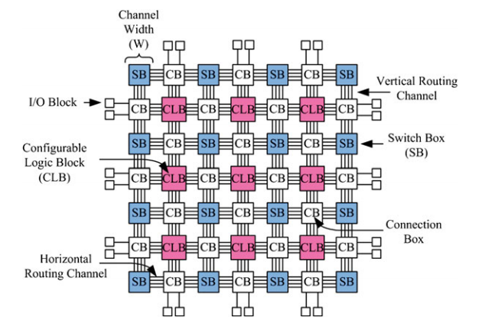
FPGA Technology Mapping

Slide 13
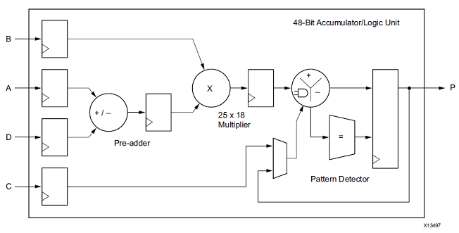
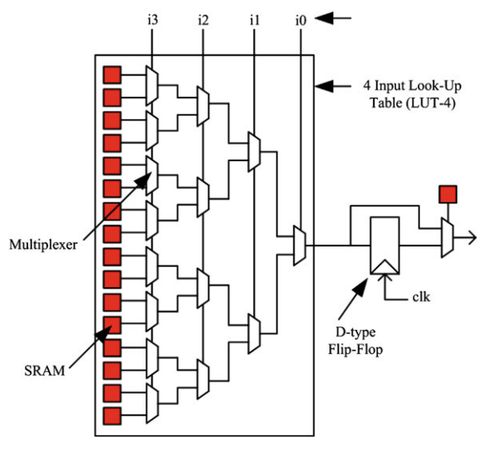
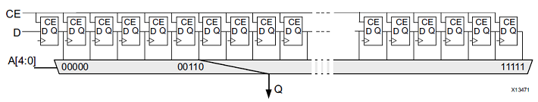
FPGA Components

Slide 14
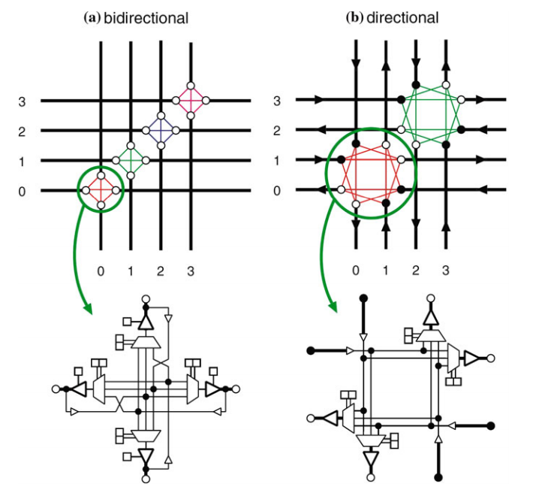
Interconnections

Slide 15
FPGA Technology Mapping
Technology Mapping:
ASIC – Cell Library (e.g., NAND, NOT, FF)
FPGA – fixed architecture
LUT
DSP
RAM/ROM
In FPGA:
Gate level design ➔ LUTs
Multiplier/MAC ➔ DSP
Memory/Large Registers ➔ RAM/ROM

Slide 16
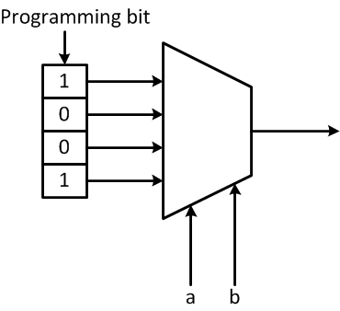
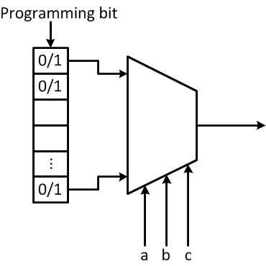
LUT Mapping
Look Up Table
2^{k} SRAM bits
A k-LUT can implement any Boolean function having k-variable,
B: 2^{k} → {0,1}
F = ab + a’b’
a | b | F
0 | 0 | 1
0 | 1 | 0
1 | 0 | 0
1 | 1 | 1
2 inputs LUTs

Slide 17
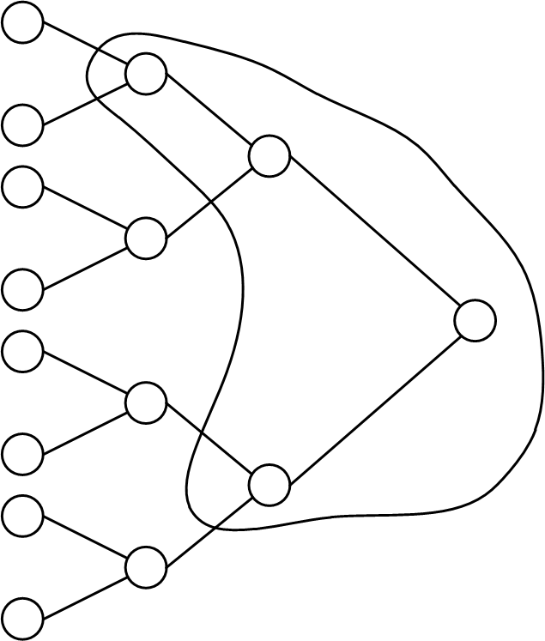
LUT Mapping

Slide 18
Introduction to logic transformations
There are various methods of logic transformations. The methods are as follows:
Factoring
Decomposition
Extraction
Substitution
Elimination.

Slide 19
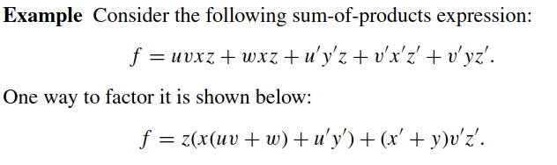
Factoring
A factored form is a recursive sum-of products representation in which the products themselves can consist of a sum of products
In factoring, an expression in sum-of-products form is converted into an expression with multiple levels without introducing any sub-functions.

Slide 20
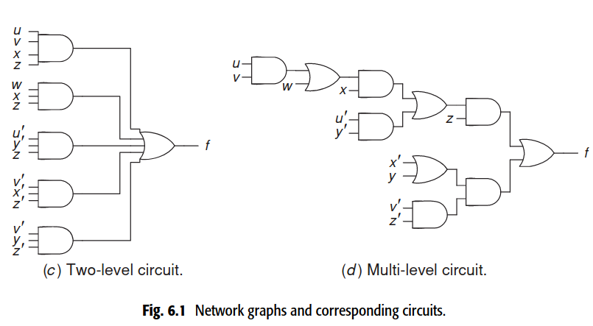
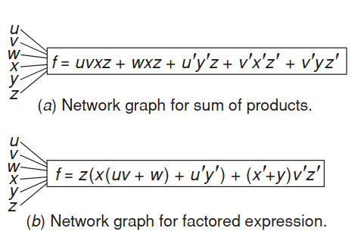
Factoring cont'd...
The above expressions can be represented by logic network graphs
the multi-level circuit has six levels of logic.

Slide 21
Factoring cont'd...
Factoring makes expression more compact.
The minimal sum-of-products expression has 16 literals whereas its factored form has only 11 literals.
The number of transistors in the complex CMOS-gate implementation of an expression is twice its literal-count.
As the number of literal in the expression increases, the implementation complexity of the expression also get increases.
Literal count is good measure of implementation complexity.

Slide 22
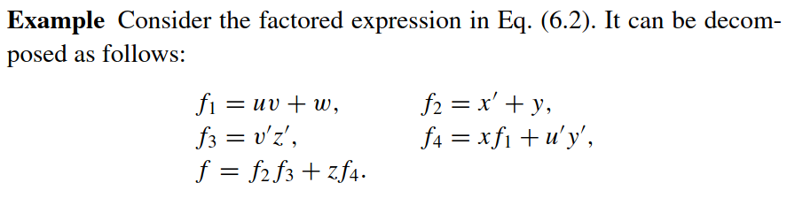
Decomposition
In decomposition, a factored switching expression is replaced with a set of new expressions.

Slide 23
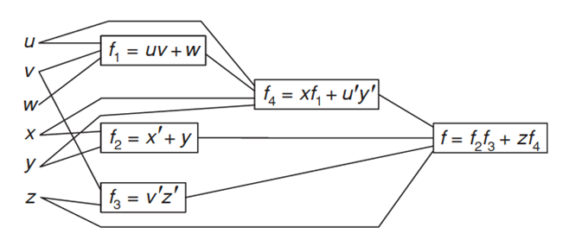
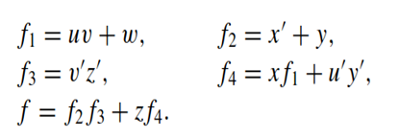
Decomposition cont'd...
Decomposition replaces subexpression in the expression by set of functions. These functions are said to be implemented separately.
The literal-count after the decomposition is the sum of the literal-counts for each function. Thus, the literal count is now 15.

Slide 24
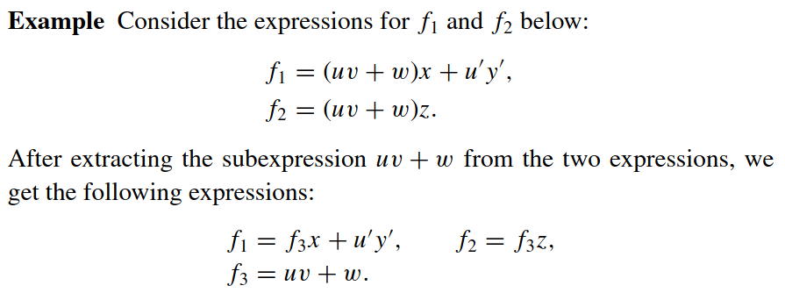
Extraction
Extraction is the process of extracting common sub-expressions (CSE) from two or more expressions in factored form.
If there is CSE between two or more expressions, then we replace CSE by a new function.

Slide 25
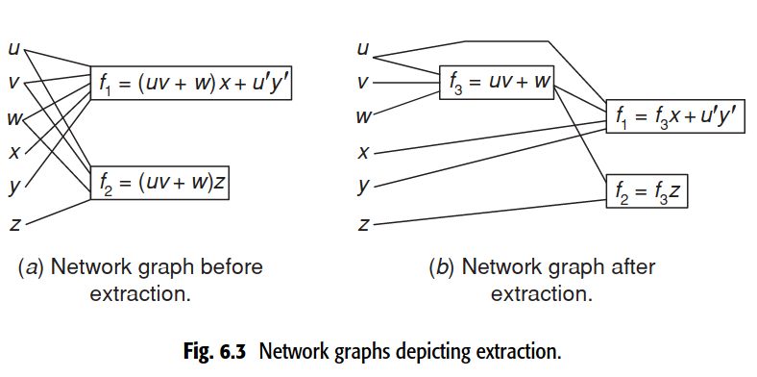
Extraction Cont'd...
The literal count reduces from 10 to 9.

Slide 26
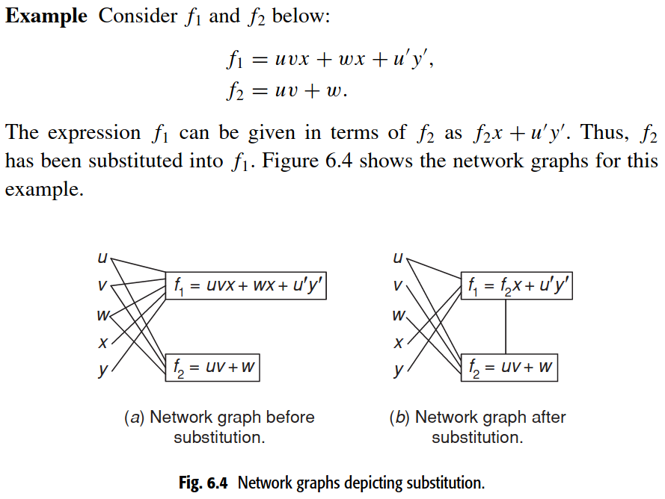
Substitution
Substitution is the process of replacing a subexpression in an expression f with a variable g corresponding to a node in a network graph. In other words, g is substituted into for f is expressed in terms of g.

Slide 27
Elimination
Elimination removes internal nodes from the network graph.
It becomes possible if the corresponding expression replaces the variable corresponding to that node. Whenever the elimination step reduces the literal-count, it may be useful to employ it.
Example: Consider f₁ = x + f₂ and f₂ = y + z. If f₂ is not needed else-where in the network then it can be eliminated in the expression for f₁ by replacing it with y + z, thus obtaining f₁ = x + y + z. This reduces the literal-count from four to three.

Slide 28
Approach
In multi-level logic synthesis, the above five logic transformations are applied to an initial logic network iteratively until no more improvement is possible in the targeted objective
They need not be applied in the given order
Synthesis objectives are optimization of area, delay, or power.

Slide 29
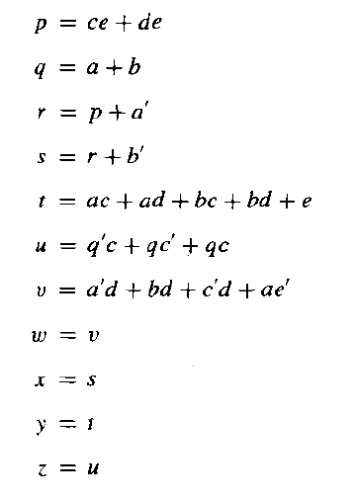
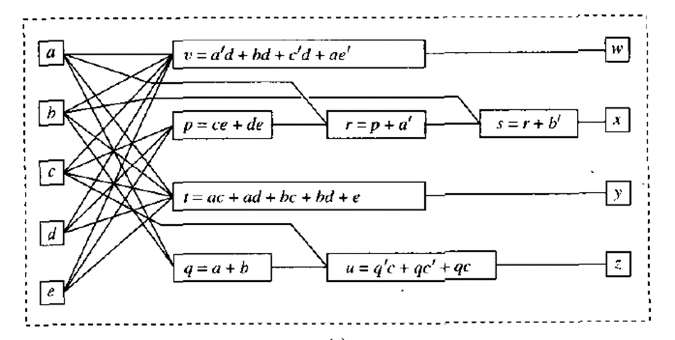
Example

Slide 30

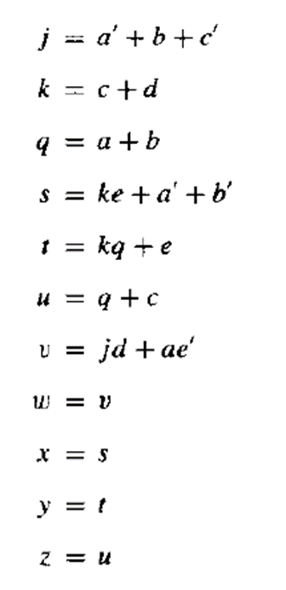

Slide 31
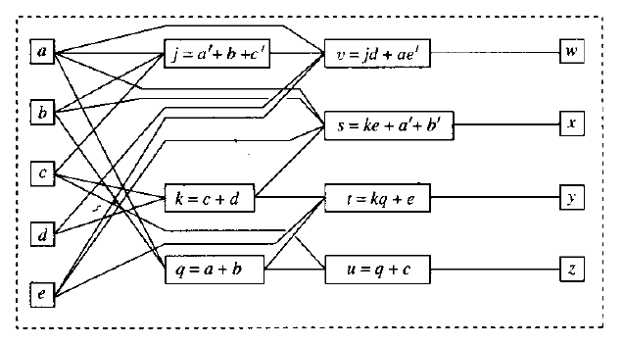

Slide 32
Thank You

