Slide 1
Multi-level logic Minimization – Algebraic Method Dr. Chandan Karfa
CSE IIT Guwahati

Slide 2
Text Book
Chapter 6, Z. Kohavi and N. Jha, Switching and Finite Automata Theory, 3rd Ed., Cambridge University Press, 2010.

Slide 3
Multi-level Logic Optimization
Input:
Set of Boolean expressions
Objectives:
Find and eliminate common sub-expressions among all expressions
Factoring is the Key
Output:
Set of optimized Boolean expressions
Q: How to perform factoring efficiently?

Slide 4
An Example
p = ce + de
q = a+b
r = p+a’
s = r+b'
t = ac+ad+bc+bd+e
u = q'c+qc'+qc
v = a'd + bd + c'd + ae'
w=v
x=s
y=t
z=u

Slide 5
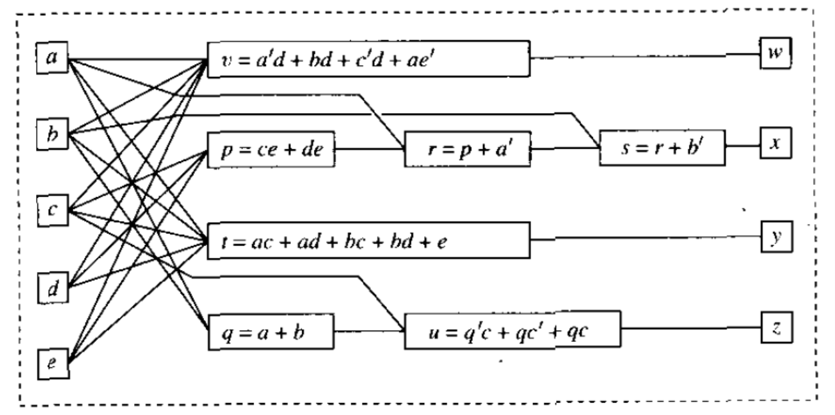
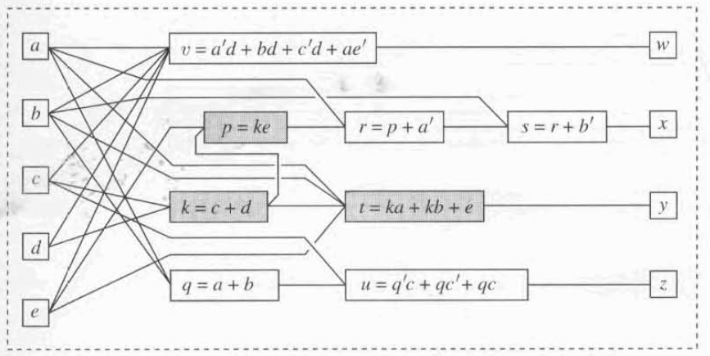
An Example
p = (c + d) e
t = (c + d) (a + b) + e

Slide 6
Multilevel Logic Optimization: The Algebraic Model
Boolean functions are represented by algebraic expressions.
Apply algebraic transformation.
Apply rule of polynomial algebra.
Ex: Apply distributive law:
a.( b + c ) = ab + ac
Ignore specific feature of Boolean algebra.
a + (b.c) != ( a + b) . ( a + c)
No complement: e and e' are treated as two different variables.
Why?

Slide 7
Algebraic Model
By dropping some assumptions about Boolean algebra and represent as Polynomial, the logic network can be optimized by using general properties of polynomial algebra.
Algebraic expressions modelling Boolean function are obtained by representing the function in sum of products form and making them minimal with respect to single-cube containment.
Boolean expression ac + ad + bc + bd can be considered as algebraic expression
aa + ac + ba + bc can not.
aa’ + ac + ba’ + bc can not

Slide 8
Division
Division plays an important role.
f = d.q + r ,
here d = Divisor, f = Dividend, q = Quotient, R = reminder
Example:
f = ac + ad + bc + bd + e
Here, d = (a + b), q = c+d and r = e,
Because, f = (a+b) (c+d) + e
= ac + ad + bc + bd + e
D
F
Q
R
F= DQ + R

Slide 9
Common Divisor/Quotient
f₁ = ce + de
= e (c + d)
f₂ = ac + ad + bc + bd + e
= (c + d) . (a + b) + e
(c + d) is common divisor here.
Extract common divisor,
f₃ = c + d
f₁ = e. f3
f₂ = f₃. (a + b) + e

Slide 10
The Algebraic Method
Objective: Look for common sub-expression.
Question: Where to look for divisor for a function F ?
Answer: In the kernel of f, K(f).
K(f) is another set of two-level SoPs which are special, foundational structure of any function f, being interpreted in algebraic model.
Kernels: A cube-free quotient k obtained by algebraically dividing F by a single cube C (co-kernel)

Slide 11
The Algebraic Method
Question: How to find a kernel k ϵ k(F) ?
Answer: Algebraically divide F by one of its co-kernel C.
Kernels: A cube-free quotient k obtained by algebraically dividing F by a single cube C (co-kernel)
C
F
K
D
F
Q
C= Single cube, abc,
ad,
efg
kernel k if multi-cube and cube-free
R
R
F= CK + R
F= DQ + R
What is cube-free ?

Slide 12
Kernel
What is cube-free ?
You can not factor out a single cube (product term) from divider that leaves no reminder.
Has no cube (product) that is a factor of the kernel expression
xy + xz = x (y+z) Not Cube free
wx + yz is cube free
xy + xy + w is Cube free no common cube can be extracted
Do F/ single cube,
look at result if you can cross-out power cube in each term, not a kernel.

Slide 13
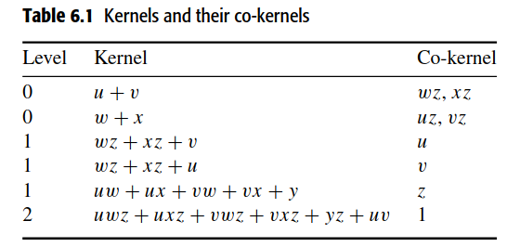
Algebraic Kernels and Co-kernels cont'd...
If a kernel has no kernel except itself, it is called a level-0 kernel.
If a kernel has at least one kernel of level n−1 but no kernel of level nor greater except itself, it is called a level-n kernel. A co-kernel has the same level as its kernel.
Consider the expression f = (uwz+uxz+vwz+vxz+yz+uv). Its kernels and co-kernels and their levels are shown in Table 6.1

Slide 14
Find all Kernels
f = abc + abd + bcd
Find all kernels
Divider cube d | F = d.Q + k | Is Q a kernel of F
1 | (abc + abd + bcd) + 0 | No, here cube b as factor.
a | a(bc + bd) + bcd | No. b is a factor
b | b (ac + ad + cd) + 0 | Yes, kernel (ac + ad + cd) is cube-free
ab | ab (c + d) + bcd | Yes, kernel (c + d) is cube-free

Slide 15
Brayton and McMullen Theorem
Kernels: Why are they important ?
If they are important, how do we actually compute them?
Brayton and McMullen Theorem:
Expression ‘F’ and G have multi-cube common divisor d if and only if,
There are kernels K₁ ϵ K(F) , K₂ ϵ K(G) such that d = k₁ ∩ K₂ (i.e. SOP form with common cubes exist)
d is an expression with at least 2 cube in it.
Interpretation:
To find common divisor of two expressions, the only place to look for is in the intersection of kernels.
This intersection of kernels is the divisor, there is no other.

Slide 16
The Algebraic Method
Find kernels of F and G
Find kernels in intersections of K(F) and K(G)
Extract multi-cube common divisor D
Rewrite F and G using D
Kernels of F
Intersect with
>= 2 cubes
F_{new}
F
K₁, k₂, k₃
K₁, k₈
yes
_{d = ab + c + --}
G
K₄, k₅, k₆, k₇
Multi-cube common
Divisor extracted
G_{new}
Kernels of G

Slide 17
The Algebraic Method
F = cube1 * kernel1 + reminder1
G = cube2 * kernel2 + reminder2
F = cube1 * ( X + Y + stuff1) + reminder1
G = cube2 * ( X + Y + stuff2) + reminder2
F = cube1 * ( X + Y) + ((cube1 * stuff1) + reminder1)
G = cube2 * ( X + Y) + ((cube2 * stuff2) + reminder2)
Kernal1 ∩ kernel2 = [ X + Y] = a multi-cube divisor of F and G
D = X + Y
F = cube1 * D + ((cube1 * stuff1) + reminder1)
G = cube2 * D + ((cube2 * stuff2) + reminder2)

Slide 18
Example
F = ae + be + cde + ab
G = ad + ae + be + bc
K(F) | Co-kernal | K(G) | Co-kernal
a + b + cd | e | a + b | e
b + c | a | d + e | a
a + e | b | d + e + c | b
ac + be + cde + ab | 1 | ab + ac + be + bc | 1
(a + b + cd) ∩ (a + b) = (a + b)
So, this is workable multi-cube divisor of F and G.

Slide 19
Thank You

