Slide 1
Multi-level logic Minimization Dr. Chandan Karfa
CSE IIT Guwahati

Slide 2
Text Book
Chapter 6, Z. Kohavi and N. Jha, Switching and Finite Automata Theory, 3rd Ed., Cambridge University Press, 2010.

Slide 3
The Algebraic Method
Find kernels of F and G
Find kernels in intersections of K(F) and K(G)
Extract multi-cube common divisor D
Rewrite F and G using D
Kernels of F
Intersect with
>= 2 cubes
F_{new}
F
K₁, k₂, k₃
K₁, k₈
yes
_{d = ab + c + --}
G
K₄, k₅, k₆, k₇
Multi-cube common
Divisor extracted
G_{new}
Kernels of G

Slide 4
Rectangle covering – Identify all Kernels
Identifying all Kernels of an Expression
Consider a sum-of-products expression f with p cubes and q distinct literals.
A p × q cube–literal incidence matrix can be defined for f in which element (i, j ) is 1 if the j th literal is used in the ith cube, and 0 otherwise.
A rectangle of this matrix denotes a set of rows and columns in which all entries are 1.
Let (r, c) denote the row and column subsets of the rectangle.
A rectangle (r1, c1) is said to contain another rectangle (r2, c2) if r1 ⊇ r2 and c1 ⊇ c2.
A rectangle is called prime if it is not strictly contained in another rectangle.

Slide 5
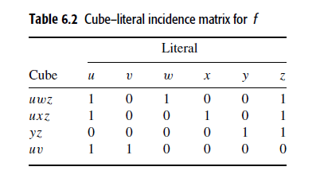
Rectangle covering
The co-rectangle of rectangle (r, c) is denoted as (r, ¯C) where ¯ c is the complement of the column subset c, i.e., it includes all columns of the matrix not in c.
f = uwz + uxz + yz + uv.
4 cubes and 6 distinct literals
Prime Rectangles:
({uwz, uxz}, {u, z})
({uwz, uxz, uv}, {u})
({uwz, uxz, yz}, {z}).
({uwz, uxz}, {u, z}) whose co-rectangle is
({uwz, uxz}, {v, w, x, y}}

Slide 6
Rectangle covering
A co-kernel of an expression can be derived from a prime rectangle (r, c) that contains at least two rows.
Its co-rectangle (r, ¯ c) yields the corresponding kernel, which can be derived as the sum of the cubes in r restricted to the literals in ¯ c.
The prime rectangle ({uwz, uxz}, {u, z}) yields co-kernel uz.
Its co-rectangle ({uwz, uxz}, {v,w, x, y}) yields the kernel w + x
Kernel is obtained by restricting uwz + uxz to literals in {v, w, x, y}.

Slide 7
Find kernels in Intersections
To perform kernel extraction, a kernel–cube incidence matrix is defined analogously to the cube–literal incidence matrix.
The kernels of each expression are identified.
The set of kernels for expression f_{i} is denoted by K(f_{i}).
To derive such a matrix, we first represent each cube in a kernel with a new variable and the kernel by a set of such variables.
For each minterm/cube in kernels, a new variable is introduced
The sets of kernels can now be represented in terms of these variables.
Form an auxiliary function f_{a} as a sum of cubes, where a cube is the product of the new variables corresponding to a kernel for all the expressions under consideration.

Slide 8
Example
f₁ = (uwz + uxz + yz)
f₂ = (vw + vx + vyz)
K(f₁) = {(w + x), (uw +ux + y)}
K(f₂) = {(w + x + yz)}
K(f₁) = {{a_{w}, a_{x}},{a_{uw}, a_{ux} ,a_{y}}}
K(f₂) = {{a_{w}, a_{x}, a_{yz}}}.
f_{a} = (a_{w}a_{x} + a_{uw}a_{ux}a_{y} + a_{w}a_{x}a_{yz})

Slide 9
Kernel–cube incidence matrix
The row headings in the kernel–cube incidence matrix denote the cubes, representing the kernels.
The columns headings denote the new variables.
Element (i, j) of this matrix is 1 if the j^{th} new variable is used in the i^{th} cube, and 0 otherwise.
A prime rectangle in such a matrix corresponds to a kernel in the intersection.
If the rows of such a rectangle correspond to different expressions, then the kernel intersection corresponds to the subexpression that can be extracted from these expressions.

Slide 10
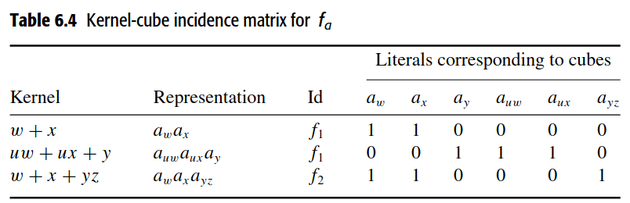
kernel–cube incidence matrix
f_{a} = (a_{w}a_{x} + a_{uw}a_{ux}a_{y} + a_{w}a_{x}a_{yz})
Prime rectangle is ({a_{w}a_{x}, a_{w}a_{x}a_{yz}}, {a_{w}, a_{x} }).
This corresponds to the kernel intersection w + x.

Slide 11
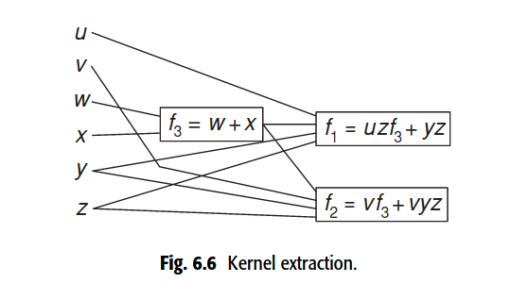
f₁ = (uwz + uxz + yz)
f₂ = (vw + vx + vyz)

Slide 12
Steps for Kernel Extraction in Intersections
Identify the kernels of each expression
Introduce a new variable for each minterm/cube in the kernels
Rewrite the kernels in terms of new variables.
Form an auxiliary function f_{a} as a sum of cubes.
Construct kernel–cube incidence matrix
A prime rectangle in such a matrix corresponds to a kernel in the intersection.

Slide 13
Cube Extraction
For Cube Extraction following steps needs to be performed:
Auxiliary expressions f_{a} is formed as the sum of all the expressions in the logic network.
Cube-literal incidence matrix is obtained for f_{a}.
Each cube of each expression is tagged with an identifier for that expression.
Rest of the approach is same as finding a prime rectangle.
f₁ = (uwz + uxz + yz + uv) and f₂ = (vz + wyz).

Slide 14
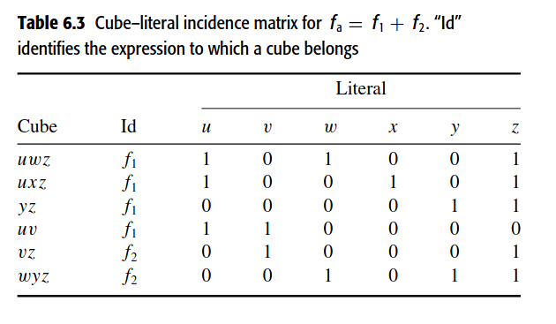
Cube Extraction
f₁ = (uwz + uxz + yz + uv) and f₂ = (vz + wyz).
The auxiliary function f_{a} = f₁ + f₂ = (uwz + uxz + yz + uv + vz + wyz).
The prime rectangle ({yz, wyz},{y,z})
The corresponding cube yz.

Slide 15
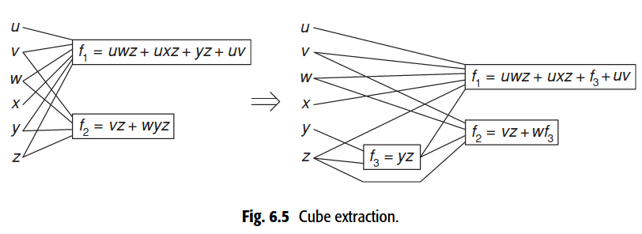
Cube Extraction

Slide 16
Thank You

Slide 17
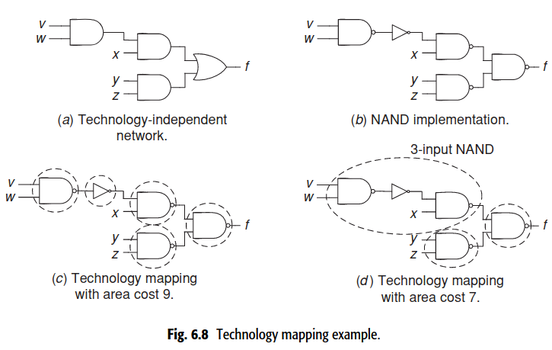
Technology Mapping
After technology-independent logic synthesis, the circuit components need to be mapped to a set of logic cells constituting the cell library that can be implemented in the targeted technology. This process is called technology mapping.
The objective of technology mapping may be to minimize circuit area or delay, or to minimize area under delay constraints.

Slide 18
Technology Mapping Example
Suppose that the cell library has only an inverter, a two-input NAND gate, and a three-input NAND gate, with area costs 1, 2, and 3, respectively.
We first implement the circuit with only inverters and two-input NAND gates, as shown in Fig. 6.8b. The area cost is 9.
A trivial technology mapping for this circuit is shown in Fig. 6.8c.
We can take advantage of the three-input NAND gate available in the cell library and obtain the alternative technology mapping shown in Fig. 6.8d. The area cost is now only 7.

Slide 19
Approach to Technology Mapping
Network Covering: It is the process of replacing subnetworks of the technology-independent logic network with cells from the cell library such that the whole network is covered, and the desired objective is met.
Subject Graph: The technology-independent logic network is first converted into a graph in which each node is derived from a set of base functions Example: a possible set of base functions may consist of an inverter and a two-input NAND gate. Such a graph is called the subject graph.
Pattern Graph: Each cell in the cell library is also represented by a graph in which each node is derived from the set of base functions. Such a graph is called the pattern graph.

Slide 20
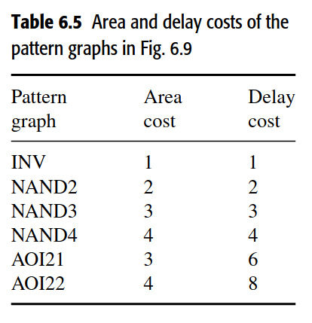
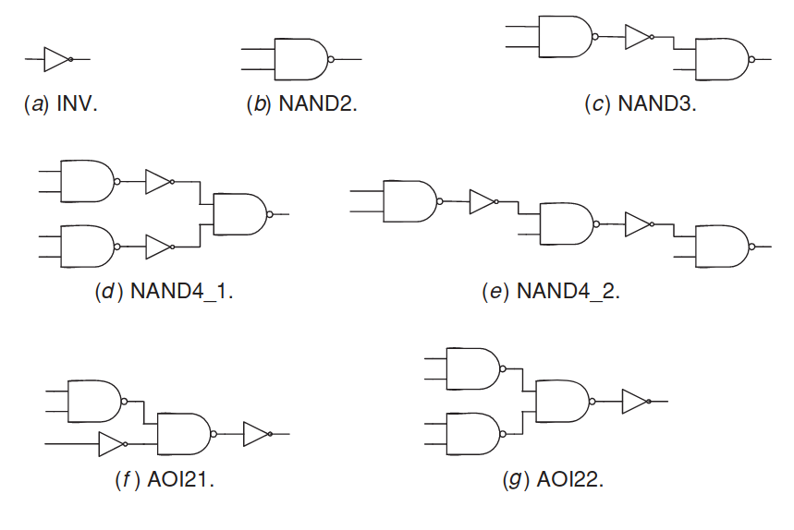
Network Cover Cont'd...
Pattern Graph:

Slide 21
Steps in Technology Mapping
Decomposition into base functions
Partitioning networks into subject graphs
Obtaining matches
Obtaining the network cover

Slide 22
Decomposing a network into base functions
To decompose arbitrary network into a set of base functions, the set must be functionally complete.
It could consist of an inverter, a two-input OR, and a two-input AND.
Other possible sets of base functions include: an inverter and a two-input NAND supported by a cell library that includes {INV, NAND2} an inverter and two-input NOR gate supported by a cell library that includes {INV, NOR2}
Even though an inverter can be obtained from a NAND or NOR gate by shorting its inputs, explicitly including an inverter in the set of base functions leads to lower cost.
With the above choice of base functions, a trivial network cover always exists.

Slide 23
Partitioning a network into subject graphs
The network is partitioned into a set of connected subject graphs and each such subject graph is then subjected to the matching and network-covering steps.
A popular way of partitioning the network is in terms of subnetworks called leaf-directed-acyclic graphs (leaf-DAGs).
A leaf-DAG does not have any internal fanouts.
All fanout points in the decomposed network can be marked and Such fanout points form the boundaries of a partition and each partitioned subnetwork forms a subject graph.

Slide 24
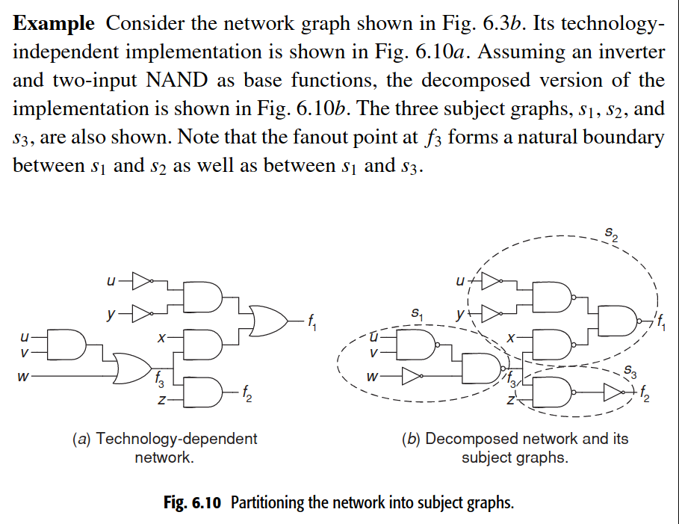
Cont'd...

Slide 25
Obtaining matches
The third step in technology mapping is to obtain all possible ways in which pattern graphs can match each node in the subject graph.
When all the pattern graphs are trees, i.e., they do not have a fanout even at their primary inputs, this step is called tree matching. For example, all the pattern graphs shown in Fig. 6.9 are trees.
Consider the subject graph shown in Fig. 6.11a. Suppose that the cell library has cells whose pattern graphs are those shown in Fig. 6.9. The various matches obtained at the different nodes of the subject graph are shown in Fig. 6.11b. We start at the output and find matches as we go towards the inputs. At node f both NAND2 and NAND3 are matches. Similarly, at node c1 both INV and AOI21 are matches. However, at nodes c2,c3, and c4, only one match is found. Since the base functions (inverter and two-input NAND) are available as cells, at least one match is guaranteed to be found at each node of the subject graph.

Slide 26
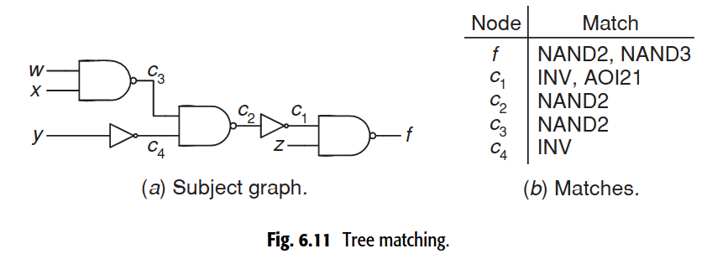
Obtaining matches cont'd...

Slide 27
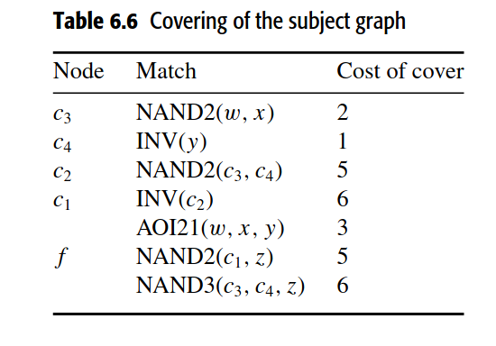
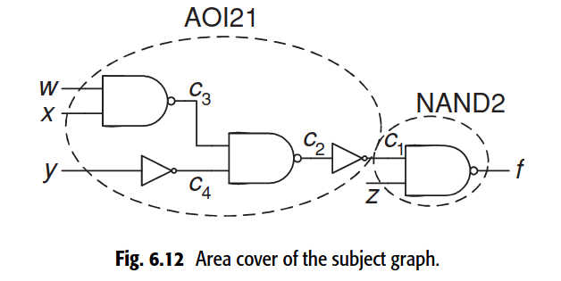
Obtaining the network cover
For each node in the subject graph a possible match needs to be chosen to obtain a network cover such that some given cost, such as area or delay, is minimized.
This method traverses the subject graph from the primary inputs towards the output and chooses the best match for each node.

Slide 28
Thank you

Slide 29
Algebraic kernels and Co-kernels
The concept of kernels and co-kernels helps determine the common sub-expressions that can be extracted from switching expressions.
If an expression cannot be factored by a cube (see Section 4.2), it is said to be cube-free.
For example, (wx+yz) is cube-free. However (xy+xz) is not cube-free since it can be factored by x.
For an expression to be cube-free, it must contain more than one cube.
When an expression is divided by a cube, the result is a cube-free quotient then the quotient is called a kernel and the cube is the corresponding co-kernel.

Slide 30
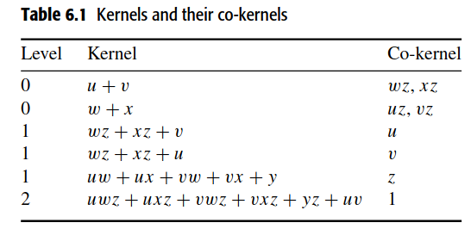
Algebraic Kernels and Co-kernels cont'd...
If a kernel has no kernel except itself, it is called a level-0 kernel.
If a kernel has at least one kernel of level n−1 but no kernel of level nor greater except itself, it is called a level-n kernel. A co-kernel has the same level as its kernel.
Consider the expression f = (uwz+uxz+vwz+vxz+yz+uv). Its kernels and co-kernels and their levels are shown in Table 6.1

Slide 31
Extraction
If two or more expressions have common divisors, the divisors can be extracted.
The rectangle-covering method can be extended to perform extraction as well.
There are two types of extraction methods:
Cube extraction: Cube extraction refers to the extraction of a cube.
Kernel extraction: Extraction of kernel from two or more expressions.

