Slide 1
Combinational Logic Design
Dr. Chandan Karfa
CSE IIT Guwahati

Slide 2
Encoder
Decoder

Slide 3
Source
Chapter 4: M. M. Mano and M. D. Ciletti, Digital Design, 5th Ed., Pearson Education.
Chapter 5: Z. Kohavi and N. Jha, Switching and Finite Automata Theory, 3rd Ed., Cambridge University Press, 2010.

Slide 4
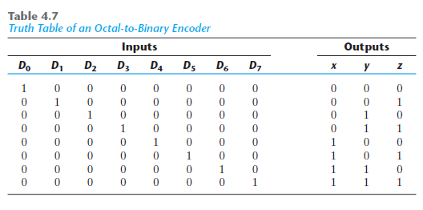

Encoder
An encoder has 2^{n} (or fewer) input lines and n output lines.
The output lines, as an aggregate, generate the binary code corresponding to the input value.
Limitations: 1. Assumes only one input can be active at any given time. If two inputs are active simultaneously,
the output produces an undefined combination.
2. Output with all 0’s is generated when all the inputs are 0; but this output is the same as when D0 is equal to 1.

Slide 5
Priority encoders
It is a device with n input lines and log2n output lines.
Input lines represent request services.
When two lines pi and pj , such that i>j , request service simultaneously, line pi has priority over line pj .
The encoder produces a binary output code indicating which of the input lines requesting service has the highest priority.
Pi indicates request service assuming value 1.

Slide 6
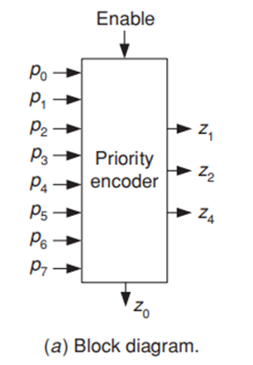
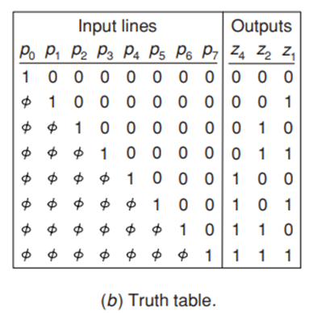


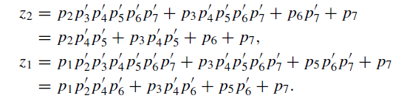
Design of priority encoder

Slide 7
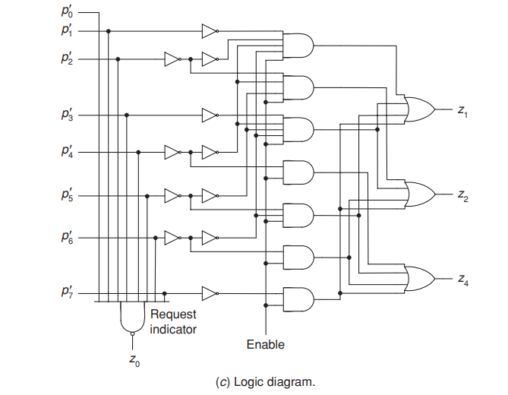



Implementation of encoder
z₂
z₁
The circuit also has an Enable signal
It contains an output z0 that indicates whether any requests are present. Specifically, z0 = 0 if there is no request and z0 = 1 if there are one or more requests present.

Slide 8
Decoders
It is a combinational circuit with n inputs and at most 2^{n} outputs.
Its characteristic property is that, ‘for every combination of input values, only one output value will be equal to 1 at any given time.’
Applications of decoders in digital technology:
Used to route input data to a specified output line.
Decode memory address
They may be used for data distribution i.e. demultiplexing.
they are also used for implementing arbitrary switching functions.

Slide 9
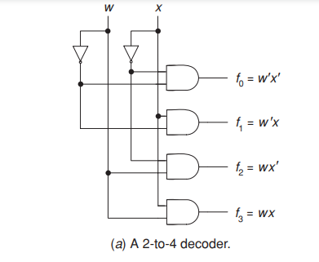
Decoders
The figure shows a basic 2-to-4 decoder.
If w and x are the input variables then each output corresponds to a different minterm of two variables.

Slide 10
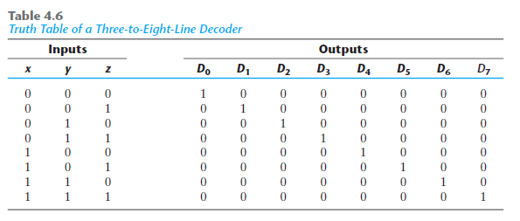
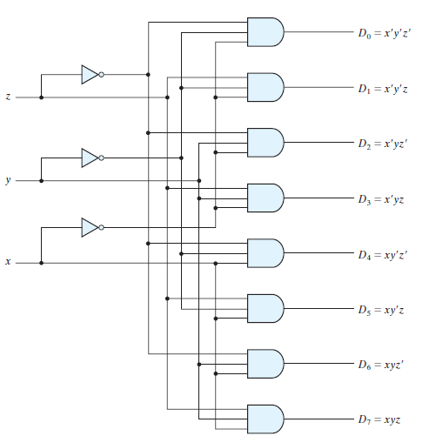
3-to-8 Decoder

Slide 11
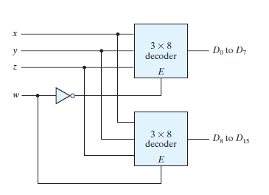
4-to-16 Decoder
Using two 3-to-eight decoder

Slide 12
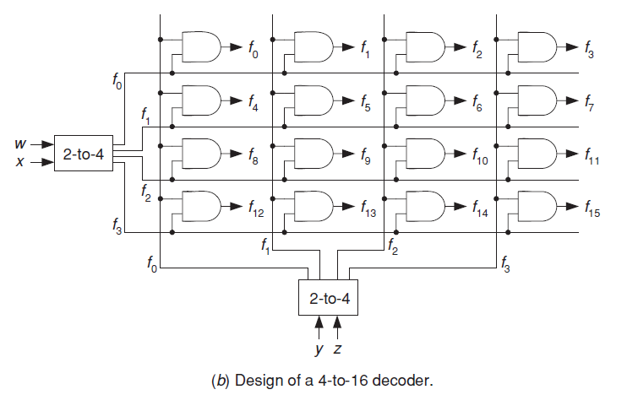
4-to-16 Decoder
Using 2-to-4 decoders and switching matrix

Slide 13
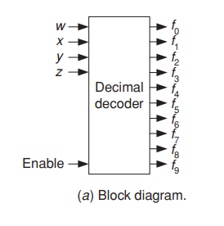
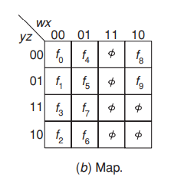
Decimal decoder
Not all decoder with n inputs has exactly 2^{n} outputs.
It converts information from BCD to decimal.
It has four inputs: w, x, y and z.
w is the most significant and z the least significant digit, and 10 outputs, f0 through f9, corresponding to the decimal numbers.

Slide 14
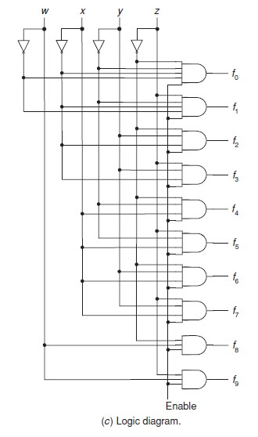
taken advantage of the don’t-care combinations

Slide 15
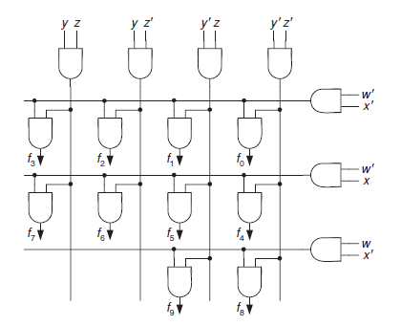
BCD-to-Decimal Decoder using gate matrix

Slide 16
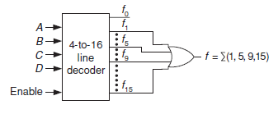
Switching function realization using decoder
A decoder with exactly n inputs and 2^{n} outputs can also be used to implement any switching function.
Each output of such a decoder realizes one distinct minterm.
Thus, by connecting the appropriate outputs to an OR gate, the required function can be realized.

Slide 17
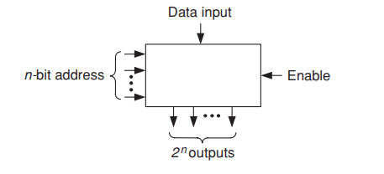
Demultiplexer
It is a decoder with one data input and n address inputs.
It directs the input data to any one of the 2n outputs, as specified by the n-bits input address.

Slide 18
`
Thank You

Slide 19
Seven-segment display
It is a popular method for displaying decimal digits.
The display consists of a BCD-to-seven segment decoder and seven separate light segments ( usually light emitting diodes or crystals).
Each of them can be turned on and off independently of the others.
The display receives its inputs in the form of BCD coded digits and transforms these inputs to obtain the pattern of the corresponding decimal digit

Slide 20
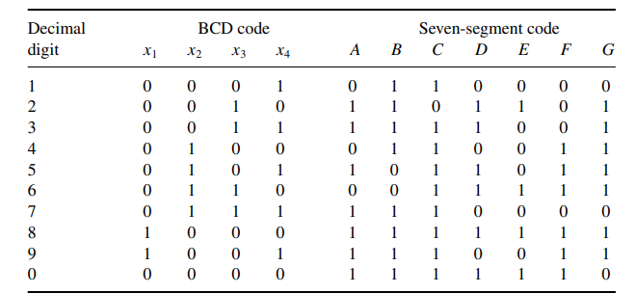
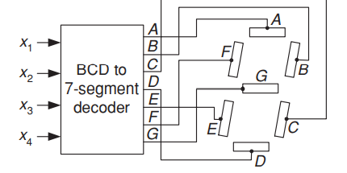
Seven-segment pattern and display

Slide 21
Seven-segment cont.
The seven-segment code corresponding to each digit is directly obtained from the pattern.
For example, to display the decimal digit 2, segments A, B, G, E, D are turned on while segments C and F remain off.
In a similar manner, the rest of the seven-segment code is obtained.

Slide 22
Sine generators
These are used whenever the sine function must be evaluated fast and repeatedly.
A combinational sine generator receives as its input the angle and as output produces the sine of that angle.
The angle is given in radians converted to binary and the sine value is produced in binary.
Let the sine function be sin(π x), where 0 ≤ x < 1.
The angle x will be described by four binary digits x1, x2, x3, x4, where x1 has weight 1/2 , x2 weight 1/4 , and so on.

Slide 23
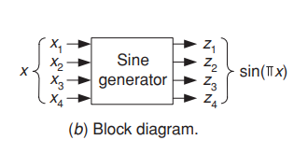
Sine generators cont.
For example, to specify an angle of 45◦, the input x must equal 1/4 , i.e., x = 0100.
To specify an angle of 30◦, x must equal 1/6 .
It is impossible to represent this value precisely with four bits; the closest possible value is 3/16 or x = 0011.

Slide 24
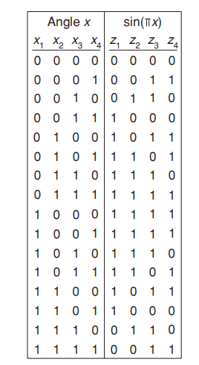
Sine generator cont.
The truth table of sine generator is shown.
The logic equations are:
z1 = x1x2 + x1x 2 + x2x3 + x1x3x4,
z2 = x1x 2 + x3x4 + x 1x2x4,
z3 = x3x4 + x2x3 + x2x 4 + x2x3x4 + x1x4,
z4 = x2x3x4 + x2x3x 4 + x1x2x3 + x1x3x4 + x 1x2x4.
The sine generator, which is a special-purpose code converter, can be implemented in a variety of ways, namely, as a conventional multi-output circuit or by using a 4-to-16 line decoder plus the necessary OR gates.

Slide 25
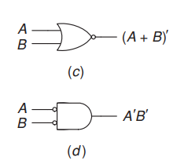
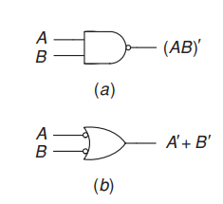
Nand and nor circuits
NAND gates constitute the major components used today by logic designers.
In some future nanotechnologies, NOR gates may play a similar role.
Fig.(a) and (b) represents NAND gate symbols.
Fig.(c) and (d) represents NOR gate symbols.

Slide 26
Nand and nor contd.
Switching algebra is not directly applicable in the case of NAND and NOR gates.
For example, the implementation of the function T = A + (B + C )(D + EF ) with AND, OR, NOT logic is straightforward, but its NAND-logic realization is not as evident.
It can be, however, considerably simplified by expressing the function as T = A|((B |C)|(D|(E|F ))).

Slide 27
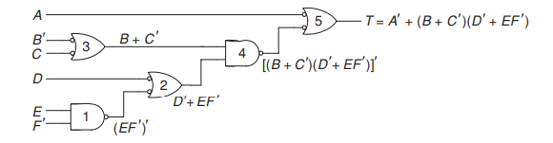
Analysis and synthesis of nand-nor network
The usefulness of having two symbols to represent a NAND gate will be demonstrated by analyzing the circuit shown.
If a line connecting two gates has circles at both ends then both circles may be ignored because their net logic effect is nil.

Slide 28
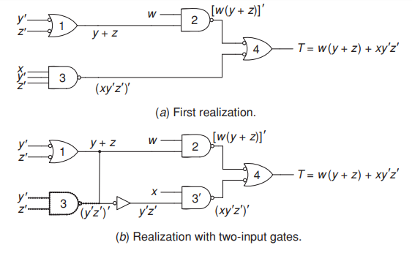
SYNTHESIS OF NAND CIRCUIT

Slide 29
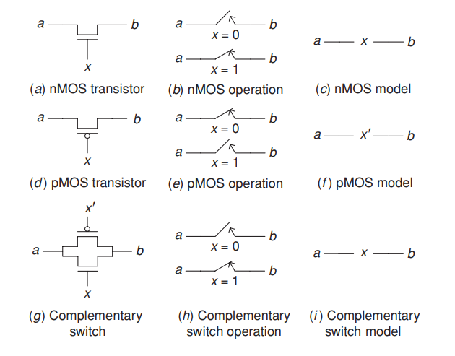
METAL-OXIDE SEMICONDUCTOR GATES AND TRANSISTORS
Complementary metal-oxide semiconductor (CMOS) is the dominant technology for implementing chips.

Slide 30
MOS CONTD.
nMOS Transistor: The switch is open when x=0 and closed when x=1
pMOS Transistor: The switch is open when x=1 and closed when x=0
An nMOS transistor passes a 0 perfectly, but a 1 imperfectly.
The opposite is true for a pMOS transistor. It is good at propagating a 1, but bad at propagating a 0.
To overcome this drawback of nMOS and pMOS transistors they can be connected in parallel.
It is called a complementary switch. This switch is closed when x = 1 since both its transistors are closed for this value.

Slide 31
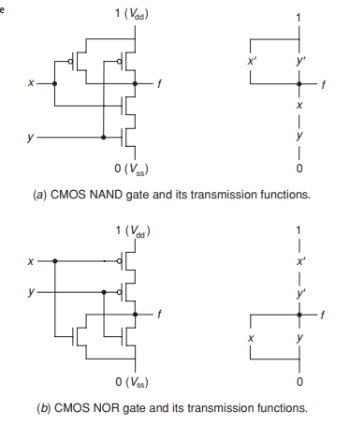
Analysis and synthesis of mos networks

Slide 32
ANALYSIS OF SERIES-PARALLEL NETWORKS
Two MOS transistors with transmission functions x and y, connected in parallel, is x + y and that the transmission function of a network consisting of two MOS transistors connected in series is xy. Since the algebra of MOS networks is isomorphic to switching algebra, the transmission function of two networks, T1 and T2, connected in series is T1T2 and the transmission function of a parallel connection of these two networks is T1 + T2. Utilizing these properties, we can determine the transmission function of any series–parallel network.

Slide 33
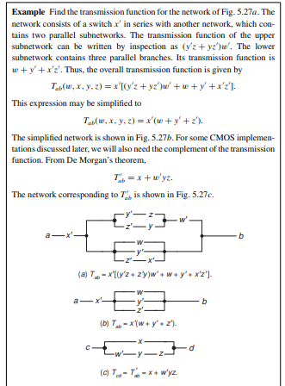

Slide 34
ANALYSIS OF NON-SERIES-PARALLEL NETWORKS
One way to obtain the transmission function between two terminals of a given network is by tracing all paths from one terminal to the other.
one path from terminal i to terminal j consists of a series connection of branches w and x. Transmission through this path is 1 if both w and x are 1, i.e., conducting. Hence, this path can be expressed by the product wx. If we associate with each path from terminal i to terminal j a product of literals corresponding to the branches encountered in the path then the sum of all these products is the required transmission function Tij . These paths are known as the tie sets of the network. Each tie set represents a minimal path between the two network terminals such that, whenever all the branches in the path are conducting, the transmission through the path is 1 regardless of the state of all other branches in the network.

Slide 35
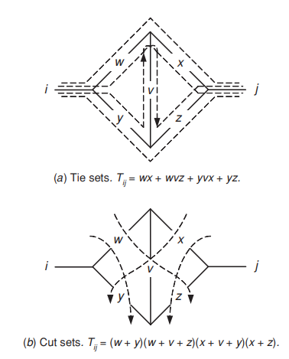

Slide 36
CONTINUED
Tij = wx + wvz + yvx + yz
Broken lines are drawn through, rather than along, the network branches, so as to separate terminal i from terminal j in all possible ways and thus to render the transmission Tij equal to 0. For example, the transmission Tij is 0 if both branches w and y are open, regardless of the state of the other branches in the network. Similarly, if w, v, and z are open then Tij is 0, and so on. If we express each such “cut” through the network by a sum of literals, e.g., w + y, then the product of all these sums is 0 whenever any of its factors is 0. For all other combinations, the product will have the value 1.
The minimal sets of switches which, when open, ensure that the network transmission is 0 are known as the cut sets of the network.

Slide 37
SYNTHESIS OF MOS NETWORKS
First, the requirements that the network needs to satisfy are expressed algebraically in the form of switching expressions.
Next, these switching expressions are simplified as much as possible and a corresponding series–parallel network is obtained.
Consequently the final step in the synthesis procedure is the simplification of the network.
When simplifying a network, extreme care must be taken to prevent the introduction of undesired paths through the network, which may change its transmission function. Such paths, called sneak paths.

Slide 38
