Slide 1
Combinational Logic Design
Dr. Chandan Karfa
CSE IIT Guwahati

Slide 2
Adder

Slide 3
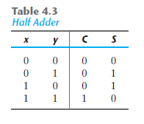
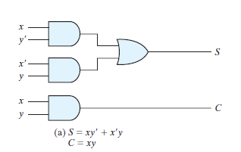
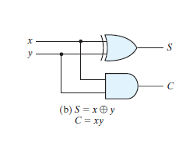
Half Adder

Slide 4
Full adder
For example, addition of the binary numbers 1011 and 0011
0 1 1 carry-in
1 0 1 1 augend
0 0 1 1 addend
1 1 1 0 sum
The carry-out produced in the addition of the ith significant digits must be incorporated, as a carry-in, in the addition process for the (i + 1)th significant digit.

Slide 5
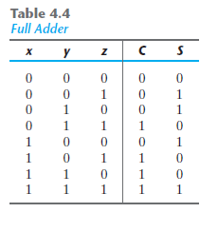
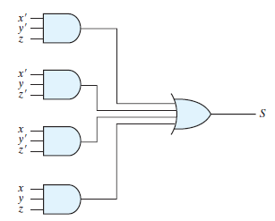
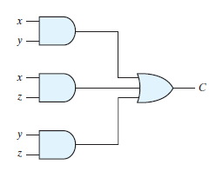
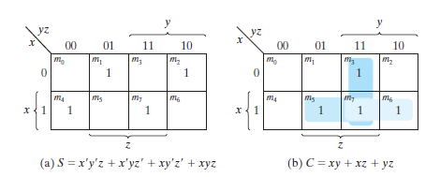
Full Adder

Slide 6
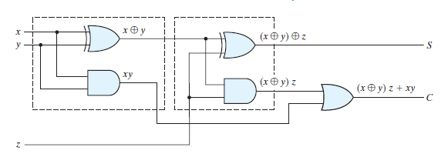
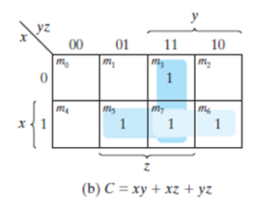


Full Adder – area optimized design

Slide 7
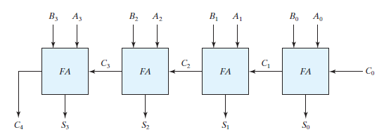
Four bit binary adder
Also known as ripple carry adder.
Large combinational/propagation delay
2n for normal design for n bits addition
3n for area optimized design for n bits addition

Slide 8
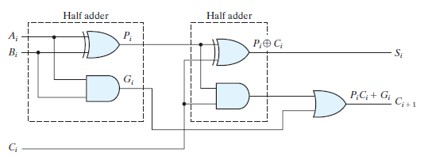
Carry Look ahead adder
G_{i} is called a carry generate, and it produces a carry of 1 when both A_{i} and B_{i} are 1, regardless of the input carry C_{i}.

Slide 9
Carry Look ahead adder
P_{i} is called a carry propagate because it determines whether a carry into stage i will propagate into stage i + 1 (i.e., whether an assertion of C_{i} will propagate to an assertion of C_{i+1} )

Slide 10




Carry Look ahead adder

Slide 11
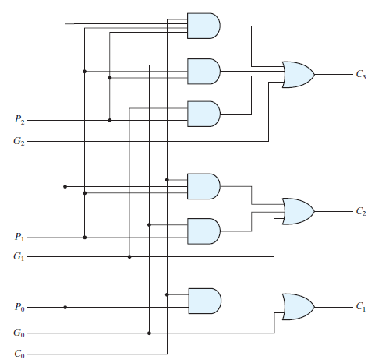
Carry Look ahead adder

Slide 12
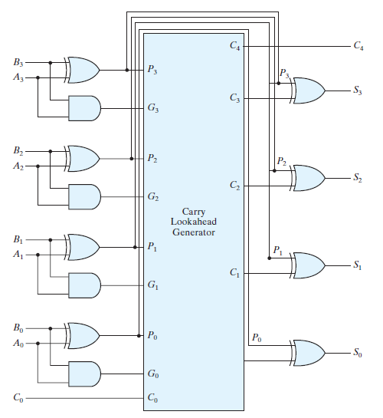
Four bit adder with carry Look ahead adder
What is the delay of a n-bit adder?
Constant 4

Slide 13
Area overhear of Carry look ahead adder
It requires a very large number of gates.
For each stage of the adder it is necessary to have an OR gate with n inputs and n AND gates with 1 through n inputs
Modern day computer is 64-bit word

Slide 14
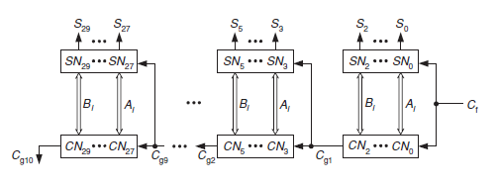
Carry look ahead adder
The limitation can be overcome, though at the expense of computation speed.
By dividing the n stages of the adder into groups such that within each group a full carry look ahead is achieved while a ripple carry is maintained between groups.
For group of size k-stages, delay: 2n/k
Area overhead:

Slide 15
Thank You

Slide 16
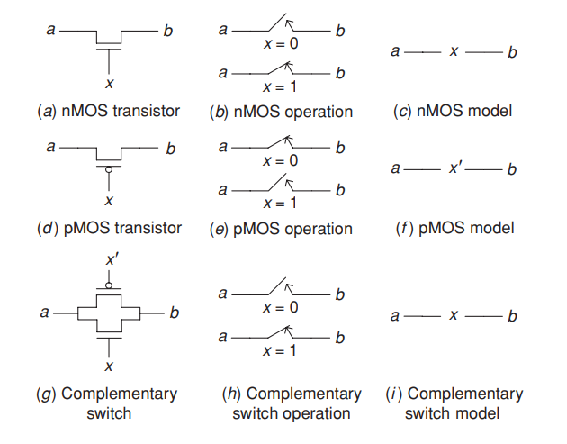
METAL-OXIDE SEMICONDUCTOR GATES AND TRANSISTORS
Complementary metal-oxide semiconductor (CMOS) is the dominant technology for implementing chips.

Slide 17
MOS CONTD.
nMOS Transistor: The switch is open when x=0 and closed when x=1
pMOS Transistor: The switch is open when x=1 and closed when x=0
An nMOS transistor passes a 0 perfectly, but a 1 imperfectly.
The opposite is true for a pMOS transistor. It is good at propagating a 1, but bad at propagating a 0.
To overcome this drawback of nMOS and pMOS transistors they can be connected in parallel.
It is called a complementary switch. This switch is closed when x = 1 since both its transistors are closed for this value.

Slide 18
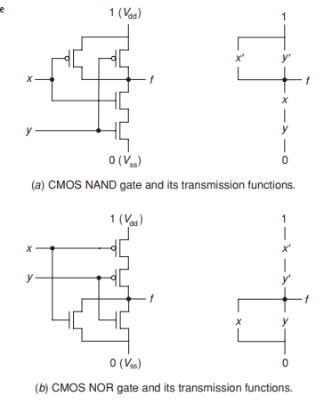
Analysis and synthesis of mos networks

Slide 19
ANALYSIS OF SERIES-PARALLEL NETWORKS
Two MOS transistors with transmission functions x and y, connected in parallel, is x + y and that the transmission function of a network consisting of two MOS transistors connected in series is xy. Since the algebra of MOS networks is isomorphic to switching algebra, the transmission function of two networks, T1 and T2, connected in series is T1T2 and the transmission function of a parallel connection of these two networks is T1 + T2. Utilizing these properties, we can determine the transmission function of any series–parallel network.

Slide 20
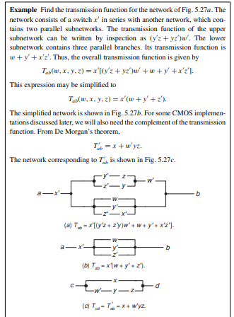

Slide 21
ANALYSIS OF NON-SERIES-PARALLEL NETWORKS
One way to obtain the transmission function between two terminals of a given network is by tracing all paths from one terminal to the other.
one path from terminal i to terminal j consists of a series connection of branches w and x. Transmission through this path is 1 if both w and x are 1, i.e., conducting. Hence, this path can be expressed by the product wx. If we associate with each path from terminal i to terminal j a product of literals corresponding to the branches encountered in the path then the sum of all these products is the required transmission function Tij . These paths are known as the tie sets of the network. Each tie set represents a minimal path between the two network terminals such that, whenever all the branches in the path are conducting, the transmission through the path is 1 regardless of the state of all other branches in the network.

Slide 22
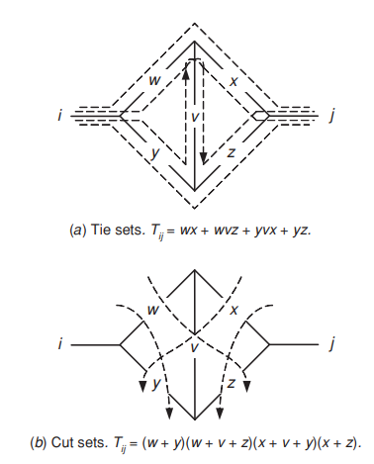

Slide 23
CONTINUED
Tij = wx + wvz + yvx + yz
Broken lines are drawn through, rather than along, the network branches, so as to separate terminal i from terminal j in all possible ways and thus to render the transmission Tij equal to 0. For example, the transmission Tij is 0 if both branches w and y are open, regardless of the state of the other branches in the network. Similarly, if w, v, and z are open then Tij is 0, and so on. If we express each such “cut” through the network by a sum of literals, e.g., w + y, then the product of all these sums is 0 whenever any of its factors is 0. For all other combinations, the product will have the value 1.
The minimal sets of switches which, when open, ensure that the network transmission is 0 are known as the cut sets of the network.

Slide 24
SYNTHESIS OF MOS NETWORKS
First, the requirements that the network needs to satisfy are expressed algebraically in the form of switching expressions.
Next, these switching expressions are simplified as much as possible and a corresponding series–parallel network is obtained.
Consequently the final step in the synthesis procedure is the simplification of the network.
When simplifying a network, extreme care must be taken to prevent the introduction of undesired paths through the network, which may change its transmission function. Such paths, called sneak paths.

Slide 25
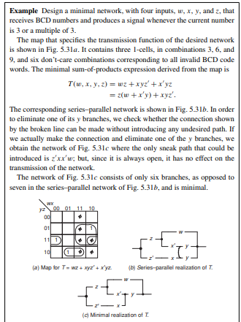

Slide 26
Thank You

Slide 27
Seven-segment display
It is a popular method for displaying decimal digits.
The display consists of a BCD-to-seven segment decoder and seven separate light segments ( usually light emitting diodes or crystals).
Each of them can be turned on and off independently of the others.
The display receives its inputs in the form of BCD coded digits and transforms these inputs to obtain the pattern of the corresponding decimal digit

Slide 28
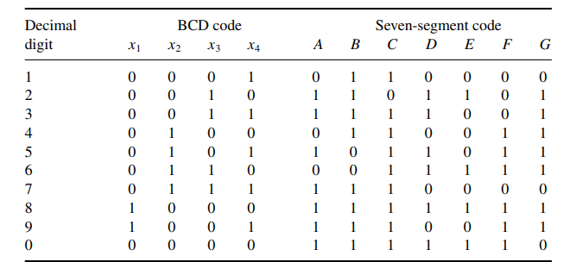
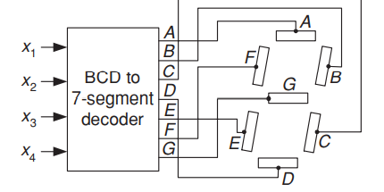
Seven-segment pattern and display

Slide 29
Seven-segment cont.
The seven-segment code corresponding to each digit is directly obtained from the pattern.
For example, to display the decimal digit 2, segments A, B, G, E, D are turned on while segments C and F remain off.
In a similar manner, the rest of the seven-segment code is obtained.

Slide 30
Sine generators
These are used whenever the sine function must be evaluated fast and repeatedly.
A combinational sine generator receives as its input the angle and as output produces the sine of that angle.
The angle is given in radians converted to binary and the sine value is produced in binary.
Let the sine function be sin(π x), where 0 ≤ x < 1.
The angle x will be described by four binary digits x1, x2, x3, x4, where x1 has weight 1/2 , x2 weight 1/4 , and so on.

Slide 31
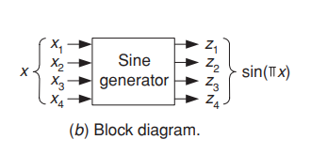
Sine generators cont.
For example, to specify an angle of 45◦, the input x must equal 1/4 , i.e., x = 0100.
To specify an angle of 30◦, x must equal 1/6 .
It is impossible to represent this value precisely with four bits; the closest possible value is 3/16 or x = 0011.

Slide 32
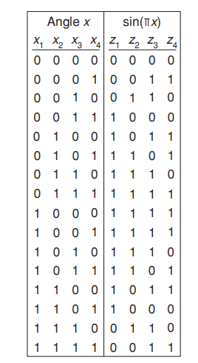
Sine generator cont.
The truth table of sine generator is shown.
The logic equations are:
z1 = x1x2 + x1x 2 + x2x3 + x1x3x4,
z2 = x1x 2 + x3x4 + x 1x2x4,
z3 = x3x4 + x2x3 + x2x 4 + x2x3x4 + x1x4,
z4 = x2x3x4 + x2x3x 4 + x1x2x3 + x1x3x4 + x 1x2x4.
The sine generator, which is a special-purpose code converter, can be implemented in a variety of ways, namely, as a conventional multi-output circuit or by using a 4-to-16 line decoder plus the necessary OR gates.

Slide 33
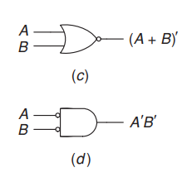
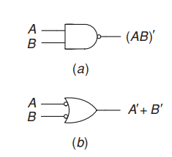
Nand and nor circuits
NAND gates constitute the major components used today by logic designers.
In some future nanotechnologies, NOR gates may play a similar role.
Fig.(a) and (b) represents NAND gate symbols.
Fig.(c) and (d) represents NOR gate symbols.

Slide 34
Nand and nor contd.
Switching algebra is not directly applicable in the case of NAND and NOR gates.
For example, the implementation of the function T = A + (B + C )(D + EF ) with AND, OR, NOT logic is straightforward, but its NAND-logic realization is not as evident.
It can be, however, considerably simplified by expressing the function as T = A|((B |C)|(D|(E|F ))).

Slide 35
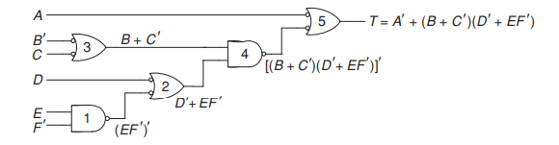
Analysis and synthesis of nand-nor network
The usefulness of having two symbols to represent a NAND gate will be demonstrated by analyzing the circuit shown.
If a line connecting two gates has circles at both ends then both circles may be ignored because their net logic effect is nil.

Slide 36
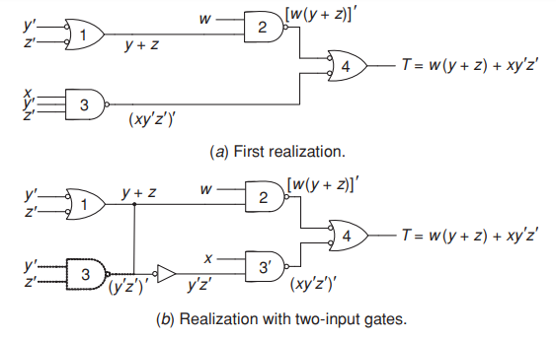
SYNTHESIS OF NAND CIRCUIT

