Slide 1
CMOS transistors and gates
Dr. Chandan Karfa
CSE IIT Guwahati

Slide 2
Metal-oxide semiconductor (MOS) transistors and gates
Chapter 5, Kohavi’s book

Slide 3
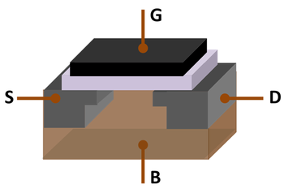
MOSFET
The metal–oxide–semiconductor field-effect transistor (MOSFET), also known as the metal–oxide–silicon transistor (MOS transistor, or MOS) is a type of insulated-gate field-effect transistor that is fabricated by the controlled oxidation of a semiconductor, typically silicon.

Slide 4
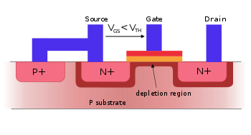
MOSFET
The traditional metal–oxide–semiconductor (MOS) structure is obtained by growing a layer of silicon dioxide on top of a silicon substrate, commonly by thermal oxidation and depositing a layer of metal or polycrystalline silicon. As the silicon dioxide is a dielectric material, its structure is equivalent to a planar capacitor, with one of the electrodes replaced by a semiconductor.
When a voltage is applied across a MOS structure, it modifies the distribution of charges in the semiconductor.

Slide 5
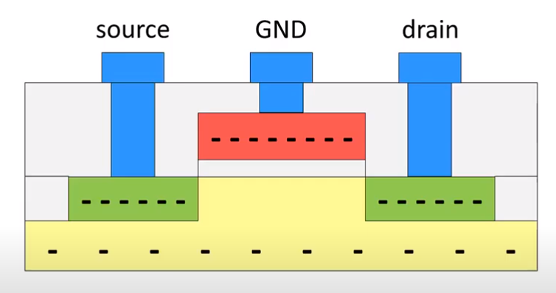
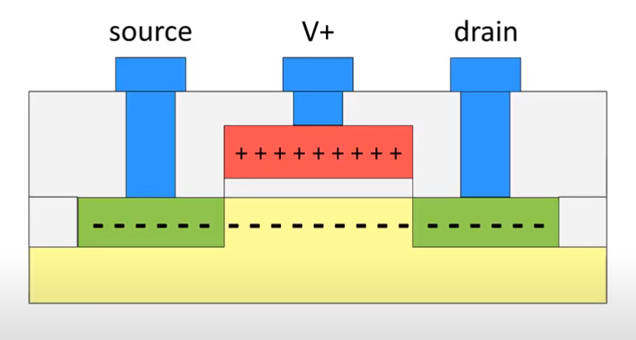
NMOS

Slide 6
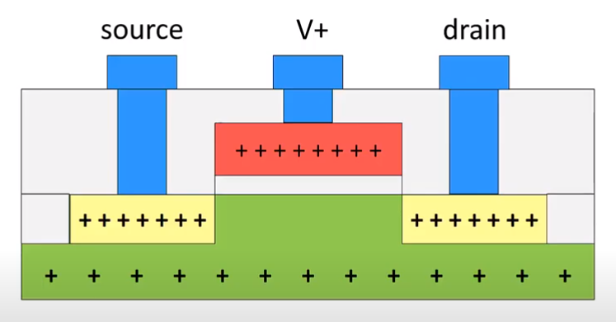
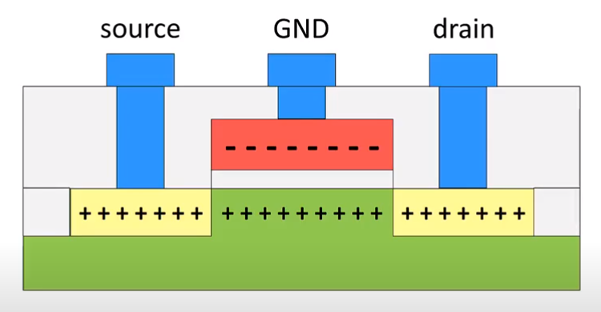
PMOS

Slide 7
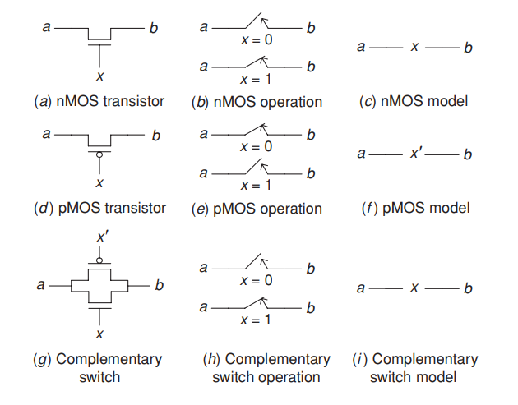
METAL-OXIDE SEMICONDUCTOR GATES AND TRANSISTORS
Complementary metal-oxide semiconductor (CMOS) is the dominant technology for implementing chips.

Slide 8
MOS CONTD.
nMOS Transistor: The switch is open when x=0 and closed when x=1
pMOS Transistor: The switch is open when x=1 and closed when x=0
An nMOS transistor passes a 0 perfectly, but a 1 imperfectly.
pMOS transistor is good at propagating a 1, but bad at propagating a 0.
To overcome this drawback of nMOS and pMOS transistors they can be connected in parallel.
It is called a complementary switch. This switch is closed when x = 1 since both its transistors are closed for this value.

Slide 9
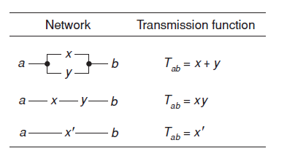
Any switching expression can be realized by an appropriate connection of such transistors

Slide 10
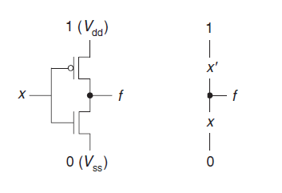
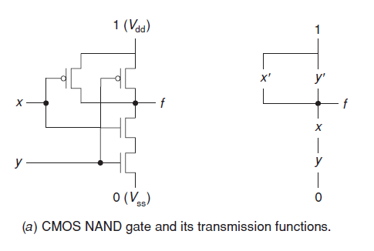
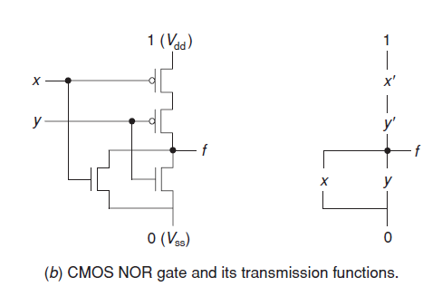
Gate realization using transistors
NOT GATE

Slide 11
Analysis of series–parallel networks
Two MOS transistors with transmission functions x and y, connected in parallel, is x + y.
the transmission function of a network consisting of two MOS transistors connected in series is xy.
Since the algebra of MOS networks is isomorphic to switching algebra, the transmission function of two networks, T1 and T2, connected in series is T1T2 and the transmission function of a parallel connection of these two networks is T1 + T2.
Utilizing these properties, we can determine the transmission function of any series–parallel network.

Slide 12


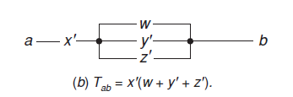
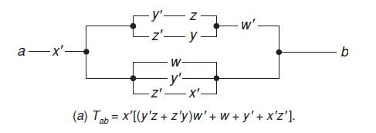
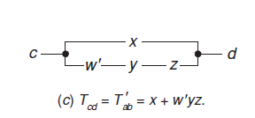
Analysis of series–parallel networks
Simplified expression
Complement

Slide 13
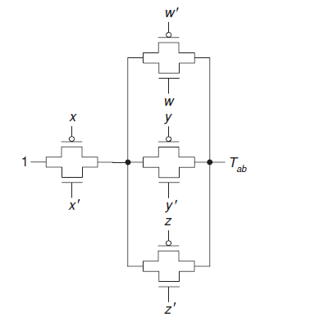
Complementary-switch-based CMOS implementation
simply involves a one-to-one mapping from the network

Slide 14
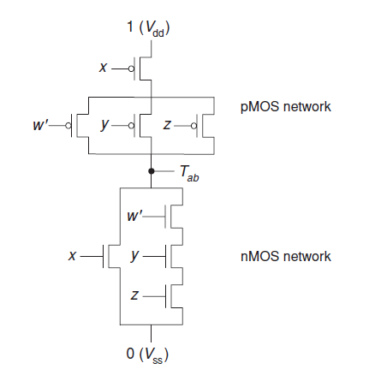
Complex CMOS-gate implementation
A CMOS gate is said to be complex if it does not implement a primitive function such as a NOT, NAND or NOR gate.
The number of transistors in complex CMOS-gate implementation
of an expression is TWICE of its literal count

Slide 15


Synthesis of MOS networks
Obtain the switching expression of the function
Obtain the minimal/simplified expression
Implement the simplified function using series-parallel network
Simplify the network if possible (if some parallel sub-paths can be merges without changing the functionality).

Slide 16
Thank You

