Slide 1
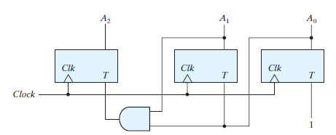
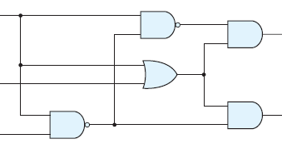
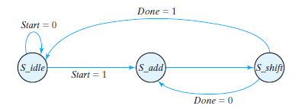
Digital Design CS221 CSE IIT Guwahati

Slide 2
Introduction
Digital systems have such a prominent role in everyday life that we refer to the present technological period as the digital age.
Digital systems are used in communication, business transactions, traffic control, spacecraft guidance, medical treatment, weather monitoring, the Internet, and many other commercial, industrial, and scientific enterprises.
Digital telephones, digital televisions, digital versatile discs, digital cameras, handheld devices, and, of course, digital computers
Online Class!

Slide 3
Introduction
These devices have graphical user interfaces (GUIs) which enable them to execute commands
Internally, it involves precise execution of a sequence of complex internal instructions over a set of data.
Electronic devices called transistors predominate in the circuitry that implements the signals.
The signals in most present‐day electronic digital systems use just two discrete values and are therefore said to be binary
Analog‐to‐digital converter, a device that forms a digital (discrete) representation of an analog (continuous) quantity.
A digital system is a system that manipulates discrete elements of information represented internally in binary form.

Slide 4
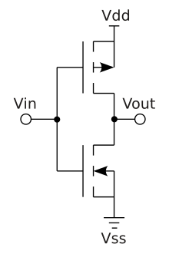
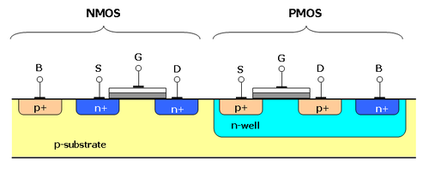
What is there inside an electronic device?
Transistors
CMOS, PMOS

Slide 5
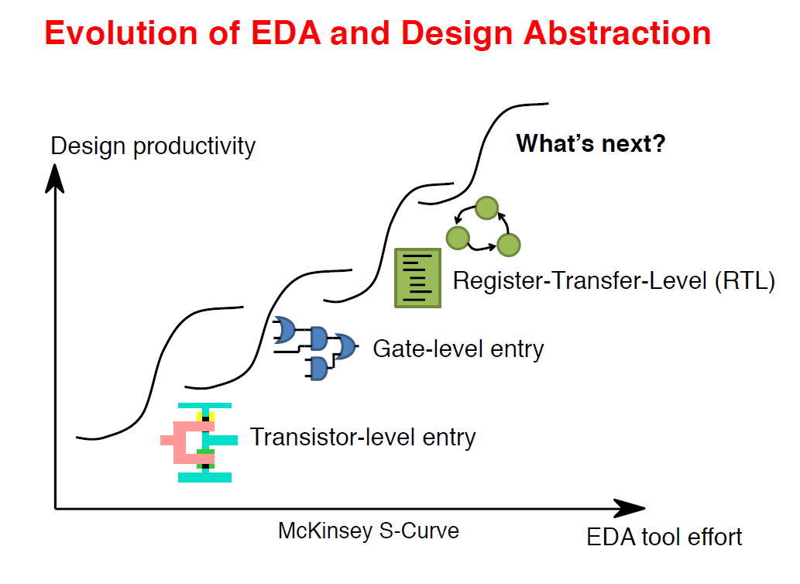
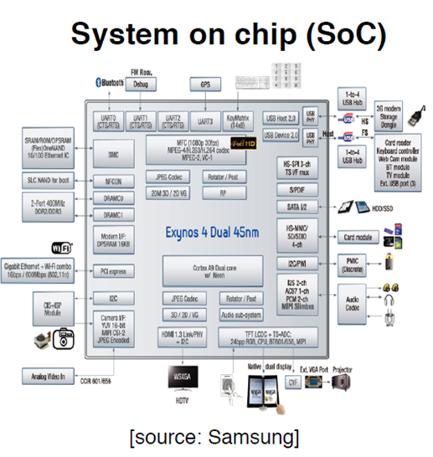
How an electronic Design built
Electronic Design Automation

Slide 6
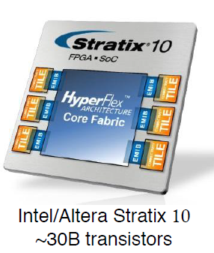
How Chips Have Shrunk?
•1946 in UPenn
•Measured in cubic ft.

Slide 7
What is Digital Design all about?
How digital circuits work?

Slide 8
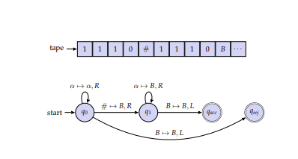
Blocks needed to design a digital computer
Ingredients:
A way to distinguish between 0’s and 1’s (called Binary digits)
A way to store information (Memory)
A way to encode Finite state instructions (Boolean functions)

Slide 9
Why do CS students need to learn Hardware?
Software runs on hardware
EDA tools is developed by Programmer

Slide 10
Syllabus
First Half:
Switching Algebra
Number Systems – coding
Boolean algebra and logic minimisation;
Design of combinational logic blocks (MUX, DeMUX, encoder, decoder, adders, multipliers, etc.);
Design using combinational logic blocks;
Programming using HDLs (Verilog).
Second Half:
Sequential circuit design: flip-flops, FSM, registers, counters, state tables and diagrams, state minimization, excitation functions of memory elements, synthesis of synchronous sequential circuits; representation and synthesis using ASM charts;
Specification and synthesis of asynchronous sequential machines;
Basics of FPGA architecture;

Slide 11
Logistics
Instructors
Dr. Chandan Karfa (first half)
Dr. Aryabartta sahu (second half)
TAs:
Debabrata Senapati - debab176101003@iitg.ac.in
Priyanka Panigrahi - priya176101006@iitg.ac.in
K Chitra - k.chitra@iitg.ac.in
Nilotpola Sarma - s.nilotpola@iitg.ac.in
Surajit Das - d.surajit@iitg.ac.in
Subham Das - subham.das@iitg.ac.in

Slide 12
Logistics
Course website is up. https://iitg.ac.in/ckarfa/current_course.html
Text Book:
M. M. Mano and M. D. Ciletti, Digital Design, 5th Ed., Pearson Education.
Z. Kohavi and N. Jha, Switching and Finite Automata Theory, 3rd Ed., Cambridge University Press, 2010.
References:
S. Palnitkar, Verilog HDL: A Guide to Digital Design and Synthesis,Pearson, 2nd Ed, 2003.
F. Vahid, Digital Design, 1st Ed., Wiley India, 2011.

Slide 13
Logistics
Youtube Channel: CS221 Digital_Design_2021
For lecture video upload
MS Teams group: Course name: CS221_2021
For online examination and Assignment submission
Online live classes
Posting Quarries

Slide 14
Grade Calculation
Quiz: 40\%. 4 Quizzes, two before mid-sem and two after mid-sem. Each carries 10\% marks.
Mid-Sem Examinations: 20\%.
End-Sem Examinations: 30\%
Class Participation: 10\%. It includes attendance, class interaction and class performance.

Slide 15



