Slide 1
Introduction to DIGITAL CIRCUITS MODELING using VERILOG Dr. Chandan Karfa CSE IIT Guwahati

Slide 2
S. Palnitkar, Verilog HDL: A Guide to Digital Design and Synthesis,Pearson, 2nd Ed, 2003.

Slide 4
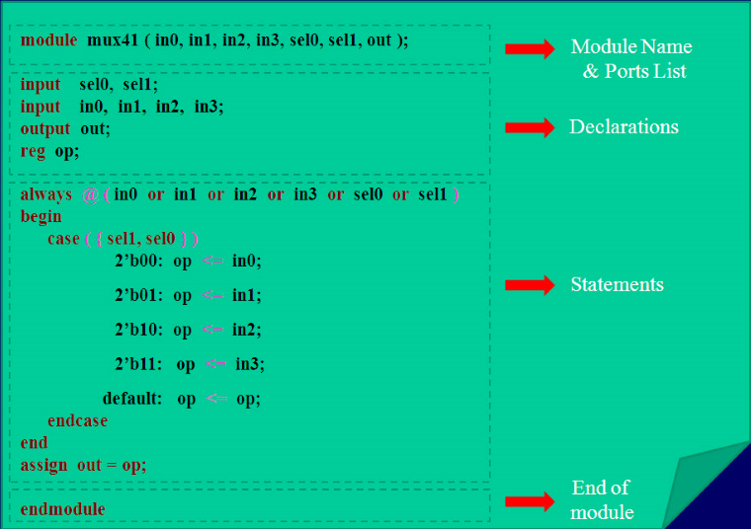

Slide 5
Modules
Basic building block in verilog.
Declared by keyword “module”.
A corresponding keyword “endmodule” must appear at the end of definition.
Modules cannot be nested.
One module can instantiate another module.
Module instantiations are used for:
-- connecting different parts of the design
-- connecting Test bench to the design.

Slide 6
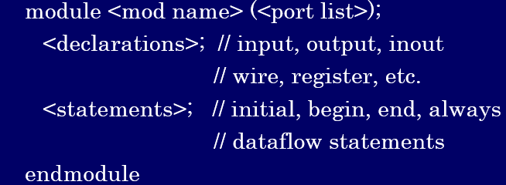
Structure of a Module

Slide 7
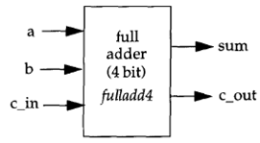
Ports
Ports provide interface by which a module can communicate with it’s environment.
input – Input port
output – Output port
inout – Bidirectional port
module fulladd4 (sum, c_out, a, b, c_in)

Slide 8
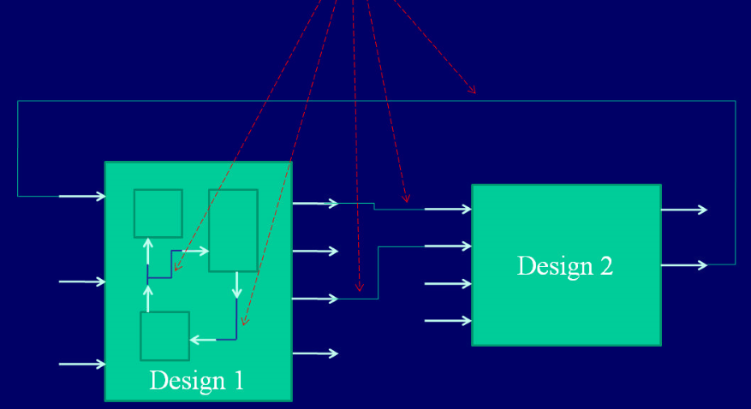
Nets
Nets represent connections between hardware elements.
They are always driven by some source.
Declared by keyword “wire”.
It can hold any one of the four values: 0, 1, x, z. Default value for any net type variable is ‘z’ (High impedance – hanging net).

Slide 9
Registers
These correspond to variables in C language.
Register data types always retain their value until another value is placed on them.
Unlike nets, registers do not need any drivers.
Declared by keyword “reg”.
It can hold any one of the four values: 0, 1, x, z. Default value for any reg type variable is ‘x’ (unknown).

Slide 10
wire a ; //1-bit wire
wire [7:0] bus; //8-bit bus
wire [31:0] busA, busB, busC ; //3 buses of 32-bit width
reg a; //1-bit register
reg [31:0] b; //32-bit register
Memories (array of registers)
reg [wordsize:0] memory [0:arraysize]
reg [3 : 0] mem_a [63:0] ; //sixty-four 4-bit registers
mem_a [address] = data_in ;
reg mem_b [0 : 4] // five 1-bit registers
Number format
<size> ’ <base_format> <number_format>
4’b1111 //This is a 4-bit binary number
12’habc //This is a 12-bit hexadecimal number
16’d255 //This is a 16-bit decimal number
23456 //This is a 32-bit decimal number by default
`hc3 //This is a 32-bit hexadecimal number
`o21 //This is a 32-bit octal number

Slide 11
Default type for input/output/inout is “wire”.
“input wire in_1” is same as “input in_1”.
“output wire out_1” is same as “output out_1”.
A parameter is defined by Verilog as a constant value declared within the module.
Syntax:
parameter <identifier> = constant;
Example:
parameter byte_size = 8;
reg[byte_size-1:0] A;

Slide 12
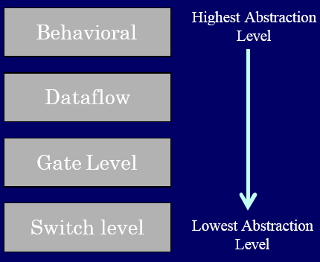
Modeling Techniques
Behavioral Modeling
Data-flow Modeling
Gate level Modeling
Switch level Modeling

Slide 13
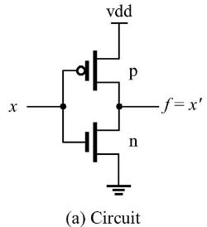

Switch-Level Modeling
//CMOS Inverter
module not_gate (x, f) ;
input x ;
output f ;
//internal declaration
supply1 vdd ;
supply0 gnd ;
//NOT gate body
pmos p1 (f, vdd, x) ;
nmos n1 (f, gnd, x) ;
endmodule

Slide 14
Gate-Level Modeling
Need to model the gate’s:
-- Function
-- Delay
→ Verilog provides built-in gate-level primitives:
and nand logical AND/NAND
or nor logical OR/NOR
xor xnor logical XOR/XNOR
buf not buffer/Inverter
bufif0 notif0 Tristate with low enable
bufif1 notif1 Tristate with High enable
Primitive_name #delay instance_name (out, in_1, in_2, … ) ;
and #1 a1 (out, in_1, in_2) ;

Slide 15
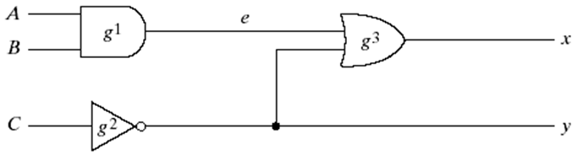
module simple_ckt (x, y, A, B, C) ;
input A, B, C ;
output x, y ;
wire e ;
and g1 (e, A, B) ;
not g2 (y, C) ;
or g3 (x, e, y) ;
endmodule

Slide 16
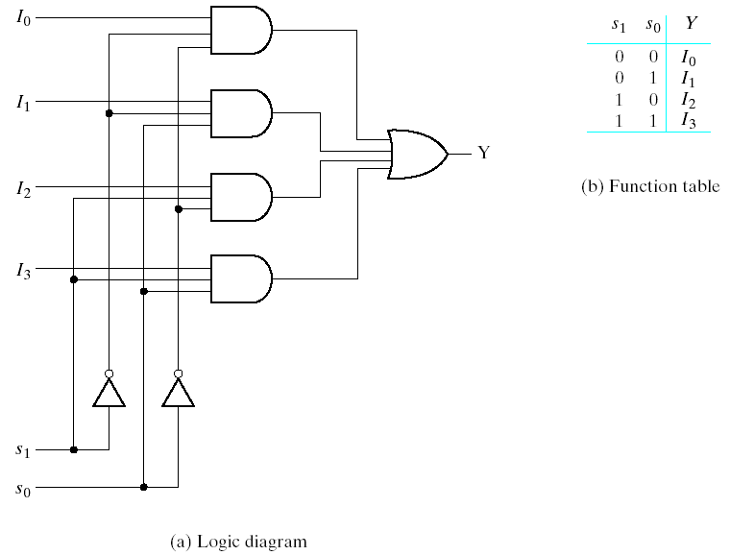
//Gate-level description of 4-to-1- line multiplexer
module mux4x1 (I0, I1, I2, I3, s1, s0, y);
input I0, I1, I2, I3, s1, s0;
output y;
//intermediate connections
wire NOT_s1, NOT_s0 ;
wire y0, y1, y2, y3 ;
not n0 (NOT_s0, s0) ;
not n1 (NOT_s1, s1) ;
and a0 (y0, I0, NOT_s1, NOT_s0) ;
and a1 (y1, I1, NOT_s1, s0) ;
and a2 (y2, I2, s1, NOT_s0) ;
and a3 (y3, I3, s1, s0) ;
or a4 (y, y3, y2, y1, y0) ; endmodule
a0
y0
a1
y1
a4
a2
y2
a3
y3
NOT_s1
NOT_s0
n1
n0

Slide 17
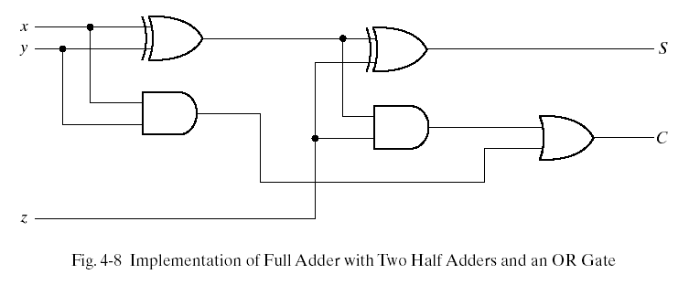
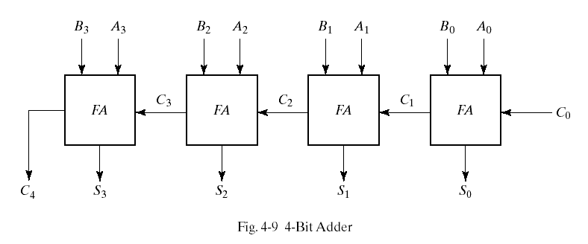
Gate-level/Structural Modeling 4 bit Full Adder – Half Adder
HA
HA
Full Adder (FA)

Slide 18
4 bit Full Adder
//Gate-level hierarchical description of 4-bit adder
// Description of half adder
module halfadder (S, C, x, y);
input x, y;
output S, C;
//Instantiate primitive gates
xor (S, x, y);
and (C, x, y);
endmodule
//Description of full adder
module fulladder (S, C, x, y, z);
input x, y, z;
output S, C;
wire S1, D1, D2; //Outputs of first XOR and two AND gates
//Instantiate the halfadder
halfadder HA1 (S1, D1, x, y),
halfadder HA2 (S, D2, S1, z);
or g1 (C, D2, D1);
endmodule

Slide 19
4 bit Full Adder
module four_bit_adder (S, C4, A, B, C0);
input [3:0] A, B;
input C0;
output [3:0] S;
output C4;
wire C1,C2,C3; //Intermediate carries
//Instantiate the full adder cells
fulladder FA0 (S[0],C1,A[0],B[0],C0),
FA1 (S[1],C2,A[1],B[1],C1),
FA2 (S[2],C3,A[2],B[2],C2),
FA3 (S[3],C4,A[3],B[3],C3);
endmodule

Slide 20
Data-flow Modeling
Dataflow modeling uses continuous assignments and the keyword “assign”.
Syntax:
assign <drive_strength> #<delay> <list_of_assignments>;
Example:
wire out ;
assign out = var1 & var2 ;
The assignment expression is evaluated as soon as one of the right-hand-side operands changes and the value is assigned to the left-hand-side net.
LHS must be net & cannot be reg. RHS can be net/reg.

Slide 21
//Data-flow description of 4-to-1- line multiplexer
module mux4x1 (I0, I1, I2, I3, s1, s0, y);
input I0, I1, I2, I3, s1, s0;
output y;
assign y = (~s1 & ~s0 & I0) |
(~s1 & s0 & I1) |
( s1 & ~s0 & I2) |
( s1 & s0 & I3) ;
endmodule
//Using conditional operator
module mux2x1 (I0, I1, sel, y);
input I0, I1, sel;
output y;
assign y = sel ? I1 : I0 ;
endmodule

Slide 22
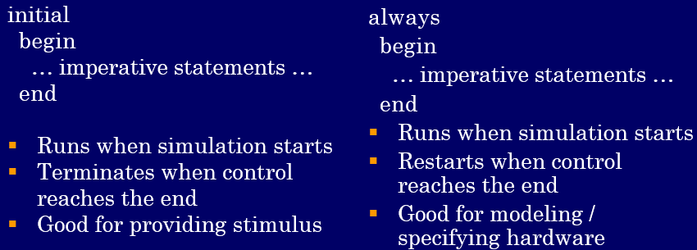
Behavioral Modeling
Used to model the behavior of a design without describing it’s actual hardware structure.
Procedural blocks are the basic components for behavioral modeling.

Slide 23
Procedural blocks are like concurrent processes. Statements in a block are executed sequentially, but all within one unit of simulated time. (unless delay is specified)
All blocks execute in parallel.
initial block – Executes only once. It is NOT synthesizable. Used in test benches.
always block - Executes repeatedly. It must have timing control, otherwise it become INFINITE LOOPS.
Procedural assignments within initial/always:
LHS must be reg & cannot be net. RHS can be net/reg.

Slide 24
//Behavioral description of 4-to-1- line multiplexer
module mux4x1_bhv (I0, I1, I2, I3, select, y);
input I0, I1, I2, I3;
input [1:0] select;
output y;
reg y;
always @ (I0 or I1 or I2 or I3 or select)
begin
case (select)
2'b00: y = I0;
2'b01: y = I1;
2'b10: y = I2;
2'b11: y = I3;
endcase
end
endmodule
Sensitivity list contains signals whose change triggers the execution of the block

Slide 25
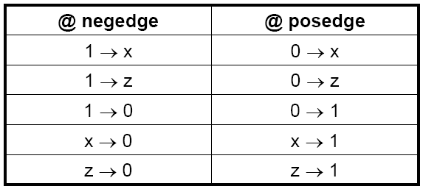
Event Control
Edge-triggered Event control
@ (posedge CLK) //positive edge of CLK
Curr_state = Next_state ;
Level-triggered Event control
@ (A or B) //change in values of A or B
out = A & B

Slide 26

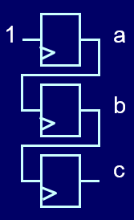
Blocking assignment ( = )
a = 1 ;
b = a ;
c = b ;
Non-blocking assignment ( <= )
a <= 1 ;
b <= a ;
c <= b ;
Used to model “Combinational ckt.”
Used to model “Sequential ckt.”

Slide 27
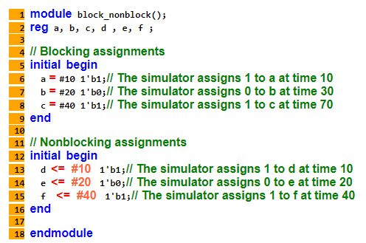

Slide 28
Modeling D-Flip Flop
//Asynchronous Reset
module dff_a (d, clk, rst, q) ;
input d, clk, rst ;
output q ;
reg q ;
always @ (posedge clk or
negedge rst)
if (~rst)
q <= 1’b0 ;
else
q <= d ;
endmodule
//Synchronous Reset
module dff_a (d, clk, rst, q) ;
input d, clk, rst ;
output q ;
reg q ;
always @ (posedge clk)
if (~rst)
q <= 1’b0 ;
else
q <= d ;
endmodule
For active high reset: if (rst)
For active low reset: if (~rst)

