Slide 1
Introduction to DIGITAL CIRCUITS MODELING using VERILOG Dr. Chandan Karfa CSE IIT Guwahati

Slide 2
FSM & Datapath
Simple Computation (C-like syntax)
…
for (x = 0, i = 0; i <= 10; i = i + 1)
x = x + y ;
If (x < 0)
y = 0 ;
else
x = 0 ;
…
Datapath modules:
→ Register for x, i, y
→ Adder
→ Comparator

Slide 4
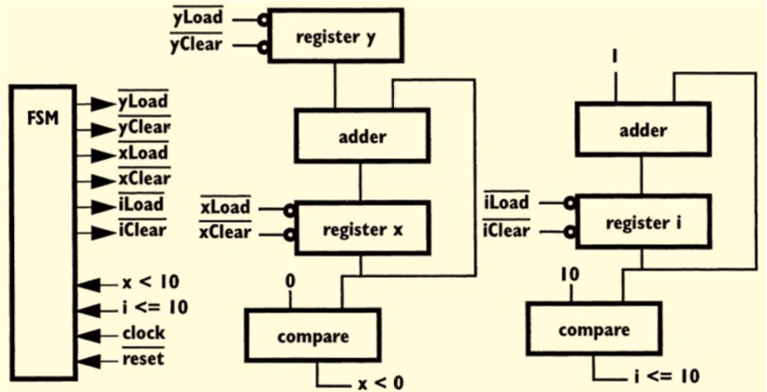
for (x = 0, i = 0; i <= 10; i = i + 1)
x = x + y ;
If (x < 0)
y = 0 ;
else
x = 0 ;
FSM & Datapath

Slide 5
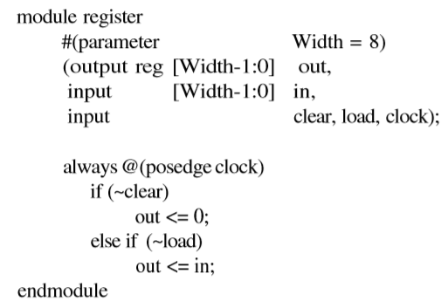
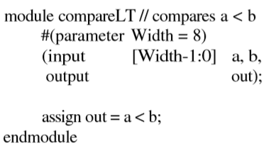
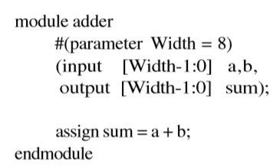
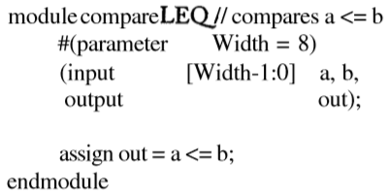
Datapath Modules

Slide 6
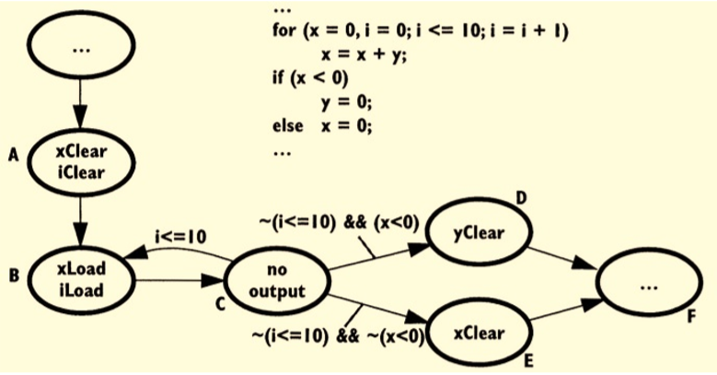
State Transition Diagram

Slide 7
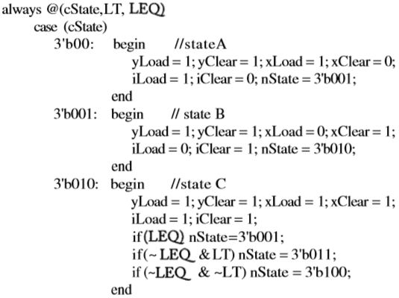
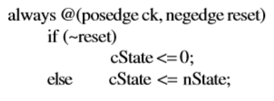
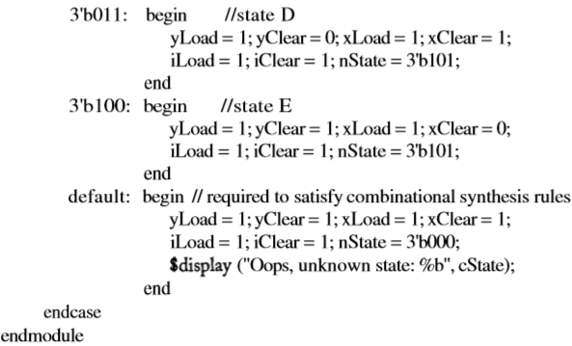
module fsm
(input LT, LEQ, ck, reset,
output reg yLoad, yClear, xLoad,
xClear, iLoad, iClear) ;
reg [2:0] cState, nState;

Slide 8
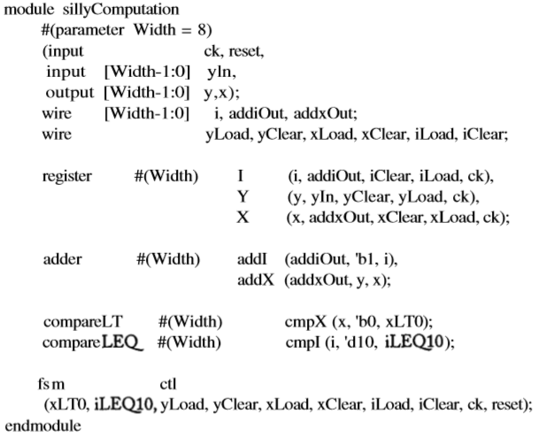
Combining the FSM and Datapath

Slide 9
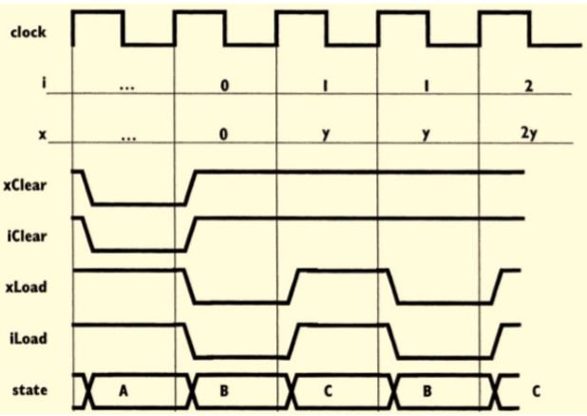
Timing Diagram:

Slide 10
Thank You

Slide 11
Compiler Directives & System Tasks
`define: used to define a text macro.
`include: used to include content of some other file inside a verilog code.
$time: It returns the current simulation time as 64-bit integer value. However this value will be scaled to the `timescale unit.
$monitor: It continuously monitors the changes in any one of the variable specified in the parameter list. Whenever, anyone of them changes, it displays the formatted string specified within double qoutes.
$finish : It terminates the simulation.

Slide 12
Compiler Directives & System Tasks
`timescale <ref_time_unit>/<precision>
Example: `timescale 1ns/ 100 ps
Time values to be read as ns and to be rounded to the nearest 100 ps.
`timescale 10ns / 10ns
#1.5 ;
1.5 x 10 ns = 15 ns.
Rounded to 20 ns.
`timescale 1ns / 1ps
#1 ; // 1 ns delay
#0.001; // 1 ps. This is the minimum delay you can have with this time scale.
#0.0001; // this will give 0 ns delay.

Slide 13
Testbench
Clock generation block
clk
clk
clk
Test vector generator
and
Monitor
Design Under Test
(DUT)

Slide 14
Clock generation with 50% duty cycle
initial clk = 0 ;
always #10 clk = ~clk ;
always
begin
clk = 0 ;
#10 ;
clk = 1 ;
#10 ;
end
parameter CLOCK_PERIOD = 5
always # (CLOCK_PERIOD / 2) clk = ~clk ;

Slide 15
Clock generation with variable duty cycle
module clk_gen (output clk) ;
parameter CLK_PERIOD = 10; parameter DUTY_CYCLE = 60; //60% duty cycle parameter TCLK_HI = (CLK_PERIOD*DUTY_CYCLE/100); parameter TCLK_LO = (CLK_PERIOD-TCLK_HI); reg clk; initial clk = 0; always begin #TCLK_LO; clk = 1'b1; #TCLK_HI; clk = 1'b0; end
endmodule

Slide 16
Verilog Coding Guidelines
When modeling sequential logic, use non-blocking assignments.
When modeling latches, use non-blocking assignments.
When modeling combinational logic with an always block, use blocking assignments.
When modeling both sequential and combinational logic within the same always block, use non-blocking assignments.
Do not mix blocking and non-blocking assignments in the same always block.
Do not make assignments to the same variable from more than one always block.

Slide 17
Example: Synchronous FIFO
FIFO
Data_In [7:0]
Data_Out [7:0]
wr_en
Full
rd_en
Empty
clk
reset
module FIFO # (parameter DATA_WIDTH = 8,
parameter FIFO_DEPTH = 10)
(Data_out, Full, Empty, Data_In, Wr_En_ Rd_En, clk, reset) ;

Slide 18
module FIFO # (parameter DATA_WIDTH = 8,
parameter FIFO_DEPTH = 8)
(Data_out, Full, Empty, Data_In, wr_en_ rd_En, clk, reset) ;
input [DATA_WIDTH – 1 : 0] Data_In ;
input wr_en ;
input rd_en ;
input clk ;
input reset ;
output reg [DATA_WIDTH – 1 : 0] Data_Out ;
output reg Full ;
output reg Empty ;
reg [DATA_WIDTH – 1 : 0] memory [FIFO_DEPTH - 1: 0] ;
reg [FIFO_DEPTH – 1 : 0] rd_ptr, wr_ptr, depth_cnt ;

Slide 19
//PUSH
always @ (posedge clk)
begin
if (reset) begin
wr_ptr <= ‘h0 ;
end
else begin
if (wr_en && !Full) begin
memory [wr_ptr] <= Data_In ;
wr_ptr <= wr_ptr + 1 ;
end
end
end

Slide 20
//POP
always @ (posedge clk)
begin
if (reset) begin
rd_ptr <= ‘h0 ;
end
else begin
if (rd_en && !Empty) begin
Data_out <= memory [rd_ptr] ;
rd_ptr <= rd_ptr + 1 ;
end
end
end

Slide 21
//Depth Count
always @ (posedge clk)
begin
if (reset) begin
depth_cnt <= ‘h0 ;
end
else begin
if (wr_en && !Full)
depth_cnt <= depth_cnt + 1 ;
else if (rd_en && !Empty)
depth_cnt <= depth_cnt - 1 ;
//add one more condition to check simultaneous WR & RD.
end
end
assign Empty = (depth_cnt == ‘h0)? 1 : 0 ;
assign Full = (depth_cnt == FIFO_DEPTH)? 1 : 0 ;
endmodule

Slide 22
Testbench
clk_gen
cg
ff
tt
clk
reset
wr_en
rd_en
Test_FIFO
FIFO
(DUT)
Full
Empty
Data_In
Data_TF
Data_out
Data_out
Data_FT
Data_In

Slide 23
module testbench # (parameter DATA_WIDTH = 8,
parameter FIFO_DEPTH = 8);
wire clk, reset ;
wire rd_en, wr_en, Full, Empty ;
wire [DATA_WIDTH - 1 : 0] data_tf, data_ft;
FIFO ff(.clk (clk), .reset (reset),
.Full (Full), .Empty (Empty),
.wr_en (wr_en), .rd_en(rd_en),
.Data_In (data_tf), .Data_out (data_ft)) ;
Test_FIFO tt(.Data_out (data_tf), .Full (Full),
.Empty (Empty), .Data_in(data_ft),
.wr_en(wr_en), .rd_en(rd_en),
.clk (clk), .reset(reset)) ;
clk_gen cg(.clk (clk)) ;
endmodule

Slide 24
Steps for Synthesizing Verilog HDL programs using Xilinx ISE.
(1). Download “Xilinx_ISE_DS_Win_14.4_P.49d.3.0.nrg “ from the following link:
http://repo.cse.iitg.ernet.in/index.php?dir=Hardware%20and%20VLSI%20%20LAB/
(2). Download & Unzip the attached file “Example_Synchronous_FIFO”.
(3). Without changing any file, first try to execute the Simulation steps described in the subsequent slides.

Slide 25
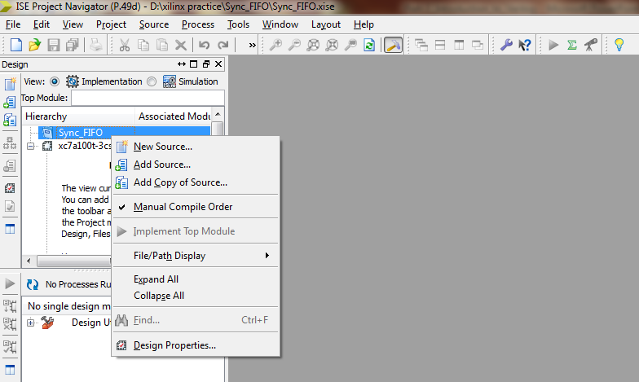
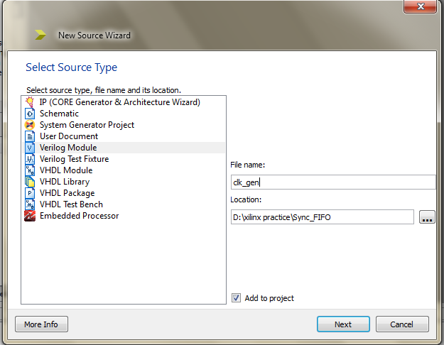
File -> New Project
Enter the Name: Sync_FIFO
Sync_FIFO → New Source → Verilog module
Use same file names. Don’t enter any Input/Output port name.

Slide 26
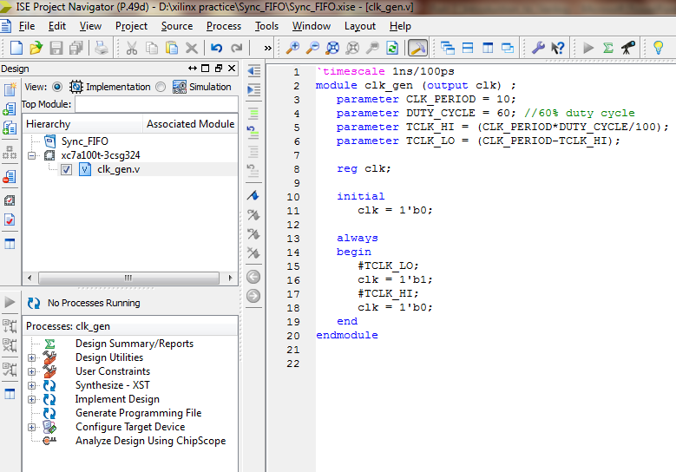
Copy & Paste the contents of attached “clk_gen.v”.
Similarly add other files also under “Sync_FIFO” project.

Slide 27
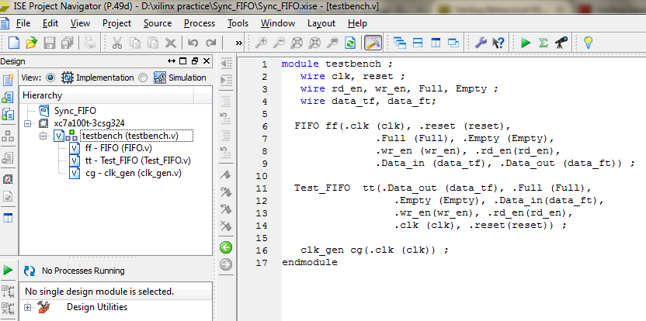
Set “testbench” as top module. Ensure “View” is in “Implementation” mode. If you want to perform “Synthesis”, Expand “Design Utilities” and synthesize the design. For “Sync_FIFO”, it is not required.

Slide 28
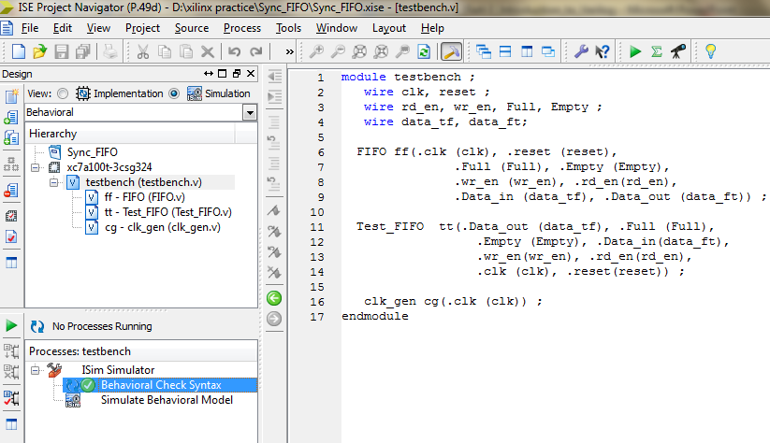
Change “View” to “Simulation”. Select “Behavioral Check Syntax” to check syntax.
If there will no syntax error. Then select “Simulate behavioral Model”.
It will open the new waveform window “Default.wcfg”

Slide 29
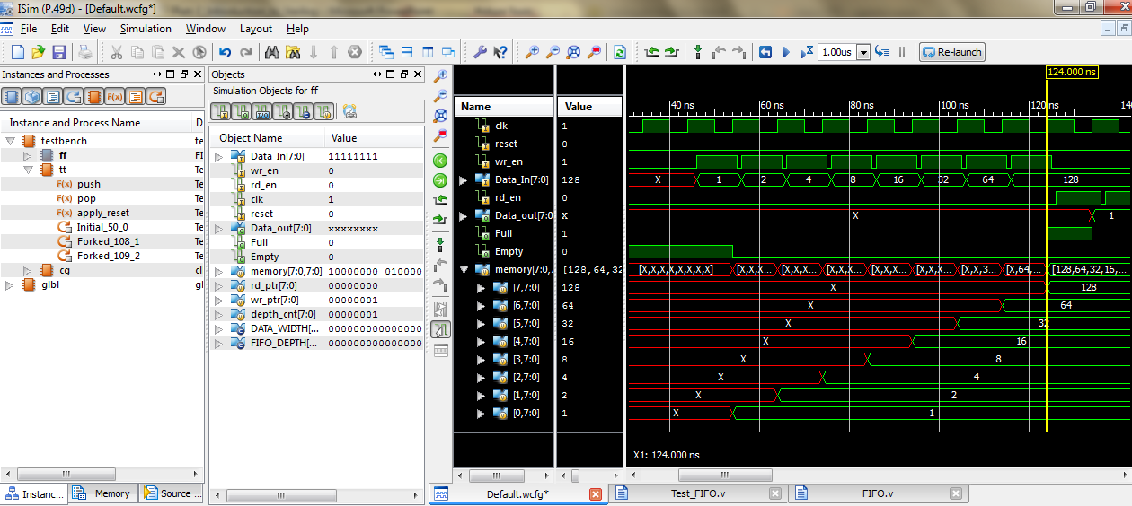
From Instance and Process Name, select “design Top”. Then from “Objects”, select required objects and the right click to “add to wavewindow”.

Slide 30
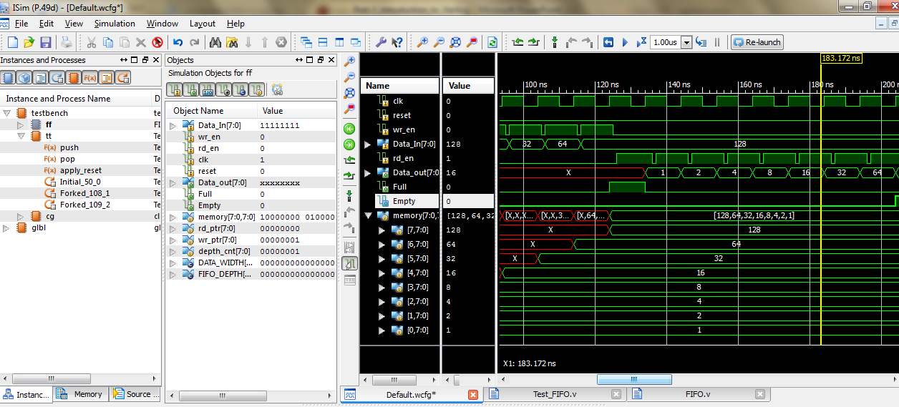
Whenever you change the testcase file. Save it and to re-run, click on “Re-launch” option.

Slide 31
Assignment - 1
Problem – 1: Counter Design
The circuit will count either up or down through the n-bit binary number range.
Up/Down
Counter
Direction
clk
Count
reset

Slide 32
Input / Output Port Description
Port | Input | Function
 |  | Groups (1,3,5,7,9) | Groups (2,4,6,8,10)
Direction | 1’b0 | Up Counter [1,3,5,7,9] | Up Counter [2,4,6,8,10]
 | 1’b1 | Down Counter [9,7,5,3,1] | Down Counter [10,8,6,4,2]
clk | 1’bx | frequency = 10 MHz. duty cycle = 30% 1st clk (low to high) | frequency = 5 MHz duty cycle = 80% 1st clk (high to low)
count | -- | Positive edge triggered. State encoding Binary: (Group 1, 3) Gray: (Group 5, 7) One-hot: (Group 9) | Negative edge triggered. State encoding Binary: (Group 10) One-hot: (Group 6,8) Gray: (Group 2,4)
reset | 1’b0 | Asynchronous reset. Active (Count = least) | Synchronous reset. Inactive
 | 1’b1 | Asynchronous reset. Inactive | Synchronous reset. Active (Count = least)

Slide 33
Submit the .pdf file with the following:
Write the Problem Statement based on your group number by taking care of all the necessary modifications mentioned in the Input / Output Port description.
Draw state transition diagram. Groups [1,3,5,7,9] follow the “Moore FSM style”. Groups [2,4,6,8,10] follow the “Melay FSM style”.
Do state encoding [Binary/One-hot/Gray] as per your problem statement. Then draw the “State Transition Table” by considering the following Flip-Flops for the design: {D-FF for Group 1,3}. {T-FF for Group 2, 4}. {JK-FF for Group 5,6}. {SR-FF for Group 7,8}.
No need to draw the K-map. However, mention the resulting boolean equations for Flip-Flop Inputs and Output. Then draw the complete Logic Diagram.
Write synthesizable RTL verilog code. Paste the code inside the .pdf file.
Synthesize (v) and generate RTL view. Paste the snapshot of RTL view in .pdf file.
Draw the top level diagram illustrating the connections b/w different modules in your testbench.
Write Behavioral Testbench to simulate (v) with the following scenarios: (apply reset for 1st five clock cycles)
Up counter: [min -> max -> min]
Down counter: [max -> min -> max]
Effect of reset input
Capture the waveform for scenarios mentioned in (viii). Also Log file with necessary descriptions for the same.
Use the following stmt. in your test case after begin: $monitor ($time, “: clk = %b, reset = %b, direction = %b, count = %d”, clk, reset, direction, count) ;

Slide 34
-- This Problem-1 will be evaluated for 15 marks.
-- Prepare the .pdf file properly. Don’t try to include any snapshot/camera images of the state transition diagram / State Transition Table / Logic Diagram.

Slide 35
Problem – 2a: Cyclic Redundancy Check
Write “Behavioral” code to implement the generic “CRC Generator”. [Group: 1, 3, 5, 7, 9]
Message_In
Sender
Polynomial
Message_Out
Generate_CRC
reset
When “Generate_CRC” is ‘1’, DUT will generate “Message_Out” by appending “CRC bits” to the “Message_In”.
CRC calculation should be dynamically based on input “Polynomial”.
When “reset” is ‘1’, output should be “all zeros”.

Slide 36
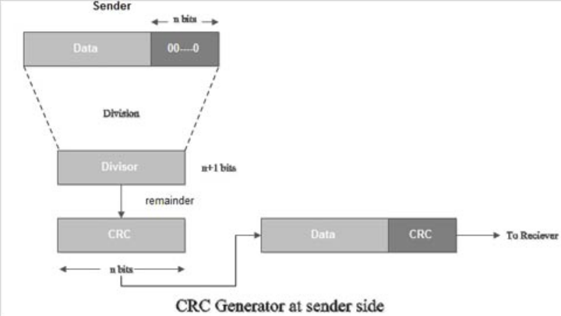

Slide 37
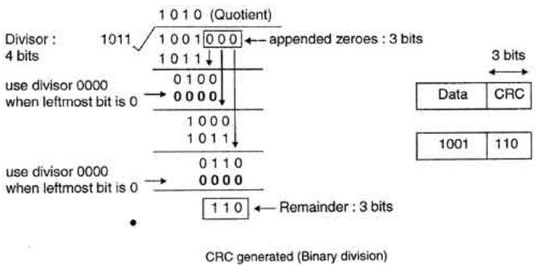

Slide 38
Problem – 2b: Cyclic Redundancy Check
Write “Behavioral” code to implement the generic “CRC Checker”. [Group: 2,4,6,8,10]
Message_In
Receiver
Polynomial
CRC_Error
Check_CRC
reset
When “Check_CRC” is ‘1’, DUT will set “CRC_Error” to ‘1’, if there is an CRC error in “Message_In”. Otherwise “CRC_Error” will always be ‘0’.
CRC check should be dynamically based on input “Polynomial”.
When “reset” is ‘1’, output should be “zero”.

Slide 39
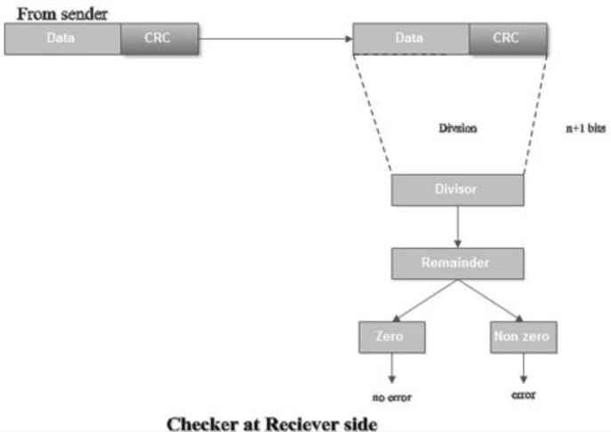

Slide 40
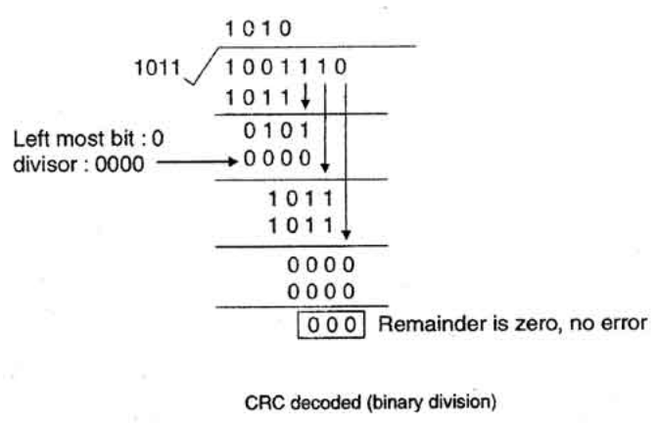

Slide 41
1. Use two “parameters” for size of Polynomial & Message.
2. Set the “parameter” value as “32” for Message. “6” for Polynomial.
3.Prepare the .pdf contains the waveform & Log file.
-- For Sender, use three different polynomials and show Message output.
-- For receiver, calculate the correct CRC value . Check for “CRC_error” as ‘0’. For same message, flip one of the bit and check for “CRC_error” as ‘1’.
4. No need to write a synthesizable verilog code for Problem-2.
5. This Problem-2 will be evaluated for 10 marks.

Slide 42
Prepare zip file with following name: <Group_No>.zip
It should contain following two folders inside:
Problem1
Problem2
Each of these folders should contain problem1.pdf which contains relevant waveforms. Waveform should contain only the Input/Output ports of top level ports. No internal signals reqiured. Also attach verilog files (*.v) only. No other files are required.
Submission Deadline: 8 A.M., 16-August-2015.
Pls install xilinx in anyone of your group member PC / Labtop. If required, You may need to show the simulation from your PC / Laptop after the deadline.

Slide 43
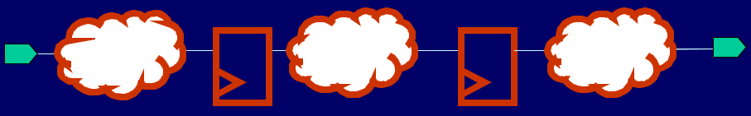
RTL Synthesis
Register Transfer Level (RTL)
Combination of both Behavioral & Dataflow.
Register : storage element, like flip-flop, latches
Transfer : transfer between input, output & register
Level : Level of abstraction

Slide 44

RTL Synthesis
RTL Synthesis is a process to transform design description from RTL abstraction to the gate description.

Slide 45
Technology Library
Contains a set of primitive cells which can be used by synthesis tools to build a circuit.
It is created by the silicon vendor. Not by synthesis tools.
A library may contain Timing & Electrical characteristics, Net delay of the cell.

Slide 46
Two Major Phases in Synthesis
Technology Independent Phase:
-- Design is read in & Manipulated without regard to the final implementation technology.
-- Major simplification in combinational logic may be made.
Technology Mapping:
-- Design is transformed to match the components in a component library.
-- If there are only two-input gates in the library, the design is transformed so that each logic function is implementable by component in library.

Slide 47
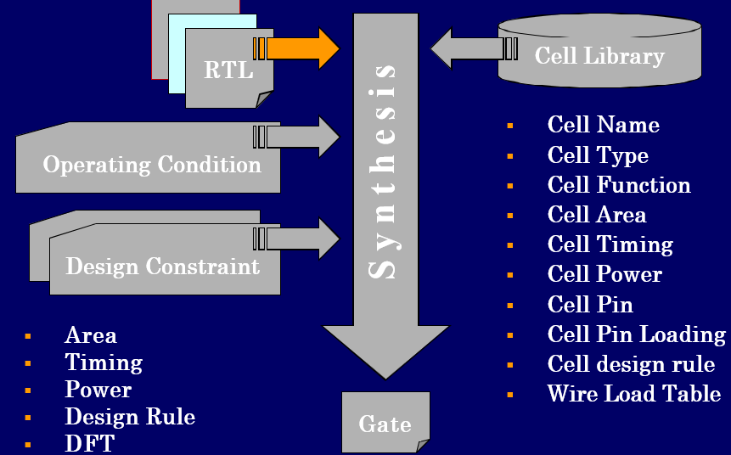
RTL Synthesis

Slide 48
Overview RTL Synthesis Steps
Verilog description
RTL level optimization
Logic level optimization
Gate level optimization
Netlist

Slide 49
RTL Level Optimization
Constant Unfolding:
A + 3 + 2 becomes A + 5
Loop Unrolling: loop statements are unrolled to a series of individual statements.
Dead code removal: any unused code is discarded.
Common sub-expression sharing

Slide 50
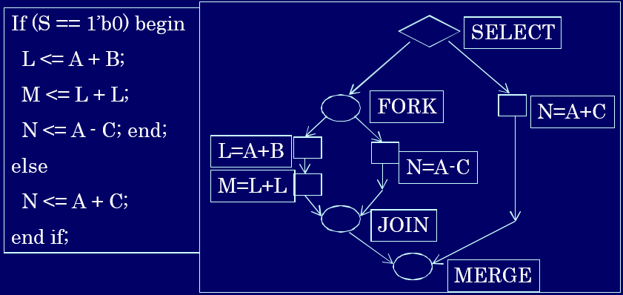
RTL Level Optimization - CDFG format
Control data flow graph is often used by synthesis tools for highest internal representation.

Slide 51
Logic Level Optimization
All registered elements are fixed, only combinational logic is optimized.
Optimization at this level involves restructuring of equations according to the rules of Boolean law.
The types of logic optimization include:
- minimization
- equation flattening
- equation factorization

Slide 52
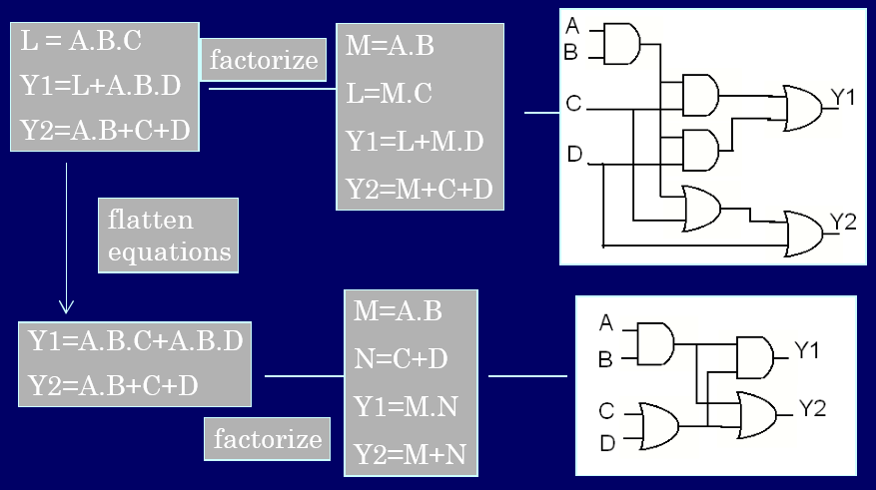
Logic Level Optimization

Slide 53
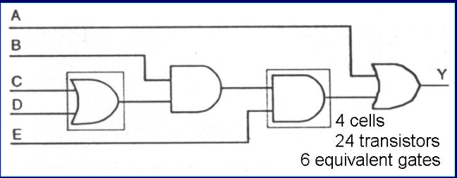
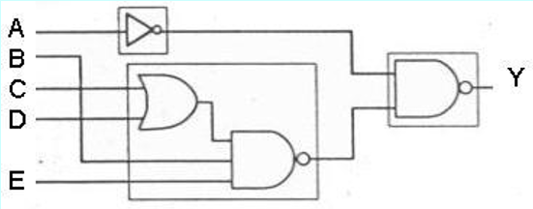
Gate Level Optimization
Mapped circuit
Before gate level
optimization
Mapped circuit
After gate level
optimization
3 cells
14 transistors
3.5 equivalent gates

